Slide 1
Machine Learning For Big Data
(CSL7110)
Dr. Dip Shankar Banerjee
Distributed Large-Scale Semantic Search System
Group Members:
Jyoti Dwivedi [M25CSA010]
Jahanvi Gajera [M25CSA012]
Akanksha Kapil [M25CSA033]

Slide 2
Goal
Search millions of Technical Q&A documents and retrieve semantically relevant results in real time.
Why keyword search isn’t enough:
Misses synonyms (“car” vs “automobile”)
Cannot understand intent
Surface-form matching only
Our approach:
Dense embeddings → vectors capture meaning
Distributed processing for scale
Approximate nearest-neighbor search for speed

Slide 3
Big Data Components
Apache Spark (distributed processing)
Parquet (columnar storage)
Spark Standalone Cluster
RDD lineage (fault tolerance)
mapPartitions (batch search)

Slide 4
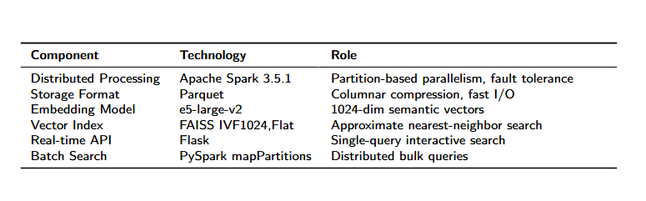
Tech Stack

Slide 5
Data Pipeline
Stage 1: Spark Preprocessing
Read XML in parallel across partitions
Parse <row> elements via UDF
Strip HTML, clean text
Output: 945,111 rows in Parquet
Stage 2: Embedding Generation (GPU)
Model: intfloat/e5-large-v2 (1024-dim)
Batch size: 4,096
Required "passage: " prefix on documents
Output: 945K × 1024 float32 (3.87 GB)
Stage 3: FAISS Indexing
IVF1024,Flat structure
Inner-product metric
nprobe=32

Slide 6
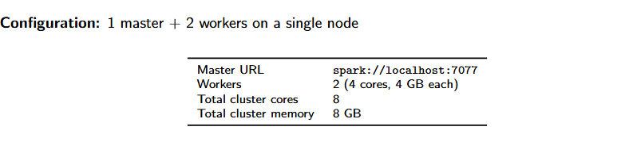
Spark Configuration

Slide 7
FAISS Indexing
Inverted File (IVF) index:
Cluster all vectors into 1024 cells (k-means at build time)
At query time: compare query to 1024 centroids
Search only the closest nprobe cells
Skip remaining cells ⇒ massive speedup
nprobe = number of clusters searched per query
nprobe=1 ⇒ ˜923 vectors checked ⇒ 51% recall, 1.5ms
nprobe=32 ⇒ ˜30K vectors checked ⇒ 95% recall, 27ms
nprobe=1024 ⇒ all vectors ⇒ 100% (= brute force)

Slide 8
Fault Tolerance Mechanism
Spark’s RDD Lineage:
Every partition’s transformation is a deterministic computation graph
If executor dies: recompute only lost partitions on surviving executors
No checkpointing needed — recomputation is correct because RDDs are immutable
Recovery Process:
Driver detects executor loss via heartbeat timeout
Tasks on dead executor marked as failed
Failed tasks rescheduled on surviving executors
Job continues without manual intervention

Slide 9
Fault Tolerance: Experimental Test
Setup:
Slow distributed map across 945,111 rows in 40 partitions
Background thread SIGKILLs one worker at the 15-second mark
Measure whether job completes
Result:
Job started with 2 workers
One worker SIGKILL’d mid-execution
Job completed: all 945,111 rows processed
Spark’s RDD lineage & task retry handled the failure transparently

Slide 10
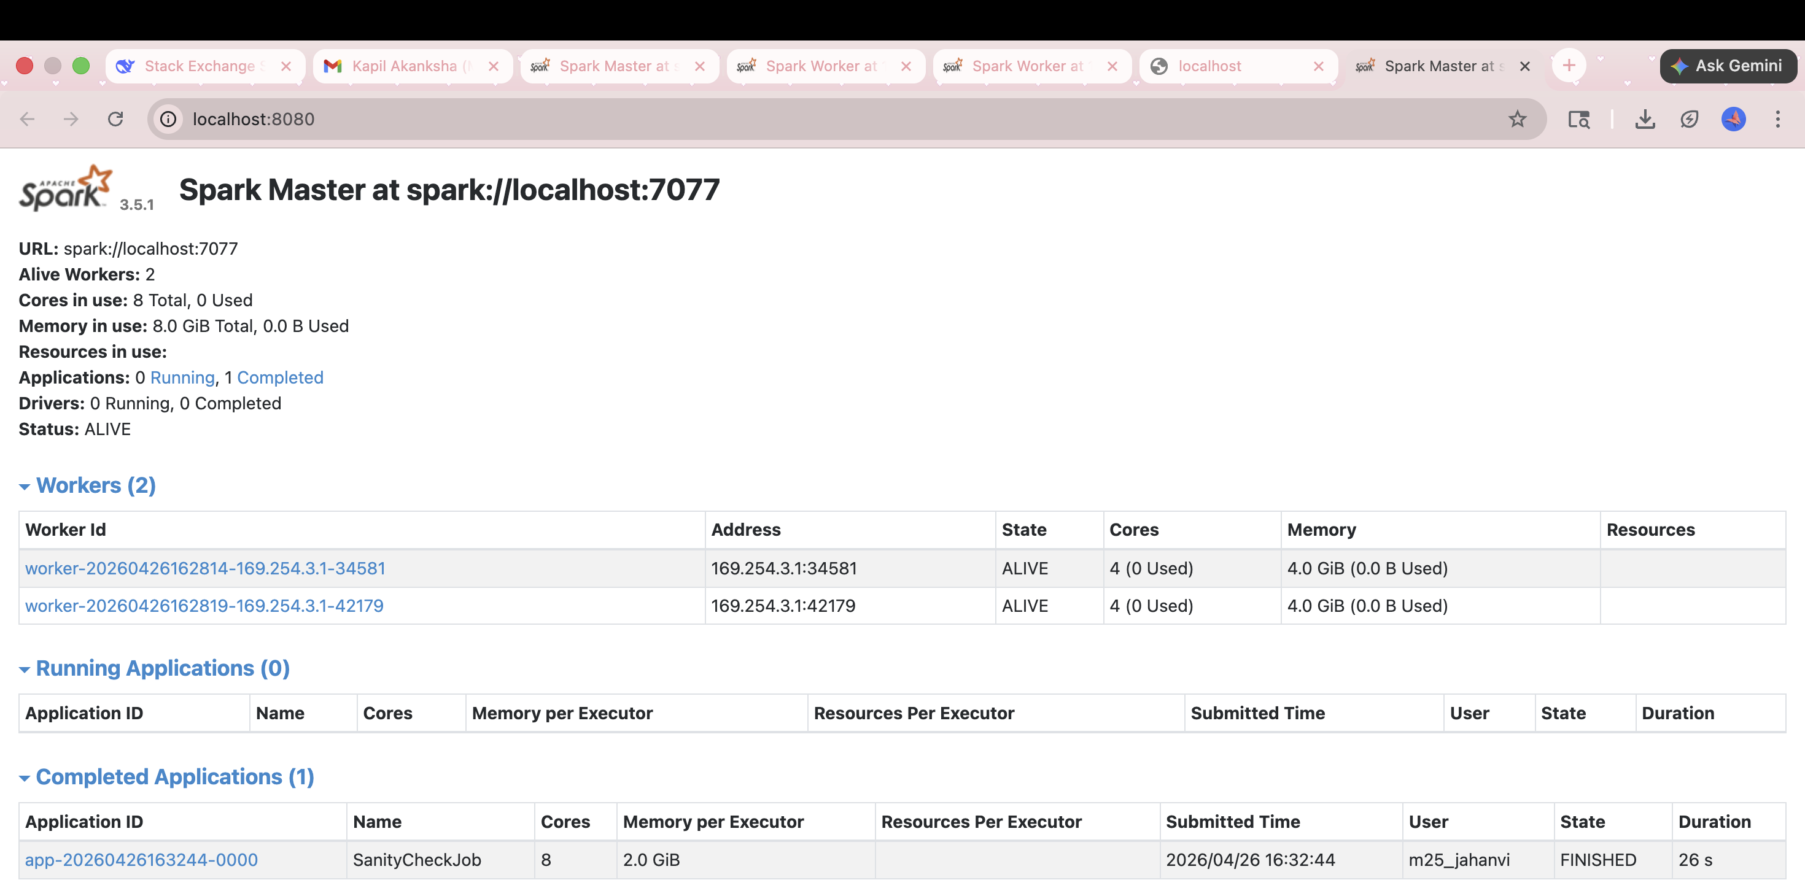
Fault Tolerance: Before & After

Slide 11
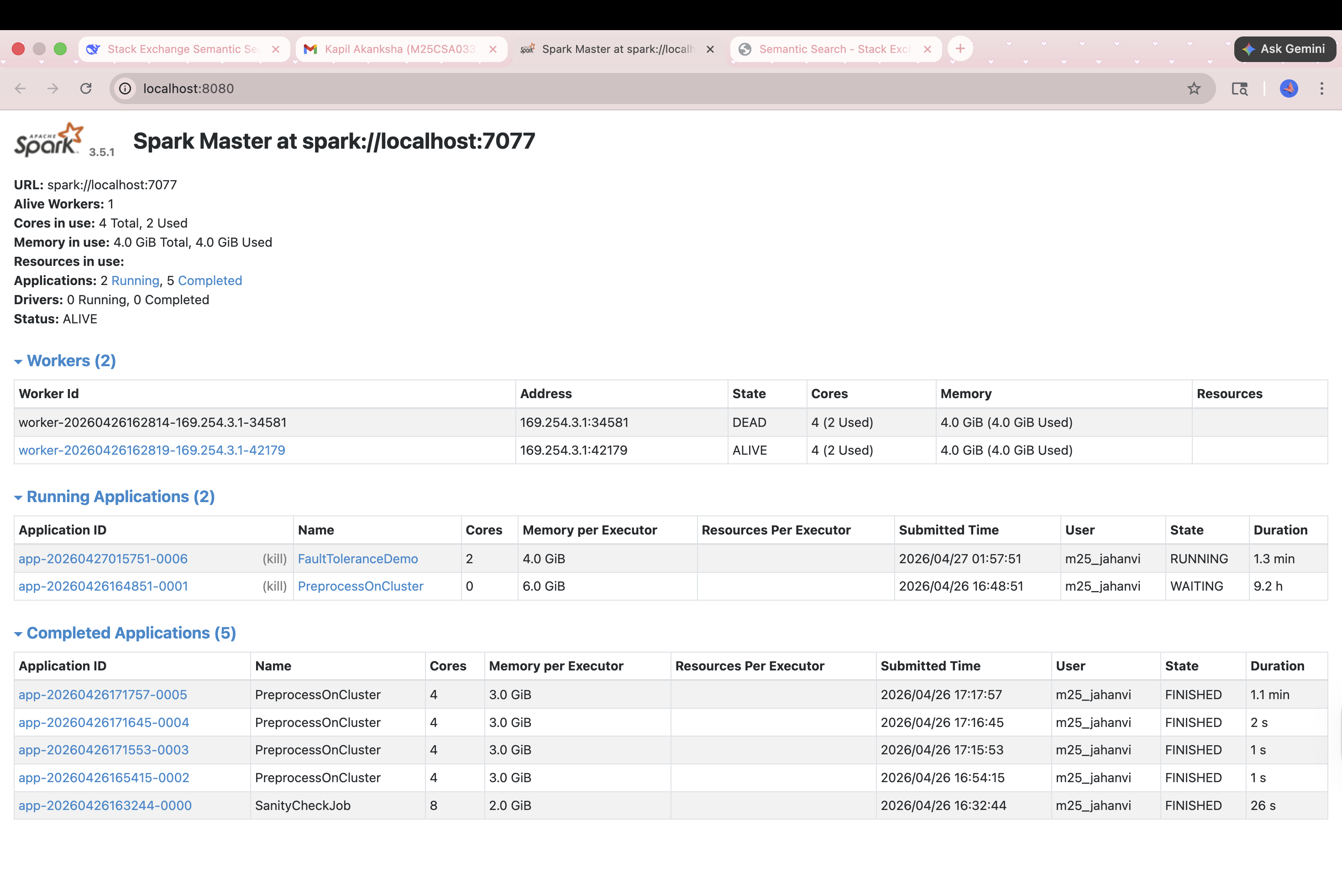
Fault Tolerance: Before & After

Slide 12
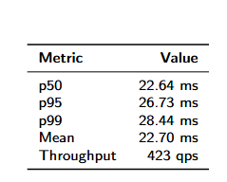
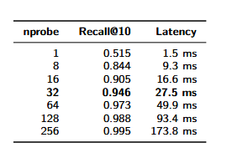
Latency Results

Slide 13
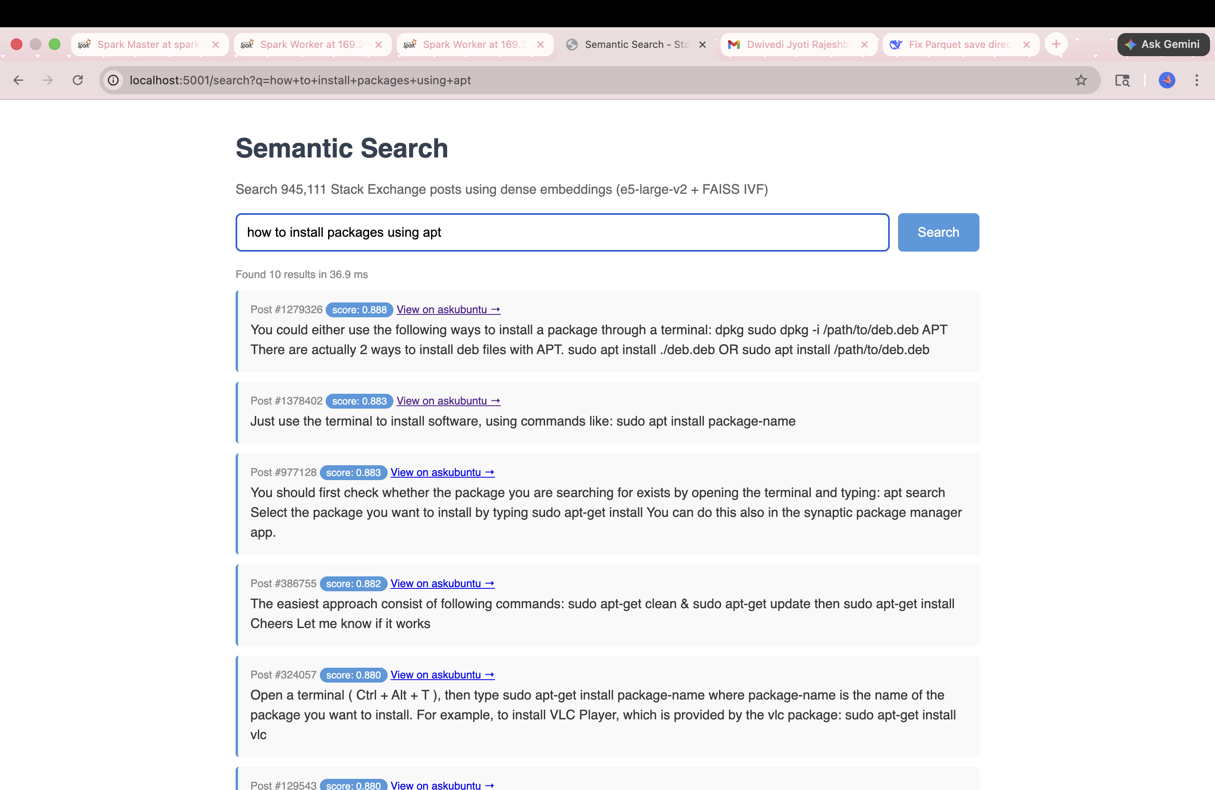
Live Demo: Flask Inference Search

Slide 14
Key Design Decisions
Spark standalone over local mode: True distributed semantics
e5-large-v2 (1024-dim): Better retrieval quality than smaller models
IVF-Flat over IVF-PQ: Index fits in RAM at our scale; PQ would lose recall
nprobe=32: Knee of recall-latency curve
Two serving paths: Flask for low-latency, Spark for high-throughput
Parquet as interchange format: Columnar compression across all stages

Slide 15
Limitations & Future Work
Limitations:
Single-node cluster (multi-node deployment is config change)
CPU FAISS due to environment-specific CUDA issues
Future work:
Cross-encoder reranking (two-stage retrieval)
Hybrid search: BM25 + semantic
Multi-node deployment with GPU-per-executor

Slide 16
Thank You

