Slide 1
GPS Project Next Steps

Slide 2
GPS Project Next Steps
Data

Slide 3

Amount of Data
Over time
  Checking concept drift
  December / Seasonality
Number of training examples
  Better models
  More certainty of a good model

Slide 4

Missing Data
Types:
  Postcodes
  GPS data
Why and how to adjust?

Slide 5

Additional Data
GPS data detail and frequency
Carrier information
  Previous deliveries
  Fleet size
Road data / estimated drive time

Slide 6
GPS Project Next Steps
Delivery Time Algorithm

Slide 7
Current Algorithm
GPS points filtered by speed
First point within proximity
Properties:
  Very optimistic
    Pre-pass
    Filtering issues

Slide 8

Possible Adjustments
Adjusting incorrect delivery locations
Improved GPS filtering

Slide 9
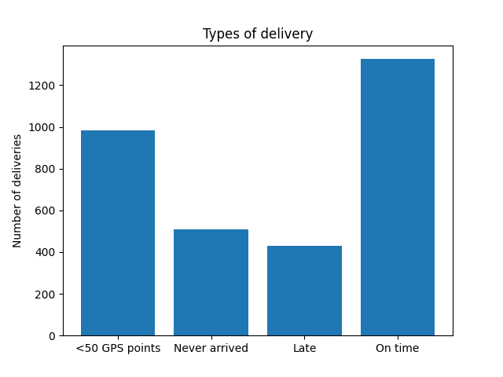
Increasing Utility of Existing Data
Inspect routes on map
  Why do so many not arrive?
  What is happening with routes that have less than 50 GPS points?
Talk to data owners

Slide 10
GPS Project Next Steps
Model

Slide 11

Issues
New Carriers
Uncertain performance
Likelihood verification

Slide 12
Additional Ajustments
Data first
Hyper parameter optimisation
Probability calibration
Test more simple models more extensively for low data
  Summary statistics over catagorical features
  One hot encoding

Slide 13
GPS Project Next Steps
Production

Slide 14

Aim
How will the model output be used?
Three deployment methods
  Micro service
  Built in
  Batch processing

Slide 15
Micro service
I’d guess at what’s needed with Digi-haul’s live model
Answers web requests of data with predictions
Pros:
  Allows instant predictions
Cons:
  Additional expense for 24/7 service
  Need for additional live monitoring

Slide 16
Built in
Written into the software that will use it
Pros:
  Extreamly fast, ideal for DS in Digi-haul’s OR algorithms
Cons:
  More complex to develop

Slide 17
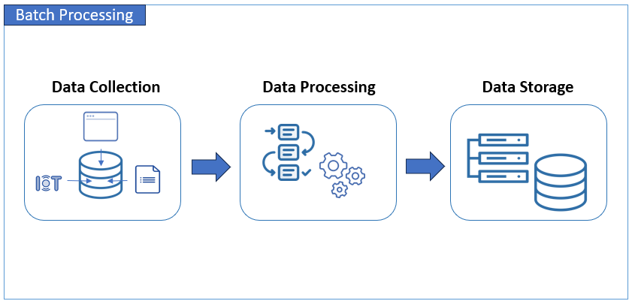
Batch Processing
Periodically ingests from one db and outputs predictions to another
Most common method
Pros:
  Cheap
  Easy

Slide 18
Questions?

