Slide 1

2. Structuring High-Quality Online Discussions with Assigned Roles

Slide 2
Course Context & Design Problem
Context | Graduate-level Seminar for Engineering Teaching Assistants(Hybrid)
Design Problem | Informal groups led to uneven participation, with some students dominating.
Instructional Solution | Implemented a data-driven group formation strategy using the Louvain community detection algorithm to support balanced, productive groups.
Key Impact | Participation became more evenly distributed. Discussions showed stronger reciprocity and less reliance on a single dominant voice.

Slide 3
1️⃣ Collected early interaction data
Initial seminar discussions and activities to see who responded to whom, and how often
Built an interaction network
2️⃣ Applied Louvain community detection
Identified natural clusters in the interaction network
Avoided isolating quieter students at the edges
Balanced more central and less central participants across groups
3️⃣ Formed stable discussion/project groups
Used cluster results to assign groups for ongoing seminar tasks
Ensured each group had a mix of voices and experience levels
Reduced the risk of one person “carrying” the group
4️⃣ Integrated into course flow
Announced final group assignments early in the semester
Groups stayed together for discussions, peer feedback, and mini-projects
Monitored collaboration patterns over time
IMPLEMENTATION IN THE COURSE

Slide 4
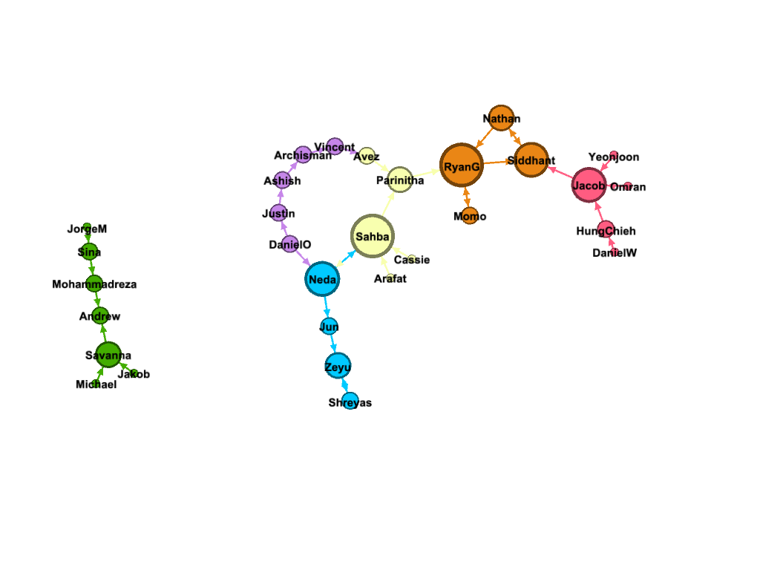

Slide 5
impacts &refinements
Observed Outcomes
Group assignment lists informed by network data
Before/after network views of group structure
Brief instructor notes on how to use data-informed grouping in future offerings
Participation became more evenly distributed across group members.
Discussions showed stronger reciprocity, reducing reliance on a single dominant voice.
Group work on teaching cases and activities was smoother and more sustained.
Groups felt fair and purpose-driven rather than arbitrary.
Less time was spent addressing group issues and reassignments.
Design Reflection & Iteration
Combine network-based grouping with brief preference data (e.g., teaching interests, prior experience).
Add a short orientation explaining why structured groups matter for their development as future instructors.
Provide simple visual feedback to TAs about how their group is participating over time.
Provided a repeatable, data-informed grouping method for future cohorts.
https://doi.org/10.1186/s41239-024-00495-w

