Slide 1

1. Sensemaking with Concept Mapping

Slide 2
Course Context & Design Problem
Context | Online undergraduate Information Science course
Design Problem | Students struggled to see how system-design concepts relate in meaningful ways.
Instructional Solution | Designed a two-step concept mapping task (Individual Map to Group Map) requiring collaboration to merge and refine ideas.
Tools Used | CmapTools, synchronous video meeting
Key Impact | Supported deeper explanation of relationships between concepts. Students actively engaged in comparing and merging their understanding.

Slide 3
Instructional Design Solution: a two-step concept mapping task
Learner Instructions (summarized):
Create an individual map identifying key concepts.
Meet in a group of three online.
Build one shared concept map (min 20 concepts)
Label relationships clearly.
Submit final map.
Design Elements Included:
Clear prompt + structured instructions
Minimum concept count to guide depth
Use of visual mapping to scaffold understanding
Collaboration guidelines to support negotiation

Slide 4
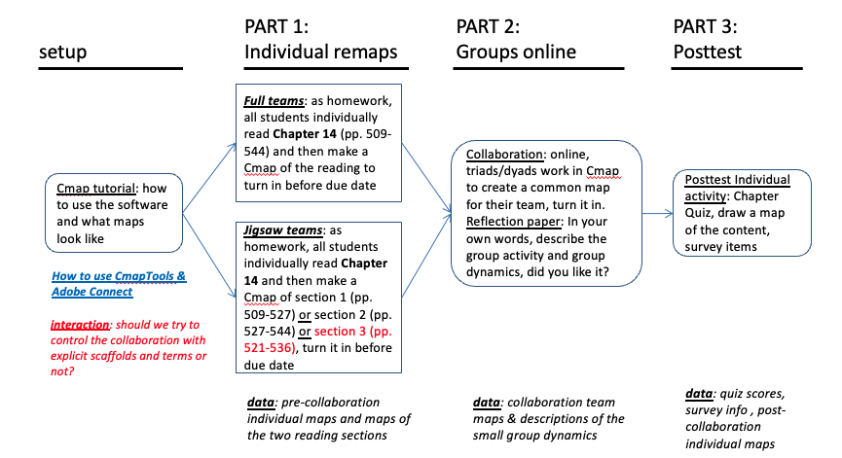

Slide 5
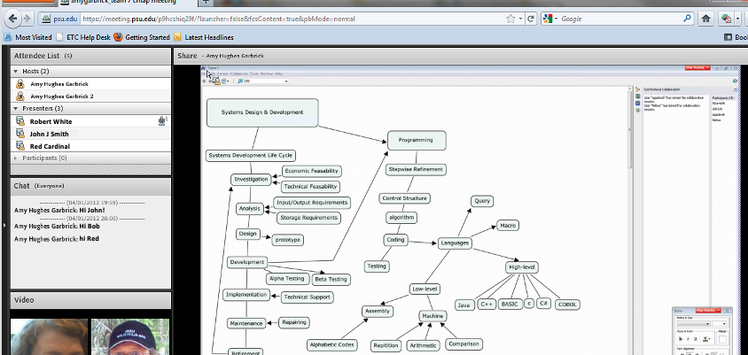

Slide 6
impacts &refinements
Impact Observed:
Students engaged actively in comparing and merging their understanding.
Groups with balanced preparation had richer conversations.
The structure supported deeper explanation of relationships between concepts.
Design Reflection & Iteration
Reduce pre-workload to avoid cognitive overload.
Provide guiding questions for negotiation (e.g., “Why connect these?”).
Add a short post-reflection to solidify understanding.
https://members.aect.org/pdf/Proceedings/proceedings21/2021/21_10.pdf

