Slide 1

Πανεπιστήμιο Θεσσαλίας
Εργασία 2^{η}
Ομαδική επικοινωνία με αξιόπιστη μετάδοση και καθολική σειρά παράδοσης μηνυμάτων
ΟΜΑΔΑ 1
Καρανίκα Αθανασία 2530
Λευκοπούλου Ελένη Μαρία 2557
Εαρινό εξάμηνο 2020-2021

Slide 2
ΠΕΡΙΕΧΟΜΕΝΑ
Group Manager (role , classes, and functions)
Messenger (classes and role)
Group Management
Group View
FIFO reliable multicast
CATOC multicast
App
Calculations

Slide 3
Group Manager (role)
Group Manager is available for all messengers and he listen on a multicast port to let them discover him.
He create tcp connections for each new messenger
Depending on the message he add(or remove) a messager on(or from) a team , and then he inform the other members of the team for the new view.
If someone messanger dies he close the connection

Slide 4
Group Manager (classes)
Member_info_send
Member_ifo
address //the ip of the messenger
Port //port for tcp connection
udp_port//port for udp connection
member_id //id of messenger
address //the ip of the messenger
Port //port for tcp connection
udp_port//port for udp connection
member_id //id of messenger
socket //tcp socket for communication

Slide 5
Group Manager (classes)
Group_info_send
name_of_group //the name that user ask to join
team_code //characteristic number of group
view_number //the current view for the team
member_list //list of members with their sockets
member_list_send //list with the members which the manager send it to the messengers every time that a view change

Slide 6
Group Manager (functions)
run() //for thread
While(true){
reading from tcp
(if the team exist){
(if member in list){
is an unjoin message → leave from team
send messages to all the other members to let them know the new team
}else{
add it on team → join
send messages to all the members of the team for the new view
}
}else{
create a new node for the team and add the member
}
}

Slide 7
Group Manager (functions)
read from multicast() //for thread
Receive data
Send messenger a message with port for tcp connection
Create new tcp socket
Communication with this client
init manager
Do the appropriate initialization

Slide 8
Messenger (role)
Messenger can join or unjoin to a group
He can join to multiple groups on the same time
He can send a message with fifo or catoc
The api offers view synchronicity and reliable multicast for the communication between the messengers
He receive messages for the groups that he is joined

Slide 9
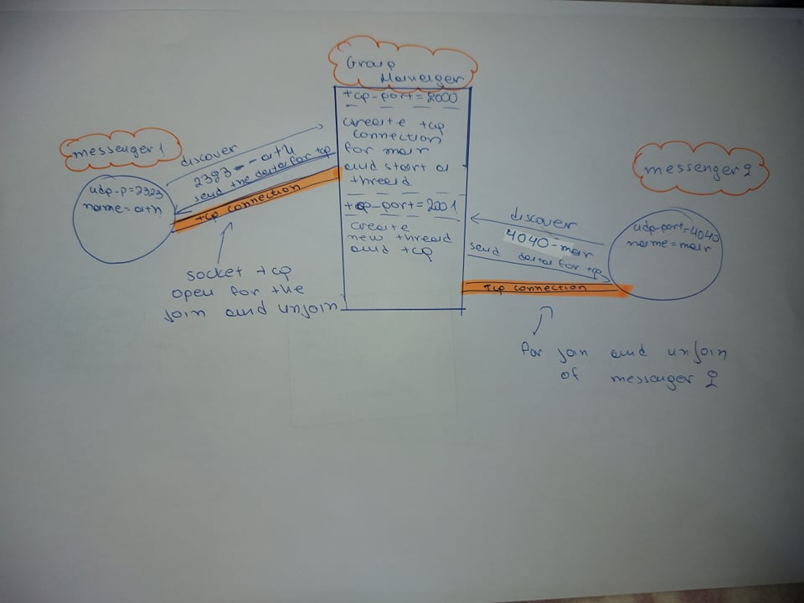

Slide 10
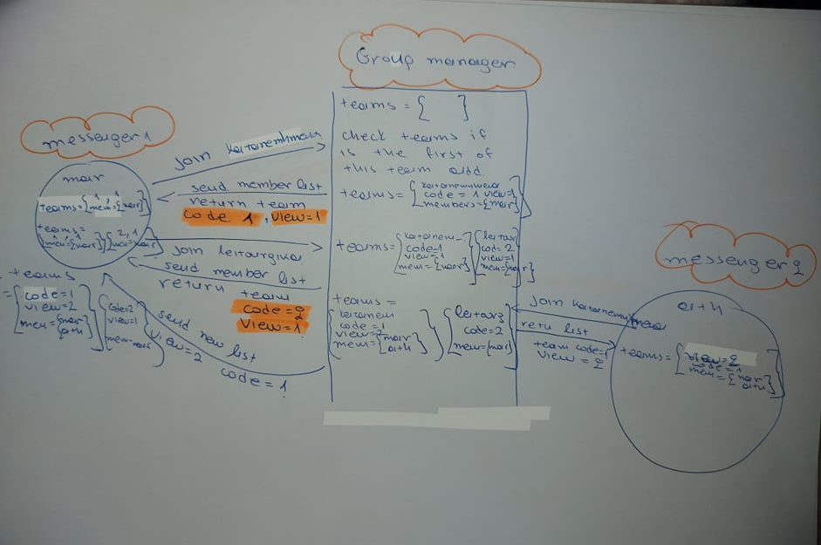

Slide 11
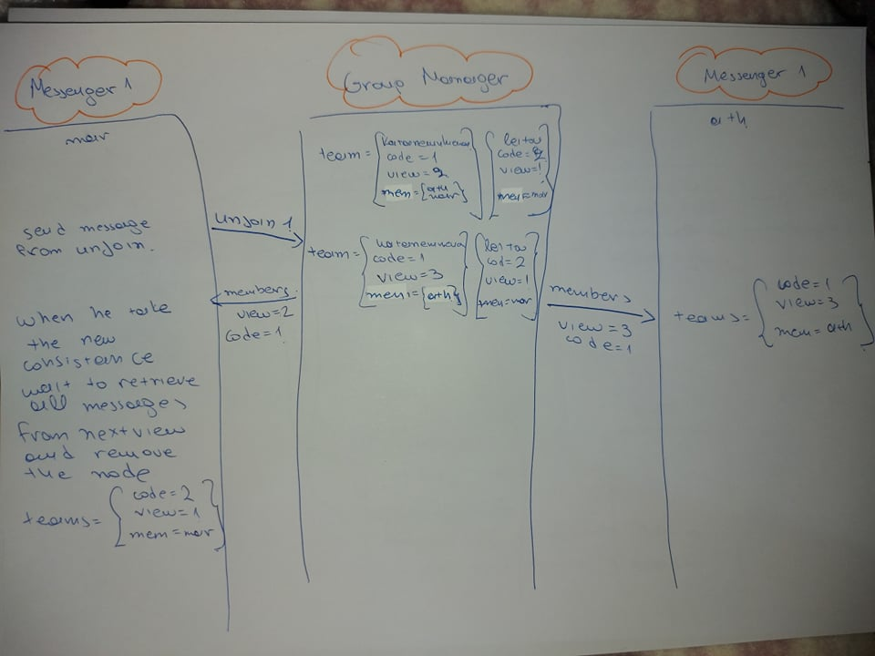

Slide 12
Messenger (classes)
application_info (for messenger app)
deliver_message
Byte[] message
length
Thread_for_team //check if the team change
Thread_for_receive //check if we have message
team_code // characteristic code of the team
current_team //the current members of the view in this team
deliver
Message
messenger id
seqno

Slide 13
Messenger (classes)
mids
team_change
id
seqno
member_send //list
change
Team_code

Slide 14
Messenger (classes)
messenger_teams
curr_view //the current view
next_view //the next view
curr_team //list of members that is on team in current view
next_team //list of the members that is on team in next view
mids_list //list of messages that we take
mbuf //list of messages that are for the next view
app_deliver //list of messages that are ready to delivered in app
taken_messages //list of messages that the app have already take
dpid //list od the last message that we take from a specific pid //for fifo
vids //list of messages that I have send
team_code
counter
group_name
seqno

Slide 15
Messenger (functions)
read_from_udp
Change_view
buf is the received message from udp
call deliver(buf);
2 lists →vids
→getTaken
While(true){
if(we have take vids from all members){
brake;
}
}
While(true){
if(getTaken == vids){
break;
}
}
Set current list and view equals to next
Init again the lists and the seqno
read_from_tcp
get team , view , and team_code
If(team code does not exist){
add team on list
set view and team on the current
}else{
add team and view on next
}

Slide 16
Messenger (functions)
grp_join
grp_leave
If (is the first join){
open the socket for udp
init threads to read from tcp and udp
}
While(true){
if(the manager send aw a team code){
return team code;
}
}
Send to manager
Wait until vieaw change remove team from list
grp_recv
If( block ==1){
while(true){
if we have a message to take
return 0
}
}else{
if(we have message)return 0;
else return -1;
}

Slide 17
Messenger (functions)
deliver
grp_send
Call reliable_send
Add message to vids
If(this message is for current view){
if(is the first time we receive this message){
add on mids
//do fifo stuff
if(header is V-SYNC){
add on vids
}
}
}
}else{
add it on mbuf
}
Redeliver to all members that have not send me the message
Reliable_send
Send message with udp
Header can be or RM-SND or V-SYNC
Message have the following form :
header | Team_code | view | Pid length | Seqno length | Message length | pid | segno | length

Slide 18
Group Management
The group management is done from group manager
Every time that someone join or unjoin the manager is responsible to inform all the members about the new team.

Slide 19
Group View
Every time that a messenger take a message for view change.
Send his vids(messages that he send in current view) to all the members
Wait until take the vids from all members
Wait until take all the messages that the other members send → taken_messages = vids
Only then we new that the view is change and we can send again a message or retrieve messages from the new view

Slide 20
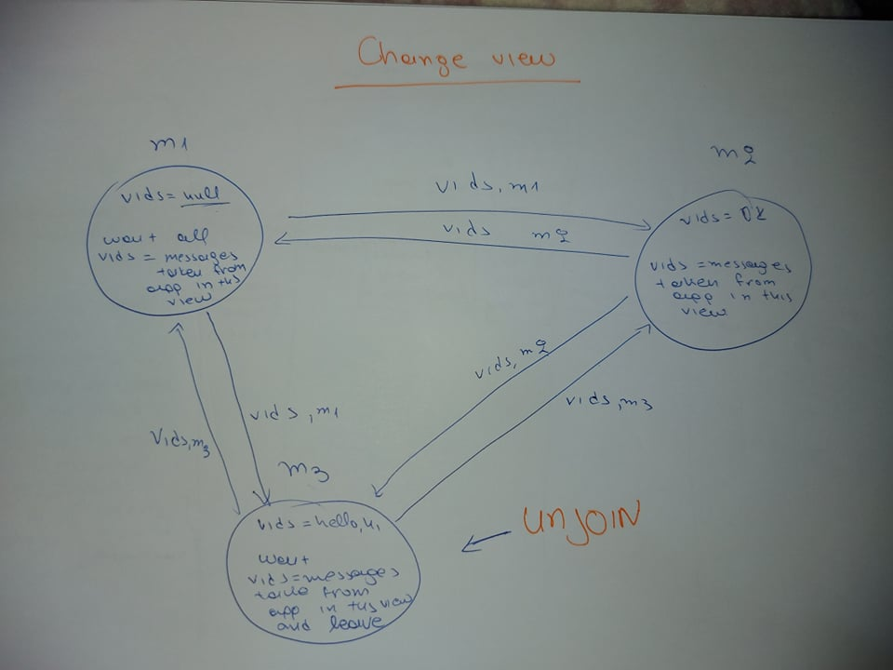

Slide 21
FIFO Reliable Multicast
In the spirit of reliable multicast every messenger of team when read a message redeliver this message to the other members from whom he has not take this message again. This process is necessary to be sure that all messages will be taken from all members.
FIFO : the api get a message from the network and put it on a buffer until be sure that the app has take the previous message. When he is sure that the previous message is taken give to the app the next one.

Slide 22
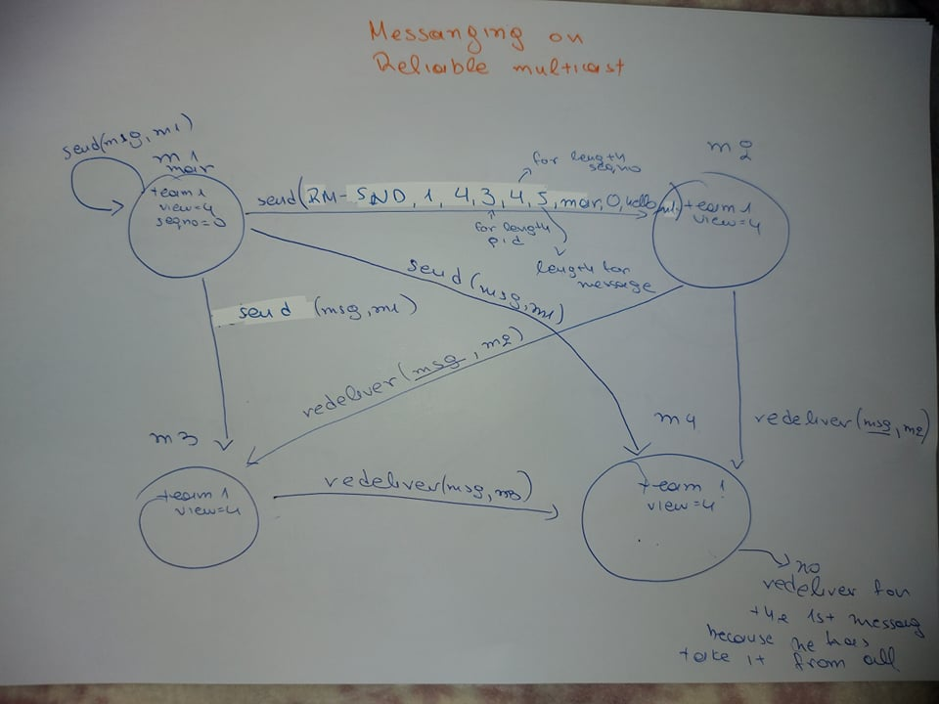

Slide 23
