Slide 1
Solving the monster of collinearity
By Alejandro Mahecha
June 25 2020

Slide 2
Definition and collinearity examples.
Synthetic data simulation OLS
Simulation Ridge, Lasso and elastic-net.
Bayesian regression
Conclusions and next steps

Slide 3
Multicollinearity

Slide 4
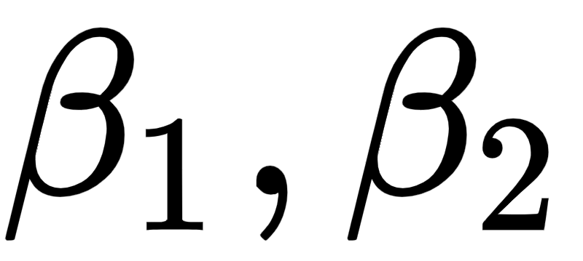
volume_sales(price, %_diff_price, …….)
salary(age, years￼_experience, …….)

Slide 5
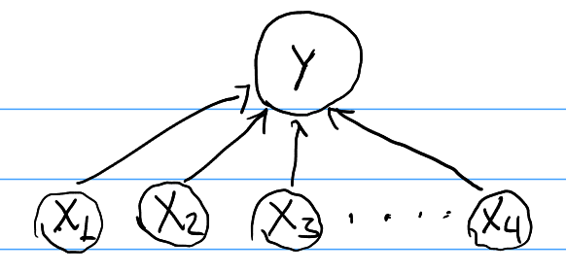
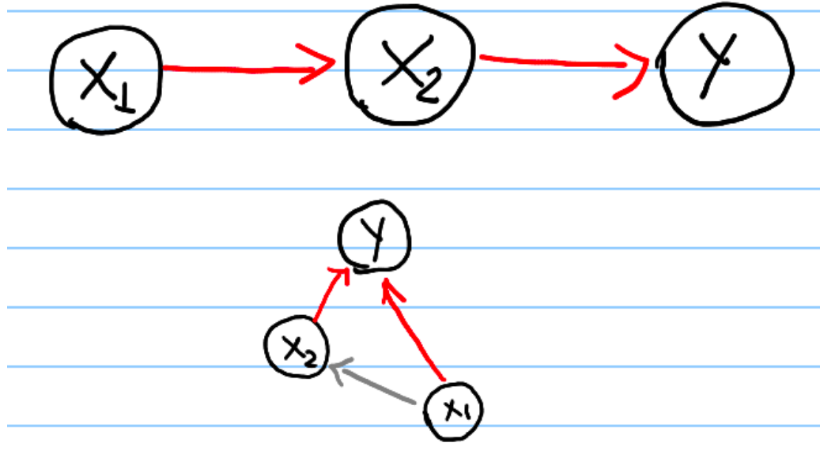

Slide 6
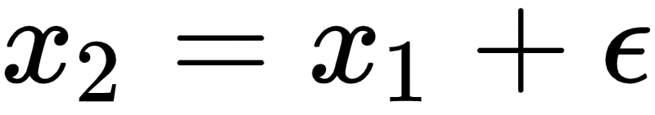
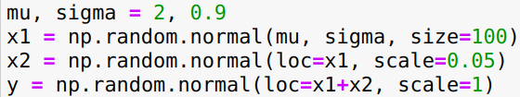
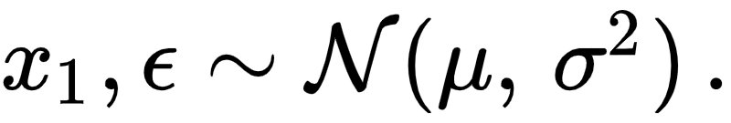
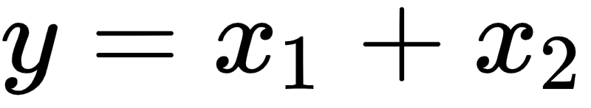
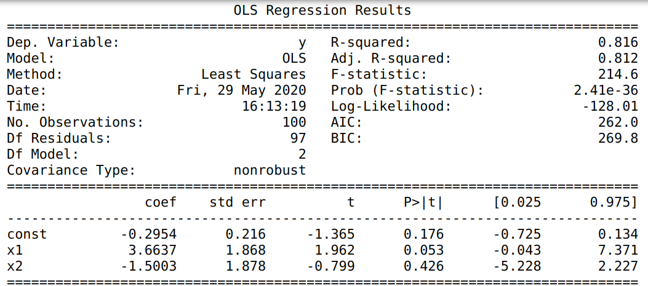

Slide 7
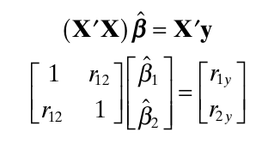
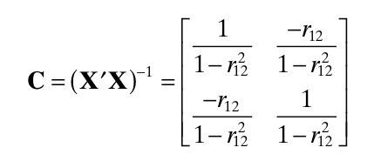


Assumptions
￼
Predictors have to be independent(pearson corr).
Probability distributions of predictors has influence on coefficients precision.

Slide 8
Simulations

Slide 9
Questions
% opposite sign coeff dist?
R_2 dist?
Coeffs dists?

Slide 10
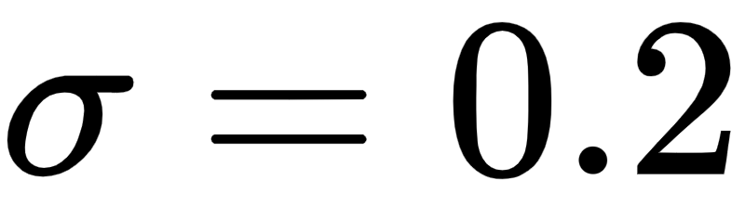
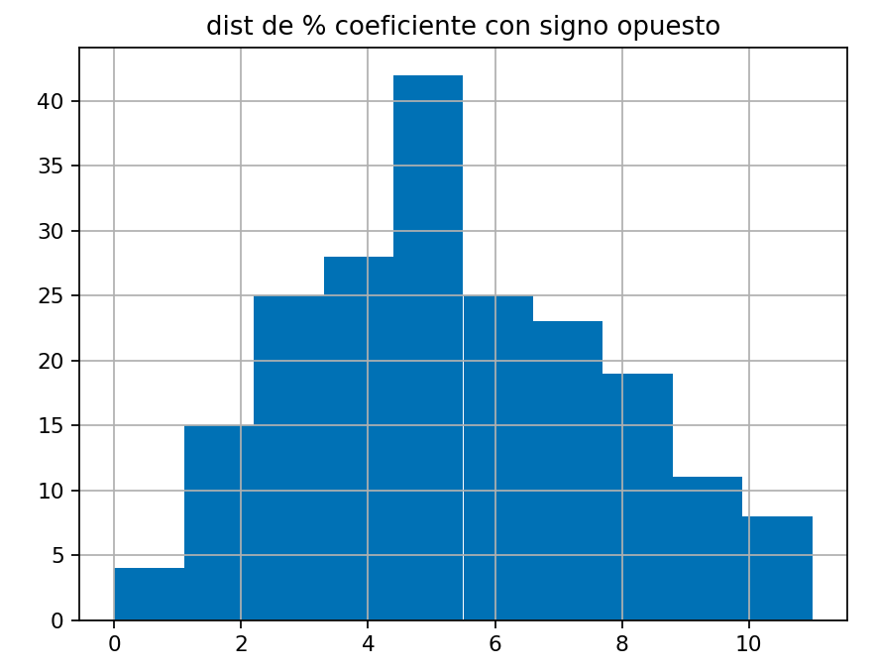
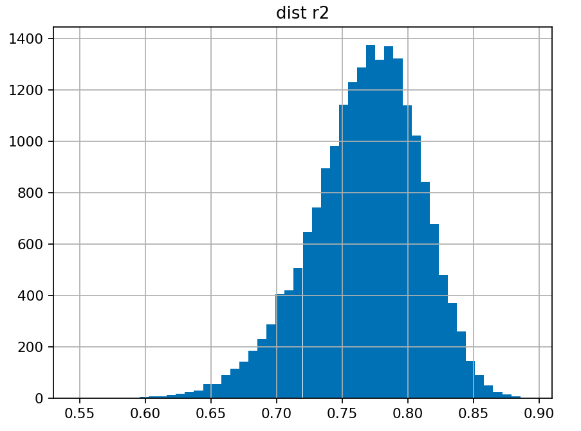
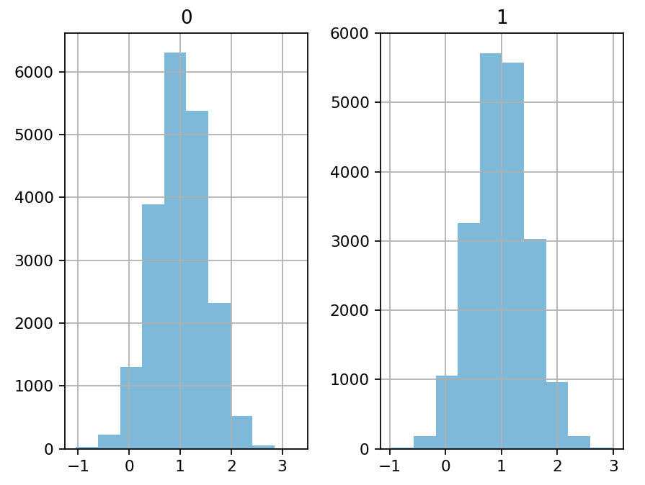
Low collinearity

Slide 11

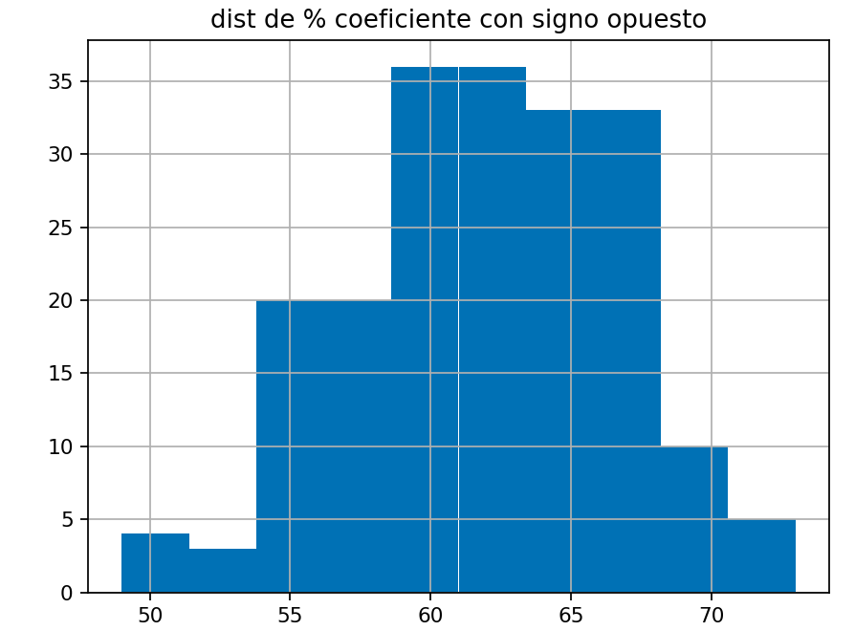
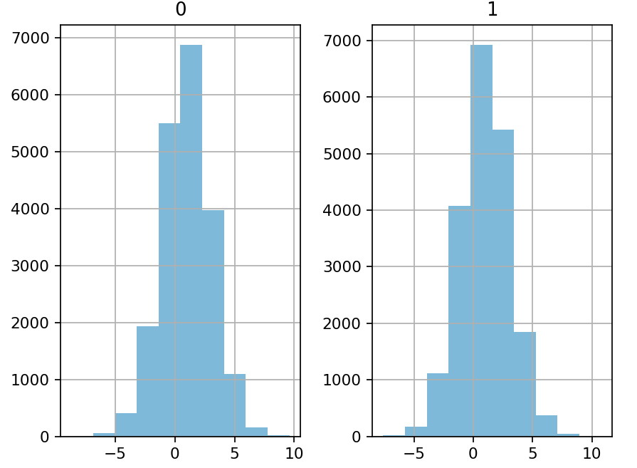
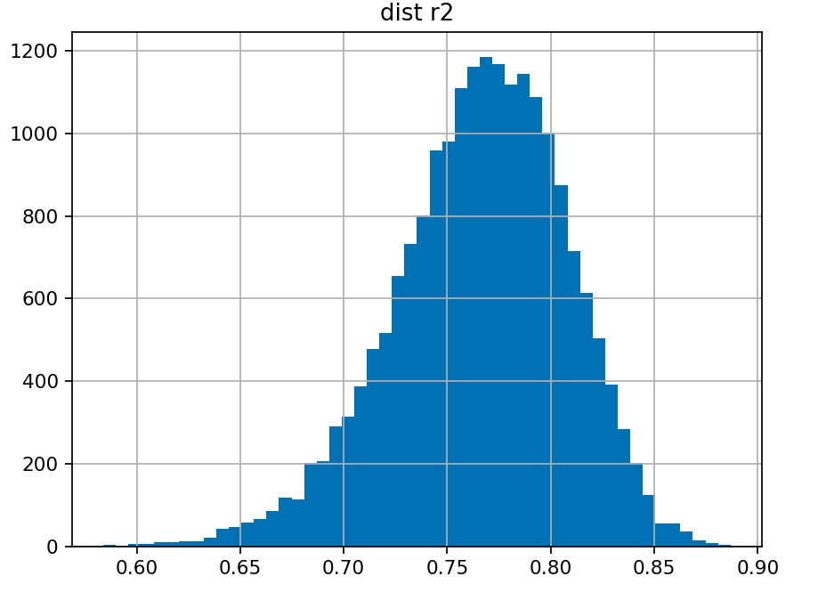
High collinearity

Slide 12
Regularization
Ridge
Lasso
ElasticNet

Slide 13
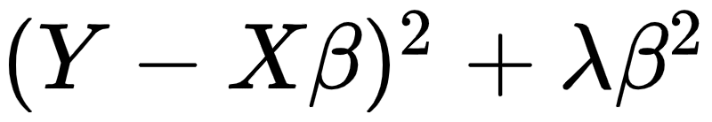
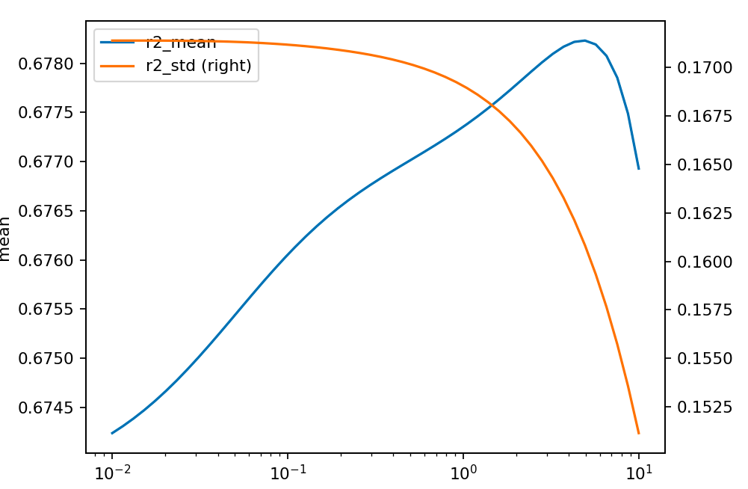
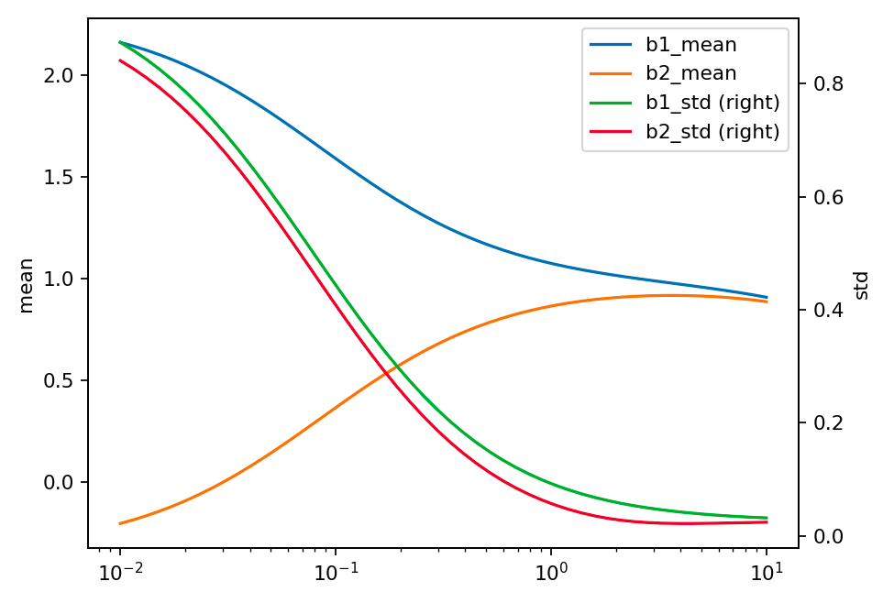

Ridge:
Test
 | Test
 |  | Test
 |  |  | Test
 |  |  |  | Test

Slide 14
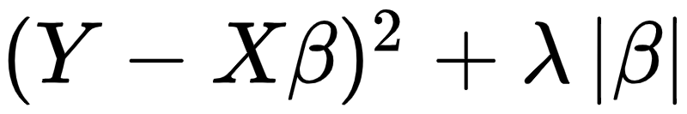
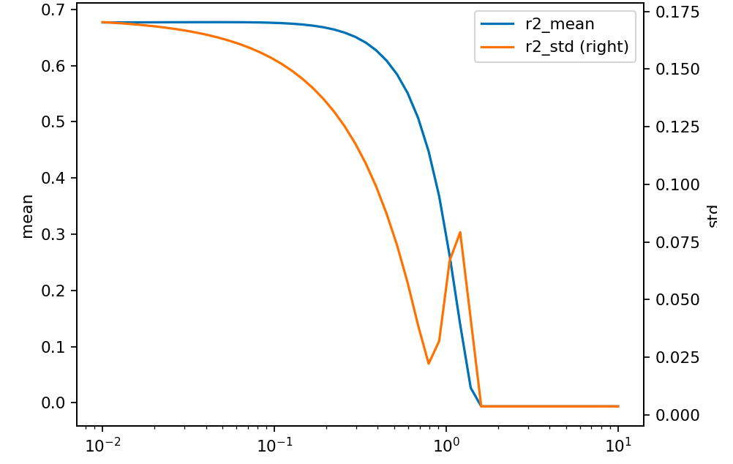
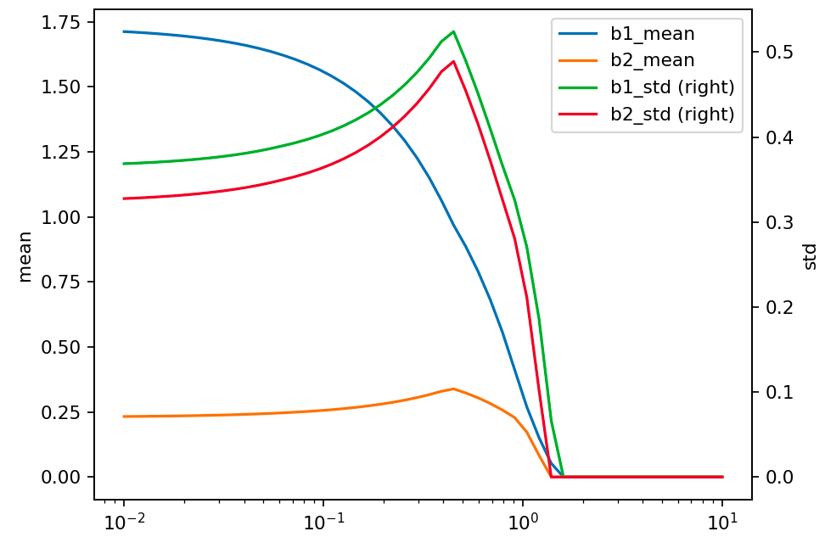
￼
￼
Lasso:

Slide 15
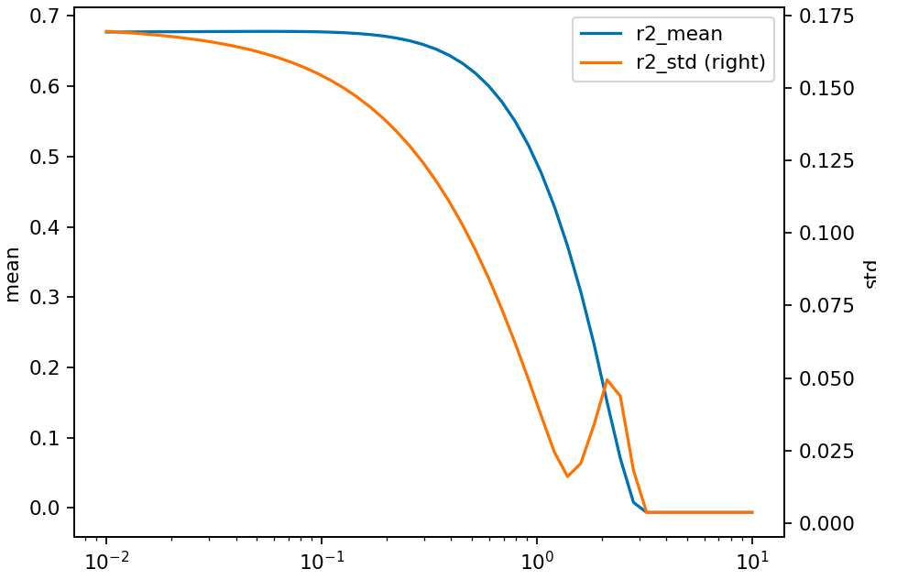
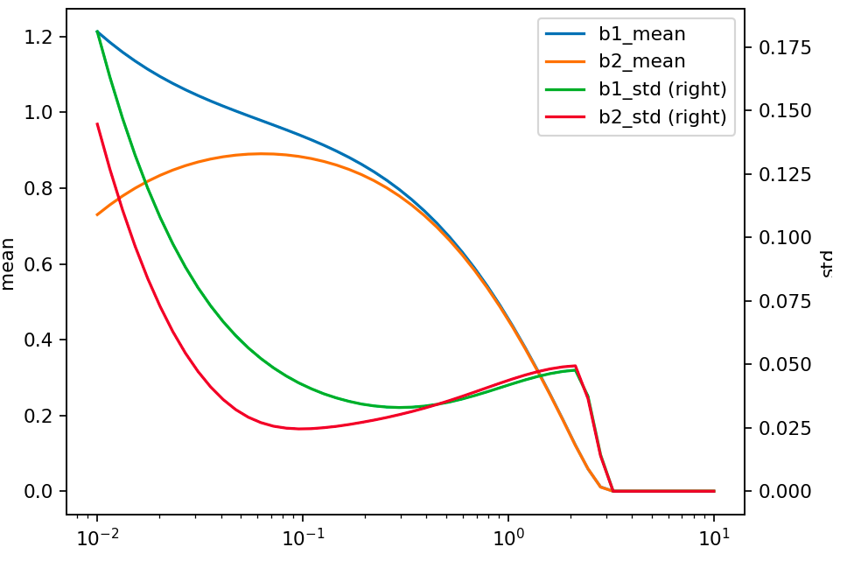
ElasticNet:

Slide 16

Bayes Regression model

Slide 17
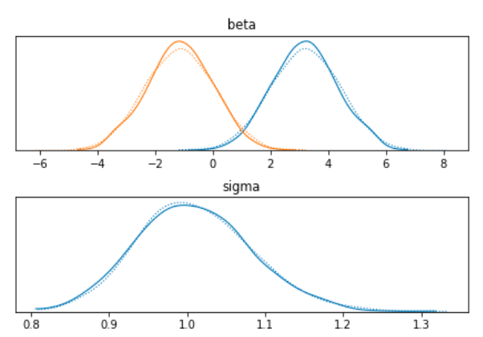
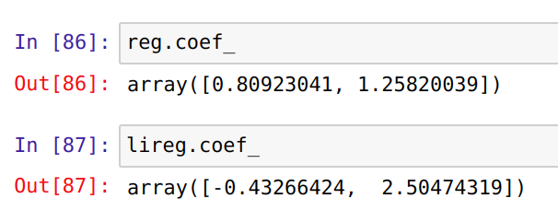
Bayes Linear regression
Pymc3
scikit-learn

Slide 18
References
https://iopscience.iop.org/article/10.1088/1742-6596/1265/1/012021/pdf
https://arxiv.org/pdf/1509.09169.pdf

