Slide 1
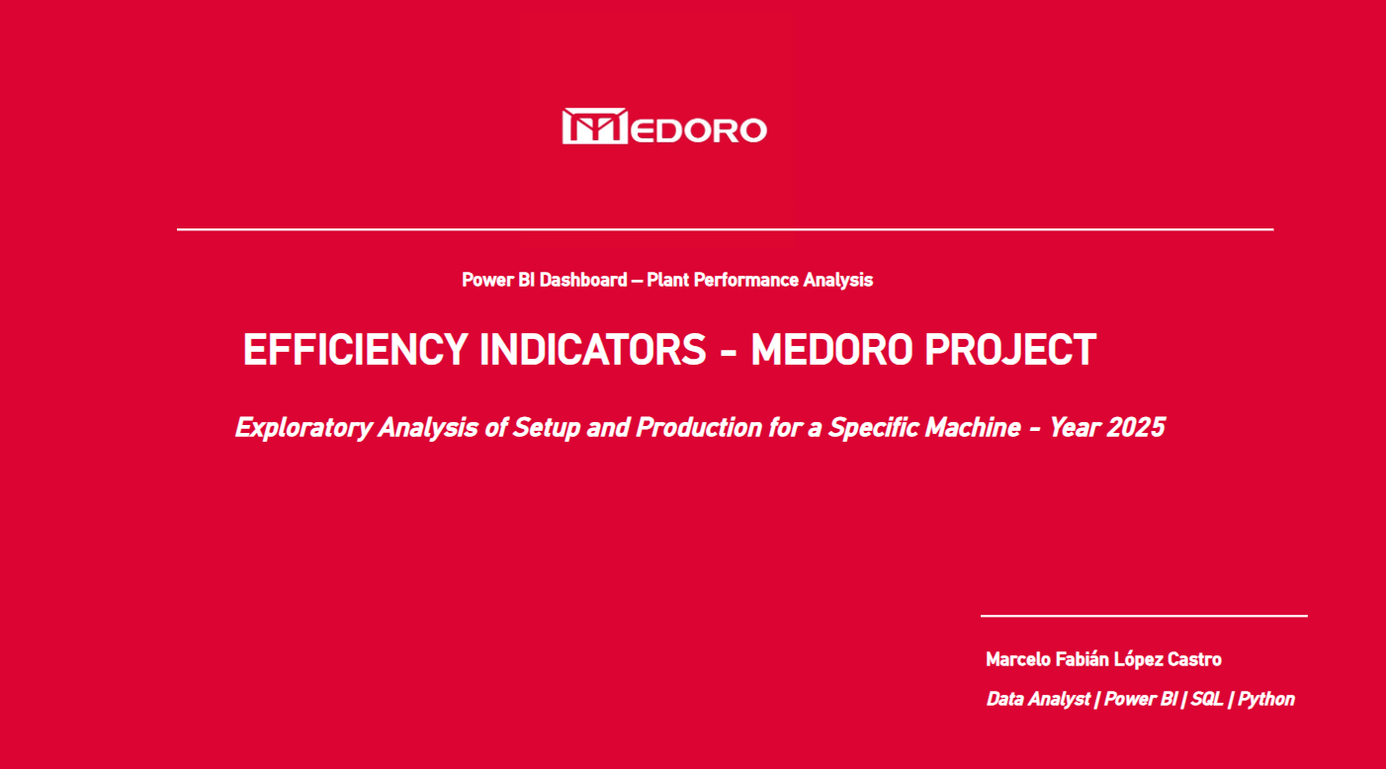

Slide 2
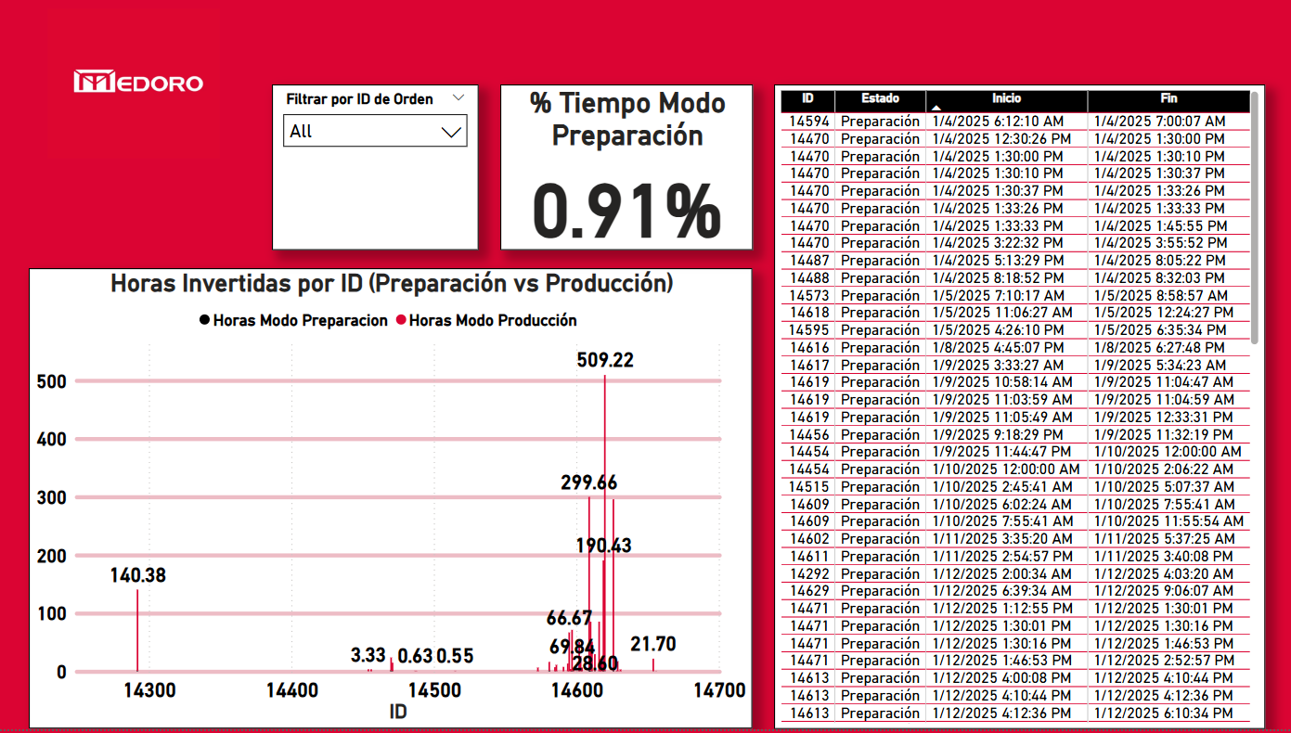
This slide displays the overall percentage of time spent in Setup Mode across all work orders processed by a specific machine in 2025.
The bar chart compares the hours invested in setup and production per order ID, helping identify discrepancies and potential inefficiencies in preparation time distribution.

Slide 3
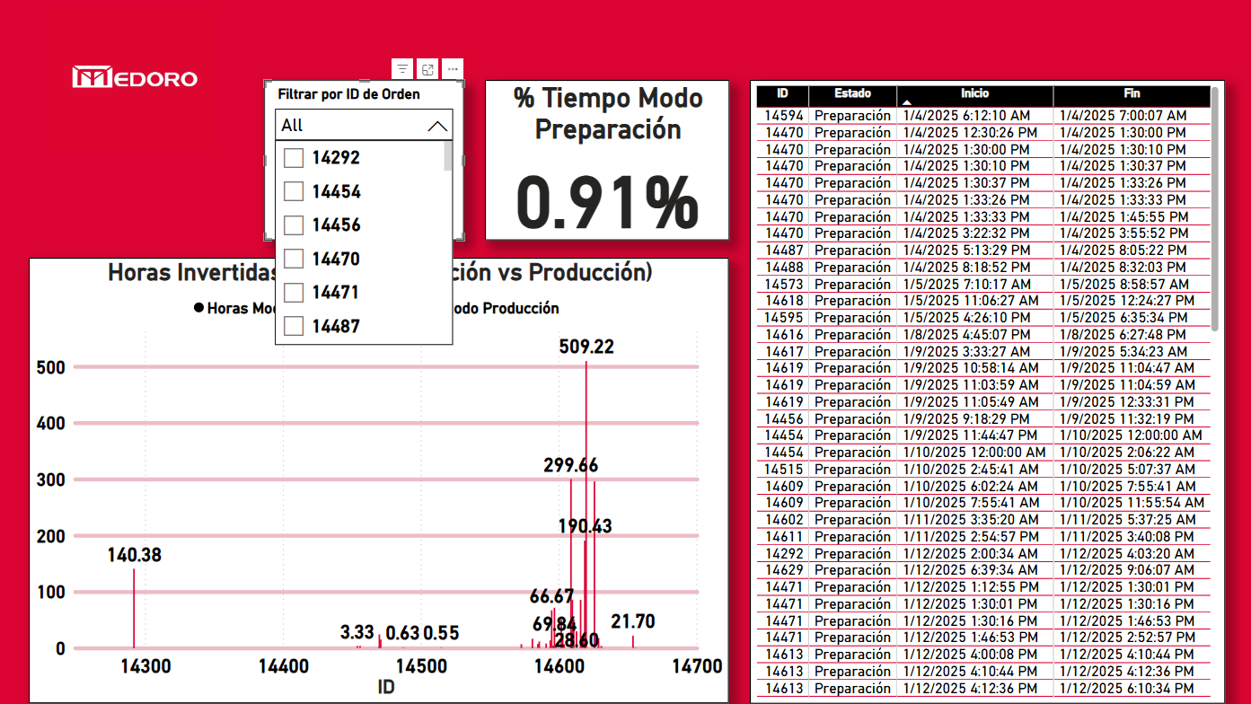
This slide illustrates the dynamic filtering capabilities of the dashboard.
By selecting a specific work order ID, users can drill down into its detailed setup and production times. This helps isolate anomalies and better understand individual performance metrics.

Slide 4
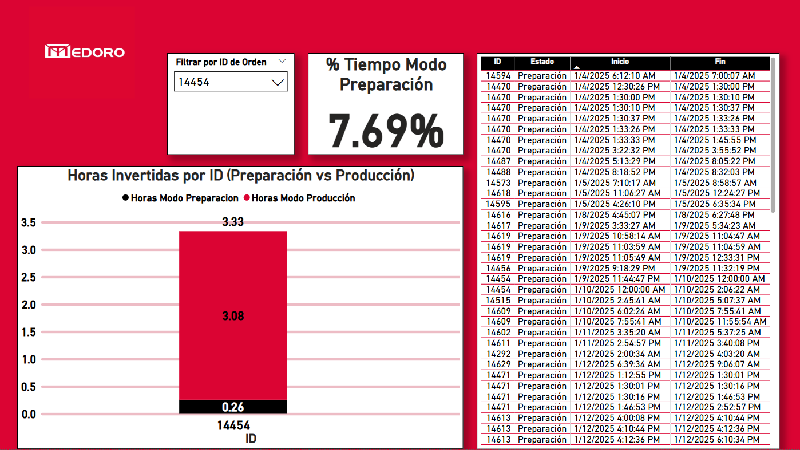
Example: Work Order 14454
This work order shows a setup time of 0.26 hours and a production time of 3.08 hours, resulting in a setup time percentage of 7.69%.
Visualizing these individual cases allows us to identify where preparation time might be disproportionately high, helping detect inefficiencies or operational issues.

Slide 5

Example: Work Order 14581
In this case, the setup time reaches 1.46 hours versus 14.62 hours of production, resulting in a setup time percentage of 9.09%.
By comparing multiple orders individually, it's possible to assess variability in efficiency across operations, even for the same machine.

Slide 6
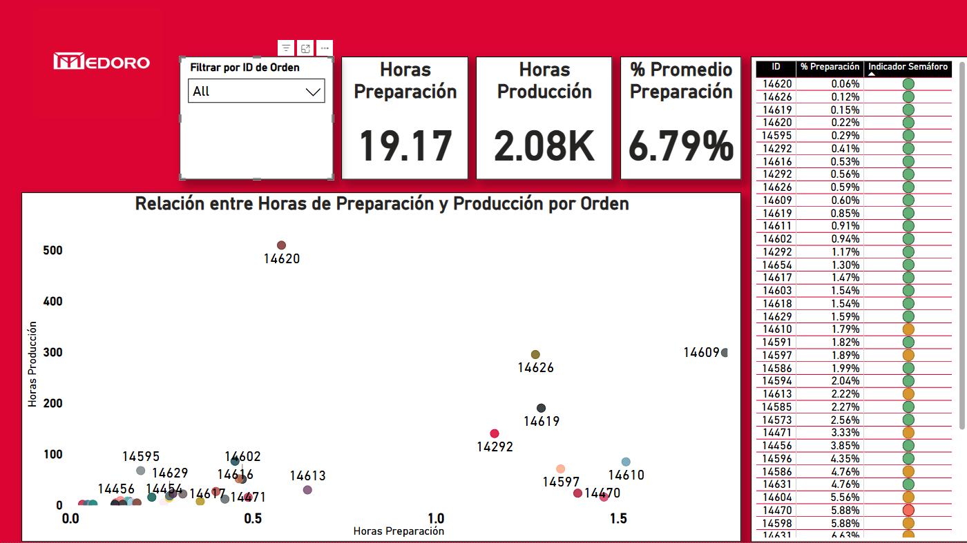
Global Comparison – Setup vs. Production TimeGlobal Comparison – Setup vs. Production Time
This scatter plot compares setup hours (X-axis) and production hours (Y-axis) for each work order. It helps detect outliers and patterns across operations. Some orders show high setup time relative to production, potentially indicating inefficiencies.

Slide 7
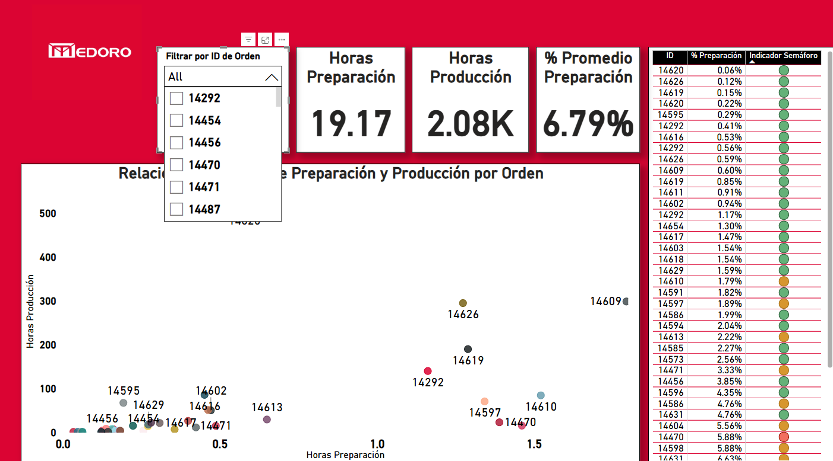
Custom Filtering for Deeper Insight
The user can filter the entire dashboard by selecting a specific Work Order ID. This feature enables focused analysis, helping identify why certain orders show higher or lower setup time proportions than average.

Slide 8
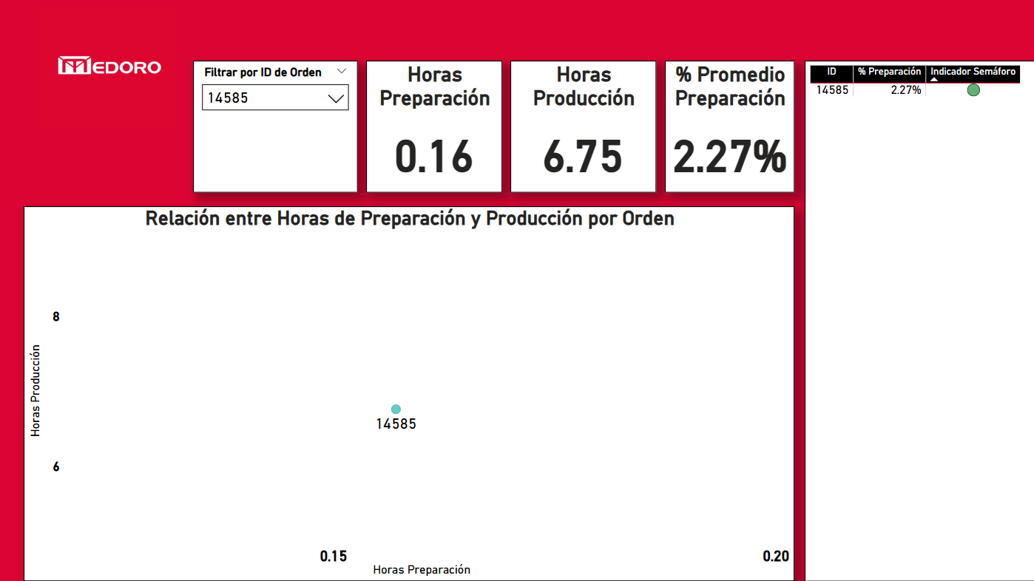
Case Example: Efficient Setup Time
Order ID 14585 shows an excellent balance, with only 2.27% of the total time spent in setup mode. This insight helps validate process efficiency and supports benchmarking for future improvements.
Notes:
x

