Slide 1
Paper ID 137 Automated ICD-9-CM Medical Coding of Diabetic Patient’s Clinical ¹⁾
{kumar64, nmistry2}@illinois.edu
CS 598: Deep Learning for Health, Spring 2022
University of Illinois, Urbana-Champaign
1) Vitor Pereira, Sérgio Matos, and José Luís Oliveira. 2018. Automated ICD-
9-CM medical coding of diabetic patient’s clinical reports. In International
Conference on Data Science, E-learning and Information Systems 2018 (DATA
’18), October 1–2, 2018, Madrid, Spain. ACM, New York, NY, USA, 6 pages.
https://doi.org/10.1145/3279996.3280019

Slide 2
Problem Statement
All patient data are stored as Electronic Health Record (EHR), which is important for better patient care – diagnosis and treatment and contains health data across time
EHR is used by other health industry players such as insurance for cost reimbursement
Codes are used in EHR to document various diagnosis and procedures used for patient care and treatment. ICD-9-CM and ICD-10-CM are industry standard coding.
There are cases where ICD codes needs to be entered for missing codes or corrections needs to be done, based on notes in EHR records
Manual entry of ICD codes is a cost intensive process and needs to be done by experts. In US, it is estimated to cost approx. 25 Billion USD per year.

Slide 3
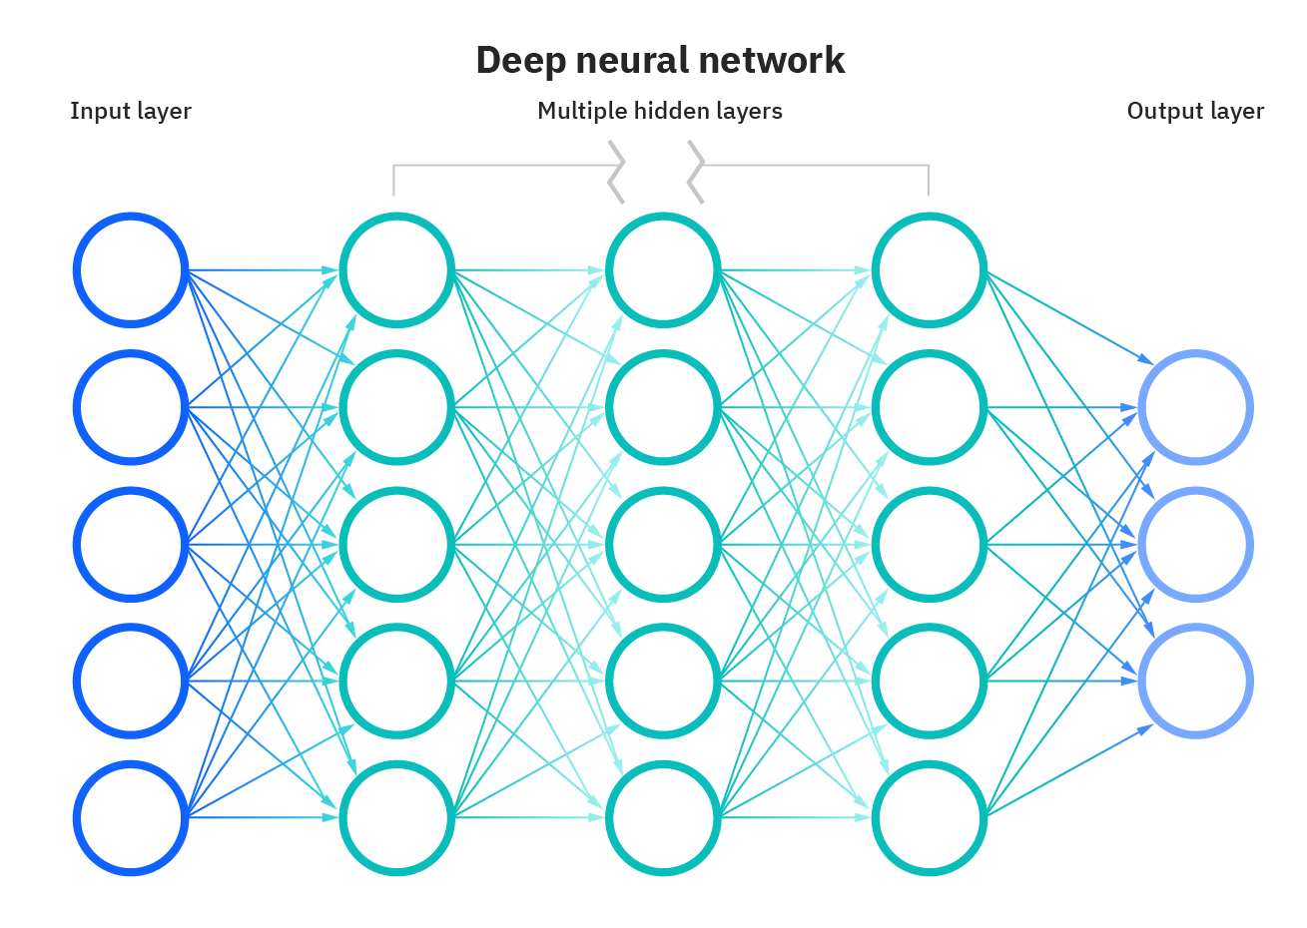
Proposal
The author of the paper «Automated ICD-9-CM Medical Coding of Diabetic Patient’s Clinical» proposes to deploy deep learning models to identify ICD-9-CM codes from the EHR notes using multi-label classification
The solution complements the current process and help health industry achieve higher quality data in EHR together with cost reduction
Cancer (Malignant Neoplasm), Hepatic (Liver) Assessment: Patient is more lethargic yesterday & today than he was on Fri ([**2-10**] days ago) Action: He was made DNR/CMO tonight, per agreement of family.
Assessment: Patient had acute SOB, midsternal chest pain, feeling that he was going to die Q **2016**] when he rolled in bed onto bedpan & had Br. HR increased to lon 70s SR. BP increased to 149/systolic. Desatted to 85%
Action: Given 100% high flow neb, 0.5 NTP & 0.25mg IV morphine EKG done during SOB. Response: Pain & SOB relieved. No changes on EKG
Plan: Now that patient is CMO, medicate W/morpnan rolling patient in bed. Continue to medicate w/Lopressor to prevent ACS as well as NTP or SL NTG, morphine
173.80,
173.89,
173.90
ICD-9-CM Code
Deep learning model for
generating ICD codes from EHR Notes

Slide 4
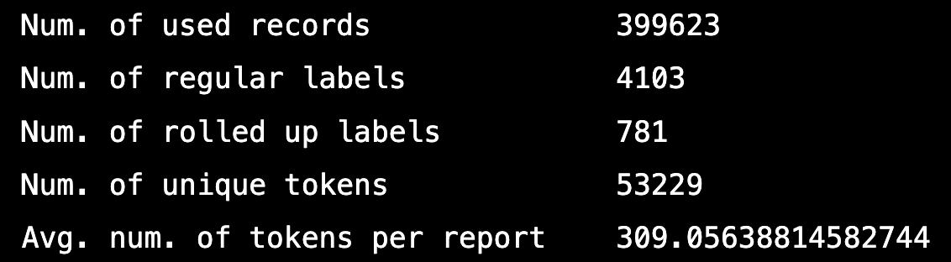
Training Dataset
MIMIC III
DIAGNOSIS_ICD and NOTEEVENTS tables
Preprocessing
Data for patients with diabetes
ICD-9-CM codes – regular and rolled up version
Tokenization of notes
Punctuation characters removal
Digits replacement with ‘d’
Lowercase
Tokenization at whitespace
Removal of all notes with less than 10 tokens and more than 2199 tokens
Replacement of infrequent word with frequent word with closest Levenshtein distance

Slide 5
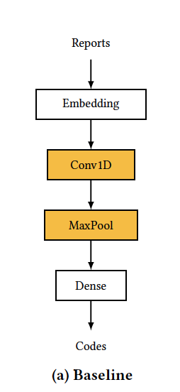
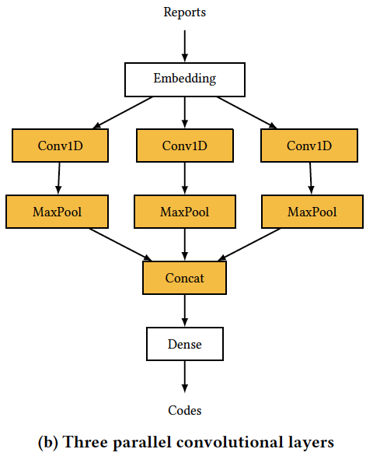
Models
Bag of Tricks – linear model
Convolutional Neural Network (CNN)
Baseline
Three parallel convolutional layer
Implementation is done using keras library
Hyperparameters:
Loss function: Binary Cross Entropy
Optimizer: Adam Optimizer
Filter size: 250
Kernel size: 2, 3, 4
Epochs: 25
Batch size: 32

Slide 6
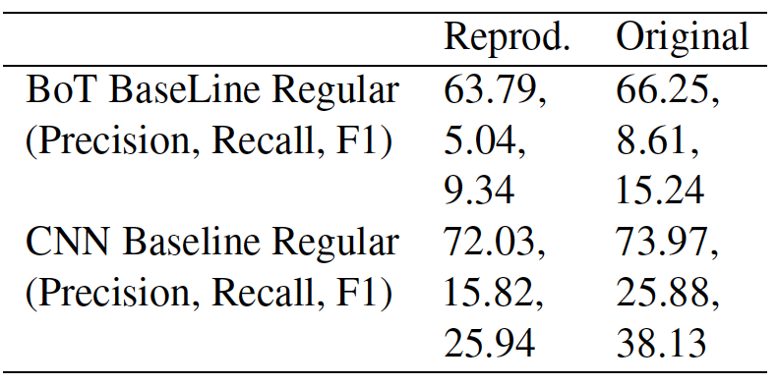
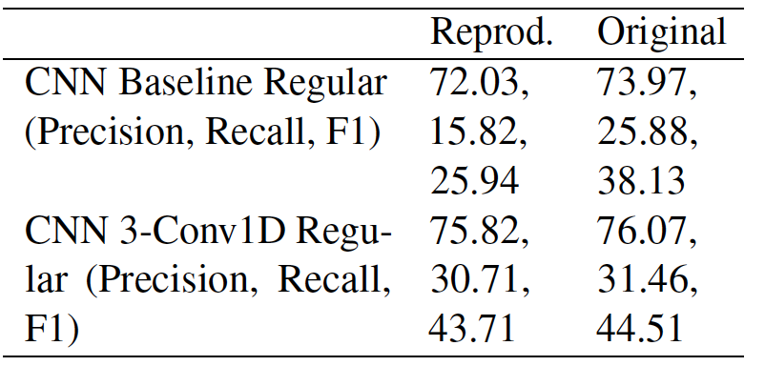
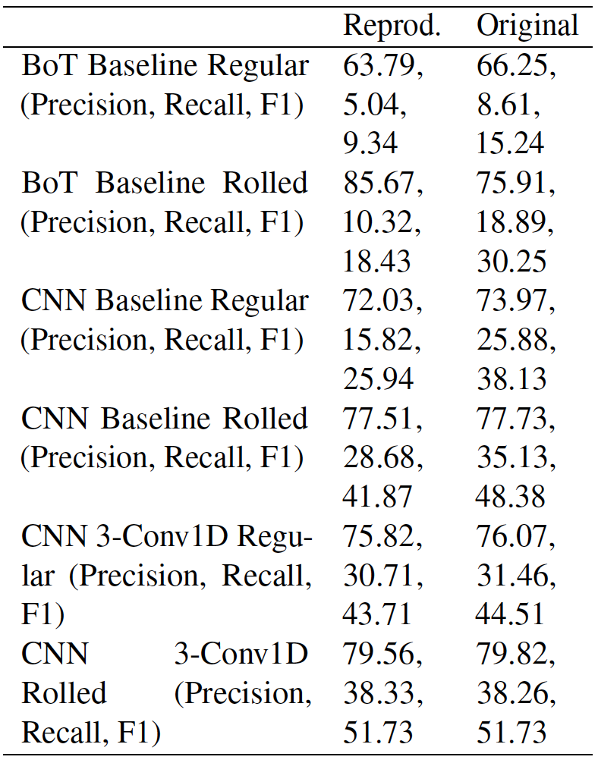
Claims and results
Result 1
Result 2
CNN Baseline has higher Precision, Recall and F1 as compared to BoT Baseline
CNN 3-Conv1D has higher Precision, Recall and F1 than CNN Baseline
Precision, Recall and F1 for Rolled up ICD-9-CM code assignment is always higher than Regular ICD-9-CM code assignment
Result 3

Slide 7
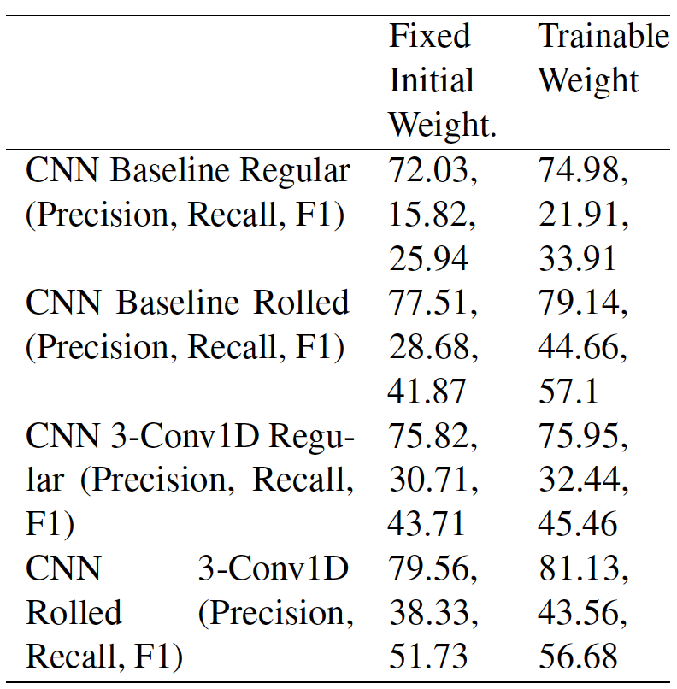
Ablation
Trainable initial weight in the first layer of CNN models – better result as compared to fix initial weight

Slide 8
Challenges
Pre-processing of MIMIC III data: Time consumed during pre-processing specially in replacing infrequent tokens with frequent ones using Levenshtein distance and Word2Vec model training
Training of models: Computation resource restriction on personal laptop and on Google Colab Pro led us to adapt improvised training approach – training with 20% of training data at a time and then saving the intermediate model for next training

Slide 9

Thank you
Although we faced several challenges during the project, it was great learning experience, which required us to think out-of-box to resolve computational resource restriction.
Thank you for the opportunity to work on a research paper experiment and establish the paper baseline.

