Slide 1

Stock Recommendation Engine - A consolidated recommender
Bringing market within the reach of commons

Slide 2

PROBLEM
Lack of consolidated recommender
More retail investors due to availability and easiness of trading platform
The retail investor of today lacks time for in-depth research
Investors lacks necessary knowledge to analyze the financial standing of a company.
Too many analysis/reports in the web
Stream of information in modern era of social computing

Slide 3

SOLUTION
One stop window to provide stock recommendation
Enable retail investors easy access to information to make informed investment decision
The recommender system combines
stock rating data from various market analyst,
market sentiments in social media (Twitter)
company profile and financial attributes

Slide 4
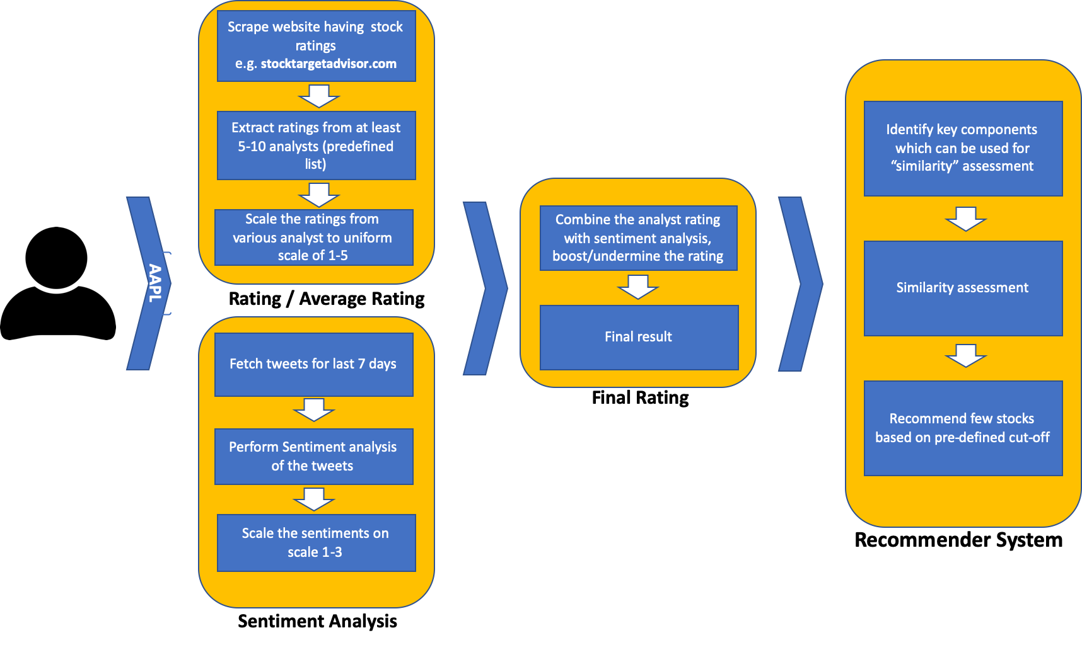
System Design

Slide 5



PRODUCT
Analyst reports
ratings_system is the component which calculates the overall rating for the user selected(searched) stock, by scraping the required ratings data from market analyst website and aggregating them.
Market Sentiments
TwitterSentimentAnalysis component fetches latest tweets for the user selected(searched) stock from Twitter used Twitter API, performs sentiment analysis and return overall sentiment for the given stock.
Financial attributes of the company
Three aspects of parameters
recommender_system takes a stock symbol as input and recommends 5 stocks matching the profile of the user selected(searched) stock and a pre-defined similarity function.

Slide 6
Project Documents
User Guide
https://github.com/MLwithSandy/CourseProject/blob/main/UserGuide.pdf
Technical Set-up Guide
https://github.com/MLwithSandy/CourseProject/blob/main/Technical_set-up_guide.pdf
Project Report
https://github.com/MLwithSandy/CourseProject/blob/main/ProjectReport_StockRecommenderSystem.pdf

Slide 7
Installation & Setup
Install Docker on your local machine
https://docs.docker.com/get-docker/
Download the project from github
https://github.com/MLwithSandy/CourseProject
Go to the folder SRE: CourseProject > ProjectCode > SRE
To start the Stock Recommendation System, run the start scripts
start.bat for windows
start.sh for linux
To stop, run the stop scripts
stop.bat for windows
stop.sh for linux

Slide 8
How to Use
Open browser, preferably Chrome or FireFox
Go to http://localhost:8080/home to access Stock Recommendation System UI
Enter any stock symbols e.g. AAPL (NASDAQ Market) in the search box and click “Search”
Stock Recommendation Engine will show
Analyst ratings
Twitter Sentiment Ratings
Overall ratings
Most recent five tweets
Similar stock recommendation
Use http://localhost:5000/ to see list of Rest API end points the product

Slide 9
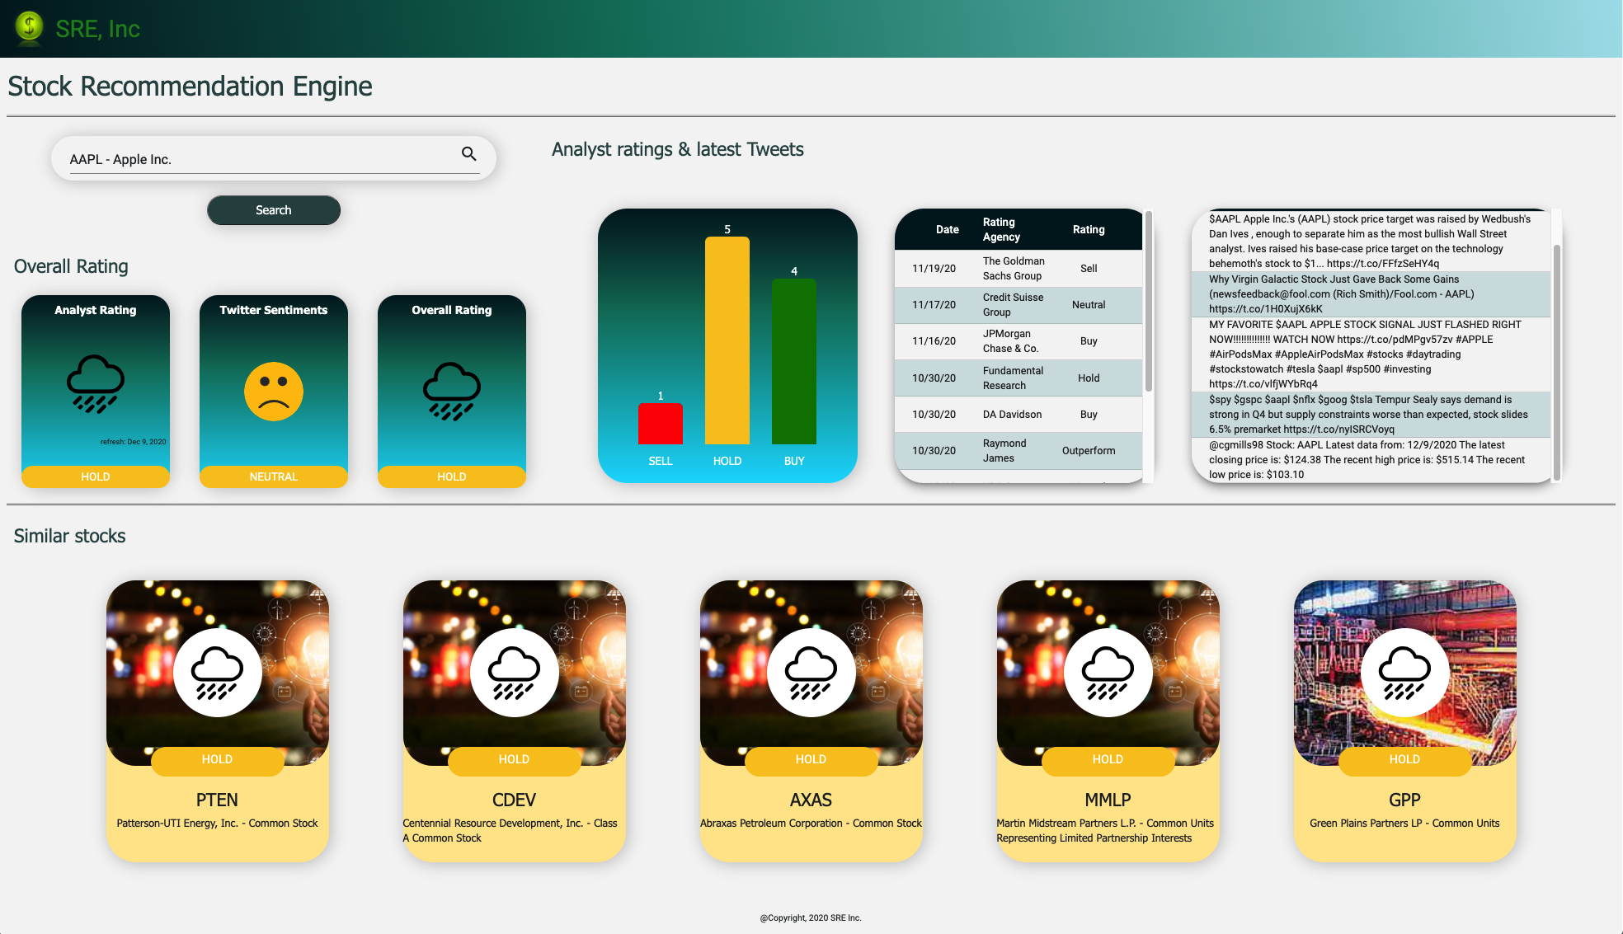
Live Demo – Use Case

Slide 10
Data Used - Acknowledgements
https://www.marketbeat.com/
https://www.cs.cornell.edu/people/pabo/movie-review-data/
https://www.kaggle.com/cnic92/200-financial-indicators-of-us-stocks-20142018?select=2018_Financial_Data.csv
https://developer.twitter.com

Slide 11



OUR TEAM
Sandeep Kumar
Rasbihari Pal
Ezra Schroeder
kumar64@illinois.edu
pal9@illinois.edu
ezras2@illinois.edu

Slide 12

Conclusion
Overall, the Stock recommending system as described in this project report has yielded satisfactory result in recommending rating for the user entered Stock symbol and recommending five similar stocks.
Future Work
Considering user input of sectors and providing recommendation and trends specific to that sector
Defining the test and train data and possibly human labeling twitter feed (for sentiment analysis) just for tweets related to stock market
Explore the timeseries data for stock adjacency.
Combine more analyst report and microblogging sites

Slide 13
THANK YOU!

