Slide 1
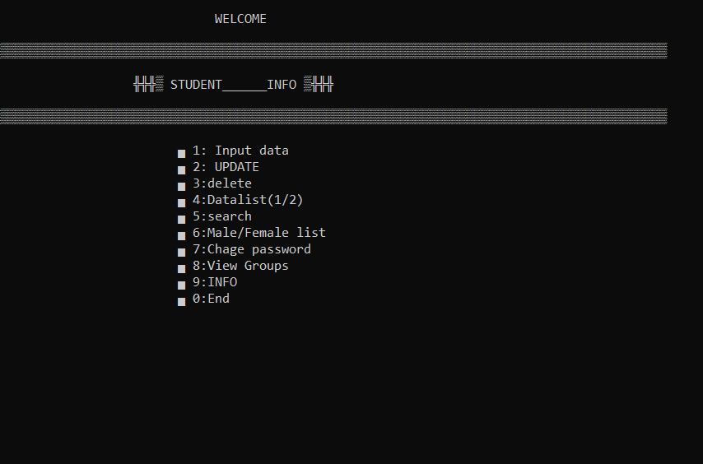
PRESENTATION
Project name: IIUC Student data of newly admitted students.
Introduction : The Software keeps the data of Newly admitted student. It also let the user to update , delete , search , sort according to many criteria, auto generate groups etc.
How it decide:
Waiver: If a student data contains 5.00 in both SSC and HSC GPA, He is considered as waiver holder.The student who got waiver will have to pay 60,000 admission fee instead of 90,000 who aren’t got waiver.It will also considered as fullpayed if the payment is 60,000.
Auto generated group: The software auto generates group by giving priority to the highest average.
Here, average = (SSC GPA * 0.25) + (HSC GPA * 0.75)
Description:
There are 4 text file already made before running the Software. Those are ‘fulldata’,’start’,’passw’,’group’. The first to file are empty at the starting and the rest 2 contains 2 integer data.
‘passw’ file contains an integer that will be used as password. It can be changed through the software later. ’start’ file contains the number ‘1’ at the starting.
In the software, After entering the correct password,the main menu will appear with 10 option.
To perform any operation pointed on the option follow the given instruction.

Slide 2

To enter new data, choose input data and It’s must to enter data according to the given instruction. It is also must, not to keep any field empty.
The ‘roll’ field should have atleast 3digits of integer number where the 2nd digit is either ‘1’(for female students) or ‘2’(for male students).
To update data, Enter to the update option and enter roll to update data of which you want to update.
To delete data, Enter to the delete option and enter roll to delete data of.
To perform searching for any students data, there are two ways for it. Search by roll or search by Name. For the ‘search by name’ option it is must to enter the exact name(Exact uppercase and lowercase letters) to find the expected data.
The male or female list is created based on the 2nd digit (If it’s ‘2’,it’s considered as male & If it’s ‘1’,it’s considered as female )of the roll.
To change password it’s necessary to enter current password.
Auto generation of groups depends on average of GPA(average = (SSC GPA * 0.25) + (HSC GPA * 0.75))
KEYPOINTS:
1.The software is time efficient.
such as,if you search any data,it will show an option to update that data instantly if you want.You need not to go back to mainmenu and update data.

Slide 3
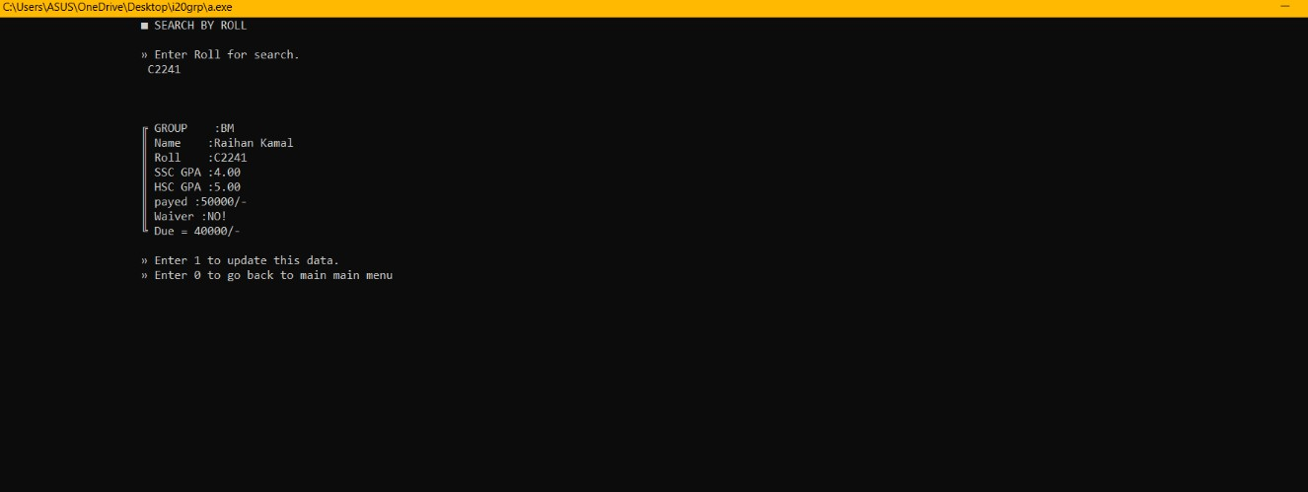
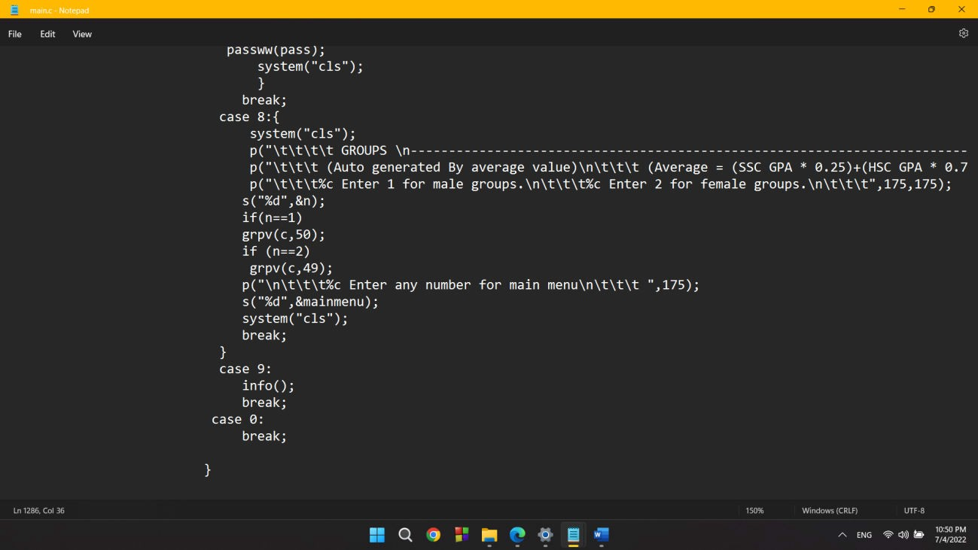
2. we worked with ASCII code ,such as in case off grouping we used mathematical expression to ASCII value to generate group like ‘AM’,’BF’ etc.

