Slide 1
FinAssist: A Personal Finance Assistant
Agentic AI Bootcamp Capstone Project
Notes:
FinAssist is a lightweight financial assistant that helps users track budgets, compare investments, and get practical financial tips.

Slide 2
Motivation
Managing money is complex (budget, bills, investments)
Tools track spending but rarely give advice
Goal: Combine insights + actionable tips in one assistant
Notes:
A lot of people struggle with managing money.
You might be tracking a budget in Excel, googling investment returns, and separately looking up financial tips.
FinAssist brings together in one simple assistant.

Slide 3
Project Goals
Answer questions like:
“Where am I over budget?”
”Compare TSLA vs. SPY over 6 mos.”
”Any ways to lower my phone bill?”
Deliver clear, interactive responses

Slide 4
System Overview
Router → Budget/Investment/Advice
Budget: over/under categories
Investment: stock summaries, charts
Advice: knowledge base (RAG)
Interface: Gradio chat demo
Notes:
The system can do 3 main things:
Analyze your budget – show over- and under-budget categories.
Compare investments – e.g., TSLA vs SPY over 6 mos.
Provide financial advice using retrieval-augmented generation (RAG)

Slide 5
Routing Logic
• Classifies user queries into three categories:
– Budget reports (monthly summaries, over/under budget)
– Investments (compare tickers, returns)
– Advice (RAG-based: rules, savings tips)
• Uses keyword + regex heuristics (e.g., 'budget', 'stock', 'how')
• Ensures each question is routed to the right module
• Provides fallback suggestions if no match
Notes:
Built a router that looks at the user’s question and sends it to the right module: budget, investments, or advice.
For example: ‘Where am I over-budget?’ goes to budget; ‘Compare AAPL and MSFT’ goes to investments; and ‘Any tips to lower my phone bill?’ goes to the advice module.
The routing logic helped us avoid mixing answers from the wrong domain.

Slide 6
Data & Preprocessing
Dataset: Kaggle personal transactions
Normalized transaction types (credit/debit)
Aggregated by month
Excluded categories: Paycheck, Credit Card Payment, etc.
Notes:
Use a Kaggle dataset of personal transactions, plus a simple budget template.
For investments, we used yfinance for stock data.
For financial advice, we build a small knowledge base.
Data was normalized – cleaned up transaction types, grouped them by month, and mapped them to budget categories.

Slide 7
Knowledge Base + RAG
Markdown finance guide → embeddings(MiniLM)
Cosine similarity + keyword/domain boosts
Preloaded with :
50/30/20 rule
Emergency fund guidelines
Bill-saving strategies
Adds concrete dollar examples
Notes:
The advice part is powered by embeddings. We chunked a small financial guide, embedded it with MiniLM, and used cosine similarity search.
Added heuristics: for example, if you ask about ‘internet bill,’ the router boosts keywords like promo, provider, or bundle so you get relevant results.

Slide 8
Demo Setup
Advice first: “reduce, lower, save” → RAG
Budget: “variance, over budget, 2019-09” → reports
Investments: ticker symbols (AAPL, TSLA) → returns & charts
Prevents mixed or irrelevant answers

Slide 9
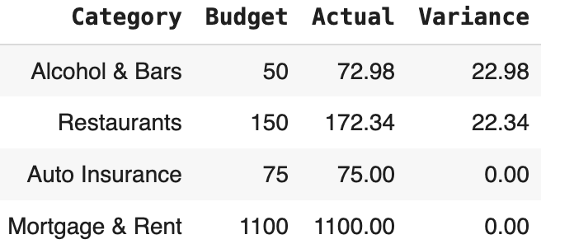
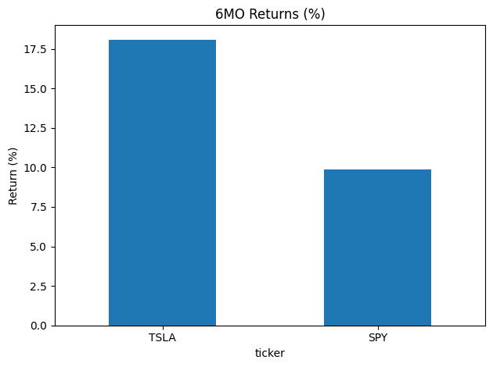
Results/Demo
FinAssist (demo)
Ask about your budget (e.g., 'Where am I over budget in 2019-09?'), investments ('Compare AAPL & MSFT over 1y'), or tips ('Any ways to lower internet bill?').
Chatbot
Any tips to lower my phone bill?
Answer: Any tips to lower my phone bill?
• Call the provider every 6-12 months for promo pricing. (ask for promo pricing; $5–$20/mo savings is common). • Bundle or auto-pay discounts can save 5-15% (bundles/auto-pay often save 5–15%, e.g., $5–$15/mo).
Source: FinAssist KB
Notes:
3 Examples:
Budget: ‘Where am I over-budget in 2019-09?’
Investments: ‘Compare TSLA vs SPY over 6 mo.’
Advice: ‘Any tips to lower my internet bill?’

Slide 10
Challenges & Lessons
RAG sometimes returned irrelevant bullets → fixed with filters
Router overlap (budget vs advice) → solved with priority order
GitHub merge issues → learned rebase + .gitignore
Key takeaway: clean data + clear routing = reliable answers
Notes:
Had to tune the RAG filtering – at first, asking about ‘phone bills’ sometimes returned restaurant advice.
GitHub merge conflicts
Importance of clean data – small differences in transaction labels caused issues.
Routing logic really matters. Without it, messy or irrelevant answers.

Slide 11
Future Work
Expand KB with broader financial topics
1
Use larger embedding model for better recall
2
Connect to live financial APIs (Plaid, brokerage)
3
Deploy on Hugging Face Spaces for public access
4
Notes:
Expand knowledge base to cover more financial topics – like credit, retirement, and taxes.
Support multi-turn conversations instead of single Q&A.
Deploy to Hugging Faces Spaces or Streamlit to make more accessible.

