Slide 1

The Digital Divide
The digital divide refers to the gap between those who have access to and can effectively use digital technologies, and those who do not. This divide can be between different socioeconomic groups, geographic regions, or even age demographics.
a
By Diwakar, Sailesh and Prawesh

Slide 2
Causes of the Digital Divide
Economic inequalities
Geographic Isolation
Education Gaps
Lack of affordability of devices, internet access, and digital skills training creates barriers for lower-income communities.
Remote or rural areas often lack the infrastructure and investment needed to provide reliable and high-speed internet access.
Insufficient digital literacy education, especially for older adults and marginalized groups, limits their ability to use technology effectively.

Slide 3
Impacts of the Digital Divide
1
Limited Access to Information
2
Barriers to Education and Jobs
Those without digital access miss out on news, educational resources, and opportunities for personal and professional growth.
The shift to online learning and remote work can disadvantage those who lack the necessary digital skills and equipment.
3
Increasing gaps between people
4
Lower community involvement
The digital divide makes it difficult for marginalized groups to improve their lives because of existing differences in wealth and where they live.
If people can't get online easily, they might not be able to take part in online civic activities and talk about politics.

Slide 4
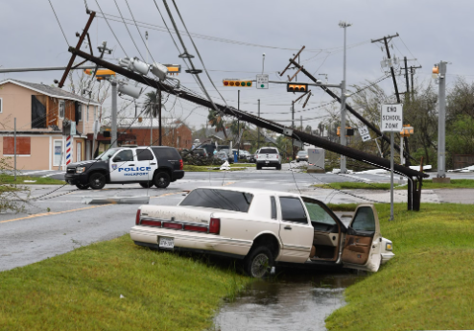
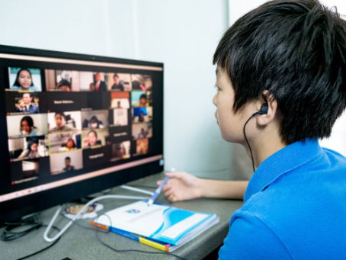
Examples:
1
2
Hurricane Harvey and limited access to information
Remote learning challenges during the COVID-19 pandemic
Hurricane Harvey in 2017 caused massive destruction in Texas. Many people without internet access could not get important information about the hurricane, like where to evacuate or find shelters.
The COVID-19 pandemic forced many schools to close and switch to remote learning. However, students who did not have access to the internet or devices were unable to participate in remote learning.

Slide 5




Bridging the Digital Divide
Invest in Infrastructure
Expand high-speed internet access and device availability in underserved communities.
Provide Digital Literacy Training
Offer programs to improve digital skills and comfort with technology for all age groups.
Partner with Communities
Collaborate with local organizations to understand and address the unique needs of different communities.

Slide 6




Different Organizations Working to Bridge Digital Divide in South Asia
Akshaya Patra Foundation
Digital Pakistan Initiative
BRAC Digital Empowerment
eSamridhi Nepal
A company uses mobile phones to help farmers in remote areas of Nepal connect to digital systems for buying and selling crops. This increases the income of farmers of Nepal.
This non-profit provides digital literacy training and affordable internet access to underserved communities across India.
A government-led program expanding broadband infrastructure and digital services to remote regions of Pakistan, bridging the urban-rural divide.
This Bangladeshi NGO offers digital literacy programs and technology access points, focusing on empowering women, youth, and marginalized groups.

Slide 7



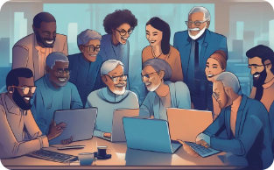
Toward a Future of Digital Inclusion
Empowered Communities
Constant connectivity
Comprehensive Education
Collaborative Solutions
Digital inclusion efforts empower people across demographics to access technology, build skills, and participate fully in the digital world.
Widespread deployment of high-speed internet and affordable devices ensures everyone can stay connected and take advantage of digital opportunities.
Adding digital literacy lessons to school curricula helps prepare the next generation for success in a world that relies more and more on digital technology.
Government and businesses team up with communities to make programs that help everyone get access to digital tools, and these programs are made to fit each community's needs and last a long time.

Slide 8
Conclusion and Key Takeaways
Bridging the Digital Divide
Collaborative Efforts
Expanding digital infrastructure, providing affordable access, and empowering communities with digital literacy are crucial steps to bridge the widening gap and ensure equitable participation in the digital age.
Working together, both public-private partnerships and community-driven efforts can use their different skills and resources to tackle the various difficulties of digital inclusion, particularly in areas that don't have many resources.
Transformative Impact
Continuous Commitment
Closing the digital divide can unlock transformative opportunities for education, healthcare, economic empowerment, and social mobility, ultimately fostering more inclusive and sustainable development.
To bridge the digital gap, it's essential to keep working over time, adjusting to changes in technology and society, so that everyone can keep up with the digital world.

