Slide 1


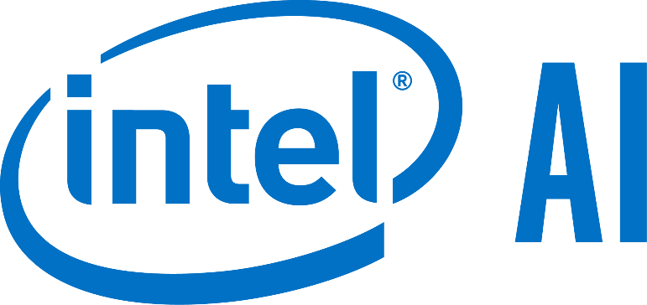
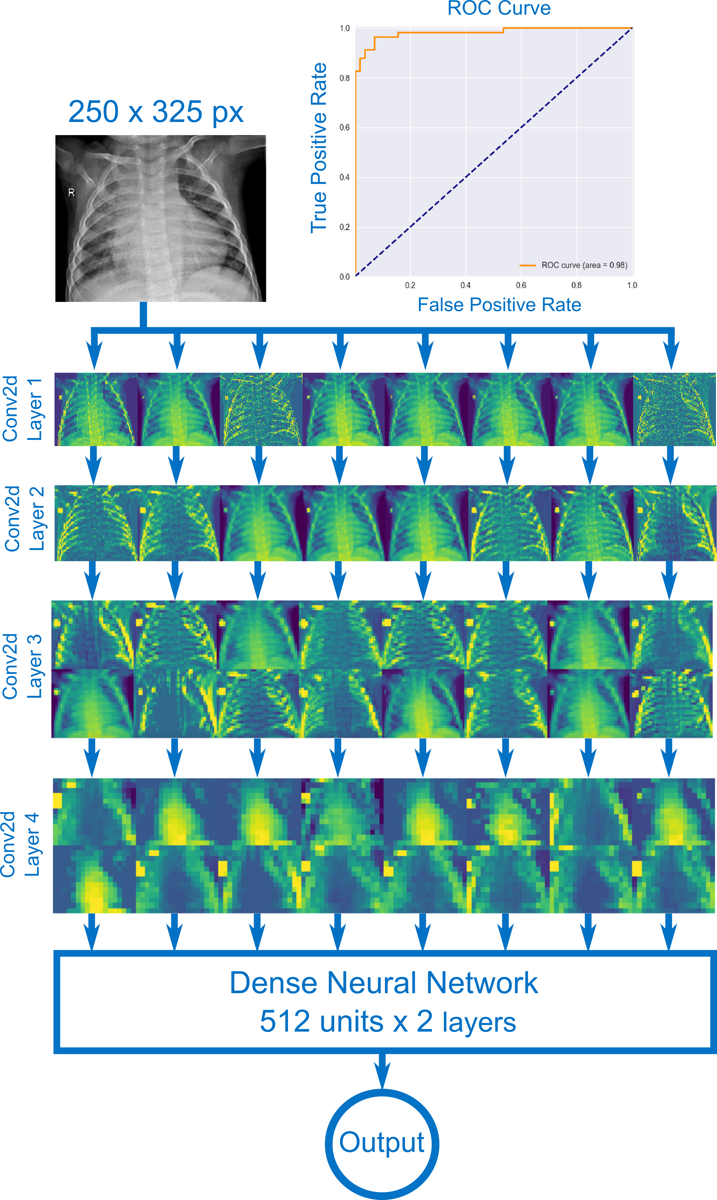

Detecting Pneumonia
from X-Ray Scans using CNNs
Cairo University
Mohamed Aesawy, Cairo University
Background
Pneumonia is a dangerous infectious lung disease which affects around 7% of the world population annually. Although it’s not dangerous to healthy adults, it’s one of the leading causes of death among children younger than the age of five. Pneumonia causes the lung’s alveoli (air sacs) to be filled up with fluid, blocking the victim’s breathing.
Intel Technology
Training done on Intel’s AI DevCloud using Intel Skylake Xeon processors
Code Details / Development Techniques
The data was adjusted for class imbalance using data augmentation/oversampling. Preprocessing only involved pixel standardization and rescaling the images to a uniform size.
The model used is a CNN with 4 max pool convolution layers followed by 2 L2 regularized dense layers and a sigmoid output. Dropout was used on the last convolution layer. Optimization was done via RMSProp using cross-entropy loss.
Diagnosis of pneumonia is usually done via
physical examination and a chest x-ray scan.
The mechanism of pneumonia can be seen in
the scan as a consolidation (fluid) in the lung.
This project is an exploration of the effectiveness of AI in the medical field and whether or not the use of AI could be helpful to medical professionals.
Conclusions
The model was able to detect pneumonia via a single image of a chest x-ray scan with an accuracy of 92.24% calculated using 116 test images. The accuracy can be further improved by training the model on more data or using other predictors in the model (e.g. results of physical examinations.)
Although the data specifies the kind of pneumonia present (viral, bacterial, or no pneumonia), a similar model that accounts for the 3 classes was ineffective at distinguishing between the types of pneumonia.
Data retrieved from kaggle.com
Kermany, Daniel; Zhang, Kang; Goldbaum, Michael (2018), “Labeled Optical Coherence Tomography (OCT) and Chest X-Ray Images for Classification”, Mendeley Data, v2 http://dx.doi.org/10.17632/rscbjbr9sj.2
Intel® AI DevCon
Notes:
1

