Slide 1

Bill tracking application
Bachelor of science in(Information systems Technology)
Mutuma Miriti
APT 3065 / 2023

Slide 2
Problem Statement
Staying informed about legislative measures that directly affect their financial obligations is extremely difficult for homeowners and tenants.
The lack of a specialised bill tracking app designed with homeowners and tenants' requirements in mind makes it difficult for them to comprehend and react to proposed legislation, which could result in additional financial responsibilities that might be completely unexpected.
if there is a large jump for the cost of electricity and water bill for example and the tenant or apartment owner is not aware of ahead of time. they are completely blind-sided by the increase; this will cause them to either default on their bill and lose power or water or force them to move funds from other areas to pay that bill. However, some people lack that ability to move their finances around to solve that problem.
Notes:
Staying informed, legislation
Unexpected financial burden

Slide 3
Significance of the study
Organisation and reminders
Avoid paying late fees and penalties
Easier record keeping
Financial and legal awareness

Slide 4
Related literature/Literature Review
THE MOBILE BASED ELECTRICITY BILLING SYSTEM: (MoBEBIS) IJSRP, Volume 3, Issue 4, April 2013 Edition [ISSN 2250-3153]
Internet of things-based energy tracking and bill estimation system
Notes:
1.Main problem was the calculation of the bills and changing to an automated one is too expensive.
2.weak-reliance on micro controller,

Slide 5
Research methodology
The research methodology used shall be qualitative
Surveys-These questions shall mostly be centred around different home owners and tenants needs.
Interviews-This a more targeted approach where we shall ask detailed questions and record facial expression and experiences.

Slide 6
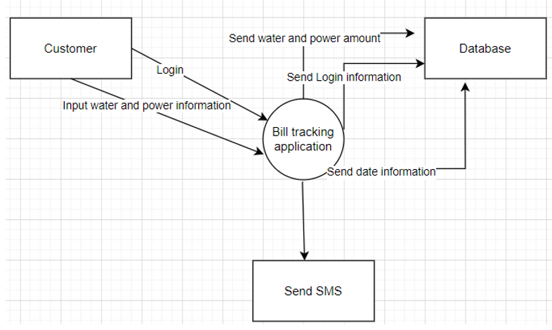
Conceptual Model

Slide 7
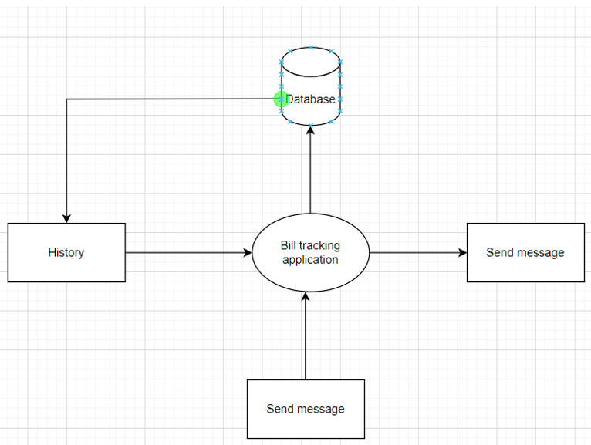
Implementation Model

Slide 8
Conclusions and Recommendations
based on the above research in relation to recording bills my application removes the aspect of the caretaker because the bill is sent directly to the user's phone and relieves them of the duty of calculating and sending the bills.
The application allows users to keep records of the dates of their previous bills instead of keeping their bills as messages on their phones. This is an easier and more efficient way to store bills.
In future the application can be upscaled to do the calculation as well. then rolled out to a larger group e.g. businesses. The application can also have a new activity to provide news with specific legislation tailor made for the user. The application still has room to be developed further based on consumer requirements and advancements in technology.

Slide 9
Project Specifics
Interfaces- Logs in multiple users
Scope-Users enter billing date and information
Db Forms-User Details, Bills, Session
Chapters
Introduction
Literature review
Methodology
System Implementation
References
Appendix

Slide 10
THE END
QUESTIONS

