Slide 1
Difference B/W Merge & Joins
Merge Features | Join Features
1. Relevant only to the SAS System – not portable to other vendor data bases. | 1. Portable to other vendor data bases.
2. More steps are often needed than with the SQL procedure. | 2. Required less steps than Data Merge
3. Data must first be sorted using by-value. | 3. Data does not need to be sorted using BY-value.
4. Requires common variable name. | 4. Does not require common variable name.
5. Duplicate matching column is automatically overlaid. | 5. Duplicate matching column is not automatically overlaid.
6. Results are not automatically printed. | 6. Results are automatically printed unless NOPRINT option is specified.
Shashi Online Class
Author : Arun Sharma

Slide 2
Cartesian Product
To understand how SQL processes a join, it is important to understand the concept of the Cartesian product.
A query that lists multiple tables in the FROM clause without a WHERE clause produces all possible combinations of rows from all tables. This result is called the Cartesian product.
select * from one, two;
Shashi Online Class
Author : Arun Sharma
Notes:
s105d01

Slide 3
Cartesian Product
Table One
X | A
1 | a
4 | d
2 | b
Table Two
X | B
2 | x
3 | y
5 | v
Shashi Online Class
Author : Arun Sharma
...

Slide 4
Cartesian Product
Table One
X | A
1 | a
4 | d
2 | b
Table Two
X | B
2 | x
3 | y
5 | v
Result Set
X | A | X | B
1 | a | 2 | x
Shashi Online Class
Author : Arun Sharma

Slide 5
Cartesian Product
Table One
X | A
1 | a
4 | d
2 | b
Table Two
X | B
2 | x
3 | y
5 | v
Result Set
X | A | X | B
1 | a | 2 | x
1 | a | 3 | y
Shashi Online Class
Author : Arun Sharma

Slide 6
Cartesian Product
Table One
X | A
1 | a
4 | d
2 | b
Table Two
X | B
2 | x
3 | y
5 | v
Result Set
X | A | X | B
1 | a | 2 | x
1 | a | 3 | y
1 | a | 5 | v
Shashi Online Class
Author : Arun Sharma

Slide 7
Cartesian Product
Table One
X | A
1 | a
4 | d
2 | b
Table Two
X | B
2 | x
3 | y
5 | v
Result Set
X | A | X | B
1 | a | 2 | x
1 | a | 3 | y
1 | a | 5 | v
4 | d | 2 | x
Shashi Online Class
Author : Arun Sharma

Slide 8
Cartesian Product
Table One
X | A
1 | a
4 | d
2 | b
Table Two
X | B
2 | x
3 | y
5 | v
Result Set
X | A | X | B
1 | a | 2 | x
1 | a | 3 | y
1 | a | 5 | v
4 | d | 2 | x
4 | d | 3 | y
Shashi Online Class
Author : Arun Sharma

Slide 9
Cartesian Product
Table One
X | A
1 | a
4 | d
2 | b
Table Two
X | B
2 | x
3 | y
5 | v
Result Set
X | A | X | B
1 | a | 2 | x
1 | a | 3 | y
1 | a | 5 | v
4 | d | 2 | x
4 | d | 3 | y
4 | d | 5 | v
Shashi Online Class
Author : Arun Sharma

Slide 10
Cartesian Product
Table One
X | A
1 | a
4 | d
2 | b
Table Two
X | B
2 | x
3 | y
5 | v
Result Set
X | A | X | B
1 | a | 2 | x
1 | a | 3 | y
1 | a | 5 | v
4 | d | 2 | x
4 | d | 3 | y
4 | d | 5 | v
2 | b | 2 | x
Shashi Online Class
Author : Arun Sharma

Slide 11
Cartesian Product
Table One
X | A
1 | a
4 | d
2 | b
Table Two
X | B
2 | x
3 | y
5 | v
Result Set
X | A | X | B
1 | a | 2 | x
1 | a | 3 | y
1 | a | 5 | v
4 | d | 2 | x
4 | d | 3 | y
4 | d | 5 | v
2 | b | 2 | x
2 | b | 3 | y
Shashi Online Class
Author : Arun Sharma

Slide 12
Cartesian Product
Table One
X | A
1 | a
4 | d
2 | b
Table Two
X | B
2 | x
3 | y
5 | v
Result Set
X | A | X | B
1 | a | 2 | x
1 | a | 3 | y
1 | a | 5 | v
4 | d | 2 | x
4 | d | 3 | y
4 | d | 5 | v
2 | b | 2 | x
2 | b | 3 | y
2 | b | 5 | v
Shashi Online Class
Author : Arun Sharma

Slide 13
Cartesian Product
Table One
X | A
1 | a
4 | d
2 | b
Table Two
X | B
2 | x
3 | y
5 | v
Result Set
X | A | X | B
1 | a | 2 | x
1 | a | 3 | y
1 | a | 5 | v
4 | d | 2 | x
4 | d | 3 | y
4 | d | 5 | v
2 | b | 2 | x
2 | b | 3 | y
2 | b | 5 | v
Shashi Online Class
Author : Arun Sharma

Slide 14
Cartesian Product
Table One
X | A
1 | a
4 | d
2 | b
Table Two
X | B
2 | x
3 | y
5 | v
3 rows
Result Set
X | A | X | B
1 | a | 2 | x
1 | a | 3 | y
1 | a | 5 | v
4 | d | 2 | x
4 | d | 3 | y
4 | d | 5 | v
2 | b | 2 | x
2 | b | 3 | y
2 | b | 5 | v
Shashi Online Class
Author : Arun Sharma

Slide 15
Cartesian Product
Table One
X | A
1 | a
4 | d
2 | b
Table Two
X | B
2 | x
3 | y
5 | v
3 rows
3 rows
Result Set
X | A | X | B
1 | a | 2 | x
1 | a | 3 | y
1 | a | 5 | v
4 | d | 2 | x
4 | d | 3 | y
4 | d | 5 | v
2 | b | 2 | x
2 | b | 3 | y
2 | b | 5 | v
Shashi Online Class
Author : Arun Sharma

Slide 16
Cartesian Product
Table One
X | A
1 | a
4 | d
2 | b
Table Two
X | B
2 | x
3 | y
5 | v
3 rows
X
3 rows
Result Set
X | A | X | B
1 | a | 2 | x
1 | a | 3 | y
1 | a | 5 | v
4 | d | 2 | x
4 | d | 3 | y
4 | d | 5 | v
2 | b | 2 | x
2 | b | 3 | y
2 | b | 5 | v
9 rows
Shashi Online Class
Author : Arun Sharma

Slide 17
Cartesian Product
The number of rows in a Cartesian product is the product of the number of rows in the contributing tables.
3 x 3 = 9
1,000 x 1,000 = 1,000,000
100,000 x 100,000 = 10,000,000,000
A Cartesian product is rarely the desired result of a query.
Shashi Online Class
Author : Arun Sharma

Slide 18
Types Of Joins :
Inner Join
Outer Join
Left Join Left Anti Join
Full Join
Full Anti Join
Right Join Right Anti Join
Shashi Online Class
Author : Arun Sharma

Slide 19
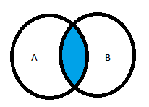
Venn Diagram (Joins Interpretation)
Inner Join
Table A Table B
Proc sql;
select a.*,sex from a,b where a.id=b.id;
Quit;
select a.*,sex from a inner join b on a.x=b.x;
ID | Name | Sal
1 | Arun | 50
2 | Shashi | 60
3 | Ankit | 70
ID | Name | Sex
1 | Arun | M
2 | Shashi | M
3 | Ankit | M
4 | Jeanette | F
5 | Janice | F
ID | Name | Sal | Sex
1 | Arun | 50 | M
2 | Shashi | 60 | M
3 | Ankit | 70 | M
Shashi Online Class
Author : Arun Sharma

Slide 20
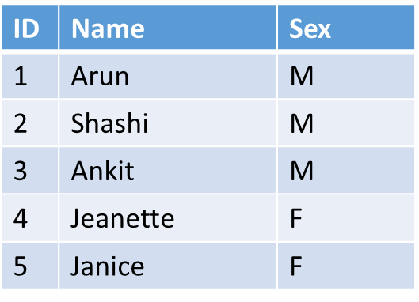
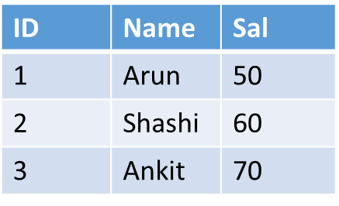

Venn Diagram (Left Joins Interpretation)
Table A
Table B
id | name | sex | sal
1 | Arun | M | 10
2 | Shashi | M | 20
3 | Ankit | M | 30
4 | Jeanette | F | .
5 | Janice | F | .
Proc sql;
select a.*,sal, sex from a left join b on a.id=b.id;
Quit;
Shashi Online Class
Author : Arun Sharma

Slide 21
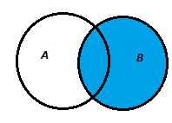
Right Join
Table A
Table B
ID | NAME | SAL
1 | Arun | 10
2 | Shashi | 20
3 | Ankit | 30
8 | Alice | 25
9 | Barbara | 30
7 | Sandy | 50
Proc sql;
Select b.*,a.sex from a right join b on a.id=b.id;
Quit;
id | name | sal | sex
1 | Arun | 10 | M
2 | Shashi | 20 | M
3 | Ankit | 30 | M
7 | Sandy | 50
8 | Alice | 25
9 | Barbara | 30
Shashi Online Class
Author : Arun Sharma

Slide 22
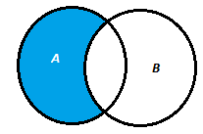
Left Anti (Semi) Join
Table A
Table B
ID | NAME | SAL
1 | Arun | 10
2 | Shashi | 20
3 | Ankit | 30
8 | Alice | 25
9 | Barbara | 30
7 | Sandy | 50
proc sql;
select a.* from a left join b on a.id=b.id where b.id is null;
quit;
id | name | sex
4 | Jeanette | F
5 | Janice | F
Shashi Online Class
Author : Arun Sharma

Slide 23
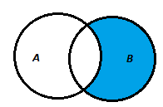
Right Anti(Semi) join
Table A
Table B
ID | NAME | SAL
1 | Arun | 10
2 | Shashi | 20
3 | Ankit | 30
8 | Alice | 25
9 | Barbara | 30
7 | Sandy | 50
Proc sql;
Select b.* from a right join b on a.id=b.id where a.id is null;
Quit;
id | name | sal
7 | Sandy | 50
8 | Alice | 25
9 | Barbara | 30
Shashi Online Class
Author : Arun Sharma

Slide 24
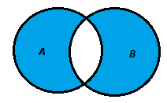
Full Anti(Semi) Join
Table B
Table A
ID | NAME | SAL
1 | Arun | 10
2 | Shashi | 20
3 | Ankit | 30
8 | Alice | 25
9 | Barbara | 30
7 | Sandy | 50
Proc Sql;
Select * from a full join b on a.id=b.id where a.id is null or b.id is null;
Quit;
id | name | sex | id | name | sal
4 | Jeanette | F | . |  | .
5 | Janice | F | . |  | .
. |  |  | 7 | Sandy | 50
. |  |  | 8 | Alice | 25
. |  |  | 9 | Barbara | 30
Shashi Online Class
Author : Arun Sharma

Slide 25
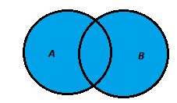
Full Join
Table B
ID | NAME | SAL
1 | Arun | 10
2 | Shashi | 20
3 | Ankit | 30
8 | Alice | 25
9 | Barbara | 30
7 | Sandy | 50
Table A
id | name | sex | id | name | sal
1 | Arun | M | 1 | Arun | 10
2 | Shashi | M | 2 | Shashi | 20
3 | Ankit | M | 3 | Ankit | 30
4 | Jeanette | F | . |  | .
5 | Janice | F | . |  | .
. |  |  | 7 | Sandy | 50
. |  |  | 8 | Alice | 25
. |  |  | 9 | Barbara | 30
Proc sql;
Select * from a full join b on a.id=b.id;
Quit;
Shashi Online Class
Author : Arun Sharma

Slide 26
Combining Tables Vertically
Final Table
Table 1
Table 2
Select data from multiple tables and combine the tables vertically, PROC SQL
can be an efficient alternative to using other SAS procedures or the DATA step
To have a different proportion from tables Proc Sql use four set operators
Proc Sql;
Select *
from a
Set operator
Select*
From B;
Quit;
Set Operator
Except Intersect Union Outer Union
Optional Keyword Corr(Corresponding) All
Corr: show only common col
All : Not to suppress dup rec
Shashi Online Class
Author : Arun Sharma

Slide 27
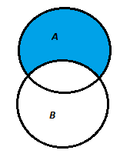
Set Operator : Except
Table B
Table A
ID | NAME | Sex
1 | Arun | M
2 | Shashi | M
3 | Ankit | M
8 | Alice | F
9 | Barbara | F
7 | Sandy | F
proc sql;
select * from a
except
select * from b
Except
Select * from c;
quit;
id | name | sex
4 | Jeanette | F
5 | Janice | F
Shashi Online Class
Author : Arun Sharma

Slide 28
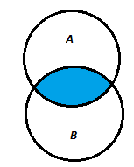
Intersect (Vertical Join)
Table A
Table B
ID | NAME | Sex
1 | Arun | M
2 | Shashi | M
3 | Ankit | M
8 | Alice | F
9 | Barbara | F
7 | Sandy | F
id | name | sex
1 | Arun | M
2 | Shashi | M
3 | Ankit | M
proc sql;
select * from a
Intersect
select * from b;
quit;
Shashi Online Class
Author : Arun Sharma

Slide 29
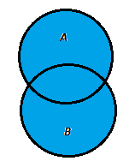
Union (Vertical Join)
Table B
Table A
ID | NAME | Sex
1 | Arun | M
2 | Shashi | M
3 | Ankit | M
8 | Alice | F
9 | Barbara | F
7 | Sandy | F
id | name | sex
1 | Arun | M
2 | Shashi | M
3 | Ankit | M
4 | Jeanette | F
5 | Janice | F
7 | Sandy | F
8 | Alice | F
9 | Barbara | F
proc sql;
select * from a union select * from b;
quit;
Shashi Online Class
Author : Arun Sharma

Slide 30
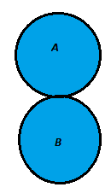
Outer Union(Vertical Join)
Table B
Table A
ID1 | NAME1 | Sex1
1 | Arun | M
2 | Shashi | M
3 | Ankit | M
8 | Alice | F
9 | Barbara | F
7 | Sandy | F
id | name | sex | id1 | name1 | sex1
1 | Arun | M | .
2 | Shashi | M | .
3 | Ankit | M | .
4 | Jeanette | F | .
5 | Janice | F | .
. |  |  | 1 | Arun | M
. |  |  | 2 | Shashi | M
. |  |  | 3 | Ankit | M
. |  |  | 8 | Alice | F
. |  |  | 9 | Barbara | F
. |  |  | 7 | Sandy | F
proc sql;
select * from a outer union select * from b;
quit;
Note: Usually adopted when tables have diff col
Here table/s col name/s has changed
Shashi Online Class
Author : Arun Sharma

