Slide 1




SpotDetect project
Analysis of CGMS data from olive brine samples
25-01-2024, Mercedes Bertotto

Slide 2
Initial problem description (meeting with Eirini on Wed 14/01/2024)
We need to know when the unnormal fermentation started
5 samples were measured at 3 different temperatures (15°C, 25°C and 30°C) for 33 days (from 11/17/2023 until 12/19/2023)
The important masses to be followed are 45, 57, 60 and 74
At 15°C, no unnormal fermentation was observed in any sample. Only At 25°C and 30°C
She sent a file with 168 observations and 1197 variables

Slide 3
Questions to find out where the unnormal fermentation began
Is there significant difference within Temperatures, in the same day, for the same Mass? 4 models
Is there significant difference within Temperatures, in the same day, considering all 4 masses together?
Is there significant difference withing Masses, in the same day, in the same Temperature? 3 models
Is there significant difference within days, in the same Temperature, all masses together? 1 models
Is there significant difference within days, in the same Temperature, in the same mass? 3 models
Is there significant difference within days, with all Temperatures, all masses?
When does the influence of temperature become significant?

Slide 4
Part 1: Analysis using a subset of masses (45, 57, 60 and 74)

Slide 5
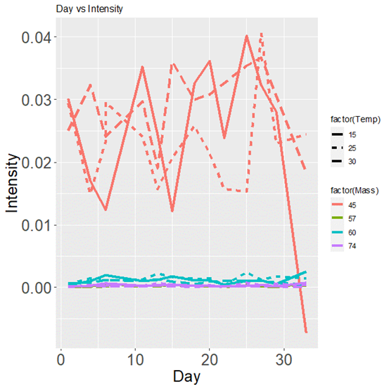
Model 1, all temperatures, 4 masses
Day and Temperature not significant
Df Sum Sq Mean Sq F value Pr(>F)
Temp 1 0.000013 0.000013 0.194 0.660
Mass 1 0.010775 0.010775 158.258 <2e-16 ***
Day 1 0.000000 0.000000 0.001 0.972
Temp:Mass 1 0.000033 0.000033 0.482 0.489
Temp:Day 1 0.000003 0.000003 0.038 0.847
Mass:Day 1 0.000000 0.000000 0.001 0.971
Temp:Mass:Day 1 0.000007 0.000007 0.096 0.757
Residuals 144 0.009804 0.000068
> coefficients(model1)
(Intercept) Temp Mass Day Temp:Mass Temp:Day Mass:Day Temp:Mass:Day
5.264595e-02 1.088739e-04 -7.833431e-04 -5.268620e-04 -1.646420e-06 2.233865e-05 8.112960e-06 -3.413475e-07

Slide 6
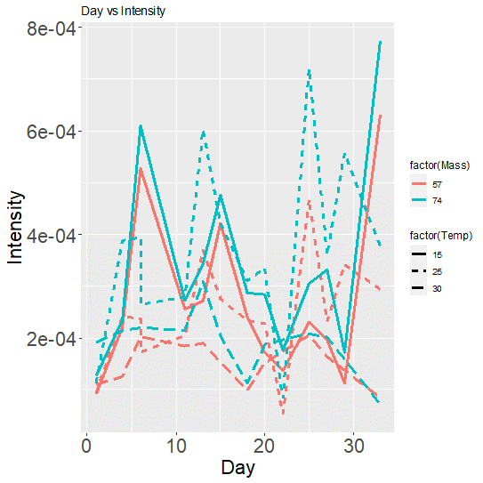
Model 2, all Temperatures, Masses 57 and 74
Day not significant, Temperature significant
Df Sum Sq Mean Sq F value Pr(>F)
Temp 1 1.368e-07 1.368e-07 6.596 0.0124 *
Mass 1 1.278e-07 1.278e-07 6.160 0.0155 *
Day 1 4.590e-08 4.586e-08 2.211 0.1416
Temp:Mass 1 1.000e-10 6.000e-11 0.003 0.9578
Temp:Day 1 1.010e-08 1.009e-08 0.486 0.4880
Mass:Day 1 1.300e-09 1.300e-09 0.063 0.8031
Temp:Mass:Day 1 4.700e-09 4.700e-09 0.227 0.6356
coefficients(model2)
(Intercept) Temp Mass Day Temp:Mass Temp:Day Mass:Day Temp:Mass:Day
4.219419e-04 -1.974636e-05 -1.806476e-06 -1.993983e-05 2.491623e-07 8.325835e-07 4.120717e-07 -1.569509e-08

Slide 7
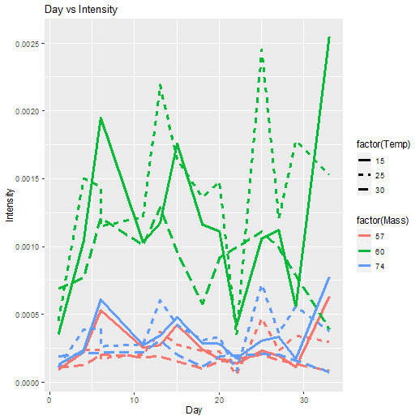

Model 3, all temperatures, only Masses 57, 60 and 74
summary(model3)
Df Sum Sq Mean Sq F value Pr(>F)
Temp 1 2.700e-07 2.733e-07 0.913 0.3415
Mass 1 1.630e-06 1.629e-06 5.444 0.0215 *
Day 1 2.300e-07 2.282e-07 0.763 0.3845
Temp:Mass 1 0.000e+00 7.000e-10 0.003 0.9602
Temp:Day 1 6.000e-08 6.230e-08 0.208 0.6492
Mass:Day 1 1.000e-08 5.300e-09 0.018 0.8943
Temp:Mass:Day 1 0.000e+00 0.000e+00 0.000 0.9977
Residuals 106 3.172e-05 2.993e-07
coefficients(model3)
(Intercept) Temp Mass Day Temp:Mass Temp:Day Mass:Day Temp:Mass:Day
1.520716e-03 -4.312456e-06 -1.577933e-05 1.936123e-05 5.289297e-08 -3.748884e-07 -8.771052e-08 -3.399608e-10

Slide 8
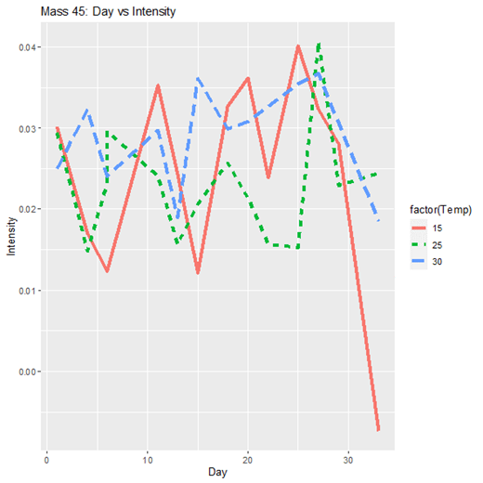
Model 4, all temperatures, only mass 45
Day and Temperature not significant
Df Sum Sq Mean Sq F value Pr(>F)
Temp 1 0.000067 6.677e-05 0.704 0.407
Day 1 0.000000 6.000e-08 0.001 0.980
Temp:Day 1 0.000013 1.317e-05 0.139 0.712
Residuals 34 0.003224 9.482e-05
coefficients(model4)
(Intercept) Temp Day Temp:Day
2.416652e-02 4.977539e-05 -2.341204e-04 9.986186e-06

Slide 9
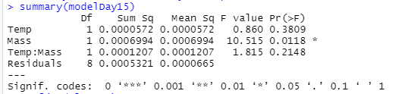
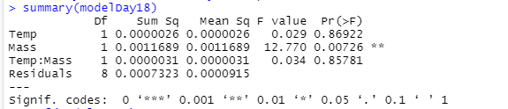
When does the influence of temperature become significant? Study the effect of temperature on each day (starting on day 15)
Day 15: Temperature is not significant (F value=0.860)
Day 18: Temperature is significant (F value=0.029)
However, Temperature before day 15 is sometimes significant, and after day 18 is sometimes not significant. There is no logic trend.
No conclusive conclusions were reached.
Other masses should be studied as well

Slide 10
Part 2: Analysis using a all masses in dataset Linear mixed and quadratic models

Slide 11
R code and PCA analysis
All the masses were considered in the new analysis
This transforms a dataset from wide format to long format:
LargeData <- pivot_longer(X, cols = -c(Name, Date, Day, Temp), names_to = "Mass", values_to = "Intensity")
5 outliers were found and removed in dataset: c("2023-12-19_30C (3)", "2023-12-19_15C (1)", "11-12-2023_15C (4)", "11-12-2023_15C (3)", "20-22-2023_15C (3)")
No important masses were highlighted
Notes:
where the variables are decomposed into two new columns, "Mass" (containing the names of the pivoted columns) and "Intensity" (containing the values associated with those columns).

Slide 12
T-test in each day
to compare difference
between Temperatures

Slide 13
Lineal mixed model model_mix_nlme <- lme(Intensity ~ Temp * Day, random = ~1 | Mass, data = LargeData)
By using a mixed model in which temperature is an independent variable, we can test the significance of the interaction between temperature and day
The p-value of 0.4898 indicates that there is not enough evidence to reject the null hypothesis that the coefficient is equal to zero. This suggests that the difference in intensities between 15 and 30 degrees is not significant at a significance level of 0.05
Value Std.Error DF t-value p-value
(Intercept) 0.0006673024 1.205616e-04 187612 5.534951 0.0000
Temp -0.0000004613 1.211450e-06 187612 -0.380788 0.7034
Day 0.0000010887 1.589940e-06 187612 0.684740 0.4935
Temp:Day -0.0000000464 6.724000e-08 187612 -0.690574 0.4898

Slide 14
Model per day
model_per_day<- lm(Intensity ~ Temp * Day + I(Day > 20), data = LargeData)
Only days 20 and day 25 were found significant
Day 20
Day 25
Estimate Std. Error t value Pr(>|t|)
(Intercept) 6.383e-04 3.608e-05 17.691 <2e-16 ***
Temp25 -1.445e-05 4.713e-05 -0.307 0.7591
Temp30 -1.131e-07 5.066e-05 -0.002 0.9982
Day 3.165e-06 2.369e-06 1.336 0.1815
I(Day > 20)TRUE -7.561e-05 3.618e-05 -2.090 0.0367 *
Temp25:Day 5.103e-07 2.534e-06 0.201 0.8404
Temp30:Day -1.555e-06 2.848e-06 -0.546 0.5852
Estimate Std. Error t value Pr(>|t|)
(Intercept) 6.421e-04 3.537e-05 18.155 <2e-16 ***
Temp25 -1.541e-05 4.713e-05 -0.327 0.7436
Temp30 1.583e-06 5.067e-05 0.031 0.9751
Day 2.287e-06 2.108e-06 1.085 0.2780
I(Day > 25)TRUE -7.801e-05 3.537e-05 -2.206 0.0274 *
Temp25:Day 7.768e-07 2.536e-06 0.306 0.7593
Temp30:Day -1.506e-06 2.847e-06 -0.529 0.5967

Slide 15
No linear model
Estimate Std. Error t value Pr(>|t|)
b0 6.098e-04 2.847e-05 21.423 <2e-16 ***
b1 8.894e-06 3.993e-06 2.227 0.0259 *
b2 -2.776e-07 1.206e-07 -2.302 0.0214 *
Intensity=b0​+b1​⋅Day+b2​⋅Day²
Intensity= 0.0006098+8.894e-06Day-2.776e-07 Day²
Statistical significance:
All coefficients are statistically significant based on stars and p-value:
b0: Very significant (p < 0.001).
b1: Significant (0.01 < p < 0.05).
b2: Significant (0.01 < p < 0.05).
Residual Standard Error:
The "Residual standard error" is 0.004356.
Notes:
El resultado que proporcionaste es el resumen de un modelo no lineal que ajusta la variable de respuesta "Intensity" en función del tiempo ("Day") utilizando un modelo cuadrático. Aquí está la interpretación de los resultados:
Coeficientes del Modelo:
b0 (Intercepto): 0.0006098. Este es el valor esperado de la intensidad cuando "Day" es igual a cero.
b1 (Coeficiente de "Day"): 8.894e-06. Este coeficiente indica la tasa de cambio lineal en la intensidad respecto al tiempo.
b2 (Coeficiente de "Day^2"): -2.776e-07. Este coeficiente indica la tasa de cambio cuadrática en la intensidad respecto al tiempo.
Significancia Estadística:
Todos los coeficientes son estadísticamente significativos según las estrellas y el valor p:
b0: Muy significativo (p < 0.001).
b1: Significativo (0.01 < p < 0.05).
b2: Significativo (0.01 < p < 0.05).
Residual Standard Error:
La "Residual standard error" es 0.004356. Es la desviación estándar de los residuos, que son las diferencias entre los valores observados y los valores predichos por el modelo.
Número de Grados de Libertad y Convergencia:
El modelo se ajustó a 188807 grados de libertad.
El modelo alcanzó la convergencia en una sola iteración con una tolerancia de convergencia muy pequeña (3.226e-10).
Interpretación Global:
El modelo cuadrático proporciona una descripción significativa de cómo la intensidad cambia en función del tiempo.
El intercepto (b0) es la intensidad estimada al comienzo del período de tiempo considerado.
El coeficiente lineal (b1) y el coeficiente cuadrático (b2) indican las tasas de cambio lineal y cuadrática en la intensidad a lo largo del tiempo.
En resumen, el modelo sugiere que la intensidad cambia de manera significativa con el tiempo, y la tasa de cambio no es constante. La significancia de los coeficientes y el buen ajuste del modelo (bajo residual standard error y rápida convergencia) respaldan la utilidad del modelo para describir la relación entre "Intensity" y "Day". La interpretación precisa dependerá del contexto específico de tu investigación y de la naturaleza de tus datos.

Slide 16
When did the intensity reach its maximum?
Use the vertex of the parabola corresponding to the quadratic function
The vertex of a quadratic parabola of the form ax²+bx+c would be, in this case, (−b1​/(2b2​), f(−b1​/(2b2​))
The value of −b1​/(2b2​) will give the day on which the intensity reached its minimum or maximum
Day at which the intensity reached its minimum or maximum: 16.02
Intensity on that day: 0.000681
Notes:
Coeficiente Lineal (�1b1​): Este coeficiente indica la tasa de cambio lineal en la intensidad respecto al tiempo. Si �1b1​ es negativo, sugiere que la intensidad está disminuyendo con el tiempo.
Coeficiente Cuadrático (�2b2​): El coeficiente cuadrático indica la tasa de cambio cuadrática en la intensidad. Si �2b2​ es positivo, puede sugerir que la disminución en la intensidad está desacelerando con el tiempo, y si es negativo, podría indicar una aceleración en la disminución.

Slide 17
Comparison between models
There is an apparent discrepancy between the results of the two models, especially regarding the significance of the Day effect
Model 1, which uses a mixed ANOVA approach, shows a p-value of 0.4935 for the term Day, indicating that there is insufficient evidence to reject the null hypothesis that the coefficient associated with Day is equal to zero
Model 2, which is a quadratic regression, presents a p-value of 0.0259 for the coefficient b1 associated with Day's linear term, indicating that there is evidence to reject the null hypothesis that this coefficient is equal to zero
This discrepancy could be due to differences in the formulation and complexity of the models, as well as the consideration of random effects in Model 1

Slide 18
Part 3: Analysis using the survival function (all masses included)

Slide 19
Model Kaplan–Meier. Introduction
A non-parametric method used to estimate the probability of an event occurring over time
It can be used to analyze the time until an event of interest happens, in this case the Unnormal Fermentation
It calculates the survival probability at each observed time point
It starts with assuming that all units are at risk at the beginning
As events occur, the probability of survival decreases
Notes:
# Suponiendo que tus datos se llaman 'tus_datos'
LargeData$Event <- ifelse(LargeData$Day >= 1, 1, 0)
# Muestra los primeros registros para verificar la adición de la columna 'Evento'
head(LargeData)
# Ejemplo de modelo de Kaplan-Meier
library(survival)
modelo_supervivencia <- survfit(Surv(Day, Event) ~ Temp, data = LargeData)
summary(modelo_supervivencia)

Slide 20
30°C
time n.risk n.event survival std.err lower 95% CI upper 95% CI
1 50190 4780 0.9048 0.001310 0.9022 0.9073
4 45410 4780 0.8095 0.001753 0.8061 0.8130
6 40630 4780 0.7143 0.002016 0.7103 0.7182
11 35850 4780 0.6190 0.002168 0.6148 0.6233
13 31070 4780 0.5238 0.002229 0.5195 0.5282
15 26290 4780 0.4286 0.002209 0.4243 0.4329
18 21510 4780 0.3333 0.002104 0.3292 0.3375
20 16730 4780 0.2381 0.001901 0.2344 0.2419
25 11950 4780 0.1429 0.001562 0.1398 0.1460
27 7170 4780 0.0476 0.000951 0.0458 0.0495
33 2390 2390 0.0000 NaN NA NA

Slide 21
25°C
time n.risk n.event survival std.err lower 95% CI upper 95% CI
1 70505 5975 0.9153 0.001049 0.9132 0.9173
4 64530 5975 0.8305 0.001413 0.8277 0.8333
6 58555 5975 0.7458 0.001640 0.7426 0.7490
11 52580 5975 0.6610 0.001783 0.6575 0.6645
13 46605 5975 0.5763 0.001861 0.5726 0.5799
15 40630 5975 0.4915 0.001883 0.4878 0.4952
18 34655 5975 0.4068 0.001850 0.4032 0.4104
20 28680 5975 0.3220 0.001760 0.3186 0.3255
22 22705 1195 0.3051 0.001734 0.3017 0.3085
25 21510 5975 0.2203 0.001561 0.2173 0.2234
27 15535 5975 0.1356 0.001289 0.1331 0.1381
29 9560 5975 0.0508 0.000827 0.0493 0.0525
33 3585 3585 0.0000 NaN NA NA

Slide 22
15°C
time n.risk n.event survival std.err lower 95% CI upper 95% CI
1 68115 5975 0.9123 0.001084 0.9102 0.9144
4 62140 4780 0.8421 0.001397 0.8394 0.8448
6 57360 5975 0.7544 0.001649 0.7512 0.7576
11 51385 5975 0.6667 0.001806 0.6631 0.6702
13 45410 5975 0.5789 0.001892 0.5753 0.5827
15 39435 5975 0.4912 0.001915 0.4875 0.4950
18 33460 5975 0.4035 0.001880 0.3998 0.4072
20 27485 5975 0.3158 0.001781 0.3123 0.3193
22 21510 5975 0.2281 0.001608 0.2249 0.2312
25 15535 3585 0.1754 0.001457 0.1726 0.1783
27 11950 5975 0.0877 0.001084 0.0856 0.0899
29 5975 3585 0.0351 0.000705 0.0337 0.0365
33 2390 2390 0.0000 NaN NA NA

Slide 23
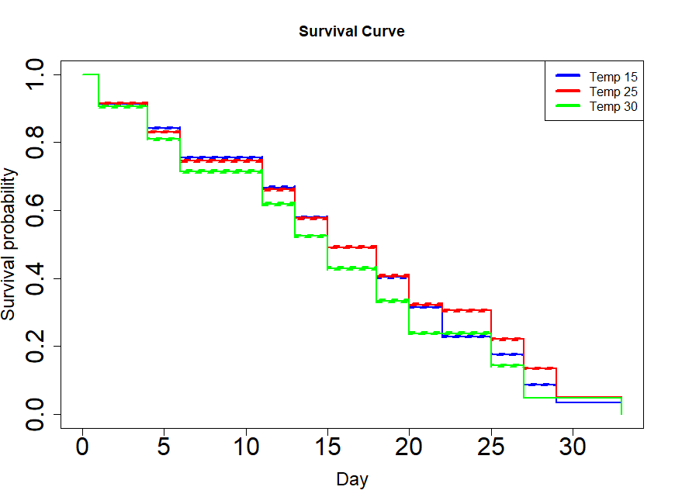

Slide 24
Temperature Impact
Temperature 15°C: The survival probability decreases steadily over time, indicating a gradual decline in intensity. The curve shows a relatively smooth decline without any abrupt changes
Temperature 25°C: Similar pattern to the 15°C curve, but with a slower decline. The slower decrease suggests a potentially more stable or slower degradation process
Temperature 30°C: The survival curve shows a steeper decline compared to 15°C and 25°C. This suggests that higher temperatures may accelerate the unnormal fermentation, leading to a more rapid decrease in intensity
All curves show a similar trend, with a survival rate of 70% from day 6. This means the probability of the event ('unnormal fermentation') occurring

Slide 25
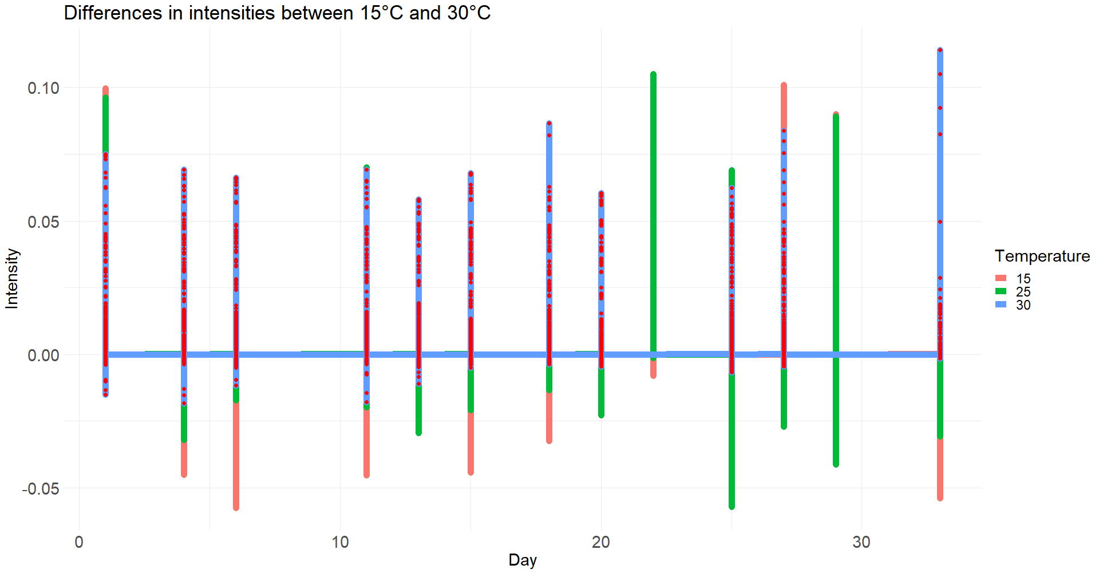

Slide 26
Thank you

