Slide 1



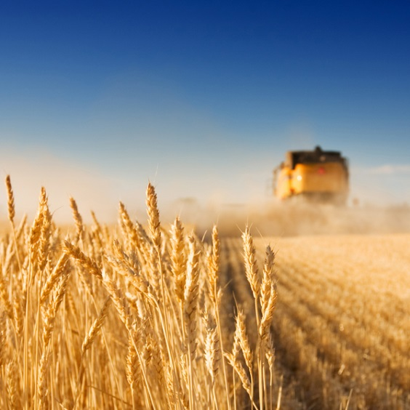
SpotDetect project
Analysis of CGMS data from olive brine samples
25-01-2024, Mercedes Bertotto

Slide 2
Initial problem description
We need to know when the abnormal fermentation started
5 samples were measured at 3 different temperatures (15°C, 25°C and 30°C) for 33 days (from 11/17/2023 until 12/19/2023)
At 15°C, no abnormal fermentation was observed in any sample. Only At 25°C and 30°C
Data dimensionality: 168 observations and 1197 variables
Ground truth data is available for each sample

Slide 3
Data analysis description
Due to the scarcity of samples per day, the data set was split into five time frames:
• Period One: 15/11, 17/11, 20/11 and 22/11 (46 samples)
• Period Two: 27/11, 29/11. (28 samples)
• Period Three: 01/12, 04/12 (28 samples)
• Period Four: 6/12, 08/12, 11/12 (32 samples)
• Period Five: 13/12, 15/12, 19/12 (29 samples)
Partial Least Square Discriminant Analysis (PLSDA) with Leave One Out Cross Validation (LOO) was performed in periods two to five, taking into account ground truth data
The aim of this analysis was to classify normal from abnormal fermentation in each period
Period one was not considered because no sample showed abnormal fermentation
1=normal fermentation and 2=abnormal fermentation. These mean no spoilage or spoilage in the samples
Data was scaled in two different ways with similar results
Each intensity was divided by the total sum of intensities: Normalization one
The media from each row was subtracted from each value, and then divided by the standard deviation: Normalization two

Slide 4
Classification results
Period | Class (Fermentation type) | Normal | Abnormal | Not assigned | Latent variables | Specificity | Sensitivity | Precision | Accuracy
Two | Normal | 24 | 0 | 0 | 7 | 1 | 1 | 1 | 1
 | Abnormal | 0 | 4 | 0 |  | 1 | 1 | 1
Three | Normal | 14 | 1 | 0 | 7 | 0.93 | 0.92 | 0.93 | 0.93
 | Abnormal | 1 | 12 | 0 |  | 0.92 | 0.93 | 0.92
Four | Normal | 9 | 1 | 0 | 9 | 0.90 | 1 | 1 | 0.97
 | Abnormal | 0 | 21 | 1 |  | 1 | 0.90 | 0.95
Five | Normal | 9 | 1 | 0 | 5 | 0.90 | 0.95 | 0.90 | 0.93
 | Abnormal | 1 | 18 | 0 |  | 0.95 | 0.90 | 0.95

Slide 5
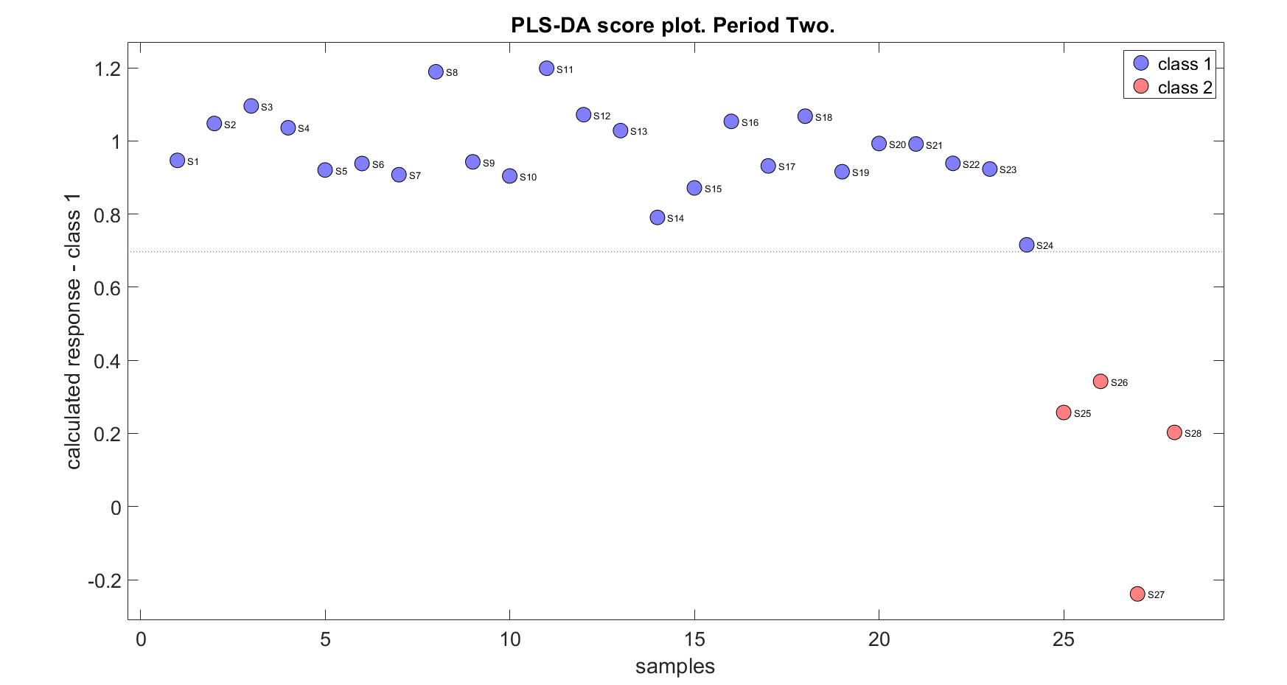
Class 1: Normal fermentation
Class 2: Abnormal fermentation

Slide 6

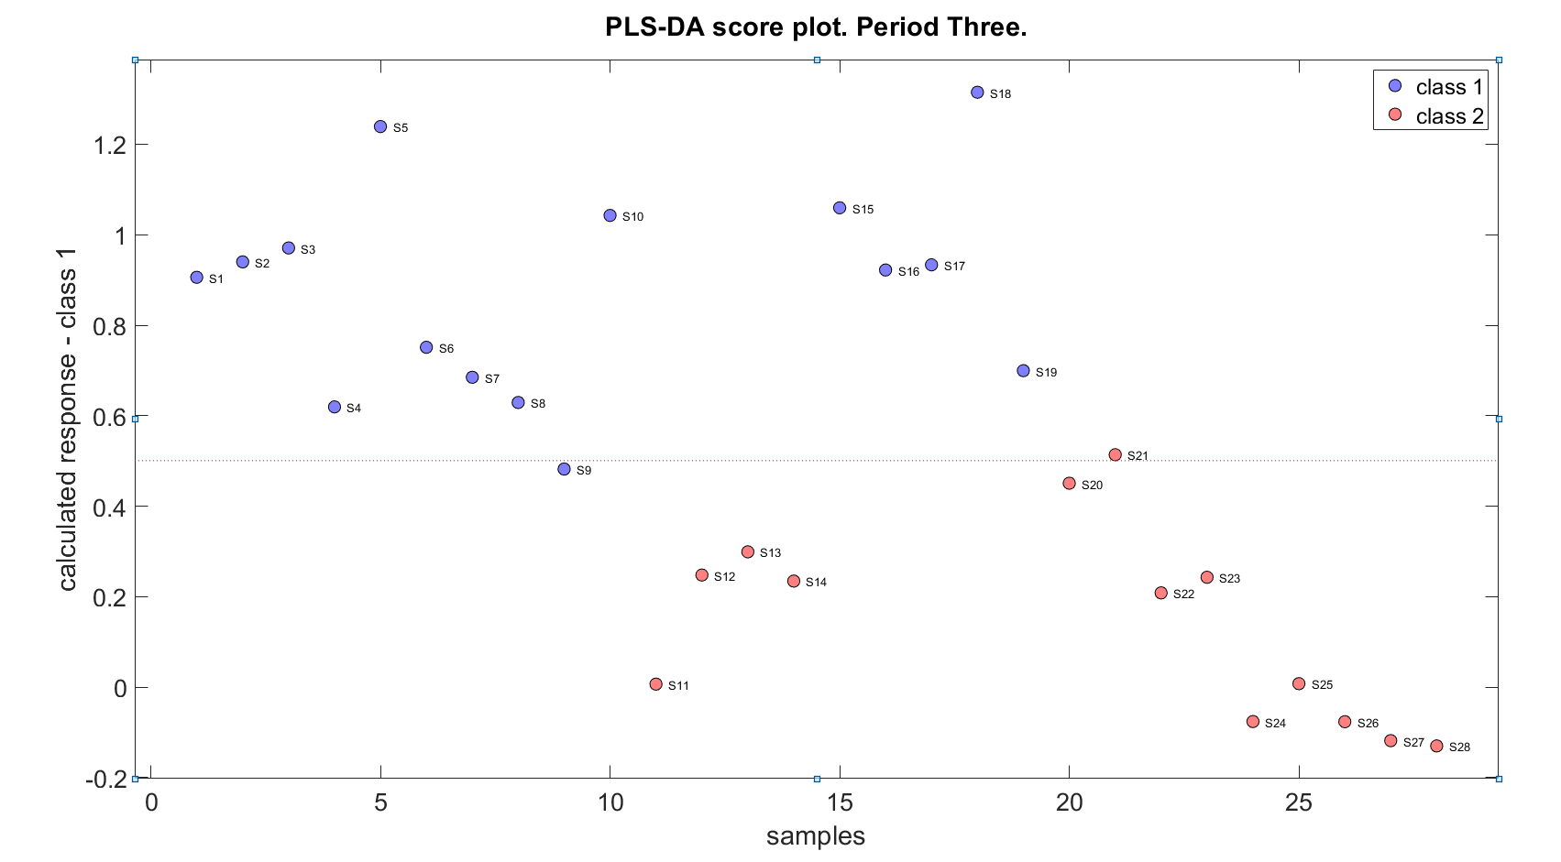

Slide 7
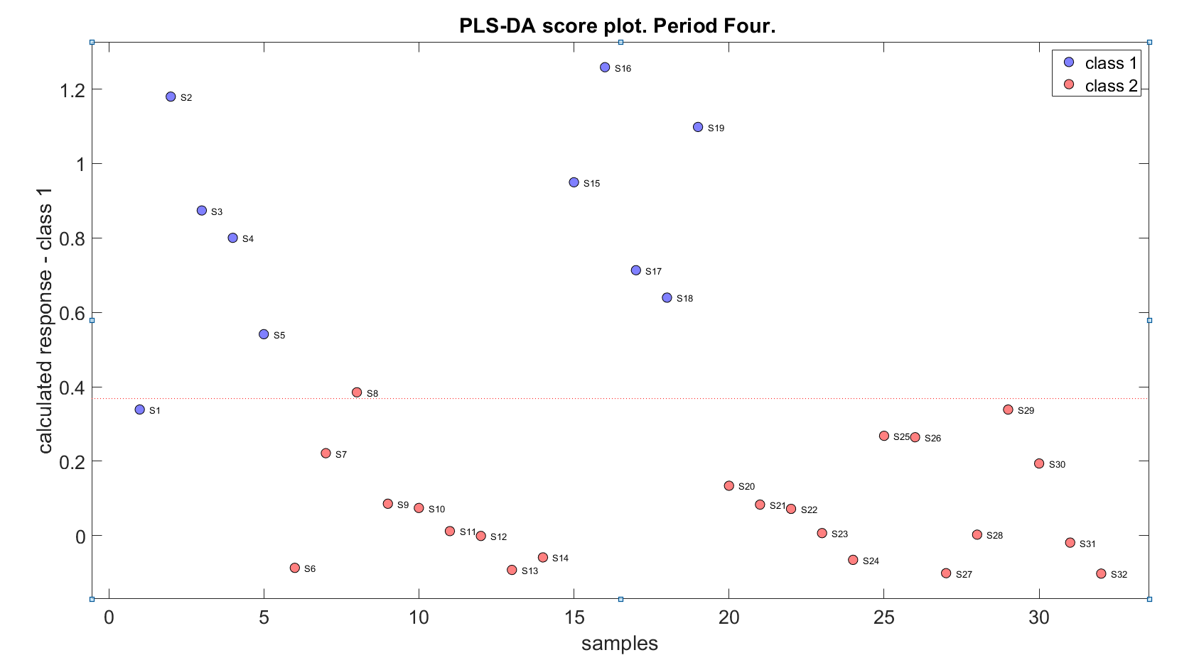

Slide 8
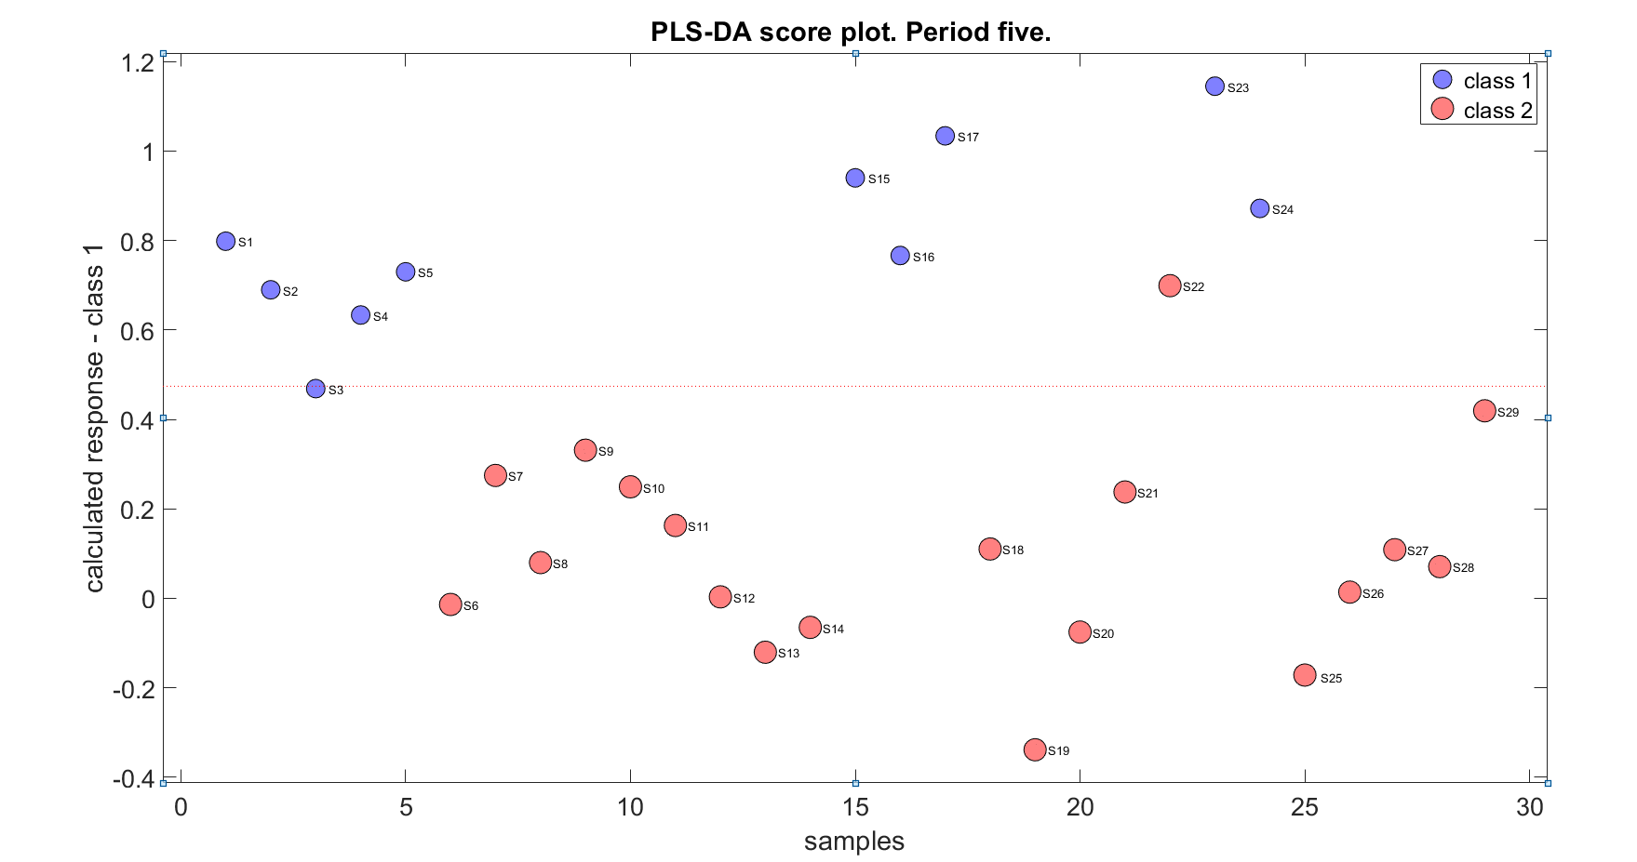

Slide 9
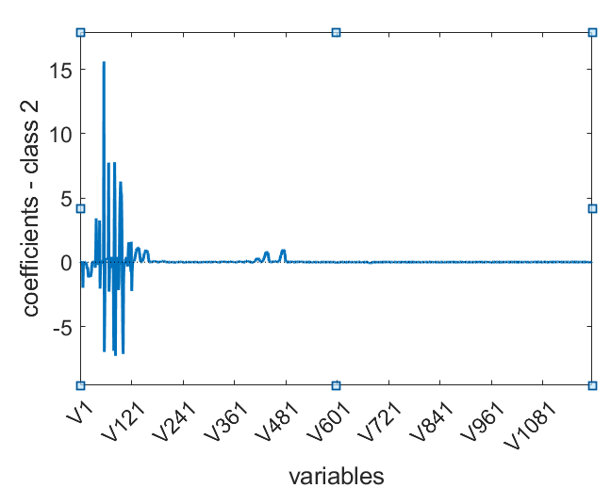
PLS-DA coefficients

Slide 10
PCA Loadings
58, 78, 79, 94, 98, 118

Slide 11
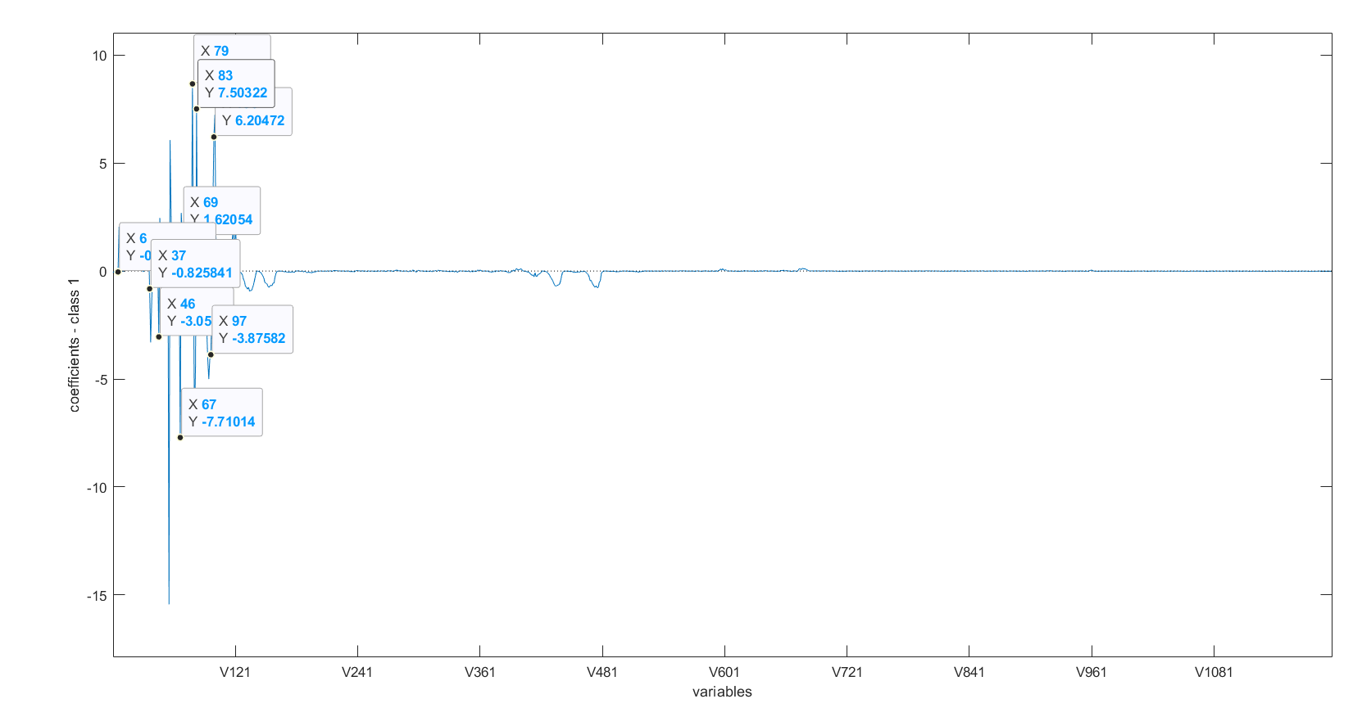
Important variables for classification
6, 37, 46, 58, 67, 69, 78, 79, 83, 94, 97, 98, 100, 118, 119, 122

