Slide 1
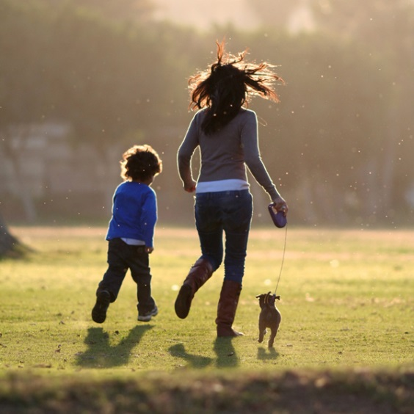
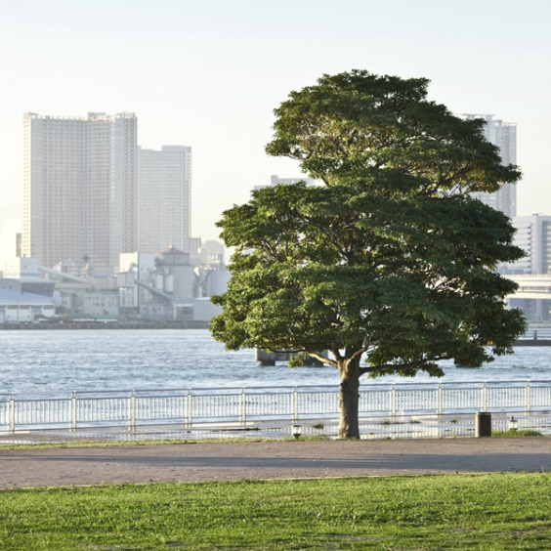
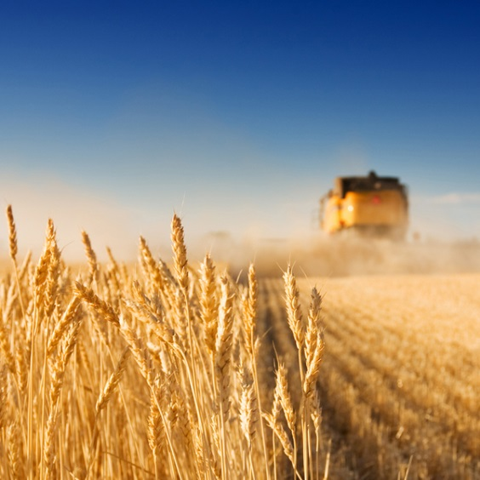
Title slide
Sub title
Date, author

Slide 2
Initial problem description (meeting with Eirini on Wed 14/01/2024)
We need to know when the unnormal fermentation started
5 samples were measured at 3 different temperatures (15°C, 25°C and 30°C) for 33 days (from 11/17/2023 until 12/19/2023)
The important masses to be followed are 45, 57, 60 and 74
At 15°C, no unnormal fermentation was observed in any sample. Only At 25°C and 30°C
She sent a file with 168 observations and 1197 variables

Slide 3
Questions to find out where the unnormal fermentation began
Is there significant difference within Temperatures, in the same day, for the same Mass? 4 models
Is there significant difference within Temperatures, in the same day, considering all 4 masses together?
Is there significant difference withing Masses, in the same day, in the same Temperature? 3 models
Is there significant difference within days, in the same Temperature, all masses together? 1 models
Is there significant difference within days, in the same Temperature, in the same mass? 3 models
Is there significant difference within days, with all Temperatures, all masses?
When does the influence of temperature become significant?

Slide 4
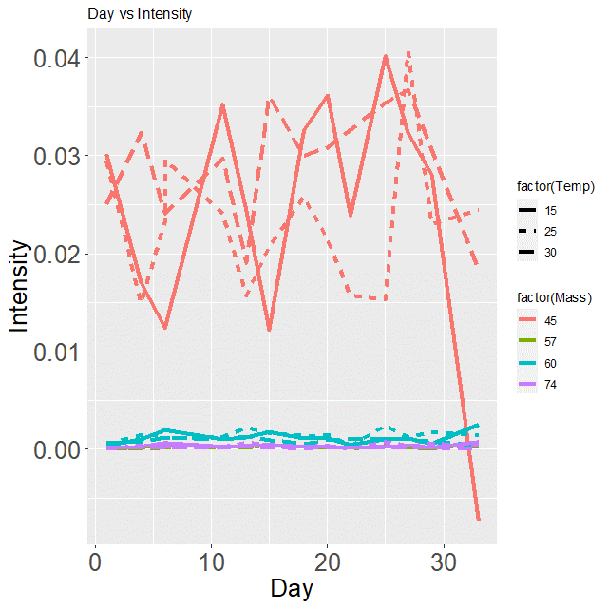
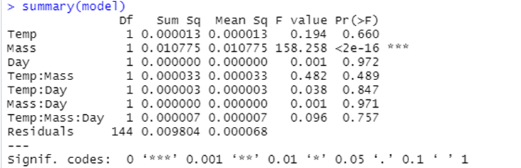
Is there significant difference within days, with all Temperatures, all masses?

Slide 5
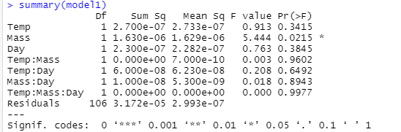
Is there significant difference within days, with all Temperatures, in Masses 57, 60 and 74?

Slide 6
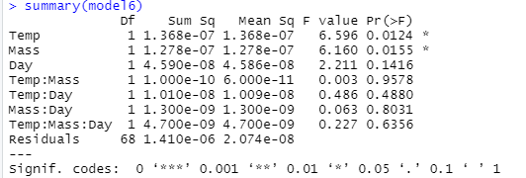
Is there significant difference within days, with all Temperatures, in Masses 57 and 74?

Slide 7


Is there significant difference within days, with all Temperatures, in Mass 45?

Slide 8
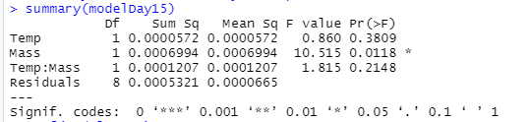
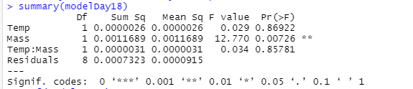
When does the influence of temperature become significant? Study the effect of temperature on each day (starting on day 15)
Day 15: Temperature is not significant (F value=0.860)
Day 18: Temperature is significant (F value=0.029)
The influence of temperature on different days was studied using those 4 masses, and no conclusive conclusions were reached.
Other masses studied as well

Slide 9
Outlier removal by PCA
2023-12-19-30C(3)

Slide 10
Full screen image with title

Slide 11
End slide or section heading
Text

