Slide 1



Title slide
Sub title
Date, author

Slide 2
Initial problem description (meeting with Eirini on Wed 14/01/2024)
We need to know when the unnormal fermentation started
5 samples were measured at 3 different temperatures (15°C, 25°C and 30°C) for 33 days (from 11/17/2023 until 12/19/2023)
The important masses to be followed are 45, 57, 60 and 74
At 15°C, no unnormal fermentation was observed in any sample. Only At 25°C and 30°C
She sent a file with 168 observations and 1197 variables

Slide 3
Questions to find out where the unnormal fermentation began
Is there significant difference within Temperatures, in the same day, for the same Mass? 4 models
Is there significant difference within Temperatures, in the same day, considering all 4 masses together?
Is there significant difference withing Masses, in the same day, in the same Temperature? 3 models
Is there significant difference within days, in the same Temperature, all masses together? 1 models
Is there significant difference within days, in the same Temperature, in the same mass? 3 models
Is there significant difference within days, with all Temperatures, all masses?
When does the influence of temperature become significant?

Slide 4
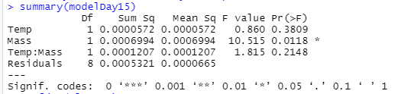
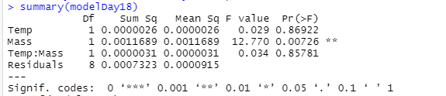
When does the influence of temperature become significant? Study the effect of temperature on each day (starting on day 15)
Day 15: Temperature is not significant (F value=0.860)
Day 18: Temperature is significant (F value=0.029)
However, Temperature before day 15 is sometimes significant, and after day 18 is sometimes not significant. There is no logic trend.
No conclusive conclusions were reached.
Other masses should be studied as well

Slide 5
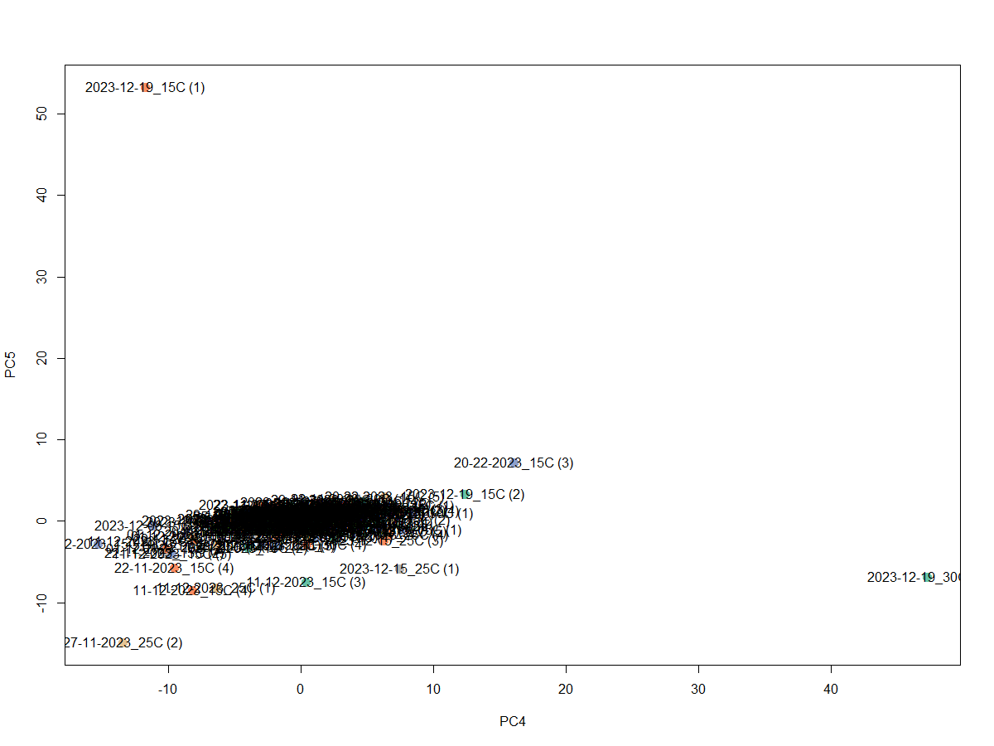
Outlier removal and identification of important masses
5 outliers were found in dataset: c("2023-12-19_30C (3)", "2023-12-19_15C (1)", "11-12-2023_15C (4)", "11-12-2023_15C (3)", "20-22-2023_15C (3)")
No important masses were highlighted

Slide 6
R code
All the masses were considered in the new analysis
This transforms a dataset from wide format to long format:
LargeData <- pivot_longer(X, cols = -c(Name, Date, Day, Temp), names_to = "Mass", values_to = "Intensity")
Notes:
where the variables are decomposed into two new columns, "Mass" (containing the names of the pivoted columns) and "Intensity" (containing the values associated with those columns).

Slide 7
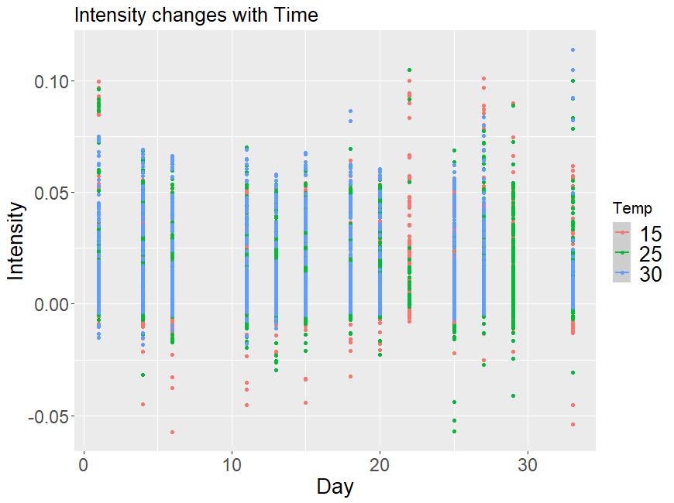

Slide 8
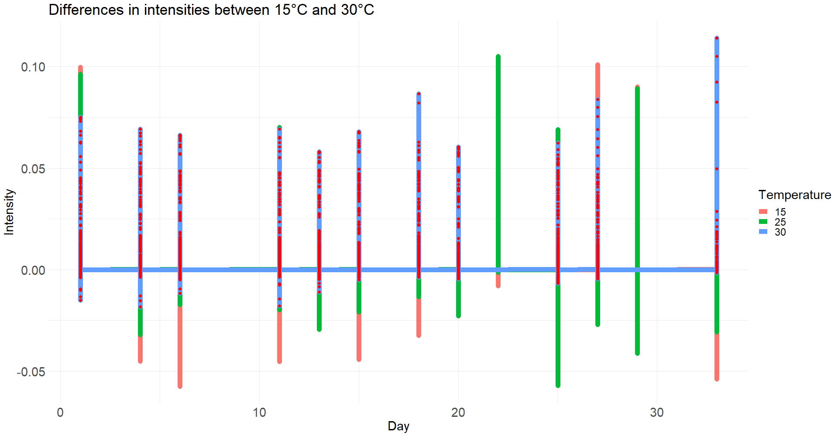

Slide 9
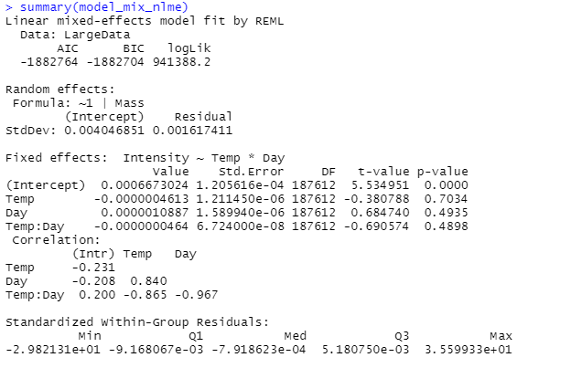
A linear-mixed model with all masses
Temperature and day are not significant

Slide 10
Lineal mixed model model_mix_nlme <- lme(Intensity ~ Temp * Day, random = ~1 | Mass, data = LargeData)
By using a mixed model in which temperature is an independent variable, we can test the significance of the interaction between temperature and day
The p-value of 0.4898 indicates that there is not enough evidence to reject the null hypothesis that the coefficient is equal to zero. This suggests that the difference in intensities between 15 and 30 degrees is not significant at a significance level of 0.05

Slide 11
T-test in each day

Slide 12
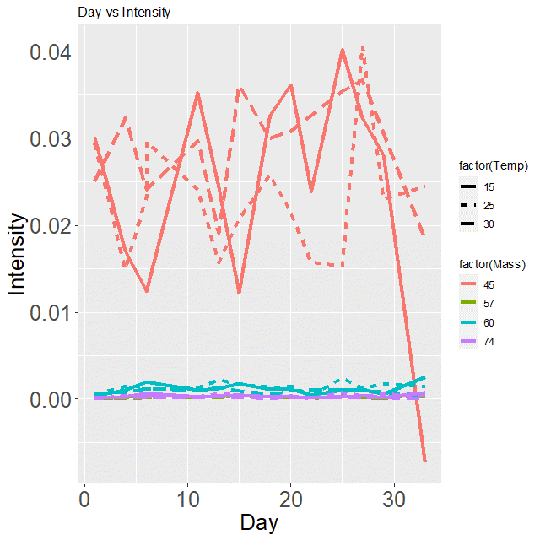
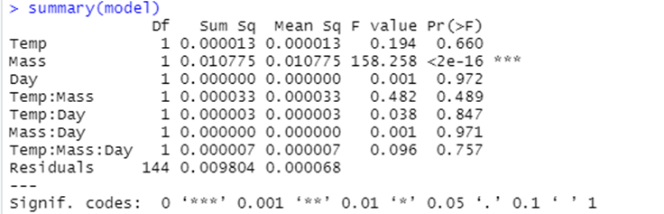
Is there significant difference within days, with all Temperatures, 4 masses?

Slide 13
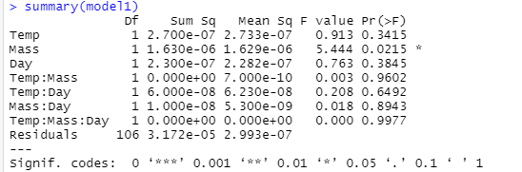
Is there significant difference within days, with all Temperatures, in Masses 57, 60 and 74?

Slide 14
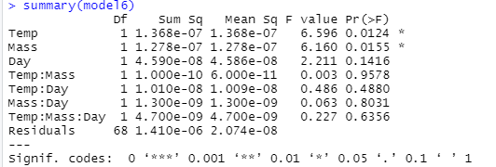
Is there significant difference within days, with all Temperatures, in Masses 57 and 74?

Slide 15


Is there significant difference within days, with all Temperatures, in Mass 45?

Slide 16
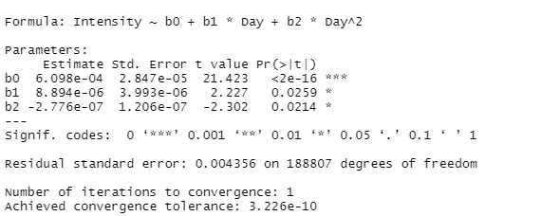
No linear model
Intensity=b0​+b1​⋅Day+b2​⋅Day²
Intensity= 0.0006098+8.894e-06Day-2.776e-07 Day²
Notes:
El resultado que proporcionaste es el resumen de un modelo no lineal que ajusta la variable de respuesta "Intensity" en función del tiempo ("Day") utilizando un modelo cuadrático. Aquí está la interpretación de los resultados:
Coeficientes del Modelo:
b0 (Intercepto): 0.0006098. Este es el valor esperado de la intensidad cuando "Day" es igual a cero.
b1 (Coeficiente de "Day"): 8.894e-06. Este coeficiente indica la tasa de cambio lineal en la intensidad respecto al tiempo.
b2 (Coeficiente de "Day^2"): -2.776e-07. Este coeficiente indica la tasa de cambio cuadrática en la intensidad respecto al tiempo.
Significancia Estadística:
Todos los coeficientes son estadísticamente significativos según las estrellas y el valor p:
b0: Muy significativo (p < 0.001).
b1: Significativo (0.01 < p < 0.05).
b2: Significativo (0.01 < p < 0.05).
Residual Standard Error:
La "Residual standard error" es 0.004356. Es la desviación estándar de los residuos, que son las diferencias entre los valores observados y los valores predichos por el modelo.
Número de Grados de Libertad y Convergencia:
El modelo se ajustó a 188807 grados de libertad.
El modelo alcanzó la convergencia en una sola iteración con una tolerancia de convergencia muy pequeña (3.226e-10).
Interpretación Global:
El modelo cuadrático proporciona una descripción significativa de cómo la intensidad cambia en función del tiempo.
El intercepto (b0) es la intensidad estimada al comienzo del período de tiempo considerado.
El coeficiente lineal (b1) y el coeficiente cuadrático (b2) indican las tasas de cambio lineal y cuadrática en la intensidad a lo largo del tiempo.
En resumen, el modelo sugiere que la intensidad cambia de manera significativa con el tiempo, y la tasa de cambio no es constante. La significancia de los coeficientes y el buen ajuste del modelo (bajo residual standard error y rápida convergencia) respaldan la utilidad del modelo para describir la relación entre "Intensity" y "Day". La interpretación precisa dependerá del contexto específico de tu investigación y de la naturaleza de tus datos.

Slide 17
When did the intensity reach its maximum?
Use the vertex of the parabola corresponding to the quadratic function.
The vertex of a quadratic parabola of the form ax²+bx+c would be, in this case, (−b1​/(2b2​), f(−b1​/(2b2​)).
The value of −b1​/(2b2​) will give the day on which the intensity reached its minimum or maximum.
Day at which the intensity reached its minimum or maximum: 16.02
Intensity on that day: 0.000681
Notes:
Coeficiente Lineal (�1b1​): Este coeficiente indica la tasa de cambio lineal en la intensidad respecto al tiempo. Si �1b1​ es negativo, sugiere que la intensidad está disminuyendo con el tiempo.
Coeficiente Cuadrático (�2b2​): El coeficiente cuadrático indica la tasa de cambio cuadrática en la intensidad. Si �2b2​ es positivo, puede sugerir que la disminución en la intensidad está desacelerando con el tiempo, y si es negativo, podría indicar una aceleración en la disminución.

Slide 18
Can we say that the change on day 16 was significantly different between temperatures of 15 and 30 degrees?

Slide 19
Full screen image with title

Slide 20
End slide or section heading
Text

