Slide 1
Capstone 2: Predicting Kickstarter Campaign Outcomes Using NLP
Bazeley,
Mikiko
Springboard – May 2019

Slide 2
Table of COntents
Project Overview
Data Acquisition & Processing
Feature Engineering & Selection
Model Selection & Performance
Take-Aways
Data Overview

Slide 3
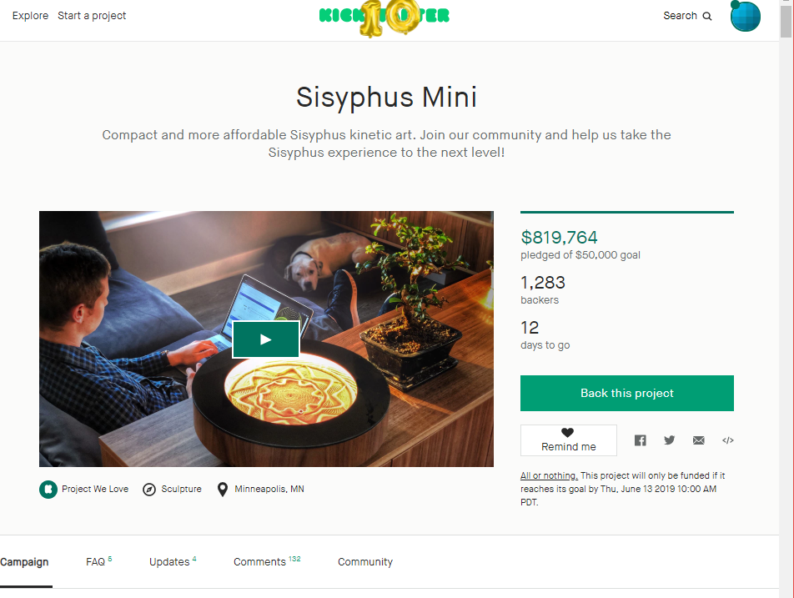
Problem Overview
Outcome:
Create predictive model utilizing numeric, text and categorical data in order to predict whether a campaign is successful within 15 days of being launched.
Goal:
Predict campaign success on Kickstarter by leveraging NLP techniques.
Potential Interested Parties:
Potential creators wanting to understand how well their campaign will perform
Competitive crowdfunding sites wanting to understand drivers of successful campaigns
Data Source:
CSV files hosted on Web Robots, site which scrapes Kickstarter monthly
Example of a Kickstarter campaign – one of the most successful in Kickstarter history!
Notes:
For my second capstone, my goal was to predict campaign success on Kickstarter by leveraging NLP techniques as well as recently developed practices in machine learning in order to organize data processing and modeling code.
Data was collected from a site hosted by Webrobots, a group that scrapes Kickstarter data monthly and hosts each month as a series of csv files. In order to analyze and create training-testing data the csv files needed to be collected and loaded into a single database and then queried.
Once the training and testing data was created I then applied various NLP techniques to create text features which, after being combined with additional features (numeric and categorical) like campaign target and creation date, were then fed through various models to understand how much signal was present.
Ultimately while showing the viability of NLP feature engineering in predicting the outcome of Kickstarter campaigns within the first two weeks of a campaign, additional data and campaign attributes would most likely have lifted the average model accuracy above 65%.

Slide 4
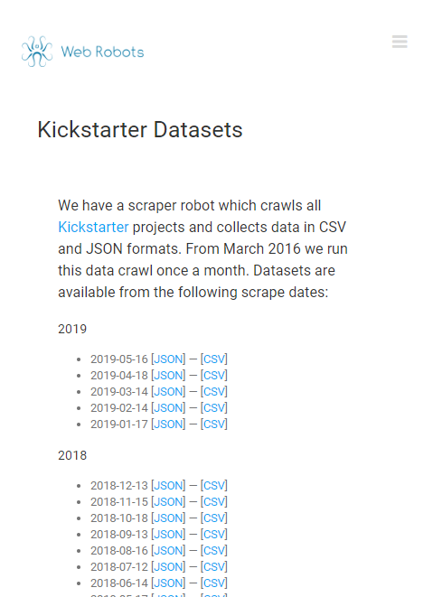
Data Overview
Series of CSV files posted to site hosted by webrobots, consisting of monthly scrapes from April 22, 2019 to current month
Each scrape produced 25=50+ csv files, stored in folders corresponding to the date scraped.
Single row represents single campaign, with each scrape being a point in time snapshot of the project
For this project, used data from Jan 28, 2016 to April 2019
Available Features:
'backers_count', 'blurb', 'category',
'converted_pledged_amount', 'country', 'created_at', 'creator',
'currency', 'currency_symbol', 'currency_trailing_code',
'current_currency', 'deadline', 'dirname', 'disable_communication',
'friends', 'fx_rate', 'goal', 'id', 'is_backing', 'is_starrable',
'is_starred', 'last_update_published_at', 'launched_at', 'location',
'name', 'permissions', 'photo', 'pledged', 'profile', 'slug',
'source_url', 'spotlight', 'staff_pick', 'state', 'state_changed_at',
'static_usd_rate', 'unread_messages_count', 'unseen_activity_count',
'urls', 'usd_pledged', 'usd_type'

Slide 5
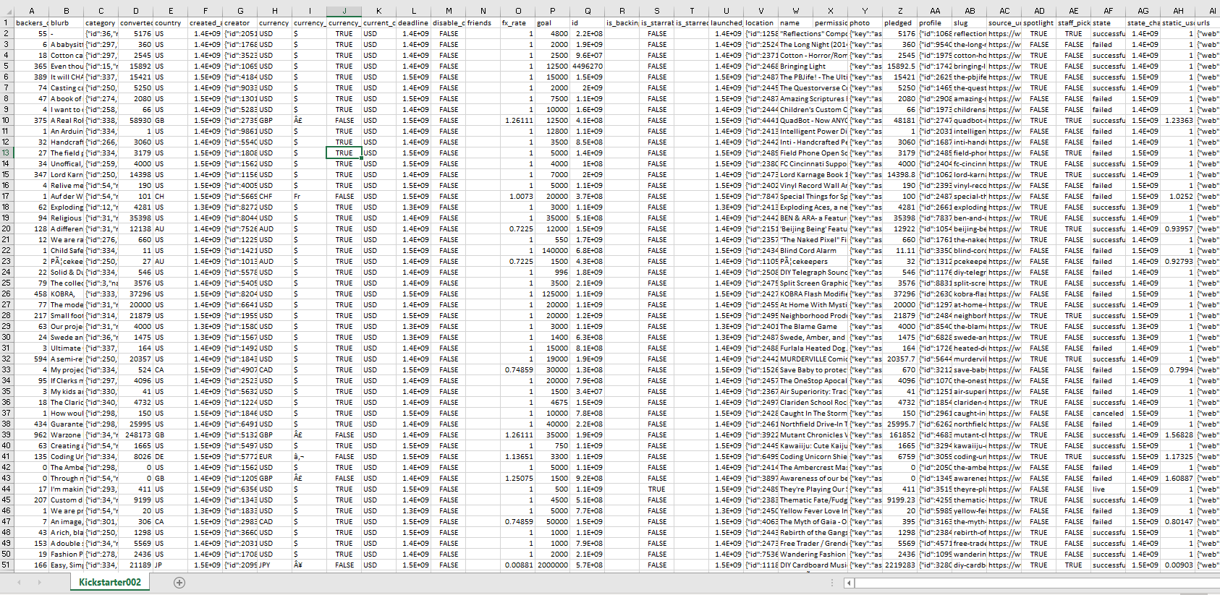

Slide 6

Data Acquisition
Challenges around data storage & training – testing data creation
Initial data set size: 30.6MB (Pandas data frame offered terrible performance)
Campaigns were duplicated across multiple scrapes (different snapshots) – needed to specifically isolate instances of records posted within 15 days of campaign
Needed to avoid data leakage regarding core metrics like backers, amount pledged, etc. and avg campaign was 30 days long.
Additional data processing needed to happen, especially the unix formatted datetime columns
Solution
Created local instance of SQLite db on external drive
Create script to load files row by row into master table
Query master table for specific subsets of data
Merge to create data set for applying NLP and modeling

Slide 7




Create instance of SQLite db ‘Kickstarter’ on external hd
Define master table used
Walk through all csv files in different folders
Read & load campaigns row-by-row into master table
Query master table for relevant datasets

Slide 8

DaTA Processing & Merging
Two data sets needed:
Projects Outcomes: unique list of projects with end state – the labels (‘State’)
Projects Starting: snapshot of campaigns in the first 15 days of launching
Features used: Name, Blurb, Creator, Category, Goal, Created At, Launched At, Deadline, Location
Merged dataset – very well balanced with regard to class:
Failed: 823 campaigns
Successful: 796 campaigns
Additional Processing Required
Unpacking nested JSON like columns: creator, category, location
NLP Specific:
Leveraged Spacy by:
Using pre-trained statistical model for English
Removing stop words, performing lemmatization, and converting tokens to lower case
After processing, text columns were then combined into a single column to then be used for BAG of Words, N-grams and TFIDF later

Slide 9

Feature Engineering & Selection
Given limited sample size & available features, feature selection options were limited & I decided to use as many as possible
Aside from text features, train-test included:
Goal, category, country, state, city, time to launch, launch to deadline, launched month, launched year, created month, created year, deadline month, deadline year (total: 13)
Process:
Pipelines created to select numeric, text, & categorical columns
Numeric pipeline:
Utilized SimpleImputer to fill nan’s with 0’s (instead of the mean, etc) as using the mean would have been misleading (i.e. some campaigns could truly have taken less time to launch, etc.)
Categorical pipeline:
Utilized SimpleImputer, OneHotEncoder
Text pipeline:
This is where I experimented with different combinations of NLP techniques including Bag of Words, TFIDF Vectorizer, N-grams to explore which techniques could work best

Slide 10

Model Selection & Performance
Because of the inclusion of text data & feature engineering techniques like Bag of Words, N-grams, etc. + the small sample size, a big driver of model selection was focused on the ability to utilize a sparse array
Classification models known to do well with sparse arrays & high dimensional data (even in cases where columns outnumbered actual record size) included:
Logistic Regression
Linear SVC (SVM’s in general)
Random Forest Classifier
Results:
Models performed equally well around ~65% accuracy (with cross validation (cv=5))
Hyperparameter tuning of Random Forest model with bi-grams & TFIDF transformer added additional ~2% lift in model accuracy
Interpretation:
Given the near equally dismal performance of all model variants, additional data + text based features could potentially have provided more insight into drivers of campaign success

Slide 11

Model Selection & Performance
Model Type | Bag of Words | TFIDF | N-grams | Hyperparameter Tuning
Logistic Regression | Model Variant 1: Accuracy: 65%
 | Model Variant 3: Accuracy: 66%
Linear SVC | Model Variant 2: Accuracy: 64%
Random Forest Classifier |  | Model Variant 4: Accuracy: 66% |  | Hyperparamter tuning: Accuracy: 68%

Slide 12
Take Away & Next Steps
Project Specific Mentions:
For NLP to be effective, lots of data is needed + for NLP to be effective in prediction, as many or more labeled samples
Time duration + frequency of data collection key in being able to (1) isolate early conditions of observatory units + (2) understand time-based trends like pledging behavior.
Model interpretability key to socializing model outcomes + decisions; pipelines offer way to streamline & productionalize models but also make interpretability challenging
Next Steps
Applying learnings from this project to similar projects with similar desired outcomes + higher quality, volume data appropriate for NLP
Exploring the use of Deep Learning models involving NLP tasks

Slide 13

About Me

Slide 14

About ME
Applied analytics and data science evangelist, Mikiko Bazeley is a seasoned analyst with 5+ years of working in high-impact roles for start-ups and enterprise tech companies.
A UCSD Economics & Anthropology graduate, Mikiko aims to use her experience in social research & modeling to strategically leverage data science in order to drive new insights for sales, marketing, finance & customer success organizations. Mikiko is also GIS & Supply Chain Management certified.
Prior to joining WalkMe (where she focuses on scaling data science & global sales analytics) Mikiko worked as a Data Scientist at Autodesk (focused on understanding product adoption & user health), as well as assisting with scaling strategic finance initiatives at Sunrun (the largest residential solar company in the US).
Please feel free to reach out:
LinkedIn: https://www.linkedin.com/in/mikikobazeley/
Email: mmbazel (at) gmail (dot) com

