Slide 1
A Mixed Generative-Discriminative
Based Hashing Method

Slide 2
Overview
With the rapid expansion of the World Wide Web, information has become much easier to access, modify and duplicate. Therefore, the hash similarity based calculates or approximate search close by next they have been proposed and received a remarkable beware of the last few years. Various applications such as information recover detect near duplicates and data mining .They are executed with hash-based methods. Because of the fast the expansion of mobile networks and social networking sites, information entry through multiple channels has as well growing attention. Images and videos are associated with tags and captions. According to a research published in EMarketer, about 75 percent of the content aside Facebook photos.

Slide 3
Overview
One users contain relevant data the different modes usually have semantic correlations. Therefore, it is desirable to support the retrieval of information using different modes. For example, images it can be used to find semantic relevant text information. On the other hand, images with no (or less) textual descriptions are very necessary to be recovered textual query.

Slide 4
Problem Statement
Image search is an important method to find images contributed by social users in such social websites. However, how to make the top ranked result relevant and with diversity is challenging. A fundamental problem in the re-ranking of the images or texts social image retrieval is how to reliably solve these images or texts mismatch problems.

Slide 5
Need Of A Problem Statement
Most of the existing works use a bag-of-words to model textual information. The semantic level similarities between words or documents are rarely considered.
Existing works focused only on textual information.
Another challenge in this task is how to determine the correlation between multi-modal representations.

Slide 6
Scope
We Perform of near-duplicate detection and cross media retrieval task.
We propose to use a set of word embeddings to represent textual information.
Social image websites such as Flickr allow users to annotate their images with a set of descriptors such as tags and offline part use as images. Thus, the tag-based image search can be easily accomplished by using the tags as query terms. However, the weakly relevant tags, noisy tags and duplicated information make the search result unsatisfactory.

Slide 7
Proposed System Architecture
Input as
Word
Text
Embedding
Fisher
Hash code
Mapping
Ranking
Result
Vector
Generation
Input as
Feature
Image
Descriptor

Slide 8
Design Diagram
Input as Text
Use wordnet
Find synonyms
Apply Word
Fetch Images
Display Result
dictionary
embedding
Input as Image
Extract
Store in file
Match With
Fetch Images
Display Result
Keypoints
database

Slide 9
UML Diagram
System
Use Case Diagram
(USER)
Registration
Login
My Profile
User
Search via text or
Images
Logout

Slide 10
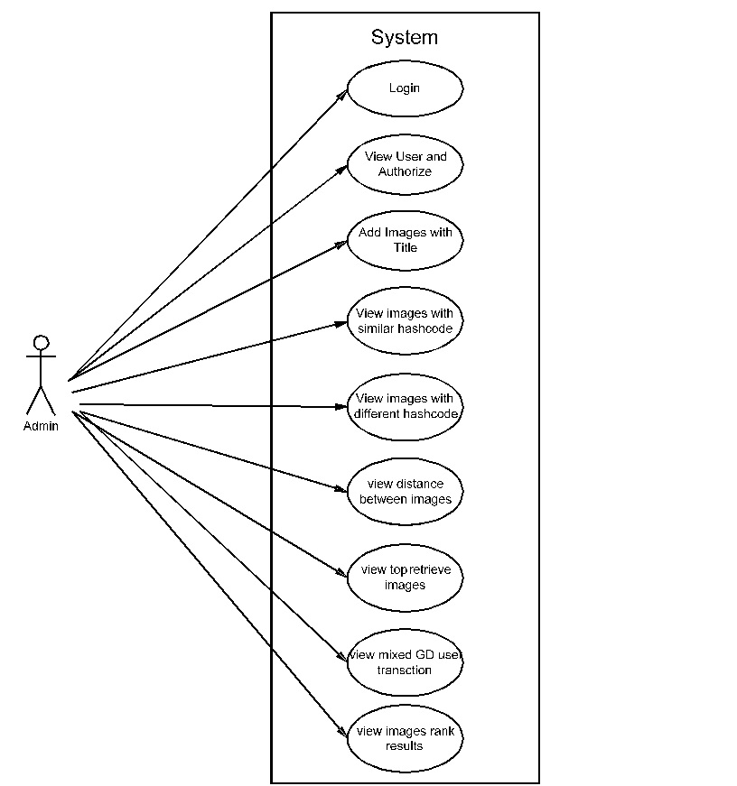
UML Diagram
Use Case Diagram
(ADMIN)

Slide 11
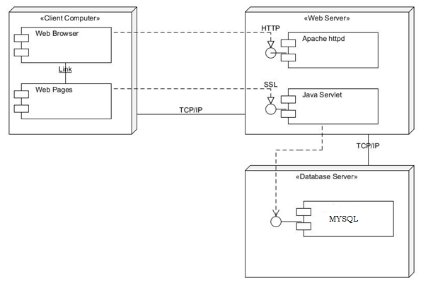
Deployment Diagram

Slide 12
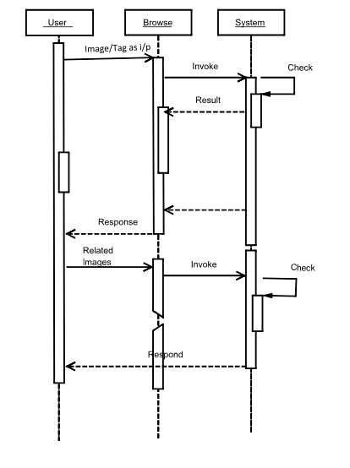
SEQUENCE DIAGRAM

Slide 13
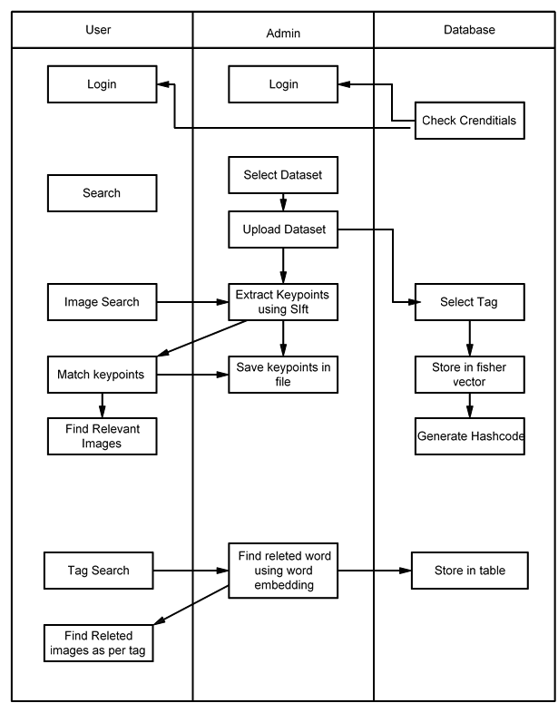
Swim Lane Diagram

Slide 14
Literature Survey
Sr.No. | Paper Details | Advantages | Disadvantages | Conclusion
1. | 1. G. Ding, Y. Guo, and J. Zhou, “Collective matrix factorization hashing for multimodal data,” in Proc. IEEE Conf. Comput. Vis. Pattern Recog., 2014, pp. 2083–2090. | 1.CMFH learns unified hash codes by collective matrix factorization with latent factor model from different modalities of one instance, Which can not only supports cross-view search but also increases the search accuracy by merging multiple view information sources. 2. We also prove that CMFH, a similarity preserving Hashing learning method, has upper and lower boundaries. | Only worked on nearest neighbor search methods | In this paper, they study the problems of learning hash functions in the context of multimodal data for cross-view similarity search. We put forward a novel hashing method, which is referred to Collective Matrix Factorization Hashing (CMFH).

Slide 15
Literature Survey
Literature Survey
Sr. No. | Paper Details | Advantages | Disadvantages | Conclusion
2. | Y. Gong, S. Lazebnik, A. Gordo, and F. Perronnin, “Iterative quantization: A procrustean approach to learning binary codes for large-scale image retrieval,” IEEE Trans. Pattern Anal. Mach. Intell., vol. 35, no. 12, pp. 2916–2929, Dec. 2013. | Y. Gong, S. Lazebnik, A. Gordo, and F. Perronnin, “Iterative quantization: A procrustean approach to learning binary codes for large-scale image retrieval,” IEEE Trans. Pattern Anal. Mach. Intell., vol. 35, no. 12, pp. 2916–2929, Dec. 2013. | 1.This paper worked on 32 bit binary image search 2.Accuracy is low | This paper addresses the problem of learning similarity-preserving binary codes for efficient similarity search in large-scale image collections.
15

Slide 16
Literature Survey
Sr. No. | Paper Details | Advantages | Disadvantages | Conclusion
3. | Y. Pan, T. Yao, T. Mei, H. Li, C.-W. Ngo, and Y. Rui, “Clickthrough-based cross-view learning for image search,” in Proc. 37th Int.ACMSIGIR Conf. Res. Develop. Inf. Retrieval, 2014, pp. 717–726 | This paper worked on 1) the surrounding texts are often noisy or too few to accurately describe the image content, and 2) the human annotations are resourcefully expensive and thus cannot be scaled up. | This paper only consider color feature. | The former aims to create a latent subspace with the ability in comparing information from the original incomparable views (i.e., textual and visual views), while the latter explores the largely available and freely accessible click-through data (i.e., “crowdsourced” human intelligence) for understanding query.
16

Slide 17
Literature Survey
Sr. No. | Paper Details | Advantages | Disadvantages | Conclusion
4. | J. Song, Y. Yang, Y. Yang, Z. Huang, and H. T. Shen, “Inter-media hashing for large-scale retrieval from heterogeneous data sources,” in Proc. Int. Conf. Manage. Data, 2013, pp. 785–796. | Implement using a query image to retrieve relevant text documents or images from different data sources. | Time complexity is high because of Heterogeneous Data Sources | In this paper, we present a new multimedia retrieval paradigm to innovate large-scale search of heterogeneous multimedia data. It is able to return results of different media types from heterogeneous data sources.

Slide 18
Literature Survey
Sr. No. | Paper Details | Advantages | Disadvantages | Conclusion
5. | D. Zhai, H. Chang, Y. Zhen, X. Liu, X. Chen, and W. Gao, “Parametric local multimodal hashing for cross-view similarity search,” in Proc. 23rd Int. Joint Conf. Artif. Intell., 2013, pp. 2754–2760. | 1.This paper implement hashing for efficient large-scale similarity search. 2. PLMH achieves higher empirical query accuracy than global-based ones | Not explore more efficient optimization algorithms to improve the scalability of PLMH. | In this paper, we study HFL in the context of multimodal data for cross-view similarity search. We present a novel multimodal HFL method, called Parametric Local Multimodal Hashing (PLMH), which learns a set of hash functions to locally adapt to the data structure of each modality.

Slide 19
THANK YOU

