Slide 1
INTRODUCTION
Domain:
Data mining is the process of sorting through large data sets to identify patterns and establish relationships to solve problems through data analysis.
Text summarization

Slide 2
Literature Survey
Sr. No. | Author, Title and Journal Name | Advantages | Disadvantage | Refer Points
1 | H. Li, J. Zhu, C. Ma, J. Zhang, and C. Zong,”-modal summarization for asynchronous collection of text, image, audio and video.” in EMNLP, 2017, pp. 1092–1102. | 1. It avoids redundant information. 2. It provides good readability. | 1. This works only limited dataset. | Proposes an extractive multi-modal summarization method that can automatically generate a textual summary given a set of documents, images, audios and videos related to a specific topic. The key idea is to bridge the semantic gaps between multi-modal content.
2 | J. Bian, Y. Yang, and T.-S. Chua, “ summarization for trending topics in microblogs,” in CIKM. ACM, 2013, pp. 1807–1812. | 1. Well organized the messy microblogs into structured subtopics. 2. Generates high quality textual summary at subtopic level. | 1. Only focus on summarizing synchronous multi-modal content. | Proposes a multimedia microblog summarization framework to automatically generate visualized summaries for trending topics. Specifically, a novel generative probabilistic model, termed multimodal-

Slide 3
Problem statement
To build and implement text Summarization for automatic generating summary using Natural Language.
Functional Specifications :
users: students , reader , book publisher etc.
Functionality
Topic Identification
Interpretation of topic
Summary Generation

Slide 4
Technical Specifications :
Language :
JAVA
Algorithms :
1. K-mean algorithm
2. Text- rank algorithm
3. Page – rank algorithm

Slide 5
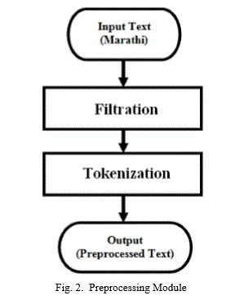
Architecture

Slide 6
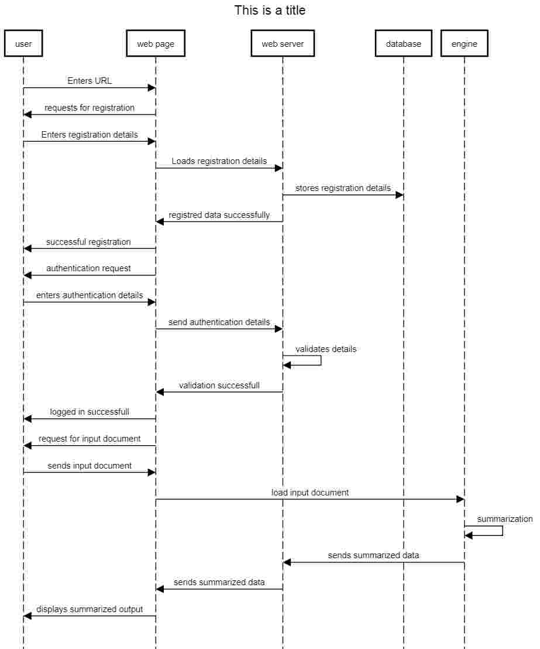
UML diagram

Slide 7
Screenshots

