Slide 1
Review – III by
Group no:- 3

Slide 2
Problem Statement
Student Performance Prediction based on academic performance history and analyzing behavioural pattern to improve results.

Slide 3
Introduction
Predicting students performance accurately is very challenging and important in terms of their further Education and to find their area of interests that will help them improve their weak sections. The main objective is to provide an implementation of Novel Machine Learning Techniques to predict students Performance.
The challenges faced by existing systems are for the accurate prediction the dependency between subjects must be identified, students evolving progress needs to be incorporated into the prediction.

Slide 4
Literature Survey

Slide 5
TITLE | YEAR | JOURNAL | DESCRIPTION
A Machine Learning Approach for Tracking and Predicting Student Performance in Degree Programs. | 2016 | IEE | Predicting Students Performance based on Academic Records using EWAF Algorithm.
Student Performance Prediction Using Machine Learning | 2015 | IJERT | Performance Prediction using neural network. Prediction performance of neural network increases as increase in Dataset.
Early Prediction of Students Performance using Machine Learning Techniques | 2014 | IJCA | For predicting performance Decision Trees (DT), Bayesian Networks (BN), Artificial Neural Networks (ANN), Support Vector Machines (SVM) is used.

Slide 6
TITLE | YEAR | JOURNAL | DESCRIPTION
Predicting Students’ GPA and Developing Intervention Strategies Based on Self-Regulatory Learning Behavior | 2017 | IEEE | Predicting Students performance using Academic data as well as by using Questionaries. Questions based on Behaviour , extra Activities etc.

Slide 7
UML Diagrams
Use Case Diagram
Class Diagram
Sequence Diagram

Slide 8
Use Case Diagram

Slide 9
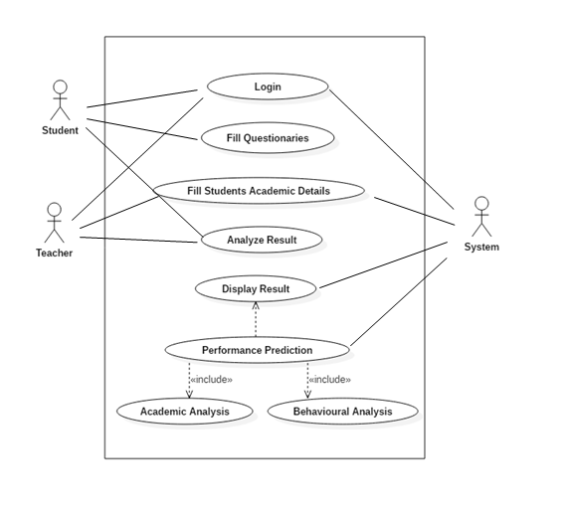

Slide 10
Class Diagram

Slide 11
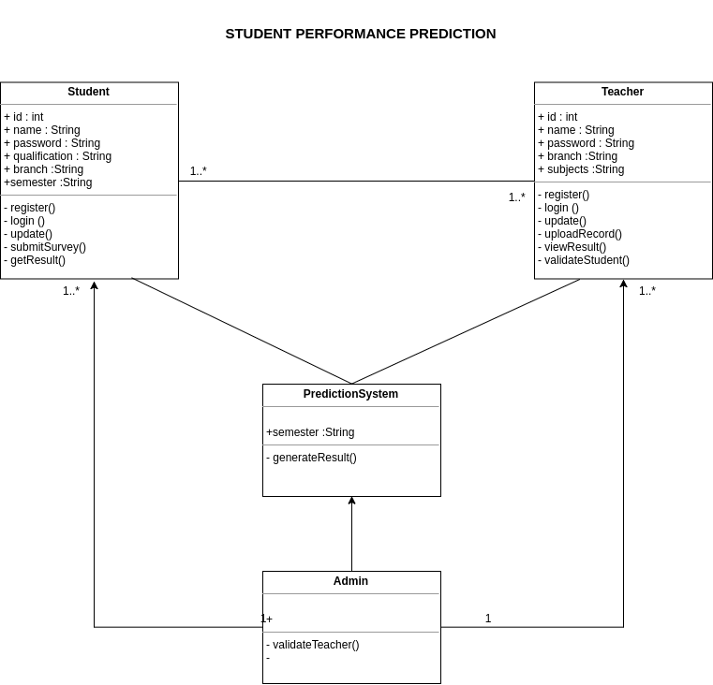

Slide 12
Sequence Diagram

Slide 13
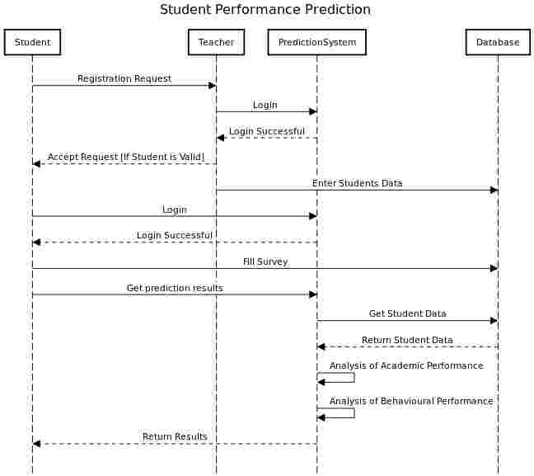

Slide 14
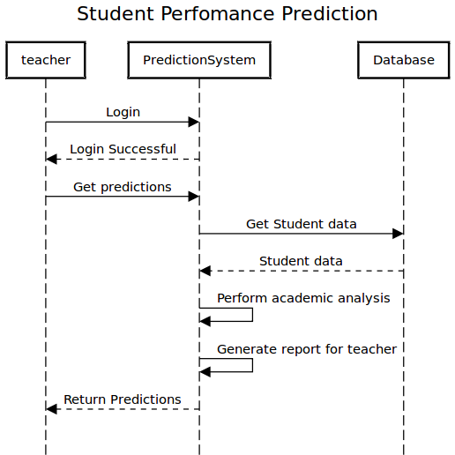

Slide 15
Screen Shots

Slide 16


Slide 17
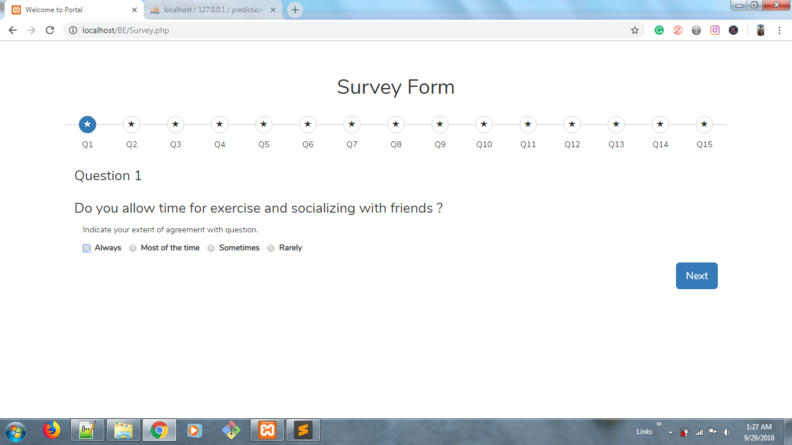

Slide 18
Thank You !

