Slide 1
NetSpam: A Network-Based Spam Detection in Shopping App
Group No. 16
Guided By,
Ms. Pranjali Kuche
Group Members :
Rutuja Fakire (BI49)
Kalyani Patil (BI39)
Arti Rode (BI53)
Pallavi Agwane (BI50)

Slide 2
Problem statement
While buying the product online people mostly believe on the written reviews in their decision-making processes, and positive / negative reviews encouraging / discouraging them in their selection of products and services.
These reviews thus have become an important factor in success of a business while positive reviews can bring benefits for a company, negative reviews can potentially impact credibility and cause economic losses.
The fact that anyone with any identity can leave comments as reviews provides a tempting opportunity for spammers to write fake reviews designed to mislead users’ opinion.
These misleading reviews are then multiplied by the sharing function of social media and propagation over the web.

Slide 4
Persona
Meera wants to buy a mobile phone. So she tries to buy it from online application. Once while suffering the online application she notices that there is more offer on the mobile phone she wants to buy. So for checking weather the quality of the phone she tries to look at the reviews and ratings given on the product. Meera finds reviews to get reflected and ratings as positive and decides to buy product. But after receiving product meera gets to know that product’s quality is not much as described.

Slide 5
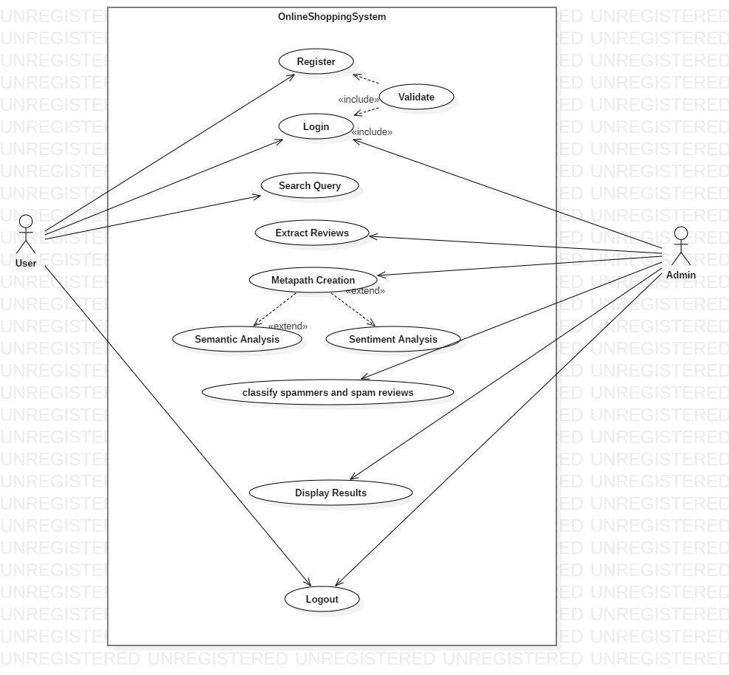

Slide 7
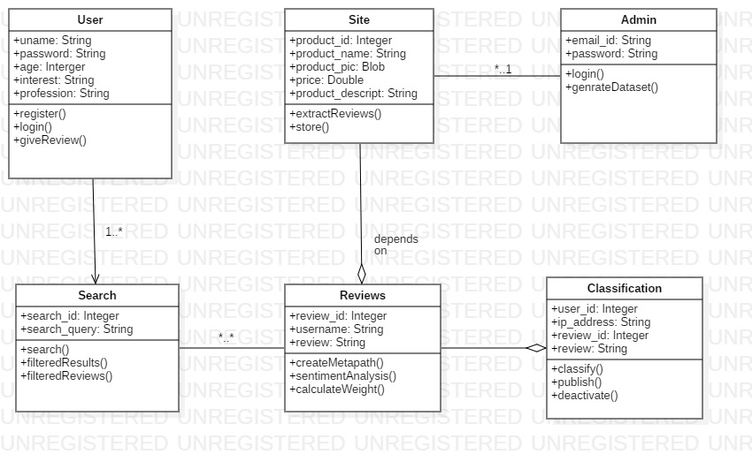

Slide 8
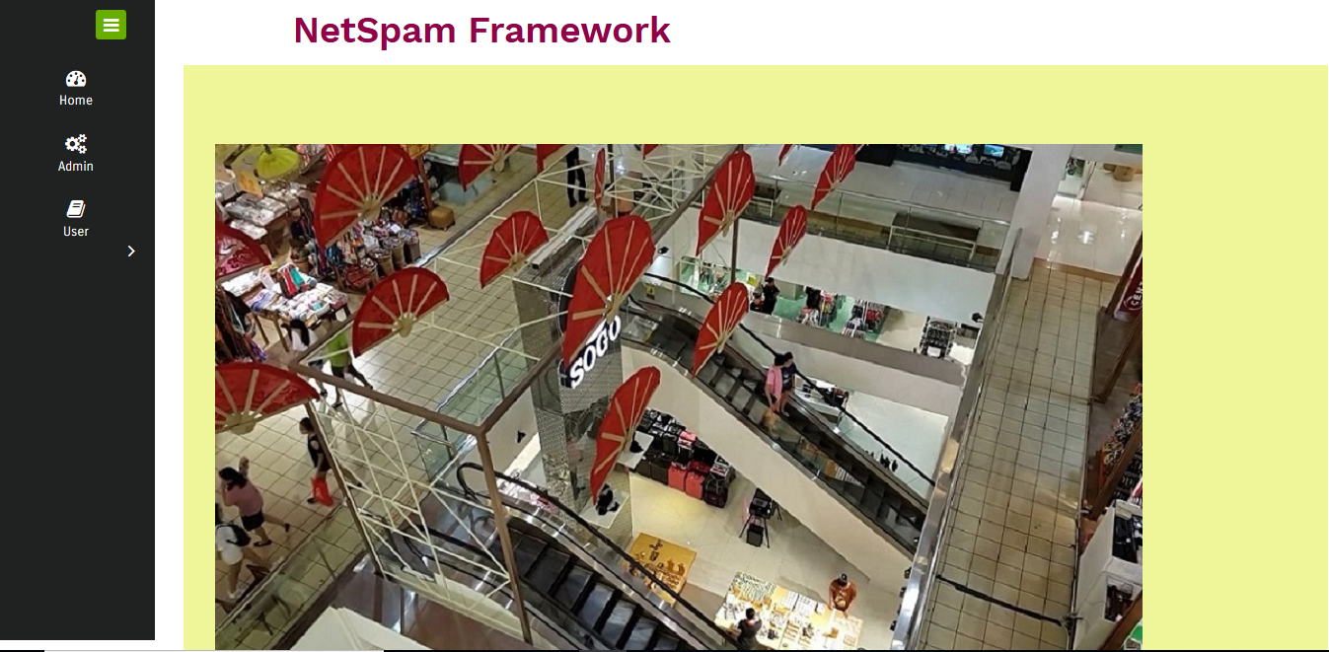

Slide 9
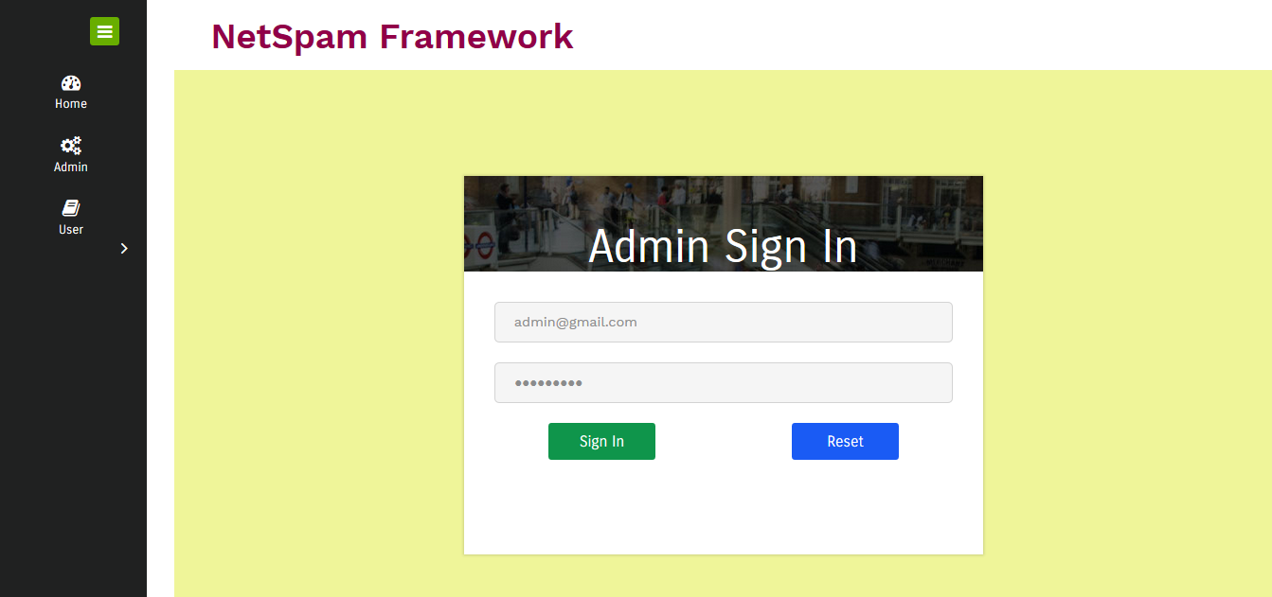

Slide 10
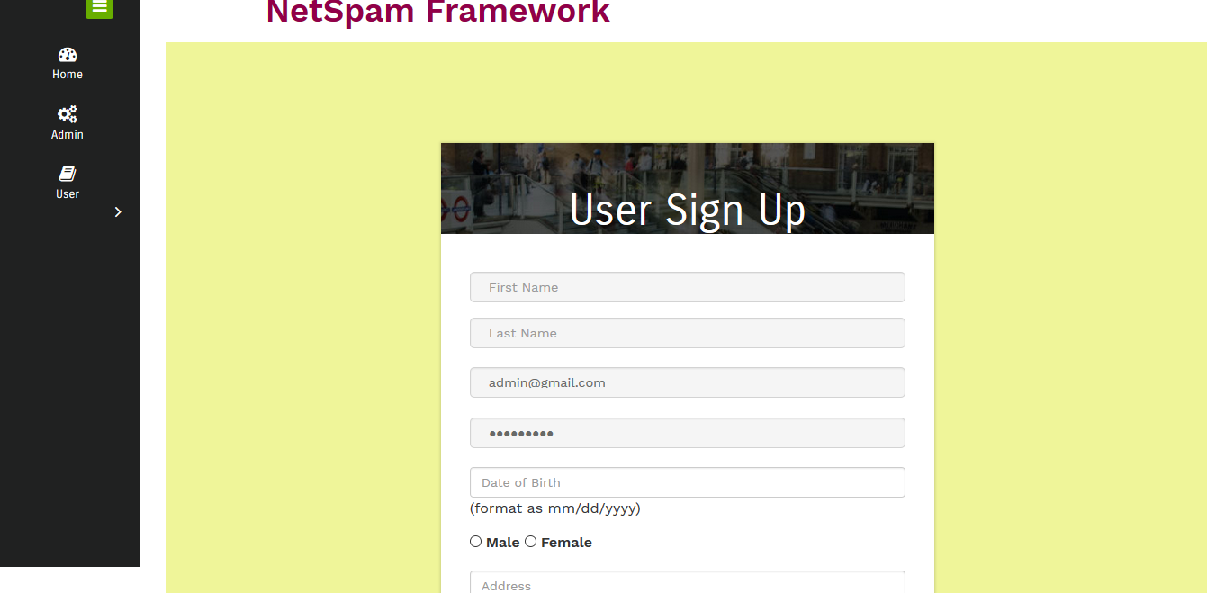

Slide 11
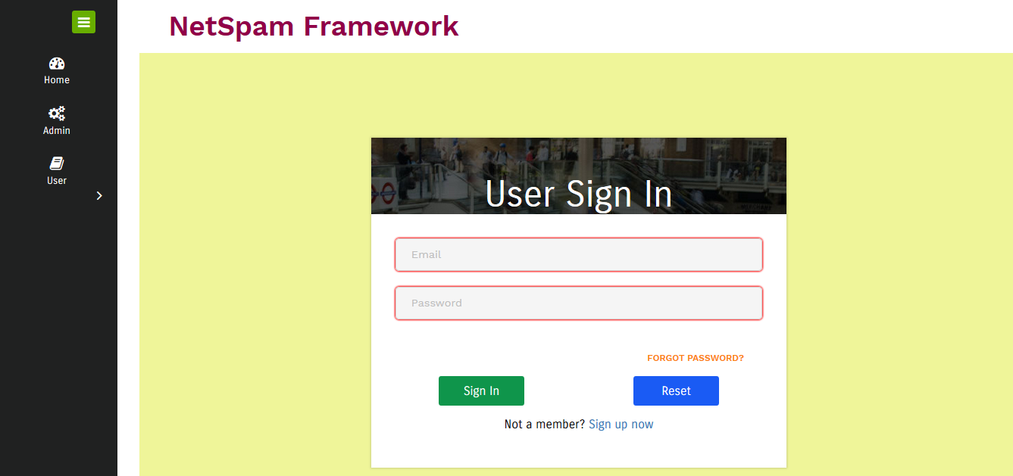

Slide 12
Thank you

