Slide 1
Location Recommendation Using Scalable Content-Aware Collaborative Filtering

Slide 2
Problem Statement
User get recommendation of the most visited locations there is need the recommended locations should be personalized to cold start user.
Also, general location recommendation cannot well meet users’ personal requirements.
.

Slide 3
Software Requirement Specification
Functional Requirements:
External Interface Requirements:
1) User Interface
Home page
Hotels and Places Recommendation
View Distance, Time and Route on Map.
2) Hardware Interfaces
Computer System
3) Software Interfaces
Microsoft as the operating system platform.
JDK 1.8 as java platform
Apache tomcat as server.
MySQL database.

Slide 4
Software Requirement Specification
Non-Functional Requirements:
Security requirements
Private links can send on users mail id.
Software quality attributes
Usable
Reliable

Slide 5
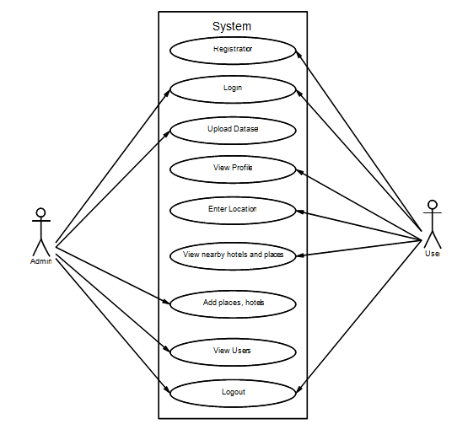
Use Case

Slide 6
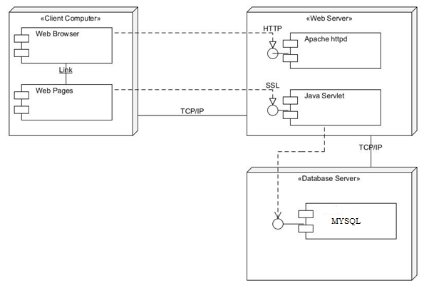

Slide 7
Test Cases
Check response on entering valid username & password
Check response on entering Invalid username & password
Check Login Functionality
Check response when username in empty
Check response when password is less than 8 characters

Slide 8
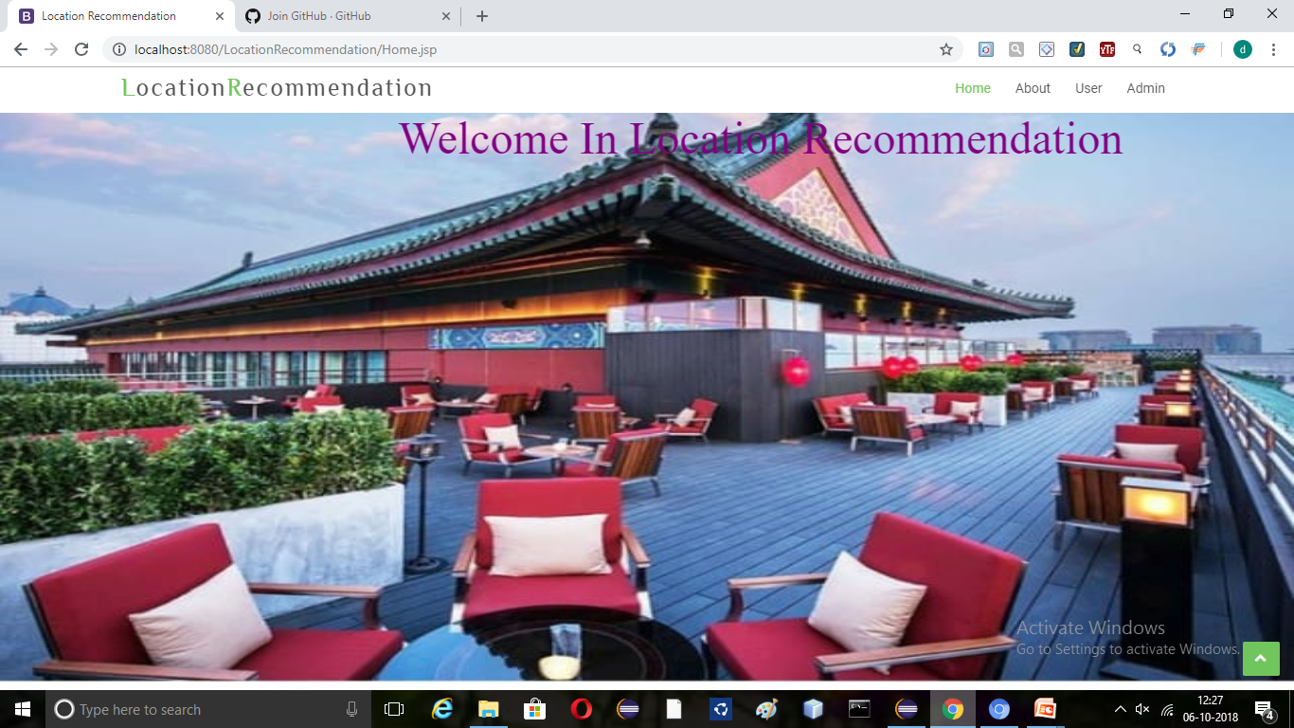

Slide 9
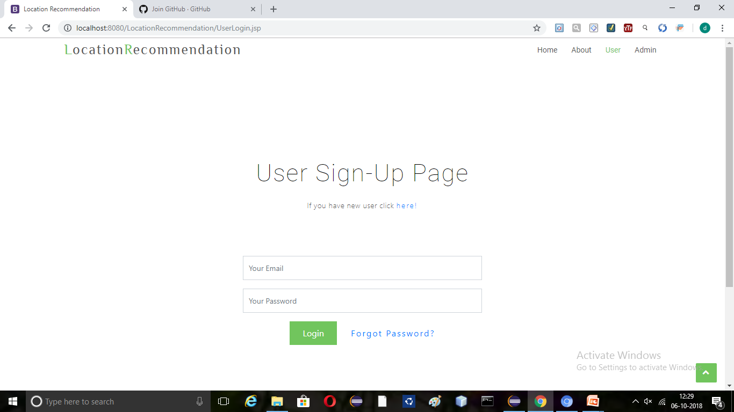

Slide 10
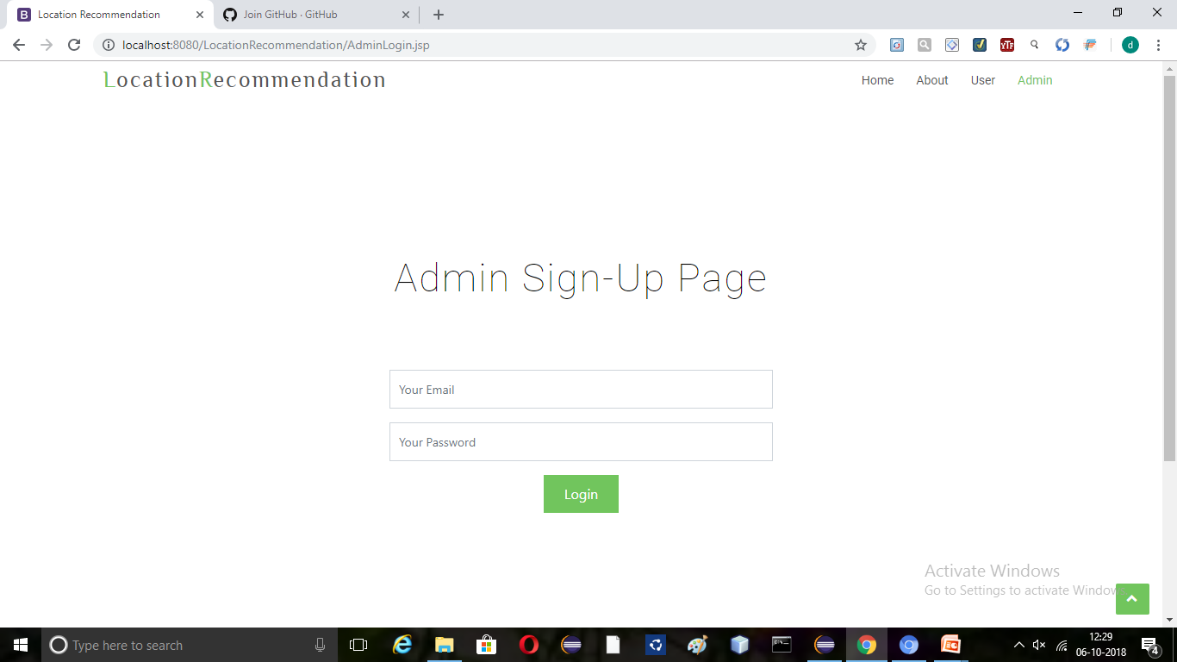

Slide 11
