Slide 1
Review iii BY
Gayatri Bhalerao(BI03)
Payal Shah(BI21)
Tushar Nemade(BI63)
Saloni Telang(BI65)
Project Guide:-
Prof. Nikhil Dhavase

Slide 2
Community based Question answering system

Slide 3
Problem statement
The social community question answering pair work on centralized framework but not on different categories of subject. Search question gives more answers and create lots of confusion of analyzing the answer, to resolve this problem CQA system works on separate subject and interest of the user. The proposed system gives more accurate and best answers by experts.

Slide 4
System Requirement
Software Requirement:
Language: Java, Advance Java
User database: MySQL
Hardware Requirement:
RAM 4 GB,
Processor Intel core i3,
Windows OS: 8, 8.1,10.

Slide 5
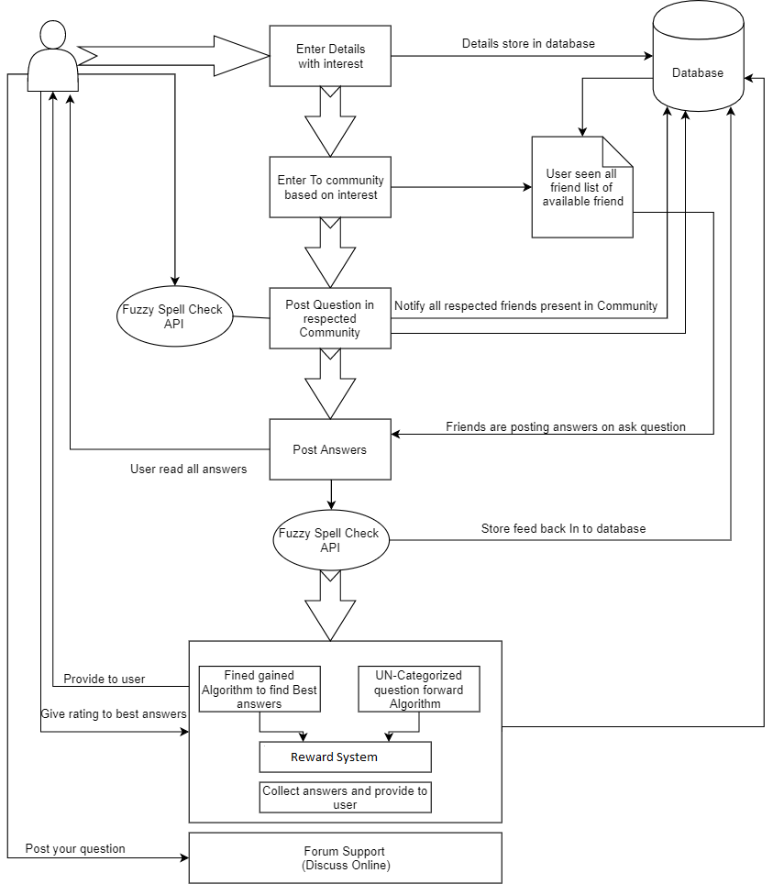
System architecture

Slide 6
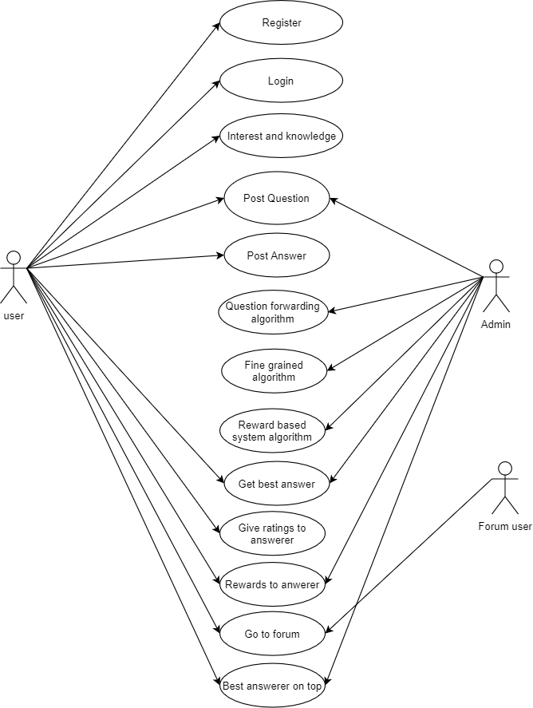
Use case diagram

Slide 7
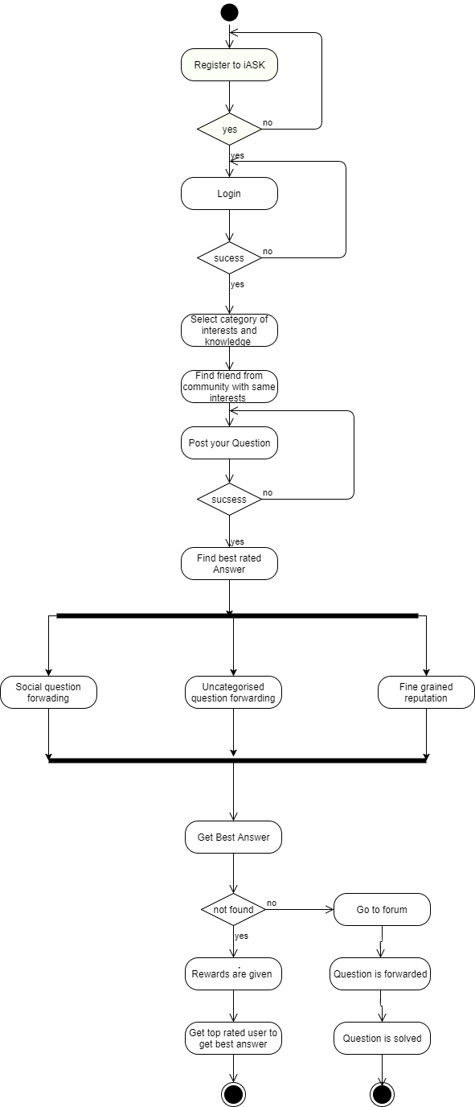
Activity diagram

Slide 8
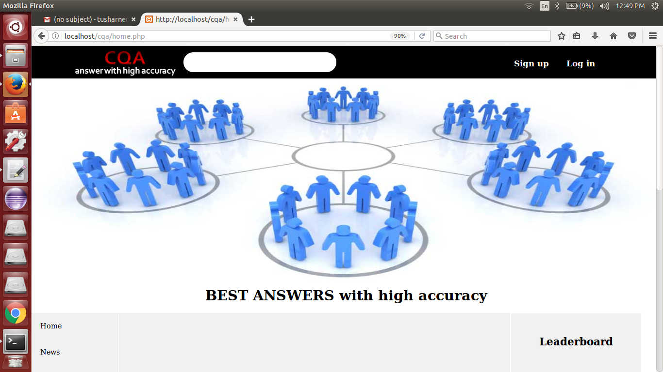

Slide 9
Thank You

