Slide 1
Review ii BY
Gayatri Bhalerao(BI03)
Payal Shah(BI21)
Tushar Nemade(BI63)
Saloni Telang(BI65)
Project Guide:-
Prof. Nikhil Dhavase

Slide 2
Community based Question answering system

Slide 3
Problem statement
Community based question answering system to increase the accuracy of answers by categorizing user according to their interests.

Slide 4
System Requirement
Software Requirement:
Language: Java, Advance Java
User database: MySQL
Hardware Requirement:
RAM 4 GB,
Processor Intel core i3,
Windows OS: 8, 8.1,10.

Slide 5
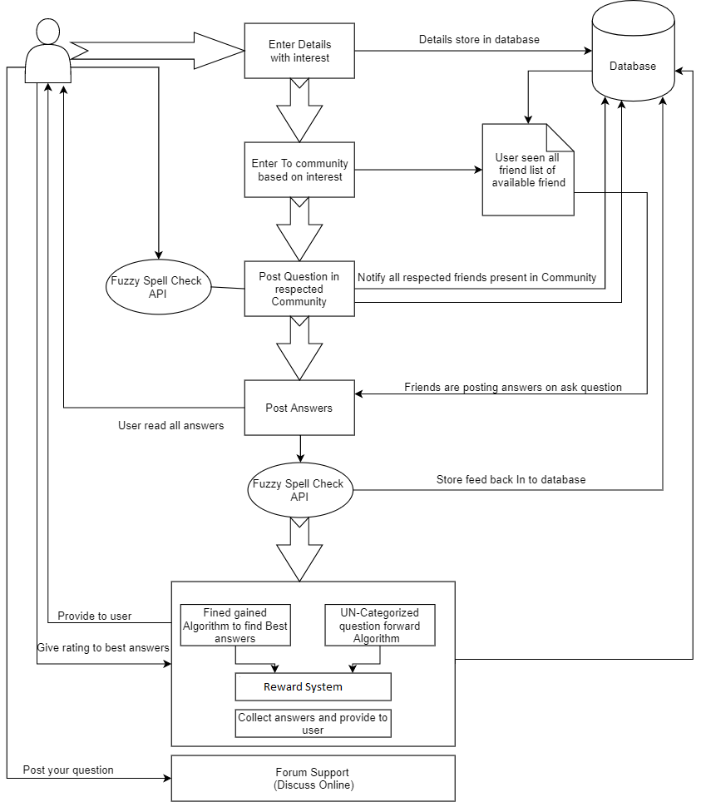
System architecture

Slide 6
Algorithm
Fine gained technique: it finds the best answers with the help of users rating.
Social based potential answers: Find posted question answers in local community
Global Based Potential answers: Find same question's answers in different answers
Question Forwarding Algorithm.

Slide 7
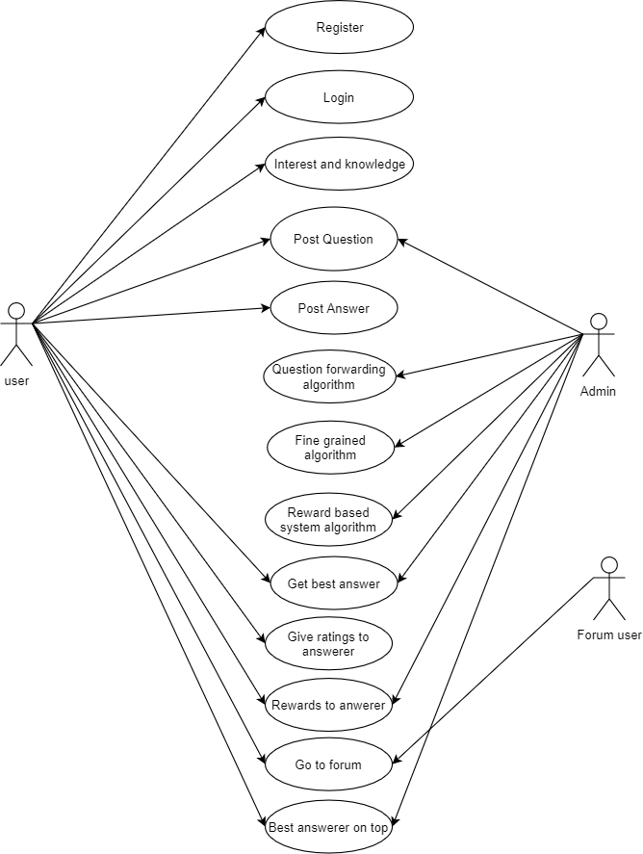
Use case diagram

Slide 8
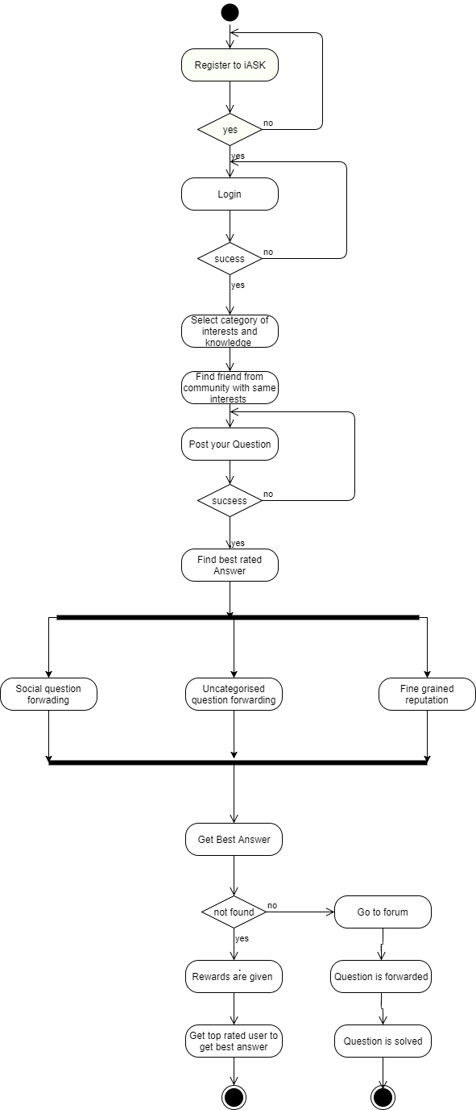
Activity diagram

Slide 9
Thank You

