Slide 1
PRESENTATION
By
Group no:- 3
Mohit Patil B150458534
Aditya Shelar B150458547
Siddhi Bendkhale B150458506
Sushmita Gatne B150458517

Slide 2
Introduction
Predicting students performance accurately is very challenging and important in terms of their further Education and to find their area of interests that will help them improve their weak sections.
The challenges faced by existing systems are for the accurate prediction the dependency between subjects must be identified, students evolving progress needs to be incorporated into the prediction.

Slide 3
Problem Statement
Student Performance Prediction based on academic performance and analysing behavioural pattern to improve results.

Slide 4
Literature Survey

Slide 5
SR NO | TITLE | Year | Journal | Description
1 | A Machine Learning Approach for Tracking and Predicting Student Performance in Degree Programs | 2016 | IEE | Predicting Students Performance based on Academic Records using EWAF Algorithm
2 | Student Performance Prediction Using Machine Learning | 2015 | IJERT | .Performance Prediction using neural network. .Prediction performance of neural network increases as increase in Dataset.
3 | Early Prediction of Students Performance using Machine Learning Techniques | 2014 | IJCA | .For predicting performance Decision Trees (DT), Bayesian Networks (BN), Artificial Neural Networks (ANN), Support Vector Machines (SVM) is used
4 | Predicting Students’ GPA and Developing Intervention Strategies Based on Self-Regulatory Learning Behavior | 2017 | IEEE | Predicting Students performance using Academic data as well as by using Questionaries‘ . .Questions based on Behaviour , extra Activities etc.

Slide 6
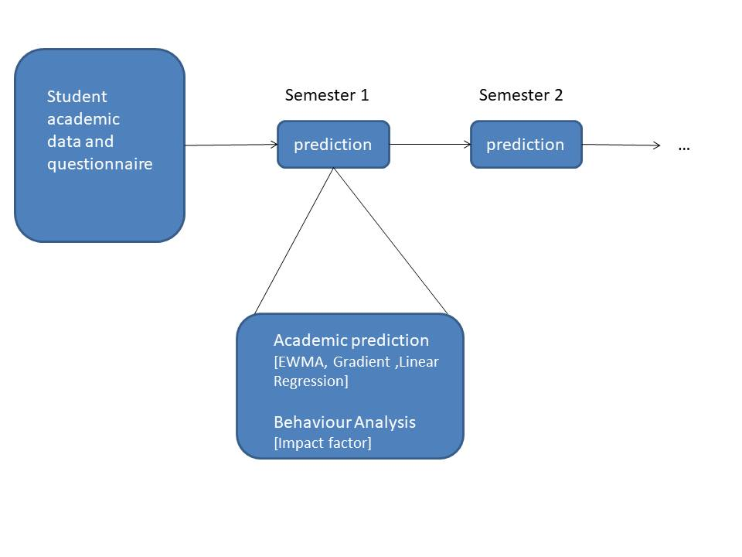
System Architecture

Slide 7
Screenshots

Slide 8
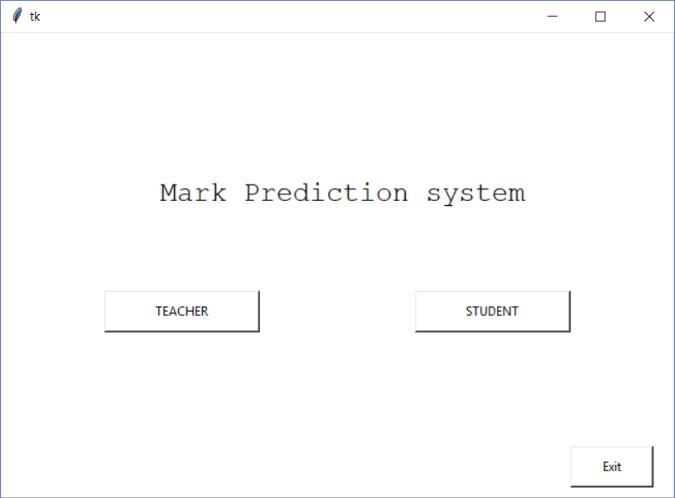

Slide 9
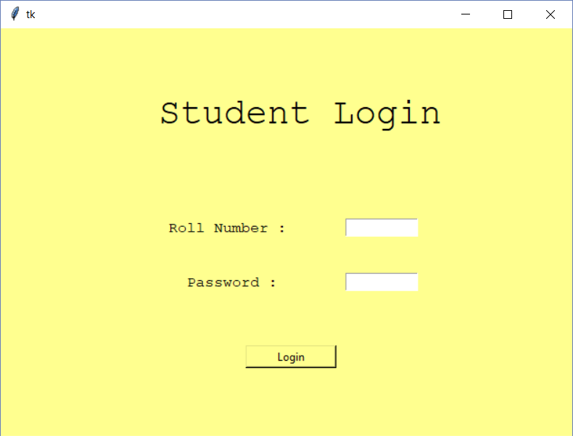

Slide 10
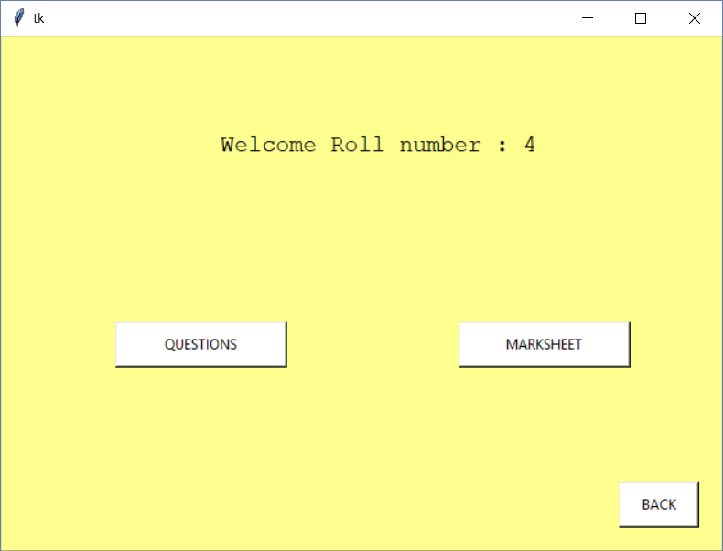

Slide 11
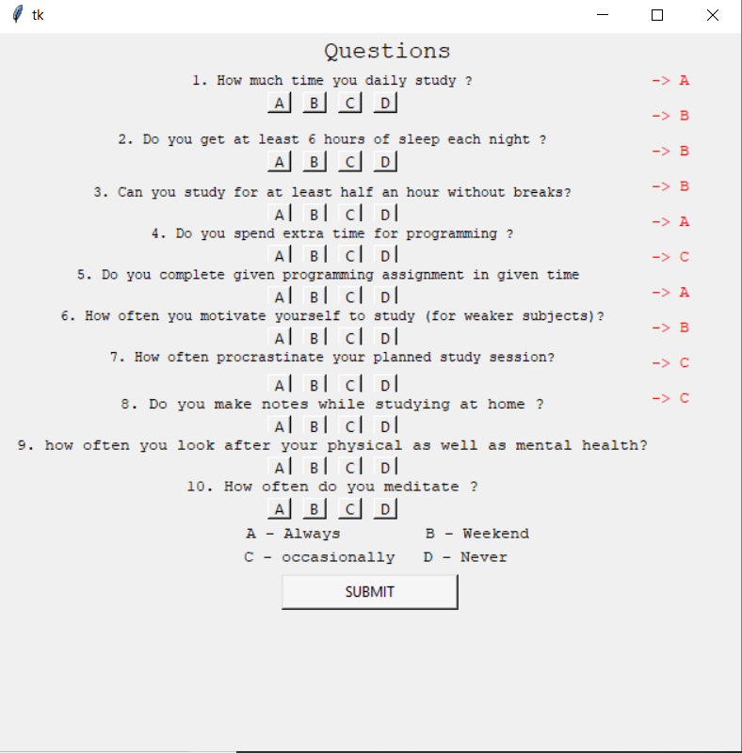

Slide 12
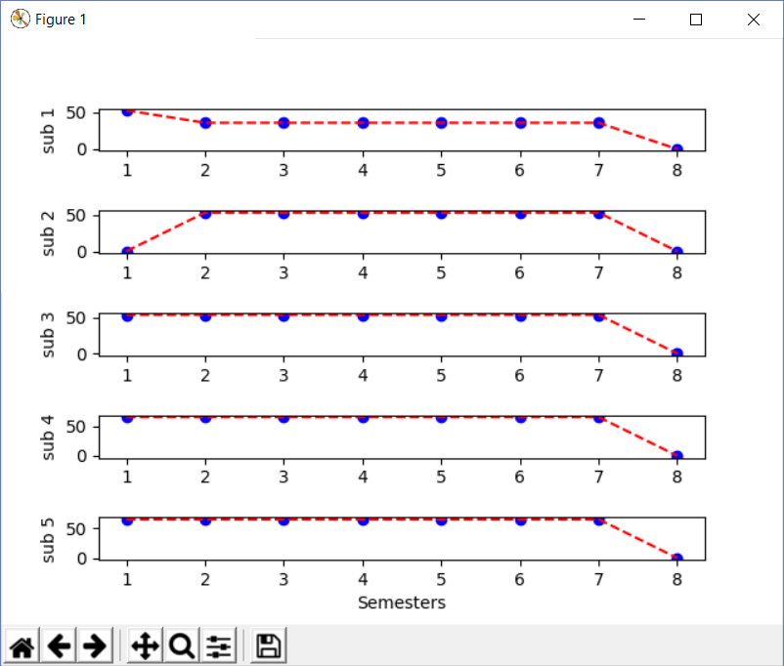

Slide 13
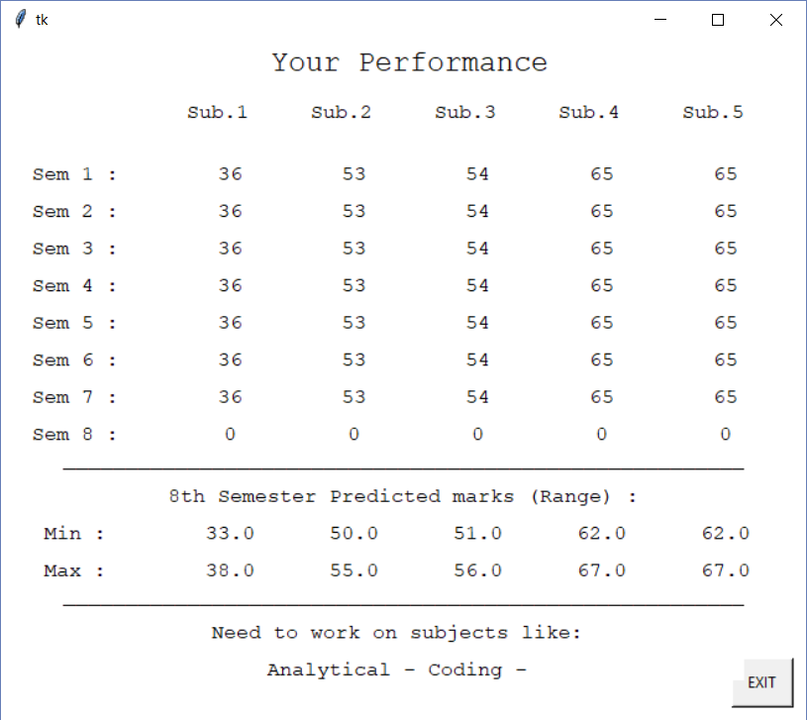

Slide 14


Slide 15
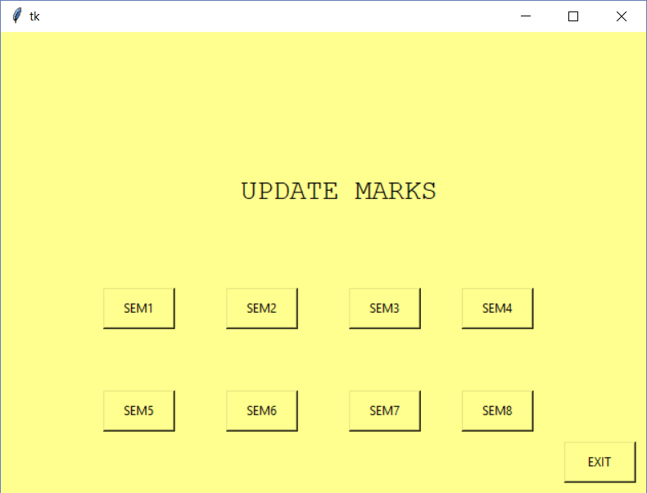

Slide 16
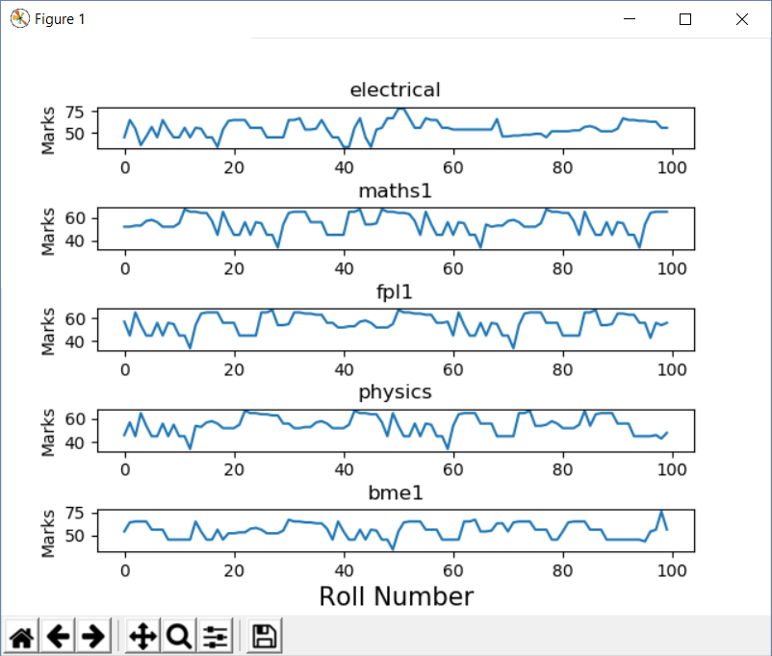

Slide 17
Conclusion
Present study shows that academic performance of the students are primarily dependent on their past performances. Past Performance indeed got a significant influence over students’ performance . Machine Learning has come far from its nascent stages , and can prove to be a powerful tool in Academic In this we propose new method by using Simple exponential smoothing.
Algorithm for predicting Students Performance using their current as well as Past Academic records And taking an input of behavioural based questions which helps to know behaviour or the attitude of the Student towards particular thing .

Slide 18
References
J. Xu is with the Department of Electrical and Computer Engineering,University of Miami, Coral Gables, FL, USA.“ A Machine Learning Approach for Tracking and Predicting Student Performance in Degree Programs” IEEE, and Mihaela van der Schaar, Fellow, IEEE 2017
Prediction by Exponentially Weighted Moving Averages and Related D. R. Cox Journal of the Royal Statistical Society. SeriesB(methodological) Vol. 23, No. 2(1961), pp. 414-422 , 2017.
The Utility of Clustering in Prediction Tasks, Shubhendu Trivedi, Zachary A. Pardos and Neil T. Haffernan, e Department of Education IES Math Centre for Mathematics and Cognition grant. Report Date: 05 September 2011.

Slide 19
References
Student Performance Prediction using Machine Learning, Havan Agarwal , Harshil Mavani Dept of Information Technology K.J.Somaiya College of Engineering,Mumbai, IJERT -2015.
Early Prediction of Students Performance using Machine Learning Techniques, Anal Acharya,Department of Computer Science,St Xavier’s College, Kolkata,India. , Devadatta Sinha, Department of Computer Science,and Engineering University of Calcutta, Kolkata, India. International Journal of Computer Applications , 2014.

Slide 20
Thank You !!!

