Slide 1
FACE DETECTION AND RECOGNITION FOR ACCESS CONTROL
Guide:
Prof. Sheetal Kakad
By:
Dnyanada Kale(BI 10)
Sneha More(BI 14)
Rini Dalvi(BI 19)
Priti Sangle(BI 32)

Slide 2
Contents
Problem statement
Persona
Introduction
Design components
LBPH algorithm
UML diagram
Literature survey
Conclusion
References

Slide 3
Problem Statement
Security of confidential material is a complex problem. To overcome this, we propose face detection and recognition system which gives the user control over the people who are trying to enter into the room.

Slide 4
PERSONA
Simica is a teen undercover agent. She works for the CBI. She has all her confidential material kept in her room. She does not want any unknown person to enter her room and steal anything that is valuable to her. She uses a face detection and recognition system to be in control of the people who enter her room.

Slide 5
Introduction
The PIR sensor in the system detects the movement.
The raspberry pi camera captures the image, and sends it to the application.
The application checks for the image in the database.
If match is found, the door will be unlocked.

Slide 6
Design Components(Hardware)
PIR Sensor
Raspberry Pi
Camera
Raspberry Pi
Stepper Motor
(Unlock Door)

Slide 7
Design Component(Software)
Mobile
Application
Face Detection
Face Recognition
Add photo
(Database)

Slide 8
Design Component
Mobile
Application
Raspberry Pi
Captured
Image

Slide 9
LBPH Algorithm
Local Binary Pattern (LBP) is a simple yet very efficient texture operator which labels the pixels of an image by thresholding the neighbourhood of each pixel and considers the result as a binary number.
Parameters:
Radius
Neighbours
Grid X
Grid Y

Slide 10
LBPH Algorithm
Verification or authentication of a facial image: it basically compares the input facial image with the facial image related to the user which is requiring the authentication. It is basically a 1x1 comparison.
Identification or facial recognition: it basically compares the input facial image with all facial images from a dataset with the aim to find the user that matches that face. It is basically a 1xN comparison.

Slide 11
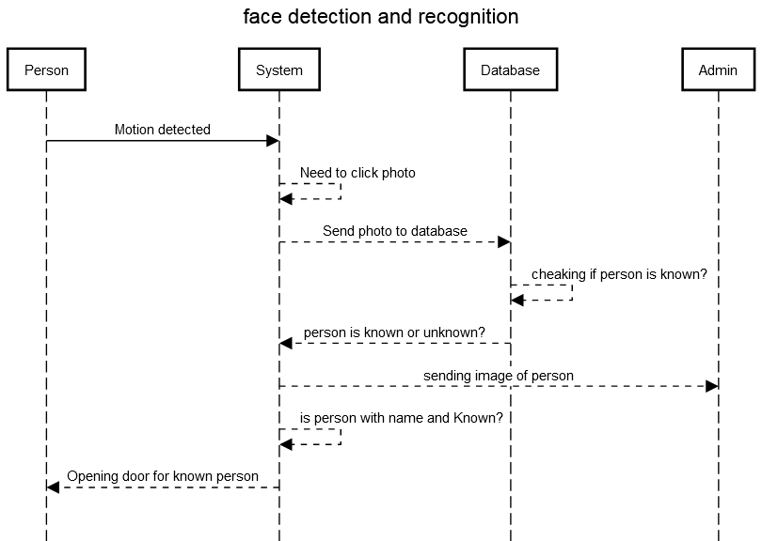
UML diagram (Sequence diagram)

Slide 12
Literature Survey
Face detection is a computer technology that determines the location and size of human face in arbitrary (digital) image. Face recognition is one of the few biometric methods that possess the merits of both high accuracy and low intrusiveness.
Face recognition technology is well advance that can applied for many commercial applications such as personal identification, security system, image-film processing, psychology, computer interaction, entertainment system, smart card, law enforcement, surveillance and so on.

Slide 13
Literature Survey
Reference [1] proposes a system, where the PIR sensor detects the movement which is captured by the camera. Then, computer vision module is applied to the captured images to detect and recognize the human faces. This message will be sent to a smartphone.
Reference [2] proposes a computer-based face detection and recognition system. The Raspberry Pi is programmed to stream live video. Faces of selected people will be detected, saved on Raspberry Pi and forwarded to selected computer.

Slide 14
Literature Survey
In reference [3] an IoT-based face detection system is proposed, where the camera attached to the Raspberry Pi will capture the image which is processed by the raspberry pi. The faces will be send to the users’ device.

Slide 15
Conclusion
The security system explained is low cost, low power consuming system.
The system can easily provide high level of security as it combines two modern technologies together that is face recognition and IoT.
These are rapidly growing technologies and scientists are still searching on it. So these have made important impact on security system development.

Slide 16
Conclusion
Remote monitoring and controlling is possible because of using IoT and Face recognition.
These technologies have made this system almost impossible to hack.

Slide 17
References
N.A. Othman, I. Aydin “A Face Recognition Method in the IoT for Security Applications in Smart Homes and Cities”
A.A. Wazwaz, Amir O. Herbawi, Mohammad J. Teeti, Sajed Y. Hmeed “Raspberry Pi and Computers-Based Face Detection and Recognition System”
Jiang Lu, Xingang Fu, Ting Zhang “A Smart System for Face Detection with Spatial Correlation Improvement in IoT Environment”

