Slide 1

Performance Analysis of Machine Learning Algorithms for Cyber Security

Slide 2
Contents
Overview
Terms Explained
Detection Layer
Classification Layer
Performance Analysis
About the Dataset
Next Steps

Slide 3
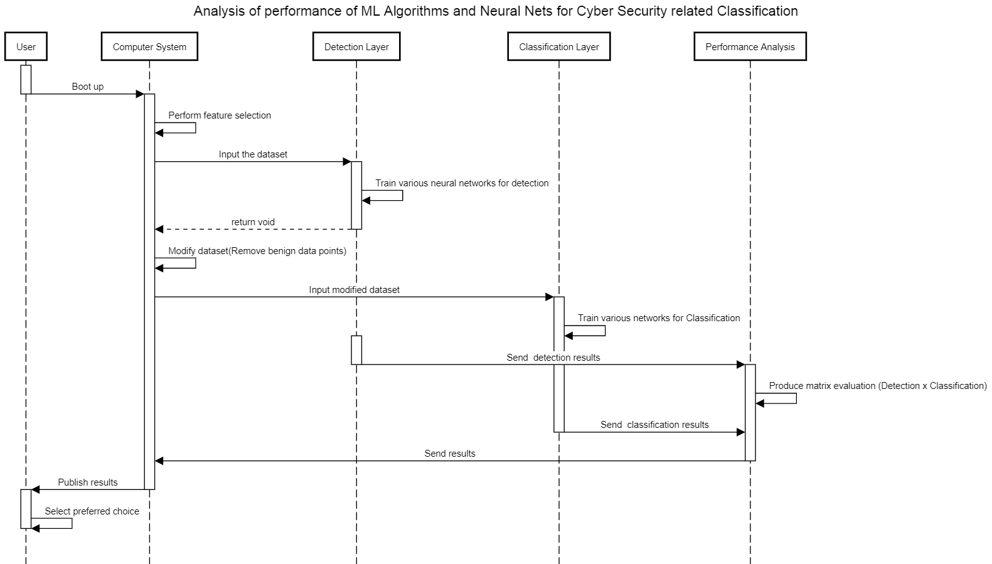
Overview
Notes:
Dscsdc sdcsd

Slide 4
Terms Explained
Detection Layer
The Detection Layer trains the classifier for detection of malicious samples in the dataset provided.
Classification Layer
The classification layer digs deeper and finds the attack category by taking dataset of only malicious samples from the Detection layer
Performance Analysis
Analysis is done by taking the inputs from prior two layers forming evaluation metrics
(Detection X Evaluation)

Slide 5
Algorithms used till now - in short
estimator.LinearClassifier
To train a linear model to classify instances into one of multiple possible classes.
We got the detection accuracy of 75% using Linear Classifier
estimator.DNNClassifier
Deep Neural network Classifier in Tensorflow
We got the detection accuracy of 98% Deep neural network

Slide 6
The
Dataset
UNSW - A network dataset
A comprehensive network based data set which can reflect modern network traffic scenarios, vast varieties of low footprint intrusions and depth structured information about the network traffic
Available from: https://www.researchgate.net/publication/287330529_UNSW-NB15_a_comprehensive_data_set_for_network_intrusion_detection_systems_UNSW-NB15_network_data_set

Slide 7
Next Steps
Generate Performance Analysis Matrix
Training Neural Nets for Classification
More Algorithms
For Detection

Slide 8
Thanks!
Any Questions?

