Slide 1
Projects 2024
Miranda M. Darby, PhD.

Slide 2
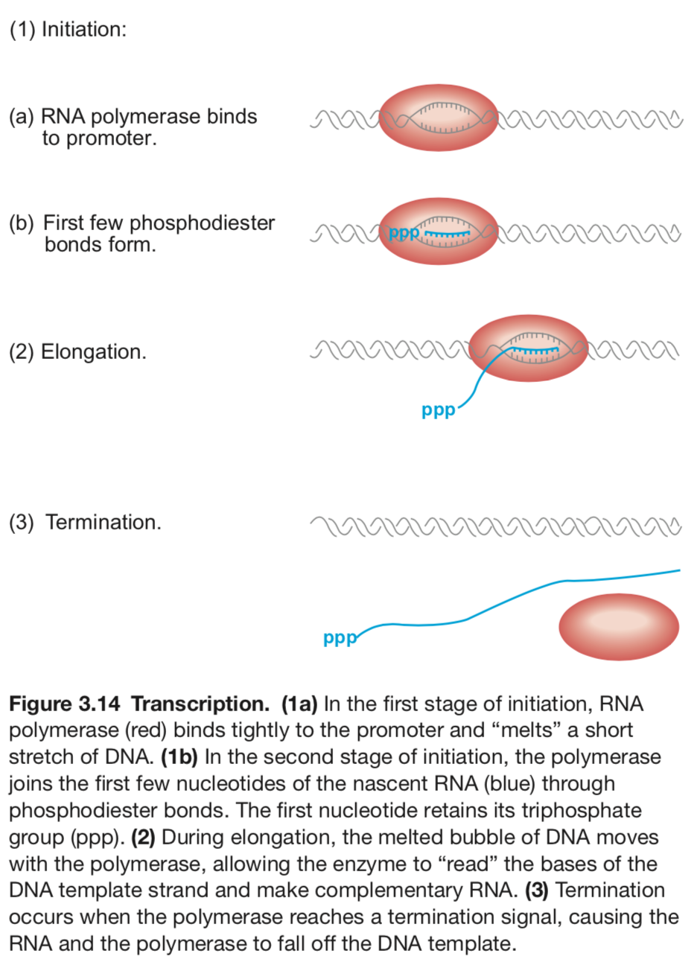
Transcription
Molecular Biology, Weaver, 5th Edition

Slide 3
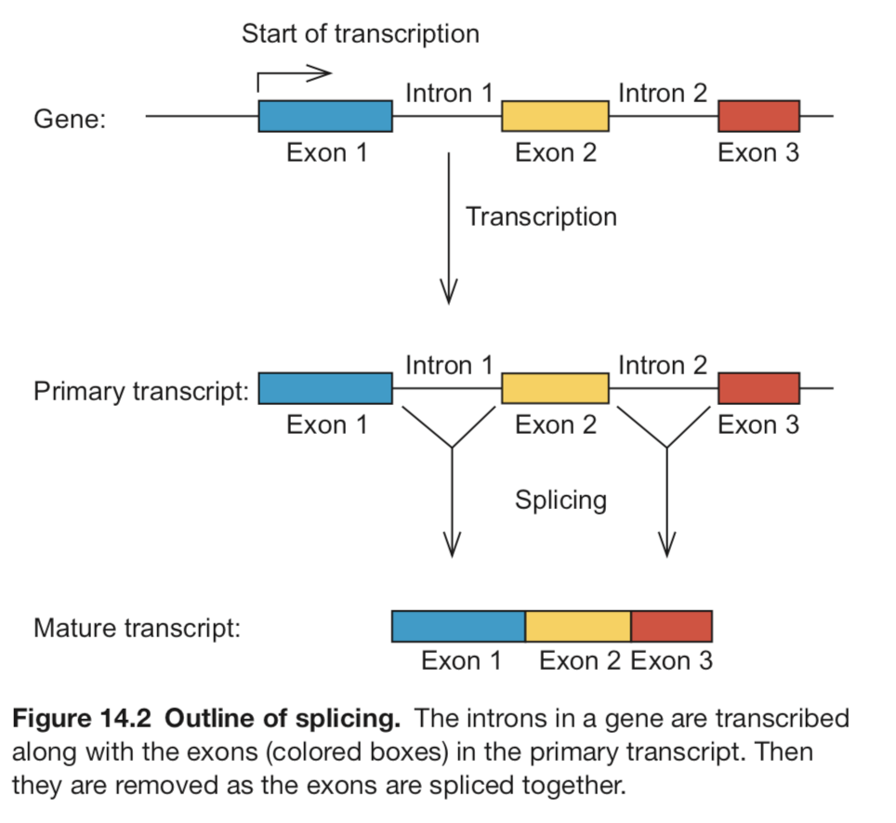
Splicing
Molecular Biology, Weaver, 5th Edition

Slide 4
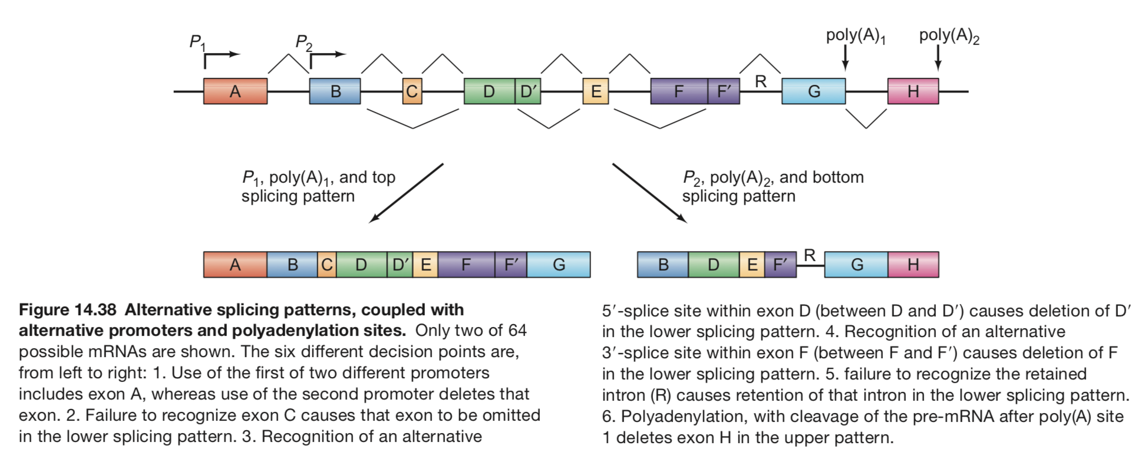
Alternative Start, Stop, Splicing

Slide 5
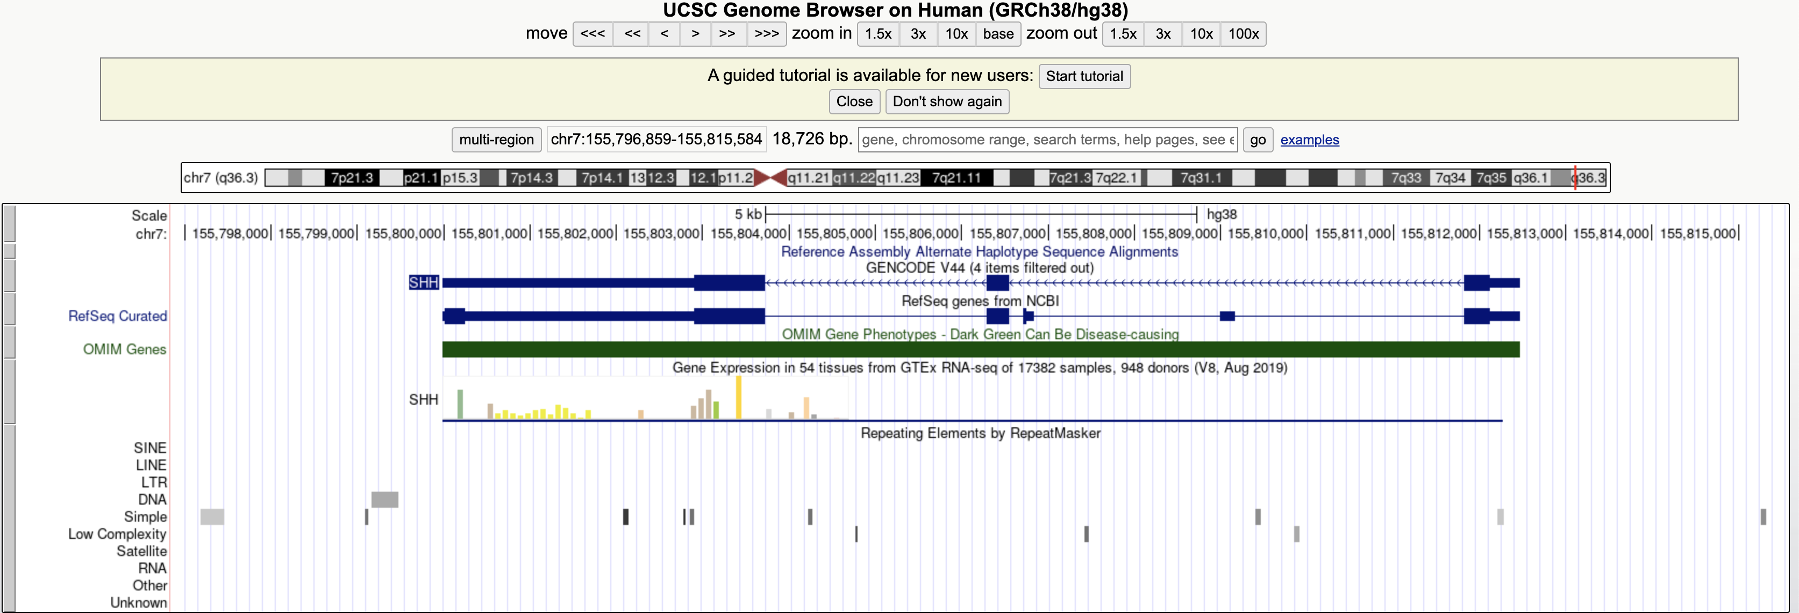
Multiple isoforms of the same gene

Slide 6
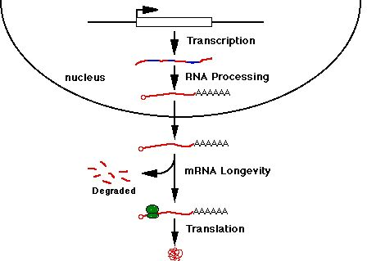
Post Transcriptional Regulation
(microRNAs)

Slide 7


EXTRACTION
FRAGMENTATION
cDNA SYNTHESIS
Purified RNA
Fragmented RNA
Double Stranded cDNA
ADAPTER LIGATION
180 Million Short Reads
Adapter Ligated Libraries
ALIGN READS TO GENOME
ATTATCACTCGAAGTATGCCCATCTATCGATGACTCGAAGTAATTGCCCTATCGATGACTCGAAGTCTCGAAACTCGAAGTCTCGAAACTCGAAGTCTCGAAGTTTTTAGTTTTTGCCCTAT
AVERAGE NUMBER OF ALIGNED READS PER SAMPLE
ORBITOFRONTAL CORTEX: 140,000,000 SINGLE-END, 59 samples
HIPPOCAMPUS: 154,000,000 X 2 PAIRED-END, 102 samples

Slide 8
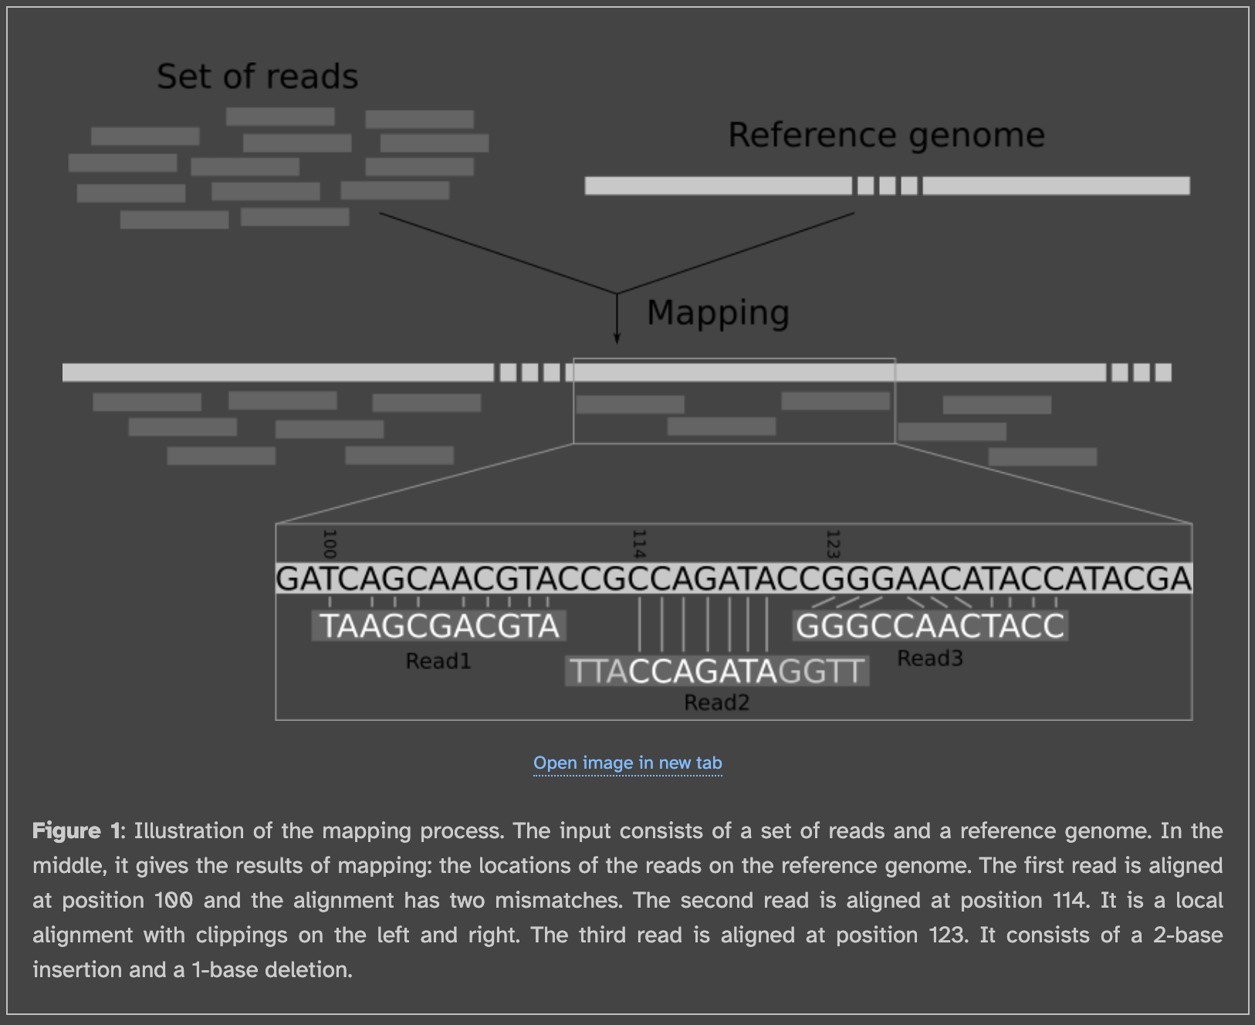
Galaxy.com

Slide 9
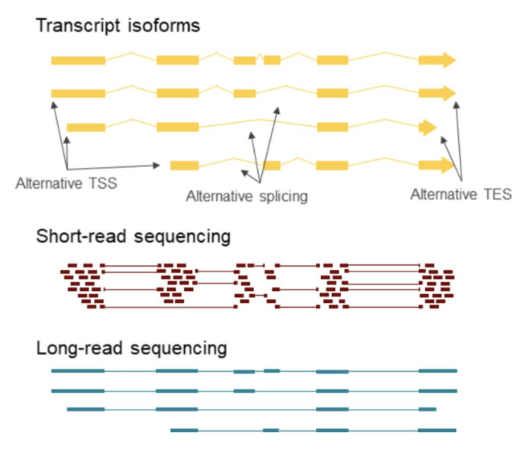

Slide 10
Repetitive elements are throughout the genome

Slide 11
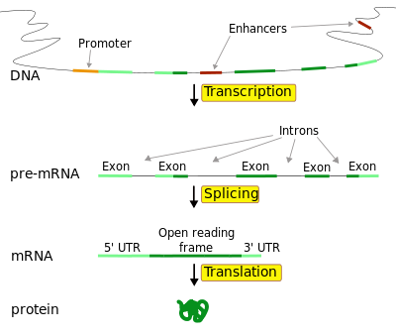
Location of Expressed Repeats
Transcribed Gene
Sense Direction:
Notes:
Exons: ~1.5 % of Genome
Introns: ~ 5% of Genome
Most of Genome is Intergenic
Majority of GWAS hits are in intergenic regions

Slide 12
Intergenic Repeat Element Expression
Intergenic
10405 expressed repeats (33% of total) are intergenic
Notes:
The majority of schizophrenia GWAS hits are far from annotated genes, so we were interested to see expression from more than 10,000 intergenic repeats. Around 1/3 of the differentially expressed repeats were in intergenic regions
Exons: ~1.5 % of Genome
Introns: ~ 5% of Genome
Most of Genome is Intergenic
Majority of GWAS hits are in intergenic regions

Slide 13
Repeat Elements Expressed in Genes
Transcribed Gene
Sense Direction:
Roughly 2/3 of expressed repeats are transcribed in the sense direction in genes
14,055 in exons
7,228 in introns
Notes:
The majority of expressed repeats were transcribed in the sense direction within exons or introns. Since introns are immediately spliced out and degraded, sequencing reads aligning to intronic repeat elements are especially interesting, since they suggest that these repeats may be retained part of the final gene product or as transcribed as independent transcript.
Exons: ~1.5 % of Genome
Introns: ~ 5% of Genome
Most of Genome is Intergenic
Majority of GWAS hits are in intergenic regions

Slide 15
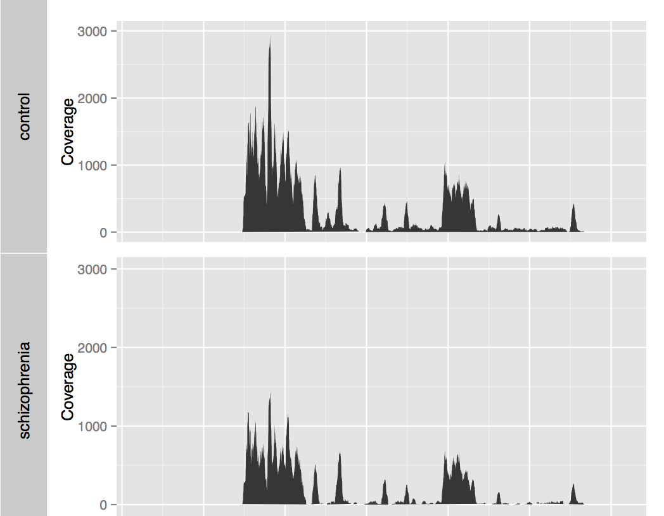
Notes:
This is an example of sequencing reads aligning to a gene. The x axis is the genomic coordinates of the gene and the y axis is the number of control or schizophrenia sequencing reads that aligned to each location. As you can see, most of the peaks of sequencing reads fall within the annotated exons of the gene, which are diagrammed below and also outlined by blue boxes, while only a few reads align to the introns.

Slide 16
Notes:
Intriguingly, there is a an additional peak corresponding to a repeat region that is retained in the control samples and absent from the schizophrenia samples. Examples such as this one may be the result of exonization of repeat elements.

Slide 17
Problem: Current Annotations are Insufficient
The DNA encoding all known proteins expressed in the human body makes up less than 3% of the genome, while the function of most of the genome remains undiscovered.
A recent analysis of 21,504 Illumina-sequenced human RNA-seq samples from the Sequence Read Archive revealed that 56,861 (18.6%) of the exon-exon junctions detected in 1,000 or more samples were not annotated.
My own previous work identified thousands of novel mRNA isoforms with the potential to code for new proteins.

Slide 18
Most Studies Rely on Annotations
Two main strategies for RNA-seq analysis
“Abundance estimation” = Map genes to annotated transcript sequences
“Alignment-based quantification” = Map to the genome and count reads that align within annotated exons
Shotgun proteomics studies are only capable of finding annotated proteins
Spectra are matched to theoretical peptides that are generated based on annotated protein sequences
Most polymorphisms identified in genetic studies as being associated with disease are between genes or in introns
Nearest gene often reported despite direct functional link

Slide 19
Tool 1: prove that a novel isoform exists
Identify that a genomic region in an intron or between genes is expressed based on RNAseq data.
Find splice junctions connecting the novel portion of the mRNA as an alternative or additional portion of an annotated mRNA.
Use publicly available data such as the ”recount” database to measure expression in a discrete region of the genome
Use publicly available splicing data such as from “snaptron” to confirm that splice junctions exist in the general population.
ALTERNATIVE RELATED EXPERIMENT
Currently we have only looked at the repetitive elements, which are known to generate new exons, but it could just as easily be true looking at the expression of any short sequences throughout the genome would help identify new isoforms.
To see whether the repetitive elements are special, compare what you find mapping the repetitive elements to what you would find selecting an equal number of equally sized genomic regions and use the above workflow to measure expression.

Slide 20
Tool(s) 2: Examine whether the novel transcript will be translated or not and what the translated protein would look like.
Translate the new mRNA to identify the novel protein sequence.
Identify whether the novel sequence will undergo nonsense mediated decay.
Identify functional protein domains in the novel and annotated protein sequences.
Report gain or loss of functional domains in the novel isoform relative to annotated proteins.
Generate structural models of the novel and annotated proteins.
GIANT CAVEAT:
This is all conjecture unless we add a step to reconstruct the full length transcript from the sequencing data.
ALTERNATE PROJECT: Add a tool that completes a full length reconstruction of the gene of interest.

Slide 21
Tool 3: Complete but may need update
Search shotgun proteomics data for peptides that match the novel portion of the protein sequence.
Report whether there is support that the protein is expressed in detectable quantities.

Slide 22
Tool 4: Complete but may need update
Perform expression analysis of the novel region of the mRNA to assess specificity of expression across tissue types and brain regions.
Perform expression analysis of the novel region of the mRNA to assess altered expression in disease.

