Slide 1
Image Classification Using CNN from Optimization Perspective
Farida Far Poor, Mohammad Mehdi Hosseini

Slide 2
Table of contents
Classification
Neural Network
Why CNN
Our Network Structure
Optimization Perspective
Experiments and Analysis

Slide 3
Classification
Classification:
Design a model
Look at many samples (providing data)
Learn features (loss minimization)
Label new unseen data
Classifier is
a model that produces labels from a set of features of a data
Image classifier:
Model
Utilize Data (images)
Train itself
Label data

Slide 4
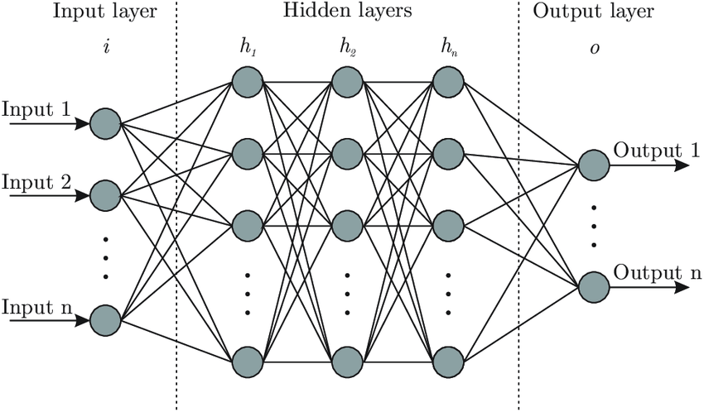
Classic Neural Network
Feed forward + Back-propagation

Slide 5
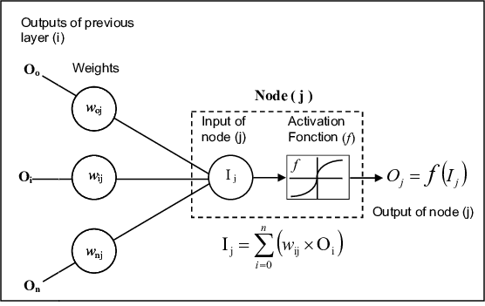
Classic Neural Network
Inside a node

Slide 6
Traditional Methods Drawbacks
Main problem in classification:
Feature extraction is
boring
time consuming
not exact
Features like: HOG, SIFT, HSV, RGB are understandable by human, not necessarily by the computers.

Slide 7
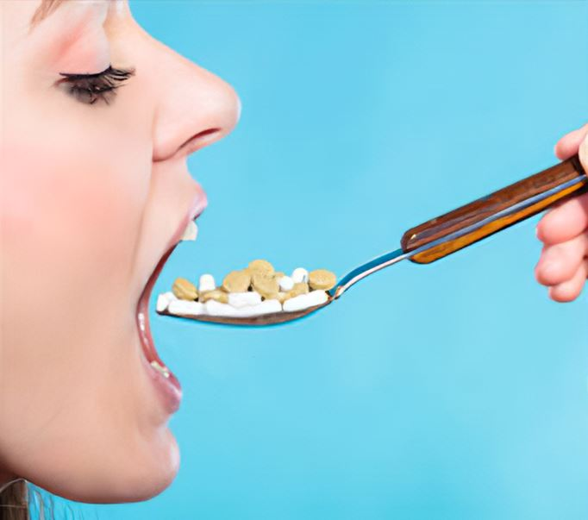
Classic Neural Network
Other assistants:
Feature selection
Feature generation
Painkillers

Slide 8

Question
Computers’ understanding is not quite the same as humans,
Isn’t it better let them do that?
Now, we know why we use convolutional neural networks

Slide 9
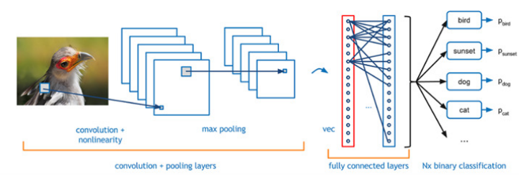
Convolutional Neural Network

Slide 10
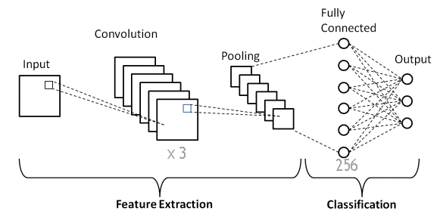
Network Structure
3 convolutional layers
1 fully connected layer

Slide 11
Optimization Perspective
Maximize Accuracy (Minimize Error)
Loss Function
Optimizer
Learning Rate
Activation function

Slide 12
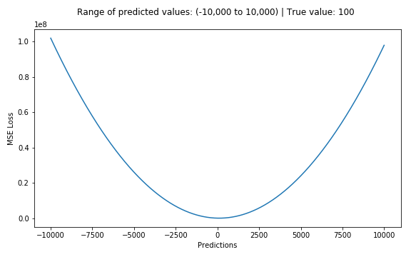
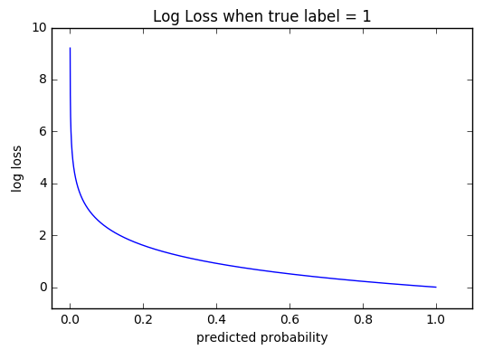
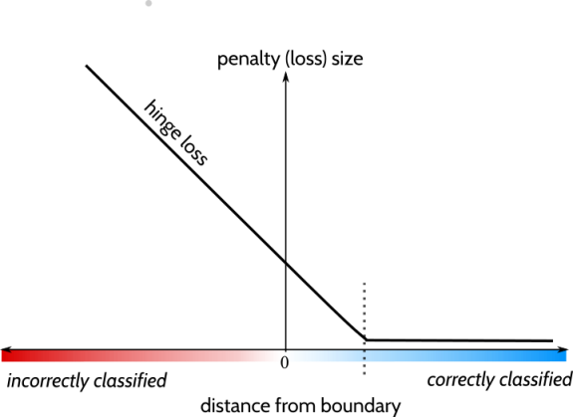
Loss Function
MSE
Cross-entropy
Hinge

Slide 13



Mean Squared Error (MSE)
General Form:
MSE (suitable for regression):
For example, in a 2D space:
w1 → slope w0 → intercept

Slide 14


Cross-Entropy
General Form:
Cross entropy (binary classifier):
Categorical Cross Entropy (Multi-class classifier):
CE is a 0/1 classifier.

Slide 15

Hinge
General Form:
Hinge (binary):
Hinge with constraint:
Hinge loss is a -1/1 classifier.

Slide 16


Optimizers
Stochastic Gradient Descent (SGD)
→ Parameters at time t
→ Learning rate
→ Gradient
Works better using batches.

Slide 17



Optimizers
ADAM
How to choose learning rate?

Slide 18
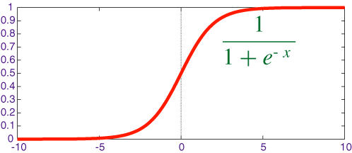
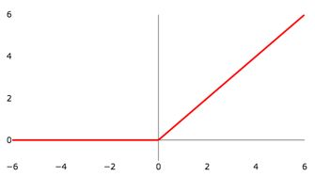
Activation Function
Sigmoid
ReLU

Slide 19
Experiments
Classification on two datasets:
Caltech 101
Cifar 100
Study network performance:
Different loss functions
Different optimizers
Different activation functions
The best learning rate

Slide 20
Baseline
Dataset: Caltech
Train-test ratio: 70-30%
Loss: categorical crossentropy
Optimizer: adam
Learning rate: 0.00003
Activation function: ReLU
Pooling: max
Batch size = 32
Epoch: 20

Slide 21
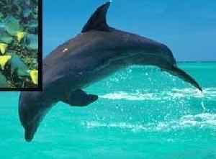

Datasets
Caltech 101
102 classes
9000 images
each class 40-800 images
different image size (200~300)
Cifar 100
100 classes
60000 images
each class 600 images
32x32

Slide 22
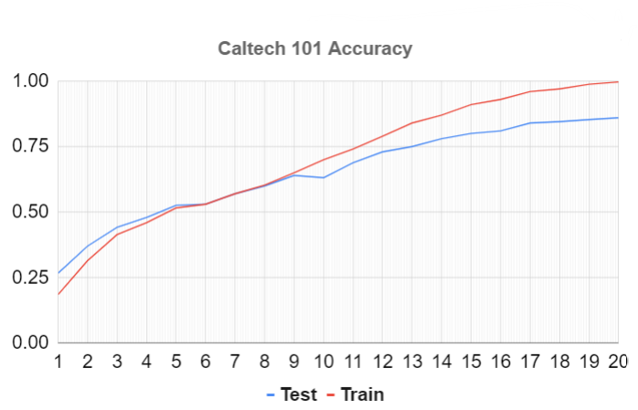
Caltech Accuracy on Model
Image Size: 256x256
Parameters ~ 15 M

Slide 23
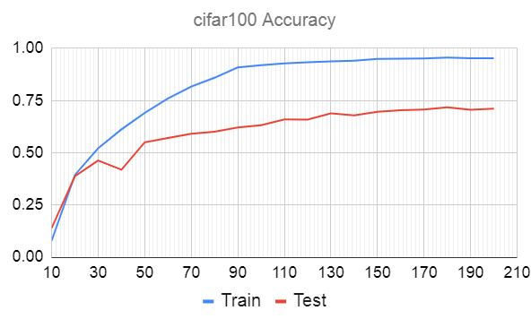
CIFAR Accuracy on Model
Image Size: 32x32
Parameters ~ 250 K

Slide 24
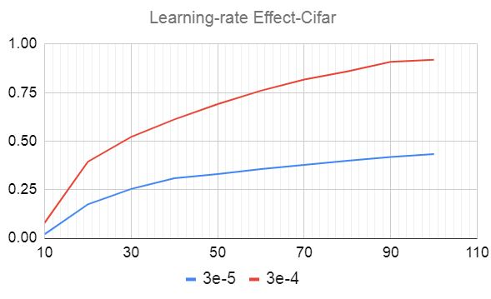
Learning Rate
Adam optimizer

Slide 25
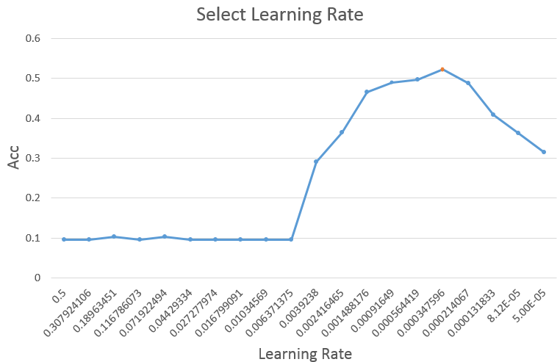
Learning Rate (Caltech)
Adam optimizer

Slide 26
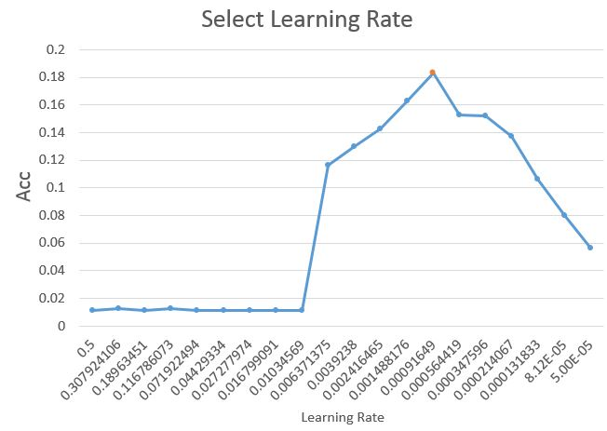
Learning Rate (Cifar)
Adam optimizer

Slide 27
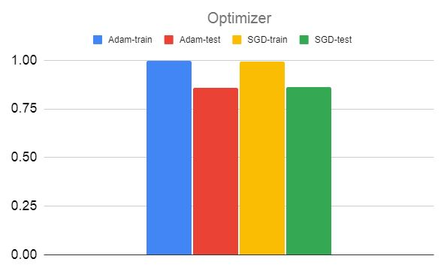
Optimizer (Caltech)
Adam vs SGD
Almost similar results

Slide 28
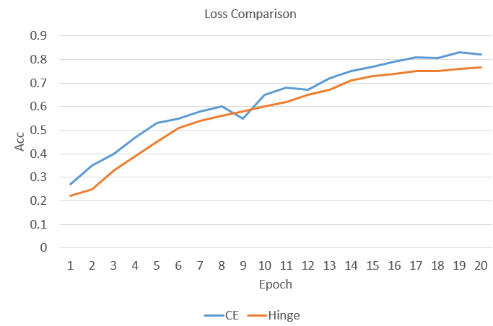
Loss Function (Caltech)
Accuracy using different loss functions

Slide 29
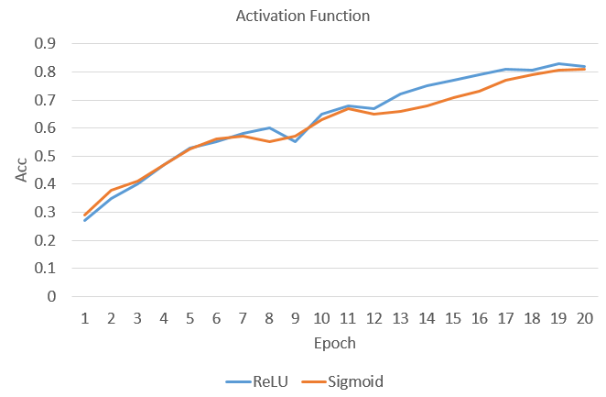
Activation Function (Caltech)
Similar results

Slide 30
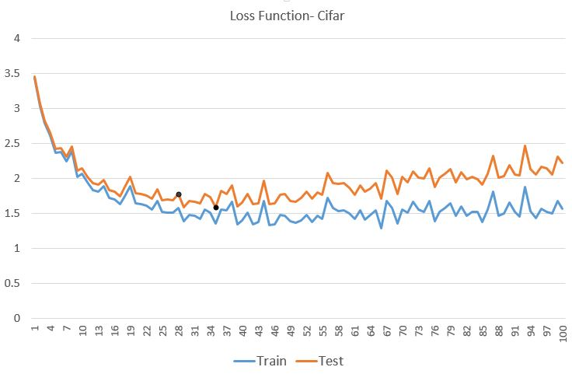
Epochs
How Many epochs?

Slide 31
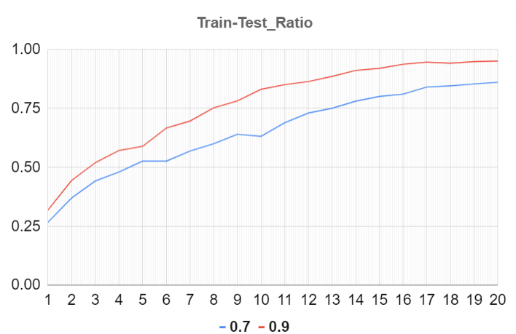
Train-Test Ratio
The more train samples, the better results
90% vs 70%

Slide 32
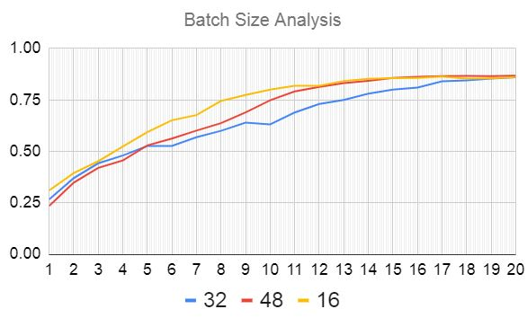
Batch Size
It’s a bit weird!

Slide 33
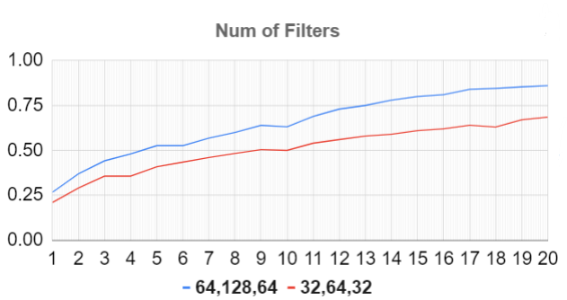
Num. of Filters
Filter | Params | Accuracy
64, 128, 64 | 15 M | 86%
32, 64, 32 | 7.5 M | 71%

Slide 34
Number of Layers
Run on:
GPU 1080X
20 epochs
 | Three Conv Layers | One Conv Layer
Parameters | 15 M | 264 M
Accuracy | 86 % | 74 %
Run Time | 2 min | 30 min

Slide 35

Question?
https://openai.com/dall-e-3

