Slide 1
ETL Project

Slide 2
Extract
Transform
Load
Extracted data from CSV files
Transformed data in jupyter notebook to fix, rename and delete columns
Loaded data into pgAdmin and then queried the data to find the different types of analysis that could be done

Slide 3
Data Sources
https://www.kaggle.com/folaraz/world-countries-and-continents-details
World Countries and Continents
https://www.kaggle.com/bitsnpieces/covid19-country-data
Covid Country Data
https://www.kaggle.com/ishivinal/covid19-useful-features-by-country
Covid Useful features
https://www.kaggle.com/gpreda/covid-world-vaccination-progress
Covid Vaccinations

Slide 4
Why this was chosen
Data from different sources
Data that can be aggregated at different levels
Data that can tell a story

Slide 5
Results
Viewed data by Continents and Countries
Viewed data by Continent population %
Viewed data by average temperature
Viewed data by health care index
etc.

Slide 6
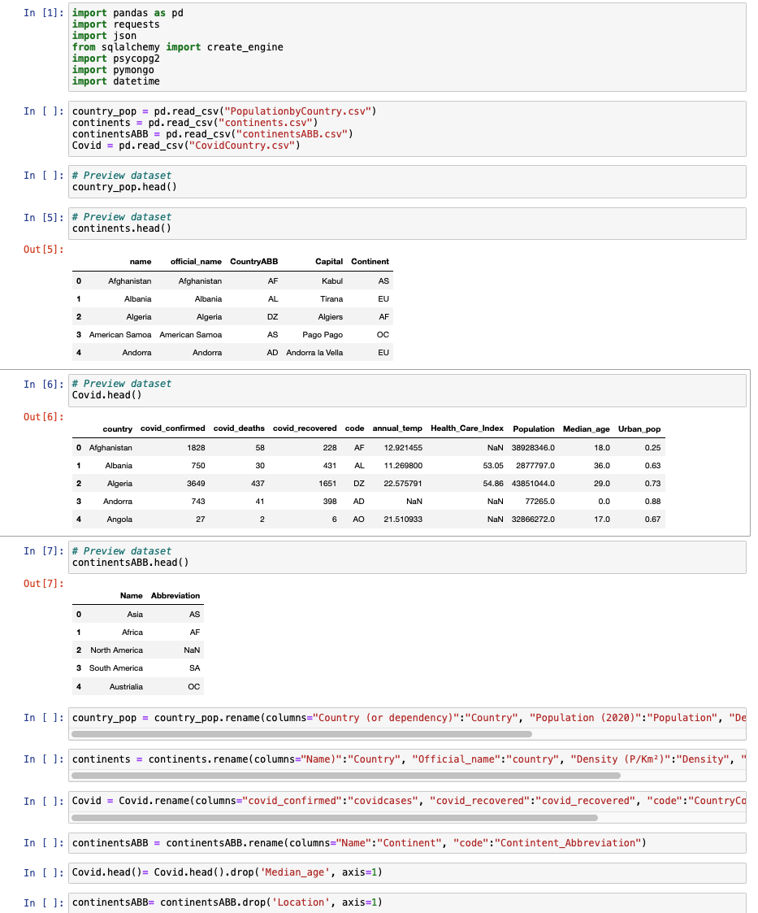
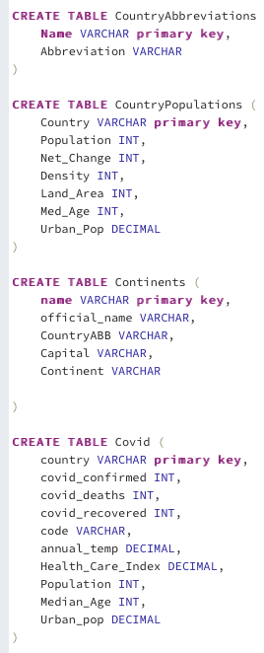

Slide 7
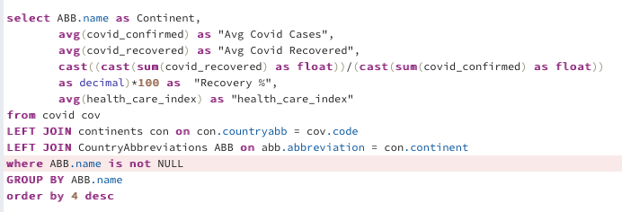
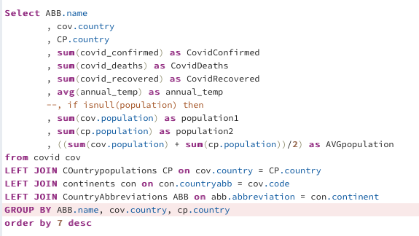
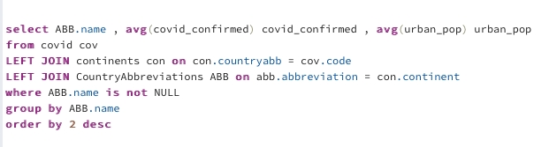

Slide 8
