Slide 1




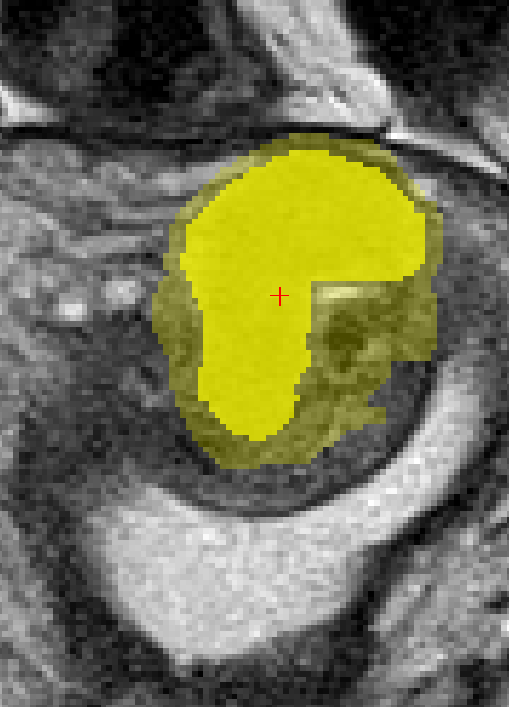

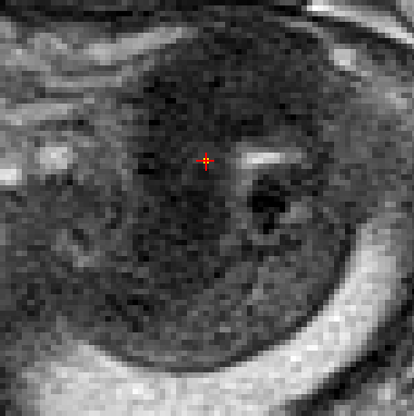
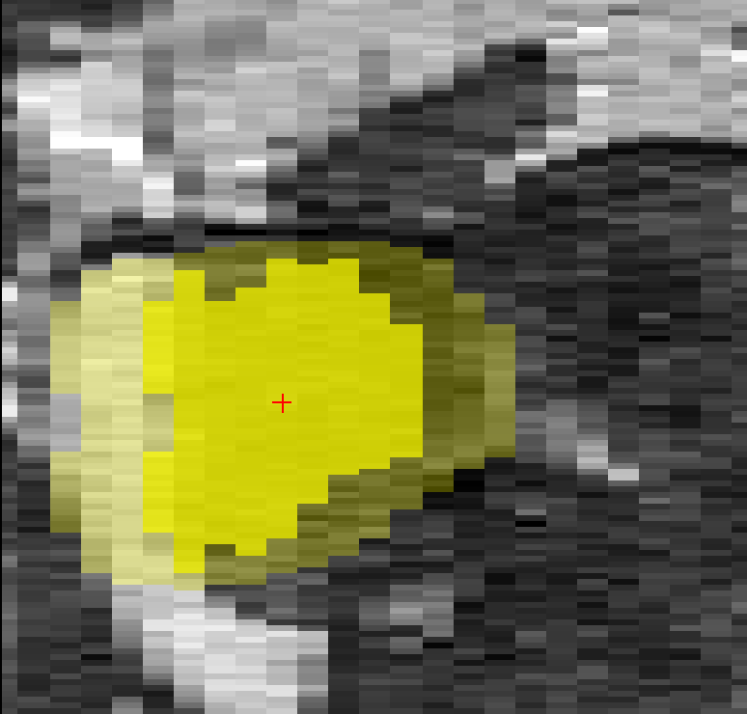
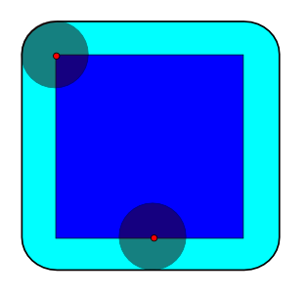
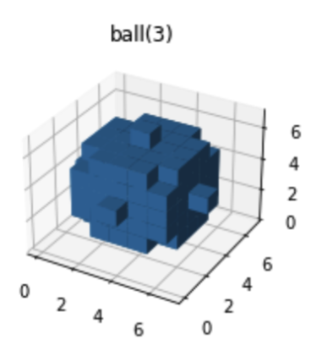
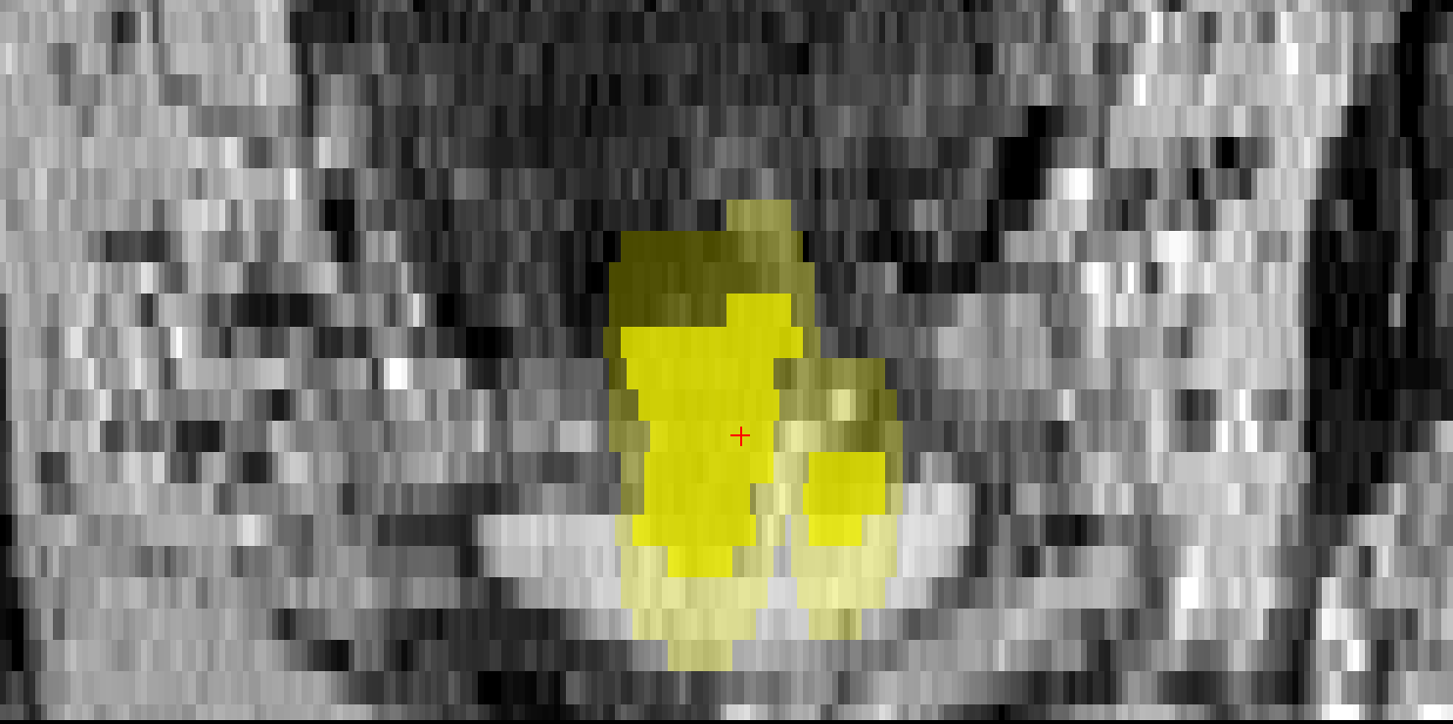
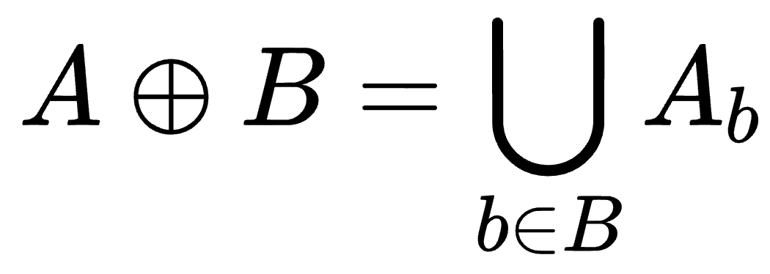
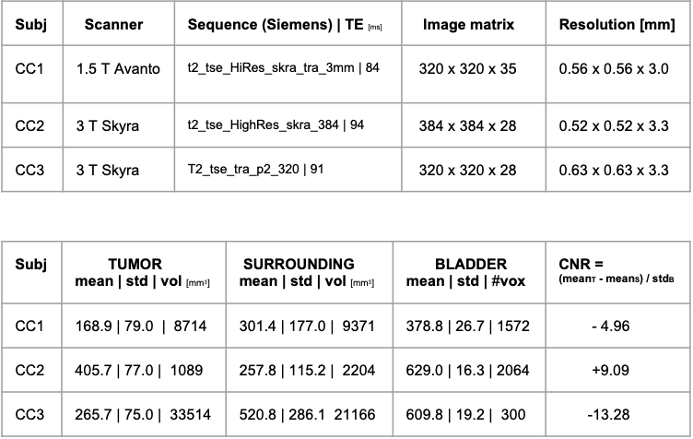
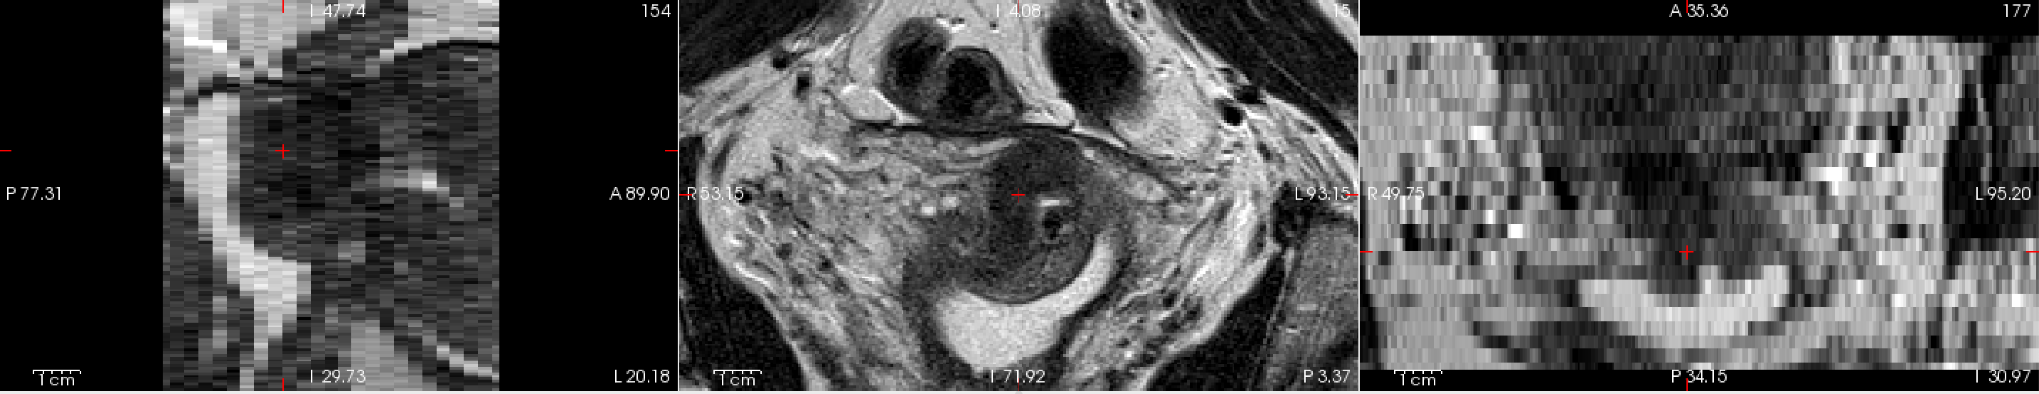

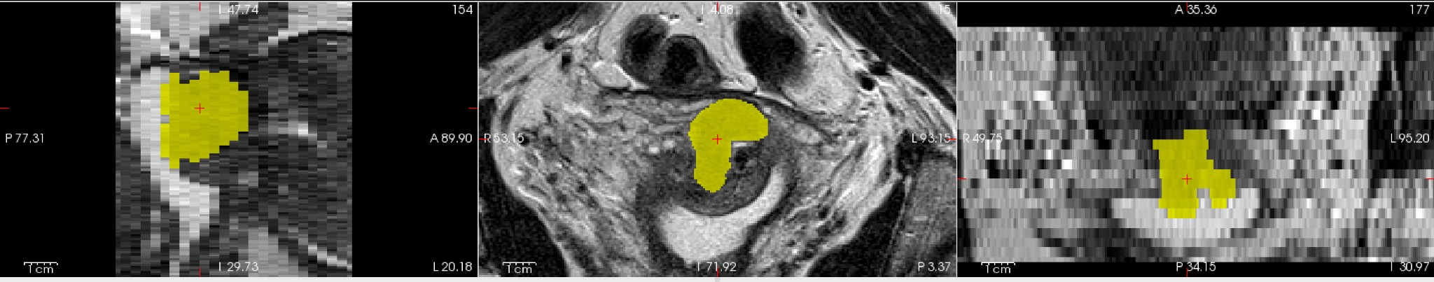
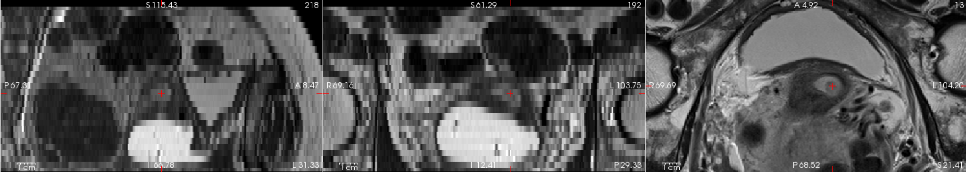
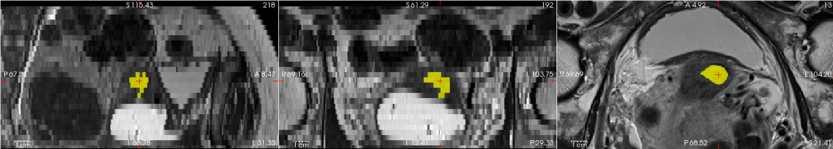
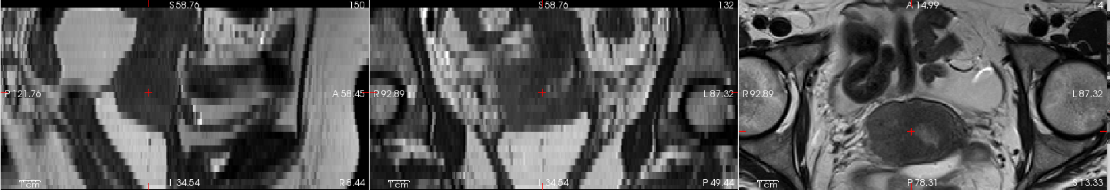
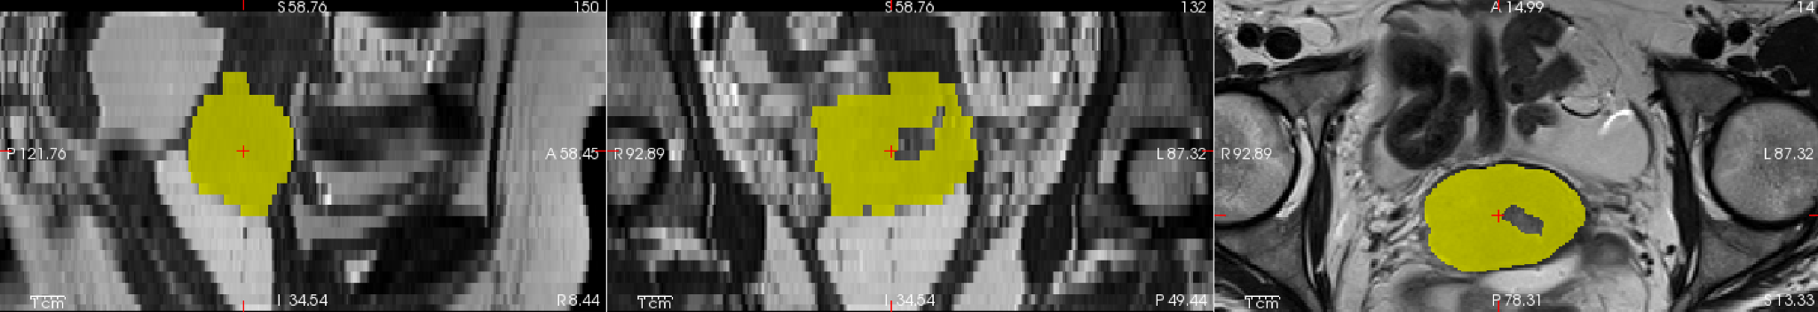
Tumor contrast-to-noise ratio in MRI
Application to image quality and segmentation
Arvid Lundervold^{1,2,3}, Marion Berge^{2,3}, Saruar Alam^{1,3}, Marek Kociński^{1,3,4}
¹ Department of Biomedicine, University of Bergen, Bergen, Norway
² Department of Health and Functioning, Western Norway University of Applied Sciences, Bergen, Norway
³ Mohn Medical Imaging and Visualization Centre, Bergen, Norway
⁴ Institute of Electronics, Lodz University of Technology, Lodz, Poland
Context & Aims
Image contrast-to-noise ratio (CNR), being a measure of image quality, is a fundamental concept in imaging and image analysis: no contrast, no discrimination; high noise level, poor ability to segment underlying image contrast.
In medical MRI, contrast and noise are influenced by a plethora of factors related to (i) tissue and patient properties, (ii) MR physics and measurement techniques, and (iii) the careful selection of MR sequences and examination procedures as performed by the MR technician.
In this study, we put CNR in the perspective of the radiographer (responsible for collecting high quality images in the clinic) and of the image segmenter - that be labeling a region of interest (ROI) by a panel of expert radiologists, or automated segmentation by a clever algorithm.
As a use-case we employ MRI recordings from a small sample of patients with cervical cancer and introduce and elaborate on the concept of contrast-to-noise ratio between tumor region and surrounding tissue.
Contrast-to-noise (Tumor / Surround)
(S_{A} - S_{B})
CNR_{A,B} =
____________
𝛔₀
Tumor
signal_{S}
A
CM
Surround
Surround array
σ₀
Surround
signal_{T}
B
SD = σ₀
Tumor region array
Bladder
Noise = SD = σ₀
Bladder
CM = center of mass
Figure 1. The concept of CNR between tumor region and surrounding tissue. Noise level the SD of urinary bladder.
CM
Signal intensity in tumor region and
surrounding tissue
(how to best define surrounding tissue?)
3D morphological dilation of ROI
Morphological dilation
Structuring element
Material & Methods
“Ground truth”
B
ball(3)
CM
(GT)
A
To implement and test our approach we employed multislice T2-w MRI of cervical cancer from three patient examinations (CC1, CC2, CC3).
The tumor ROI was segmented by a 3D-CNN model developed in another project, and to define its surrounding we used 3D morphological dilation from the scikit-image library employing a ball of a fixed radius as the structuring element.
To estimate the noise level, we manually delineated a region within the urinary bladder and calculated the mean and standard deviation of its signal intensities (see Fig. 1 & 2 for details and examples).
In the spirit of open science and reproducible research, Python jupyter notebooks and deidentified example data will be available on GitHub (https://github.com/arvidl/tumor-cnr).
3D binary
dilation
The dilation of a dark-blue square A (the ROI) by a red disk B (the structuring element), resulting in the light blue enlarged square with rounded corners.
If B has a center on its origin,
then the dilation of A by B, i.e.
can be understood as the locus
of the points covered by B
when the center of B moves
inside A [Wikipedia].
Figure 2. Surrounding tissue defined as 3D morphological dilation of tumor region with a fixed structural element.
a)
c)
25
CC1
Results
b)
CC2
The CNR between tumor and surrounding tissue calculated for each of the examinations CC1, CC2, and CC3 are given in Fig. 3. This also illustrates the large global differences in CNR and tumor volumes between patients, and, importantly, local differences in CNR between parts of the tumor and its surrounding tissue.
This observation has led us to the refined concept of “radial CNR”, being a direction-sensitive image representation of CNR between tumor and tumor environment (Fig. 4).
CC3
Figure 3. (a) Description of MR scanner and field strength,
pulse sequence (T2-w turbo spin echo), image matrix, and
the various spatial resolutions in the three MR exams.
(b) Summary statistics of the signal intensities and volumes within the entire 3D tumor region (the ROI in yellow), within the surrounding tissue, and within the urinary bladder for each of the subjects CC1, CC2, CC3. Last column
shows estimated CNR between tumor and surrounding tissues for each of the subjects. A CNR > 0 indicate that the tumor has an higher mean signal intensity (i.e. “hyperintense”) compared to its surrounding tissue. (c) Selected orthogonal slices from the tumor region and surroundings from each of the three subjects. This illustrates the large variation in tumor size and in global and local contrast between tumor and surrounding tissues in our sample. Such global and local CNR differences might also reflect inter-rater variation in tumor labeling (i.e. poor Dice coefficient) and discrepancy between “ground truth” and automated segmentation.
Discussion
Our CNR approach and its tentative generalisation to 3D and to “radial CNR” might have interesting applications to the selection of “best” MRI sequences and parameter settings (in terms of CNR) for a given tumor examination. It might also be useful for the assessment and better understanding of inter and intra-observer (local) variability in tumor delineation - in addition to the commonly used Dice coefficient being a global measure.
Our CNR approach might also assist in uncertainty / confidence assessment and support “explainable AI” in (semi-)automated tumor segmentation. Radial CNR might be incorporated in segmentation pipelines such as finding/adjusting ROI contours using stochastic optimization driven by energy terms as described in the legend of Fig. 4
Finally, we plan to apply and test our CNR approach to multiparametric MRI of brain tumors, both local data and data from the BRATS brain tumor segmentation challenge.
a)
b)
Radial CNR (voxel rays)
r₁
Tumor Surround
r₁
CM
…...
Tumor boundary
CM
r_{i}
r_{i}
…...
c)
r_{n}
Tumor Surround
r₁
…...
r_{i}
…...
r_{n}
0 100%
Fig 4. (a) “Radial CNR” as 1-dimensional local refinement of CNR based on contrast-to-noise along radii originating from the tumor center of mass (CM) with end point at the boundary of the surrounding rim defined by a 3D morphological dilation. (b) One-dimensional radial images representing contrast-to-noise and directional signal intensity gradients between tumor region and surrounding tissue. (c) Length-normalized radial CNR, enabling directional signal intensity information being represented as an n x 100 rectangular gray-level image. Planar radii in (a) can be generalized to rays in 3D. This representation can also be incorporated into a segmentation algorithm driven by directional signal intensity gradients (edge detectors) and a smoothness constraint based on length differences between neighbouring radii ad modum Friedman & Adam (Automatic ventricular cavity boundary detection from sequential ultrasound images using simulated annealing. IEEE-TMI 1989;8(4):344-353); see also [2].
References
[1] Friedman N & Adam D. Automatic ventricular cavity boundary detection from sequential ultrasound images using simulated annealing. IEEE-TMI 1989; 8:344-53 https://ieeexplore.ieee.org/document/41487 [2] Storvik G. A Bayesian approach to dynamic contours through stochastic sampling and simulated annealing. IEEE-PAMI 1994;16(10):976-986) [3] GitHub repository: https://github.com/arvidl/tumor-cnr [4] In Vivo Imaging and Physiological Modelling: https://github.com/computational-medicine/BMED360-2021/blob/main/Lab1-MRI/03-mri-snr-cnr.ipynb
Acknowledgment
Supported by the Trond Mohn Research Foundation (Grant BFS2018TMT07). We thank Prof. Ingfrid Haldorsen for access to the example data, PhD Erlend Hodneland and MSc Sahtiesh Kaliyugarasan for providing CNN tumor segmentation masks and useful input.
MMIV Conference, December 9-10, 2021

