Slide 1
Housing Market Analysis
Group Members
Rose Kimondo
Cynthia Atieno
Richard Macharia
Cynthia Njambi

Slide 2
Overview
In the King County (KC) housing market, multiple dynamics play a major role in shaping the prosperity of Real Estate companies.
This project aims to help a Real Estate Development Company by providing a comprehensive analysis that focuses on the key factors that influence housing prices.
By leveraging insights gained from the data from the King County House Sales dataset, we hope to advise the Real Estate Development Company on the most important characteristics/features to focus on when constructing homes, in order to generate more income and be as profitable as possible.

Slide 3
Business Problem
The Real Estate Development Company is venturing into the King County Housing market and would like to develop a sales strategy that makes it profitable by targeting houses that have the highest prices in the market.

Slide 4
Data Understanding
The King County House Sales dataset is central to this project, encompassing features pertinent to house sales in King County.
The dataset is considered comprehensive for the project's aims, although additional features may be necessary to fully explain the relationships involved.
However, the dataset has certain limitations that could impact the project's outcomes. Firstly, the data is not normally distributed, which might affect the model's reliability, especially at the extremes of the price distribution. To mitigate this issue, the data has been scaled. Additionally, some columns in the dataset contain missing values, which has been addressed to maintain data integrity and ensure accurate analysis.

Slide 5
Data Preparation
Based on the correlation coefficients with price from the KC Housing Data dataset, the two features that have strong relationships with housing prices are:
Sqft_living – (Footage of the home) :- Sqft_living has a very strong positive correlation with price (0.7). This indicates that as the square footage of the home increases, its price increases.
Grade - Overall grade given to the housing unit, based on King County grading system :- Grade has a strong positive correlation with price (0.67). This indicates that as the grade of the home increases, its price increases.

Slide 6
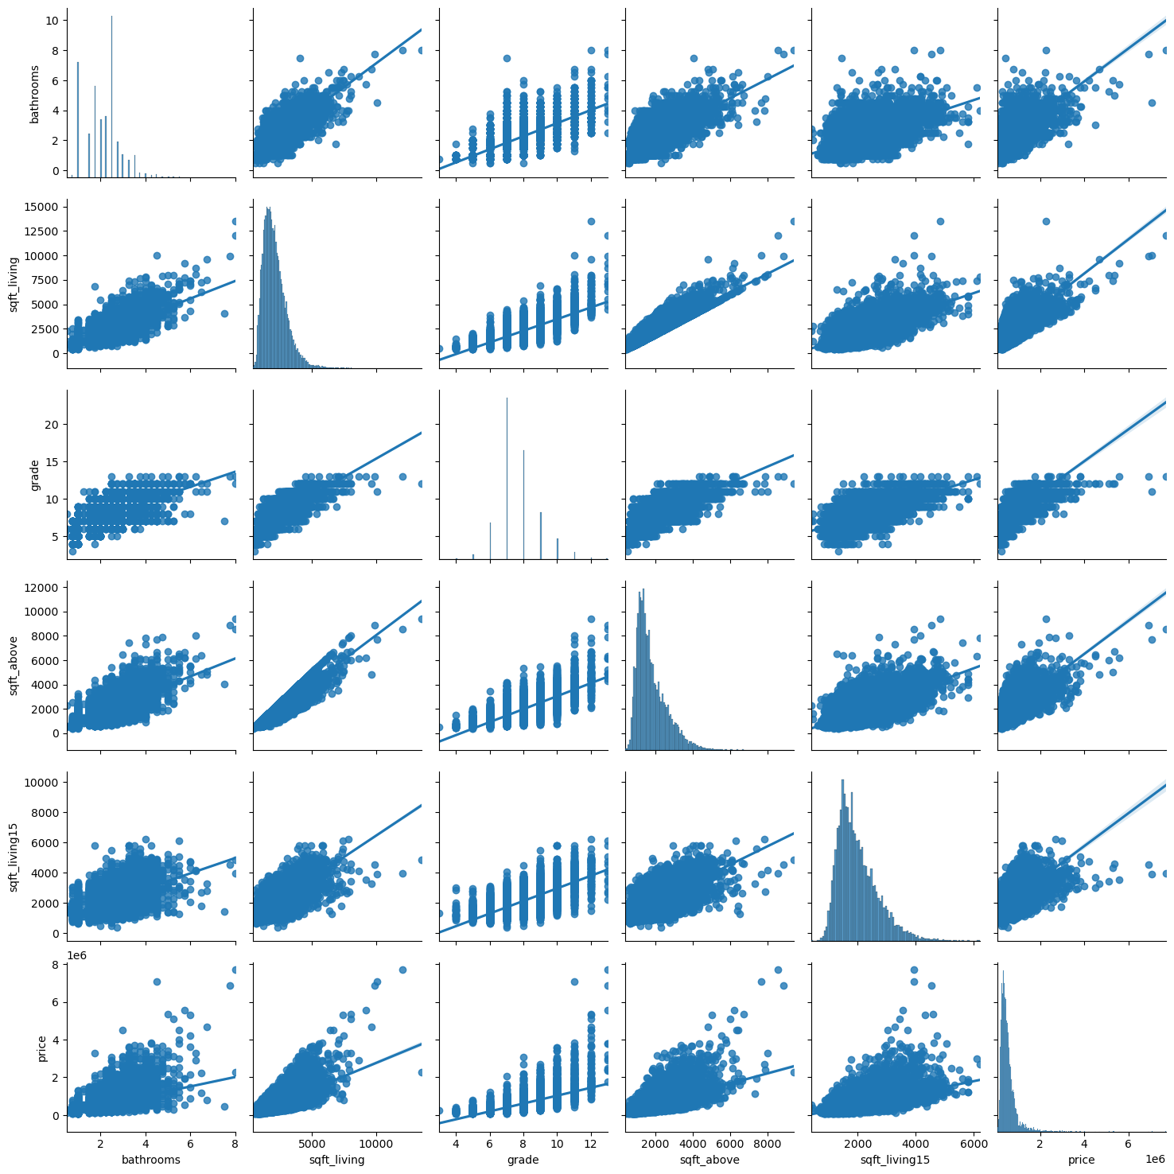
Correlations for the selected features

Slide 7
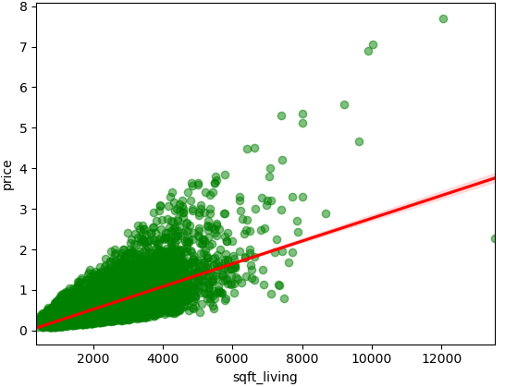
Data Analysis
Relationship between sqft_living and price
Trend Observation:
In the scatter plot with a regression line of square footage of the home (sqft_living) against price, you can observe a positive trend. As the average square footage of the home increases, the price of the house tends to increase as well.
Implication:
This suggests that houses with a higher square footage have higher prices in the King County housing market. They are priced higher.

Slide 8
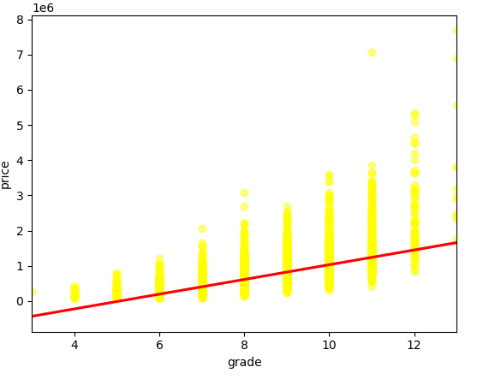
Data Analysis
Relationship between grade and price
Trend Observation:
In the scatter plot with a regression line of grade (overall grade given to the housing unit, based on King County grading system) against price, you can observe a positive trend. As the grade given to the home increases, the price of the house tends to increase as well.
Implication:
This suggests that houses with a higher grade have higher prices in the King County housing market. They are priced higher.

Slide 9
Results
Based on the regression results the features with strong relationships to sale prices are: - Sqft_living
- Grade
Their coefficients are:
Sqft_living: For each additional square foot of living space, the house prices increases by approximately 197,023
Grade: For each increase in grade, the house price increases by approximately 107, 900

Slide 10
Conclusion
Square Footage of Living Space (sqft_living): The coefficient suggests that for each additional square foot of living space, house prices are estimated to increase by $197.0231, holding other variables constant. This indicates that larger houses tend to command higher price
Grade of the House (grade): A higher grade is associated with higher house prices, with each unit increase in grade estimated to increase house prices by $107,900, holding other variables constant. Grades typically reflect the quality and features of the house, influencing buyer preferences and willingness to pay.

Slide 11
Conclusion
The overall model has an R-squared value of 0.539, indicating that approximately 53.9% of the variance in house prices can be explained by the predictors (sqft_living, grade, bathrooms) included in the model. This suggests that while these predictors are significant, there are other factors not captured by the model that also influence house prices.
The F-statistic is very high (5895) with a low p-value (0.00), indicating that the model is statistically significant. This implies that at least one of the predictors is significantly related to house prices, reinforcing the reliability of the model's predictions.

Slide 12
Recommendations
Target Larger Houses:
Since the model indicates that house price increases with the square footage of living space, the company should focus on acquiring or developing larger houses to maximize potential sales prices.
Focus on High-Grade Houses:
Houses with higher grades are significantly associated with higher prices. The company should aim to develop or invest in properties with higher quality finishes, better construction, and more desirable features.
Use Predictive Analytics for Targeted Marketing:
By using the model to predict high-priced houses, the company can create targeted marketing strategies to attract high-end buyers. This can involve highlighting the features that are most strongly associated with higher prices, such as larger living spaces and higher grades.

