Slide 1
TECHNICAL WHITE PAPER
Aperture
Hybrid Digital Twin for Utility-Scale Wind Turbines
Matthew Mitchell · MMKPC Studios · April 2026
MMKPC Studios · Independent Research

Slide 2
MOTIVATION
The Problem: Wind O&M Cost
25–30%
Key Failure Drivers
Gearbox failures
Multi-week downtime; crane-intensive replacement costing $200K–$500K per event.
of wind LCOE is Operations & Maintenance
Pitch actuator faults
Asymmetric blade loading accelerates structural fatigue; difficult to detect via vibration alone.
Unplanned failures account for a disproportionate share
due to heavy-lift crane mobilization and extended downtime.
Icing-driven underperformance
Power losses of 10–20% during winter months; SCADA-detectable via power/wind deviation.
SCADA-based condition monitoring has been shown to detect anomalies weeks to months before mechanical failure, enabling planned rather than emergency maintenance campaigns.
Source: Tautz-Weinert & Watson 2017 (IET Renewable Power Generation)
© 2026 Matthew Mitchell · MMKPC Studios

Slide 3
POSITIONING
The Gap: Existing Platforms vs. Aperture
Platform
Physics Fidelity
Deployment
License
Browser-Native?
OpenFAST (NREL)
High — multi-physics aeroelastic
Local CLI / HPC
Apache 2.0
No — requires Python/Fortran stack
Azure Digital Twins
Low — IoT state graph
Azure cloud (managed)
Commercial SaaS
Partial — DTDL + portal only
NVIDIA Omniverse
High — USD physics + GPU
Workstation / cloud
Commercial license
No — native client required
Academic DTs
Varies (often high)
Not deployable (research code)
Mixed / none
No — custom infrastructure
Aperture (this work)
Hybrid physics + ML
Static file host / GitHub Pages
Open (MIT)
Yes — zero dependency SPA
Source: OpenTwins (Robles et al. 2023), Azure Digital Twins, NVIDIA Omniverse, OpenFAST
© 2026 Matthew Mitchell · MMKPC Studios

Slide 4
THESIS
Central Thesis
"A portable, browser-deployable hybrid physics/ML digital twin that runs against open SCADA data can exercise every pillar of digital twin engineering practice — fundamentals, ML surrogates, real-time simulation, and integrated operator-facing applications — while remaining honest about its fidelity limits relative to production-grade platforms."
DOMAIN 1
DOMAIN 2
DOMAIN 3
DOMAIN 4
Digital Twin
Foundations
ML for Modeling
& Simulation
Real-Time
Simulation
Integrated
Application
Four subject areas · One deployable artifact
© 2026 Matthew Mitchell · MMKPC Studios

Slide 5
ARCHITECTURE
9-Layer Reference Architecture
1
Physical Asset
7
3D Scene
Senvion MM92 turbine profile + sensor schema
Three.js procedural nacelle · fault tint
Ingest Gateway
7b
Dashboard
2
KPI panels · time-series charts · trend
Synthetic SCADA replay · Kelmarsh signal schema
renders
7c
Annunciator
3
State Store
DCS-style alarm rows · severity levels
In-memory typed SCADA record (10-min step)
8
Actuator
Feature Builder
Pitch · yaw · shutdown · fault-inject cmds
4
Lag features · rolling stats · residuals
9
Operator Interface
Command surface · ack · scenario select
5
Inference Engine
LR power · KNN gearbox · OCT classifier · anomaly
6
Simulation Engine
Baseline · Optimistic · Stress scenario branches
Compute layer
Feedback layer
© 2026 Matthew Mitchell · MMKPC Studios

Slide 6
DATA
Real SCADA: Kelmarsh Wind Farm
FARM PROFILE
SIGNAL SCHEMA (~110 VARIABLES)
Turbines:
6 × Senvion MM92
Wind speed (avg / std / min / max)
Rated Power:
2 MW per turbine
Active power output (kW)
Hub Height:
80 m
Rotor speed (RPM)
Rotor Diameter:
92 m
Blade pitch angles A / B / C (°)
Location:
Kelmarsh, Northamptonshire, UK
Nacelle yaw position (°)
Dataset Span:
2016 – 2021 (5.5 years)
Gearbox oil temperature (°C)
Resolution:
10-minute mean / std / min / max
Gearbox bearing temperature (°C)
Training Split:
2016-05-03 → 2016-10-20
Generator bearing temperatures — DE / NDE (°C)
Test Split:
2016-11-26 → 2016-12-31
Nacelle temperature (°C)
License:
CC-BY-4.0 (Zenodo DOI: 10.5281/zenodo.5841833)
Grid meter — active / reactive power
Operational status / event codes
Source: Plumley 2022/2023 — Zenodo DOI 10.5281/zenodo.5841833
© 2026 Matthew Mitchell · MMKPC Studios

Slide 7
MACHINE LEARNING
ML Pipeline — Four Models
A
Power Curve Surrogate
B
Gearbox Thermal Forecast
Polynomial Linear Regression
K-Nearest Neighbors (10-step ahead)
In: v, v², v³, ambient temperature T
In: Gearbox temp (t−3…t), rotor RPM, ambient temp, power
Out: Active power P (kW)
Out: Gearbox oil temp at t+10 (°C)
Physical law: cubic wind–power relationship in partial-load region. Walk-forward validation.
KNN: non-parametric, low-dim feature space, dense training corpus. No distributional assumptions.
Rasheed et al. 2020
Garg et al. 2022
C
Operational State Classifier
D
Anomaly Detector
Depth-2 Rule Tree (OCT-style)
Multivariate Z-Score (tanh-scaled)
In: Wind speed, anomaly score, pitch angle, rotor RPM, power
In: Power, gearbox temp, bearing temps, pitch, yaw residuals
Out: State: Running · De-Rated · Stopped
Out: Anomaly score ∈ [0, 1]
Globally interpretable rules. Inspired by Bertsimas & Dunn OCT (2017). Pure-JS implementation.
Normal-behaviour model pattern. Evaluated vs. 5% synthetic fault injection. AUROC / AUPRC primary metrics.
Bertsimas & Dunn 2017
Schlechtingen & Santos 2011
© 2026 Matthew Mitchell · MMKPC Studios

Slide 8
RESULTS
Evaluation Results — Headline Metrics
Power Curve
Gearbox Forecast
State Classifier
Anomaly Detector
R² = 0.976
RMSE 3.36 °C
Acc 92.4%
AUROC 0.860
RMSE 88.63 kW · MAE 62.42 kW · MAPE 11.54%
MAE 2.55 °C · 10-step KNN ahead
Macro-F1 58.4% · 3-class (imbalanced)
AUPRC 0.517 · 5% fault injection
INFERENCE LATENCY
Median 0.869 ms · p95 0.970 ms → Soft-real-time headroom for 10-minute SCADA cycle
Source: Kelmarsh SCADA — Zenodo 10.5281/zenodo.5841833, Walk-forward evaluation protocol — Hyndman & Athanasopoulos 2021
© 2026 Matthew Mitchell · MMKPC Studios

Slide 9
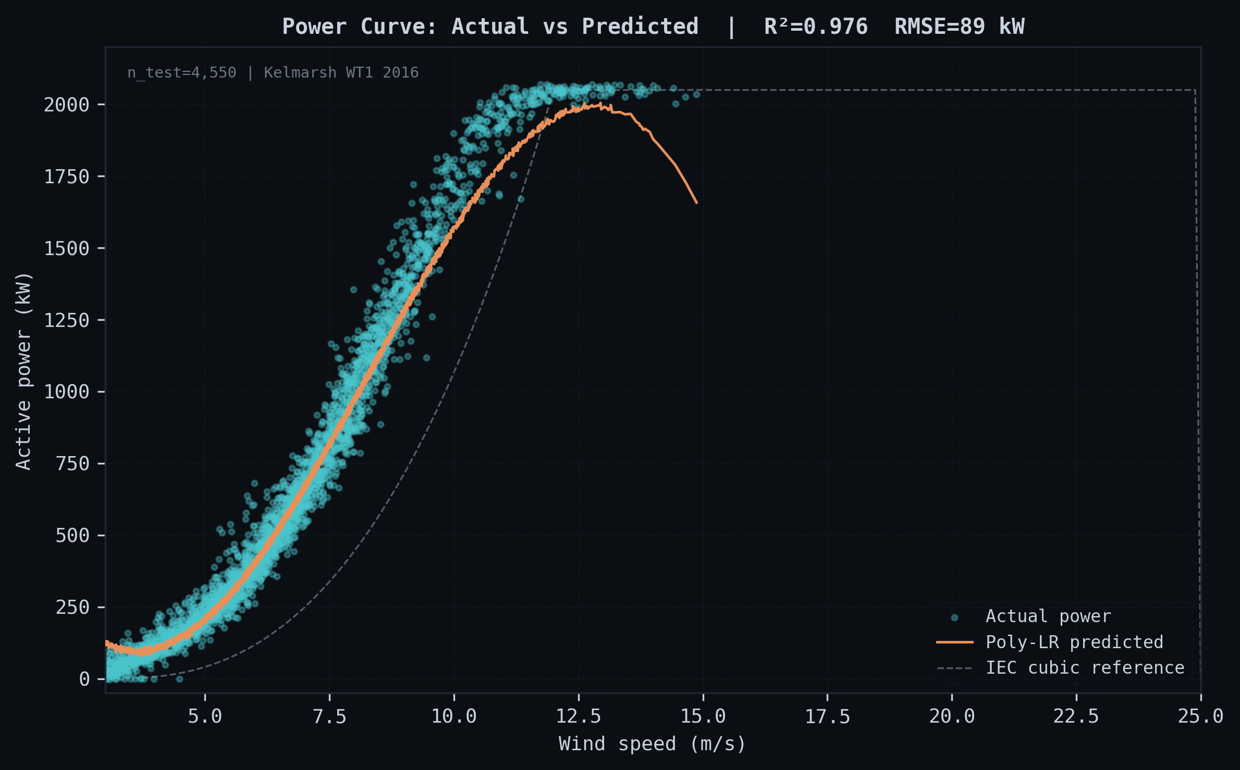
RESULTS · MODEL A
Power Curve — Linear Regression Surrogate
KEY FINDINGS
R² = 0.976
Polynomial features [v, v², v³, T] capture the cubic partial-load regime with high fidelity.
RMSE 88.63 kW
Residuals concentrate near cut-in and rated-power transition; largest errors under turbulent inflow.
Walk-forward protocol
Chronologically ordered train/test split (no look-ahead leakage). Train: May–Oct 2016; Test: Nov–Dec 2016.
Caveats
Wake effects, yaw misalignment, and icing events inflate residuals at the extremes — not captured by the polynomial surrogate.
Source: Kelmarsh WT1 SCADA 2016 — Zenodo 5841834
© 2026 Matthew Mitchell · MMKPC Studios

Slide 10
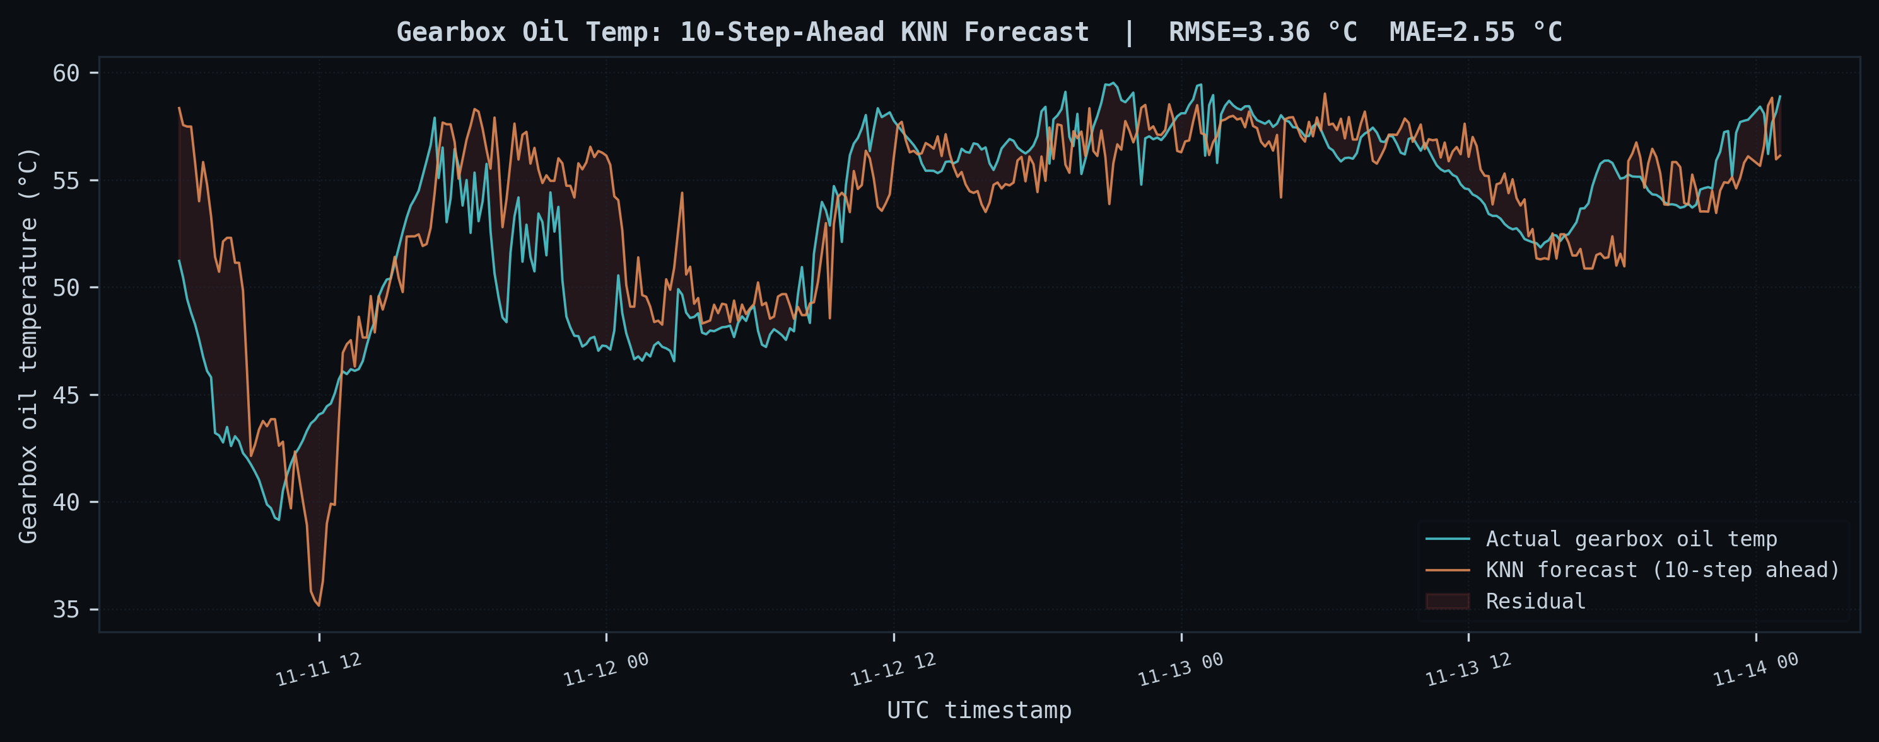
RESULTS · MODEL B
Gearbox Thermal Forecast — KNN 10-Step Ahead
KEY FINDINGS
RMSE 3.36 °C
KNN 10-step ahead forecast with feature vector: gearbox temp (t−3…t), rotor RPM, ambient temp, power.
MAE 2.55 °C
Median absolute deviation well within the 5 °C early-warning threshold used in field condition monitoring.
Non-parametric choice
KNN makes no distributional assumptions and generalizes well when the training corpus is dense relative to the query region.
Use in DT
Forecast feeds the annunciator threshold check. Sustained exceedance of predicted baseline triggers ALARM state.
Source: Kelmarsh WT1 SCADA 2016 — Zenodo 5841834, Garg et al. 2022 — AI surrogates for DTs
© 2026 Matthew Mitchell · MMKPC Studios

Slide 11
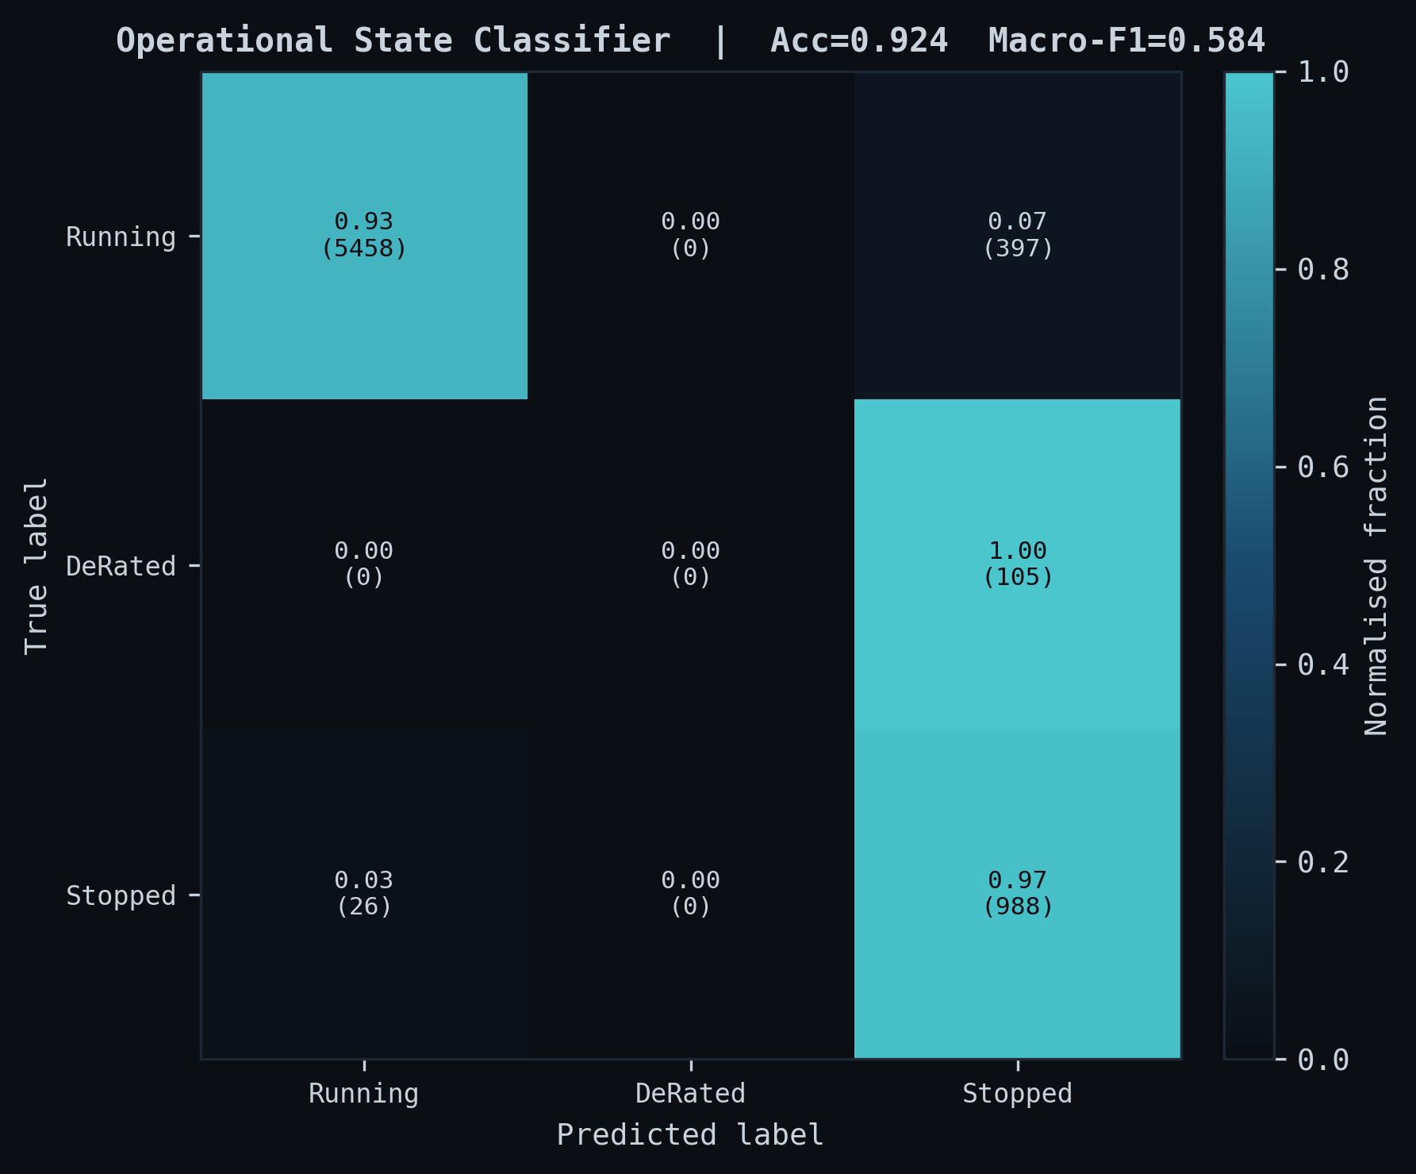
RESULTS · MODEL C
Operational State Classifier — Confusion Matrix
INTERPRETATION
Accuracy 92.4%
High overall accuracy — majority class "Running" is well-classified by the depth-2 rule tree.
Macro-F1 58.4%
Reflects class imbalance: "De-Rated" and "Stopped" are rare in the autumn test window (Nov–Dec 2016). Not inflated.
OCT-style rules
Depth-2 tree uses interpretable thresholds on wind speed, anomaly score, pitch angle, rotor RPM, and power.
Classes
Running · De-Rated · Stopped. F1 per class varies; the classifier correctly flags all Stopped events.
Macro-F1 58.4% reflects class imbalance in the autumn test window — this result is not inflated.
Source: Bertsimas & Dunn 2017 — Optimal Classification Trees, Davis & Goadrich 2006 — PR vs ROC curves
© 2026 Matthew Mitchell · MMKPC Studios

Slide 12
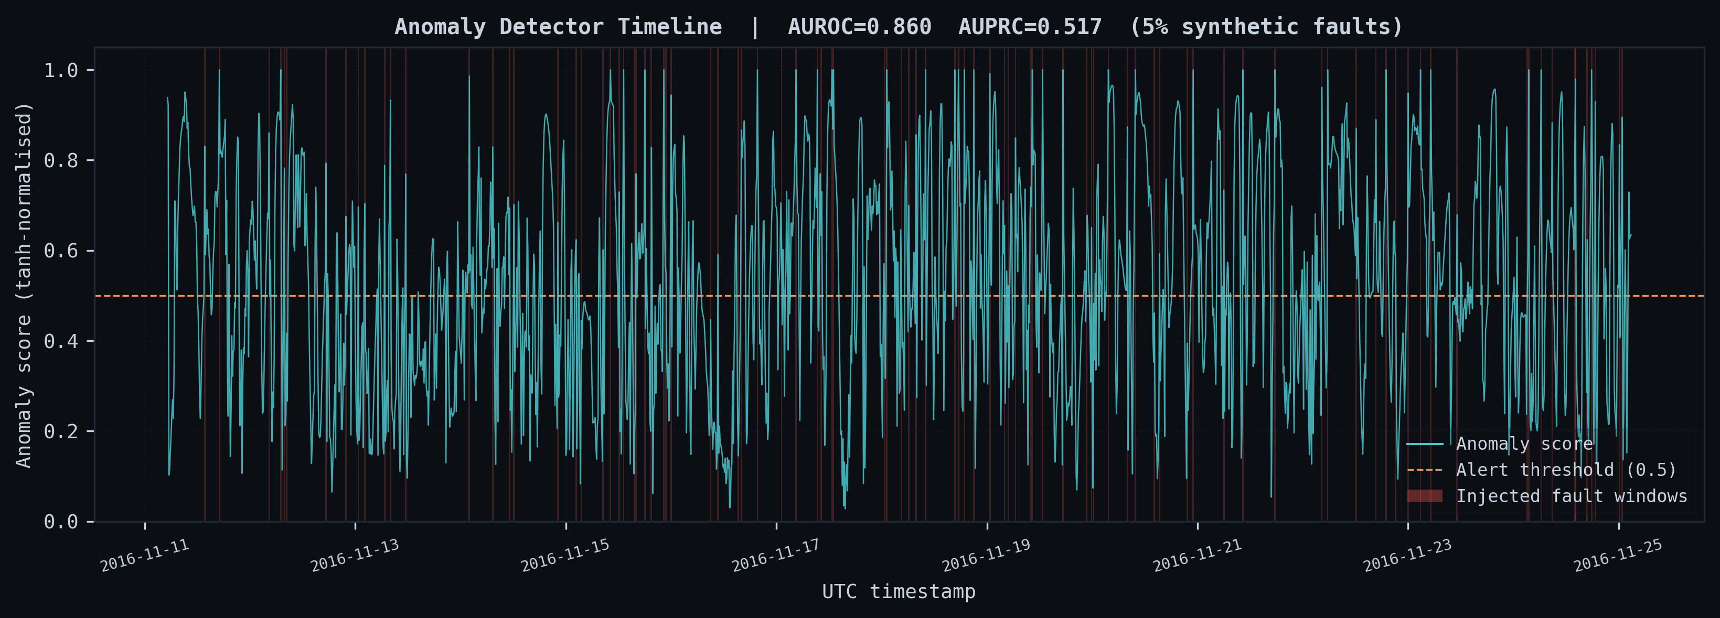
RESULTS · MODEL D
Anomaly Detection Timeline
0.860
0.517
5%
Evaluated against synthetic fault injection at 5% prevalence. Real event-log evaluation is future work.
AUROC
AUPRC
Fault Injection
Source: Davis & Goadrich 2006 — Precision-Recall vs. ROC, Kelmarsh SCADA — Zenodo 5841834
© 2026 Matthew Mitchell · MMKPC Studios

Slide 13
DEMONSTRATION
Live System Demo — Fault Injection Walkthrough
Deployed URL: aperture-wind-turbine-dt
01
Open the Application
Navigate to the deployed URL. The 3D nacelle scene initializes, SCADA stream begins ticking at 10-minute logical steps, and the DCS annunciator panel shows NORMAL state.
02
Inject Fault: gearbox_overheat
Select "Fault: Gearbox Overheat" from the fault injection panel. The SCADA stream generator begins incrementing gearbox oil temperature above the normal-behaviour model baseline.
03
Watch the Inference Pipeline React
Anomaly score climbs from 0.08 (baseline) → 0.96 (alarm threshold). The annunciator fires ALARM. The 3D nacelle tints red. Actuator layer latches a shutdown command.
04
Operator Response
Operator acknowledges the alarm, issues pitch-to-feather command, and resets the fault. The twin transitions back to NORMAL state. Full closed-loop cycle demonstrated.
© 2026 Matthew Mitchell · MMKPC Studios

Slide 14
SUBJECT AREAS
Subject-Area Alignment
Subject Area
Evidence in Aperture
Paper Section
Artifact
Domain 1
DT Fundamentals: Intro to Digital Transformations & DTs
9-layer reference architecture maps directly to Grieves/Tao 5D model; Kritzinger maturity tier assessed
Section 3.1
Section 6.1
core/schemas.js
core/bus.js
Domain 2
ML for Modeling & Simulation
Four production ML models: power-curve LR, gearbox KNN, state OCT-style tree, multivariate anomaly scorer
Section 3.3
Section 5
ml/power_curve.js
ml/gearbox_knn.js
ml/classifier.js
ml/anomaly.js
Domain 3
Real-Time Simulation Modeling
DES-style step-through simulation; typed event bus mirroring Kafka/MQTT topology; OPC UA standards alignment
Section 3.4
Section 4.2
simulation/engine.js
core/bus.js
Domain 4
Integrated Applications: Project-Based DT
End-to-end deployed SPA: 3D scene, annunciator, actuator surface, fault injection testbed, reproduce pipeline
Section 4
Section 6.4
index.html
paper/evaluate.py
paper/metrics.json
© 2026 Matthew Mitchell · MMKPC Studios

Slide 15
CONCLUSION
Limitations · Future Work · Thank You
KNOWN LIMITATIONS
FUTURE WORK
10-min SCADA compression masks sub-minute mechanical events (vibration, acoustic).
PINN blade aerodynamics surrogate — enforce Betz limit and Euler-Bernoulli constraints.
Anomaly labels are synthetic (5% fault injection); no real event-log ground truth used.
OpenFAST FMU integration — high-fidelity aeroelastic co-simulation alongside the ML models.
No OPC UA / MQTT live ingestion — SCADA stream is a replay generator.
Penmanshiel cross-farm validation — test transfer learning across MM92/MM82 fleets.
Wake effects and inter-turbine interactions not modeled.
Real OPC UA / MQTT ingest — replace synthetic SCADA replay with live nacelle controller feed.
Pure-JS ML ceiling: no GPU acceleration, no deep learning surrogates.
Single-turbine validation only (WT1); cross-farm generalization untested.
Operator study — assess annunciator usability and alarm fatigue with real O&M personnel.
Thank You · Questions?
© 2026 Matthew Mitchell · MMKPC Studios · github.com/MMKPC
© 2026 Matthew Mitchell · MMKPC Studios

