Slide 1
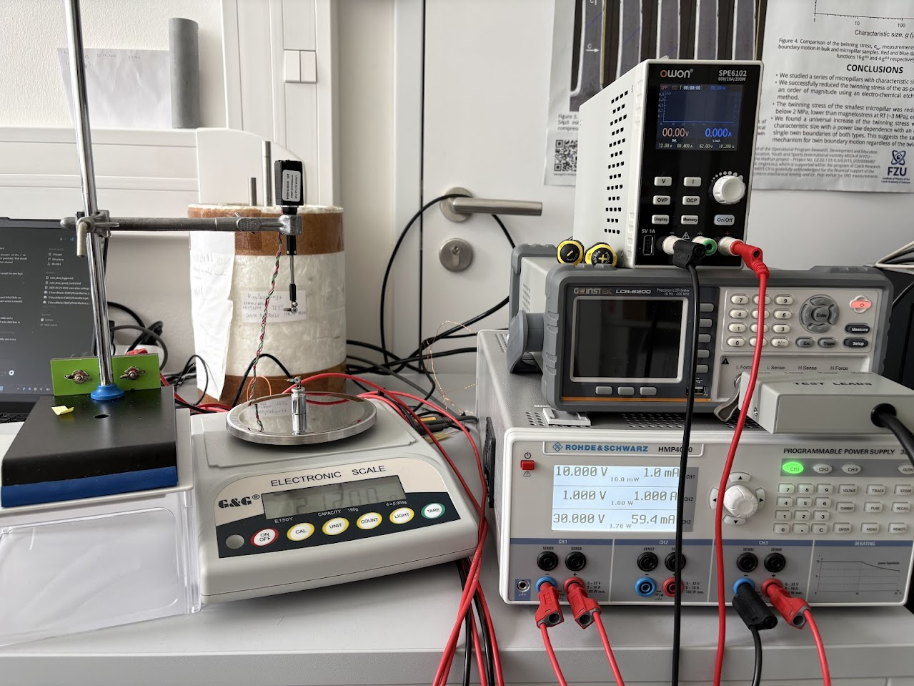
NI-FE-GA COLLOQUIUM / 21 MAY 2026
Instrumentation for Ni-Fe-Ga microwire research
Faster measurement workflow for preparation mapping.
Mini DMA
screening
validation
Martin Elias
Notes:
Limpat has already introduced the microwire side, so I would not spend time repeating that.
I would start by saying: I will show the instrumentation problem that appeared once we began preparing many wires.
The key message is that this is not a single-machine story; it is a workflow story.

Slide 2
RESEARCH QUESTION
The goal is preparation, not a single plot
In Prague I need to learn which preparation routes actually produce useful functional wires.
many
compositions and annealing conditions
-
select samples with clear transformation
-
connect preparation to strain response
-
reserve slow measurements for the best candidates
fast
screening before high-precision validation
few
commercial DMA slots per week
Notes:
I would phrase this naturally: the practical goal is not just to measure one nice wire.
The goal is to understand how to prepare good wires reproducibly.
That means I need a way to make quick decisions before investing time in the slow, precise measurements.

Slide 3
MEASUREMENT LOAD
The real workload is the sample matrix
Each preparation choice creates another branch to test.
sample 1
sample 2
sample 3
sample 4
sample 5
as-cast
screen
screen
screen
screen
screen
-
current annealing conditions
-
stress during activation
anneal A
screen
screen
screen
screen
screen
-
thermal and electrical response
-
repeatability after cycling
anneal B
screen
screen
screen
screen
screen
selected
DMA
DMA
skip
DMA
skip
Notes:
This is the motivation slide. I would not over-explain the matrix.
Just say that each change in preparation creates a new measurement branch, and if every branch needs commercial DMA first, the project becomes too slow.

Slide 4
SELECTION CRITERIA
What the measurements must answer
01
02
03
04
Transition temperature
Recoverable strain
Stress dependence
Power and current
where the response begins and ends
how much usable motion is available
whether the effect survives load
what actuation costs electrically
These are selection variables: they decide which wires deserve slow validation.
Notes:
This slide is the clean bridge into DMA.
I would say: for each wire I need transition temperatures, strain values, stress dependence, and now also current/power.
These are not just nice plots; they are criteria for choosing the next experiment.

Slide 5
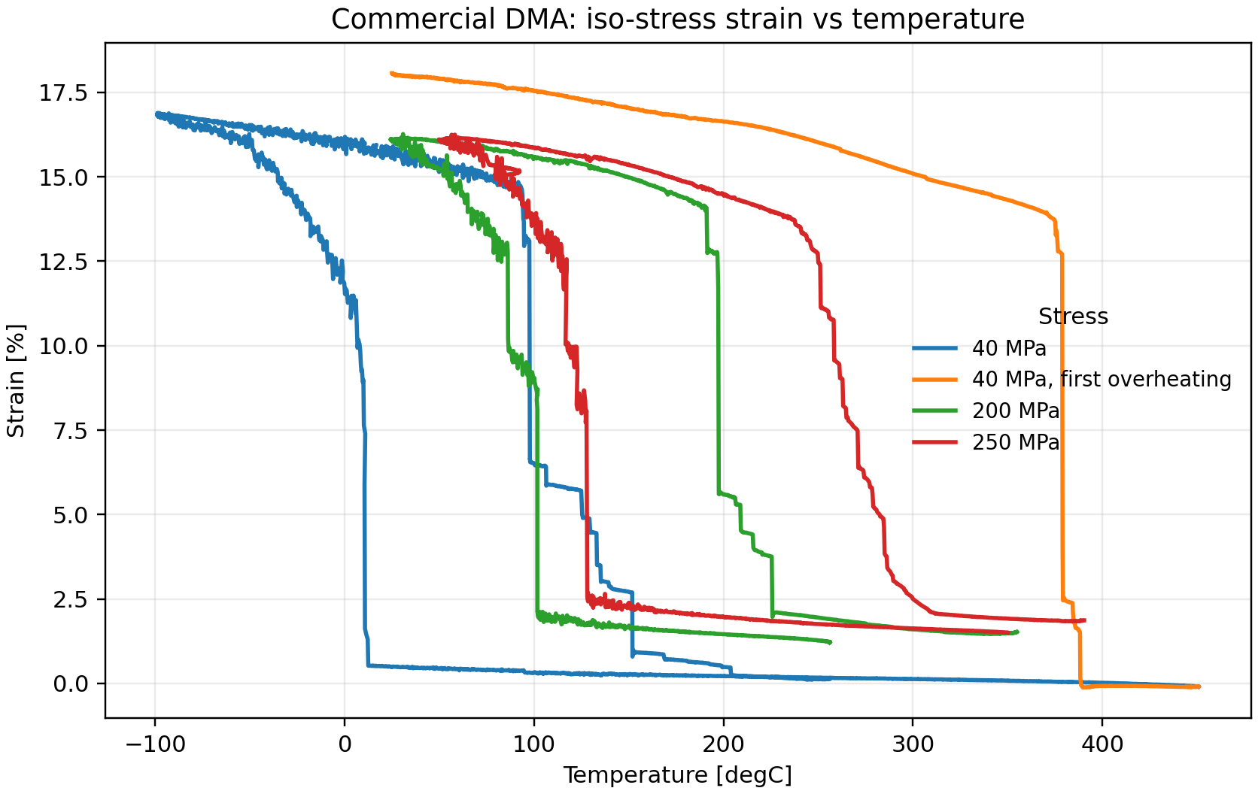
BOTTLENECK
Commercial DMA gives the answer, slowly
precise
transition temperatures and strain values
slow
long runs, setup time, liquid nitrogen
scarce
not ideal for testing every branch
Notes:
I would be fair here: commercial DMA is not the problem; it is the reference method.
The problem is using it as the first filter for many samples.
It gives excellent strain and temperature values, but it takes time and consumes liquid nitrogen.

Slide 6
STRATEGY
Two speeds instead of one bottleneck
->
->
1
2
3
Fast screening
Mini DMA
Commercial DMA
many wires, quick electrical and mechanical checks
controlled stress/current sweeps on promising samples
high-precision validation only where it matters
The Mini DMA is a decision instrument before it is a replacement instrument.
Notes:
This is the main logic of the talk.
I would say: I am not trying to replace the commercial DMA.
I am trying to build the missing middle step: enough precision and control to decide which samples are worth validating.

Slide 7
INSTRUMENT
Mini DMA concept
A
motorized displacement
sets length and controlled strain path
B
balance feedback
keeps target stress instead of target position
C
source meter
logs current, voltage, resistance, power
D
software loop
runs recipes and records synchronized data
Notes:
I would introduce the setup physically: one side is a motorized stage, the load is monitored by a balance, and the source meter gives the electrical part.
The important point is synchronization: current, resistance, power, displacement, and load are recorded together.

Slide 8
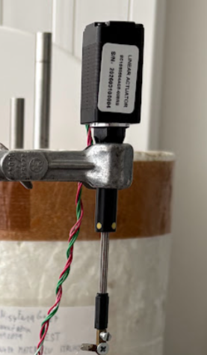
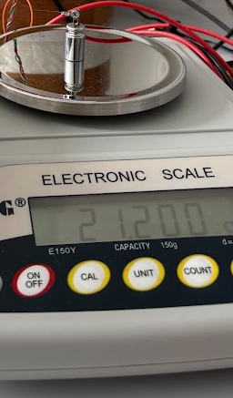
CONTROL SCALE
At microwire scale, grams are not small
13 um
wire diameter used for the estimate
1 g -> ~74 MPa
stress scale for this cross-section
0.005 g -> ~0.37 MPa
balance noise is already visible
This is why the setup needs closed-loop control, not only a motor position.
Notes:
This is where I would slow down for a few seconds.
A gram sounds small, but for a 13 micrometer wire it is already tens of MPa.
That makes the balance feedback and control algorithm necessary, not cosmetic.

Slide 9
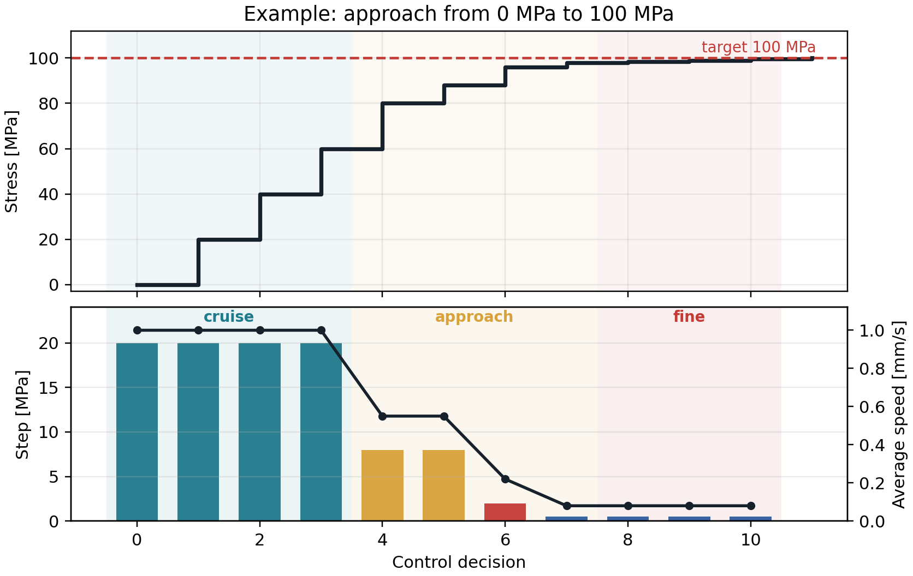
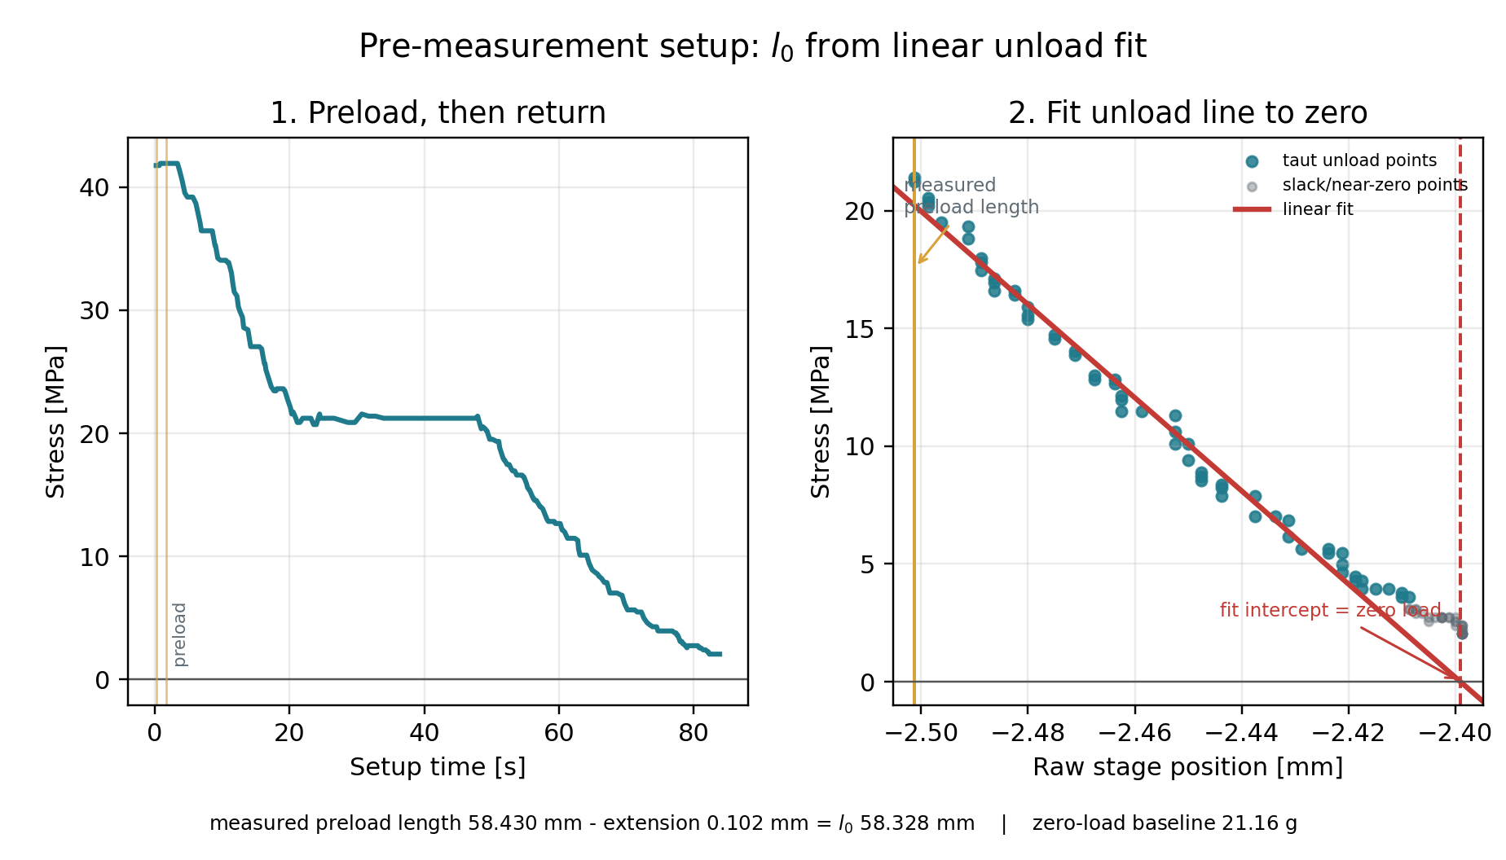
CONTROL LOGIC
Define l0, then approach stress carefully
preload / unload
fit initial length
approach with fresh feedback
Notes:
I would explain only the practical idea.
First the setup estimates l0 from a preload/unload sequence.
Then, during a stress plateau, it uses fresh balance readings and smaller corrections near the target so it does not overshoot.

Slide 10
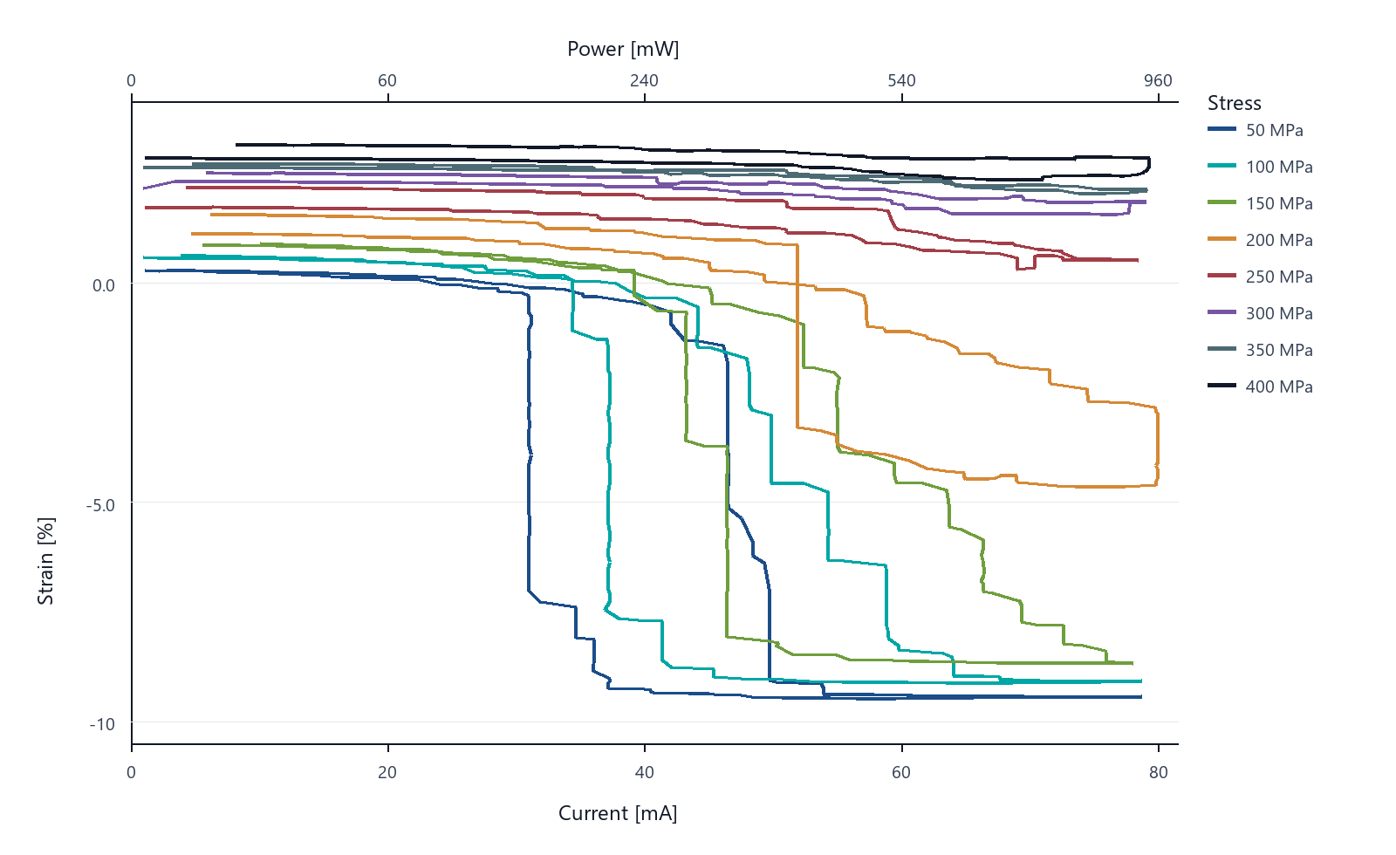
FIRST RESULT
Current sweeps can be read as power sweeps
P = I^2R
power is available from logged current and resistance
top axis
Mini DMA plots can show power directly
screening trace
enough structure to decide what to validate next
Notes:
This is the place to mention the merged plotting functionality.
I would say: because current and resistance are logged together, power is not an extra measurement.
The Mini DMA plots can put power on the top axis, which is more physically useful for Joule-heated actuation than current alone.

Slide 11
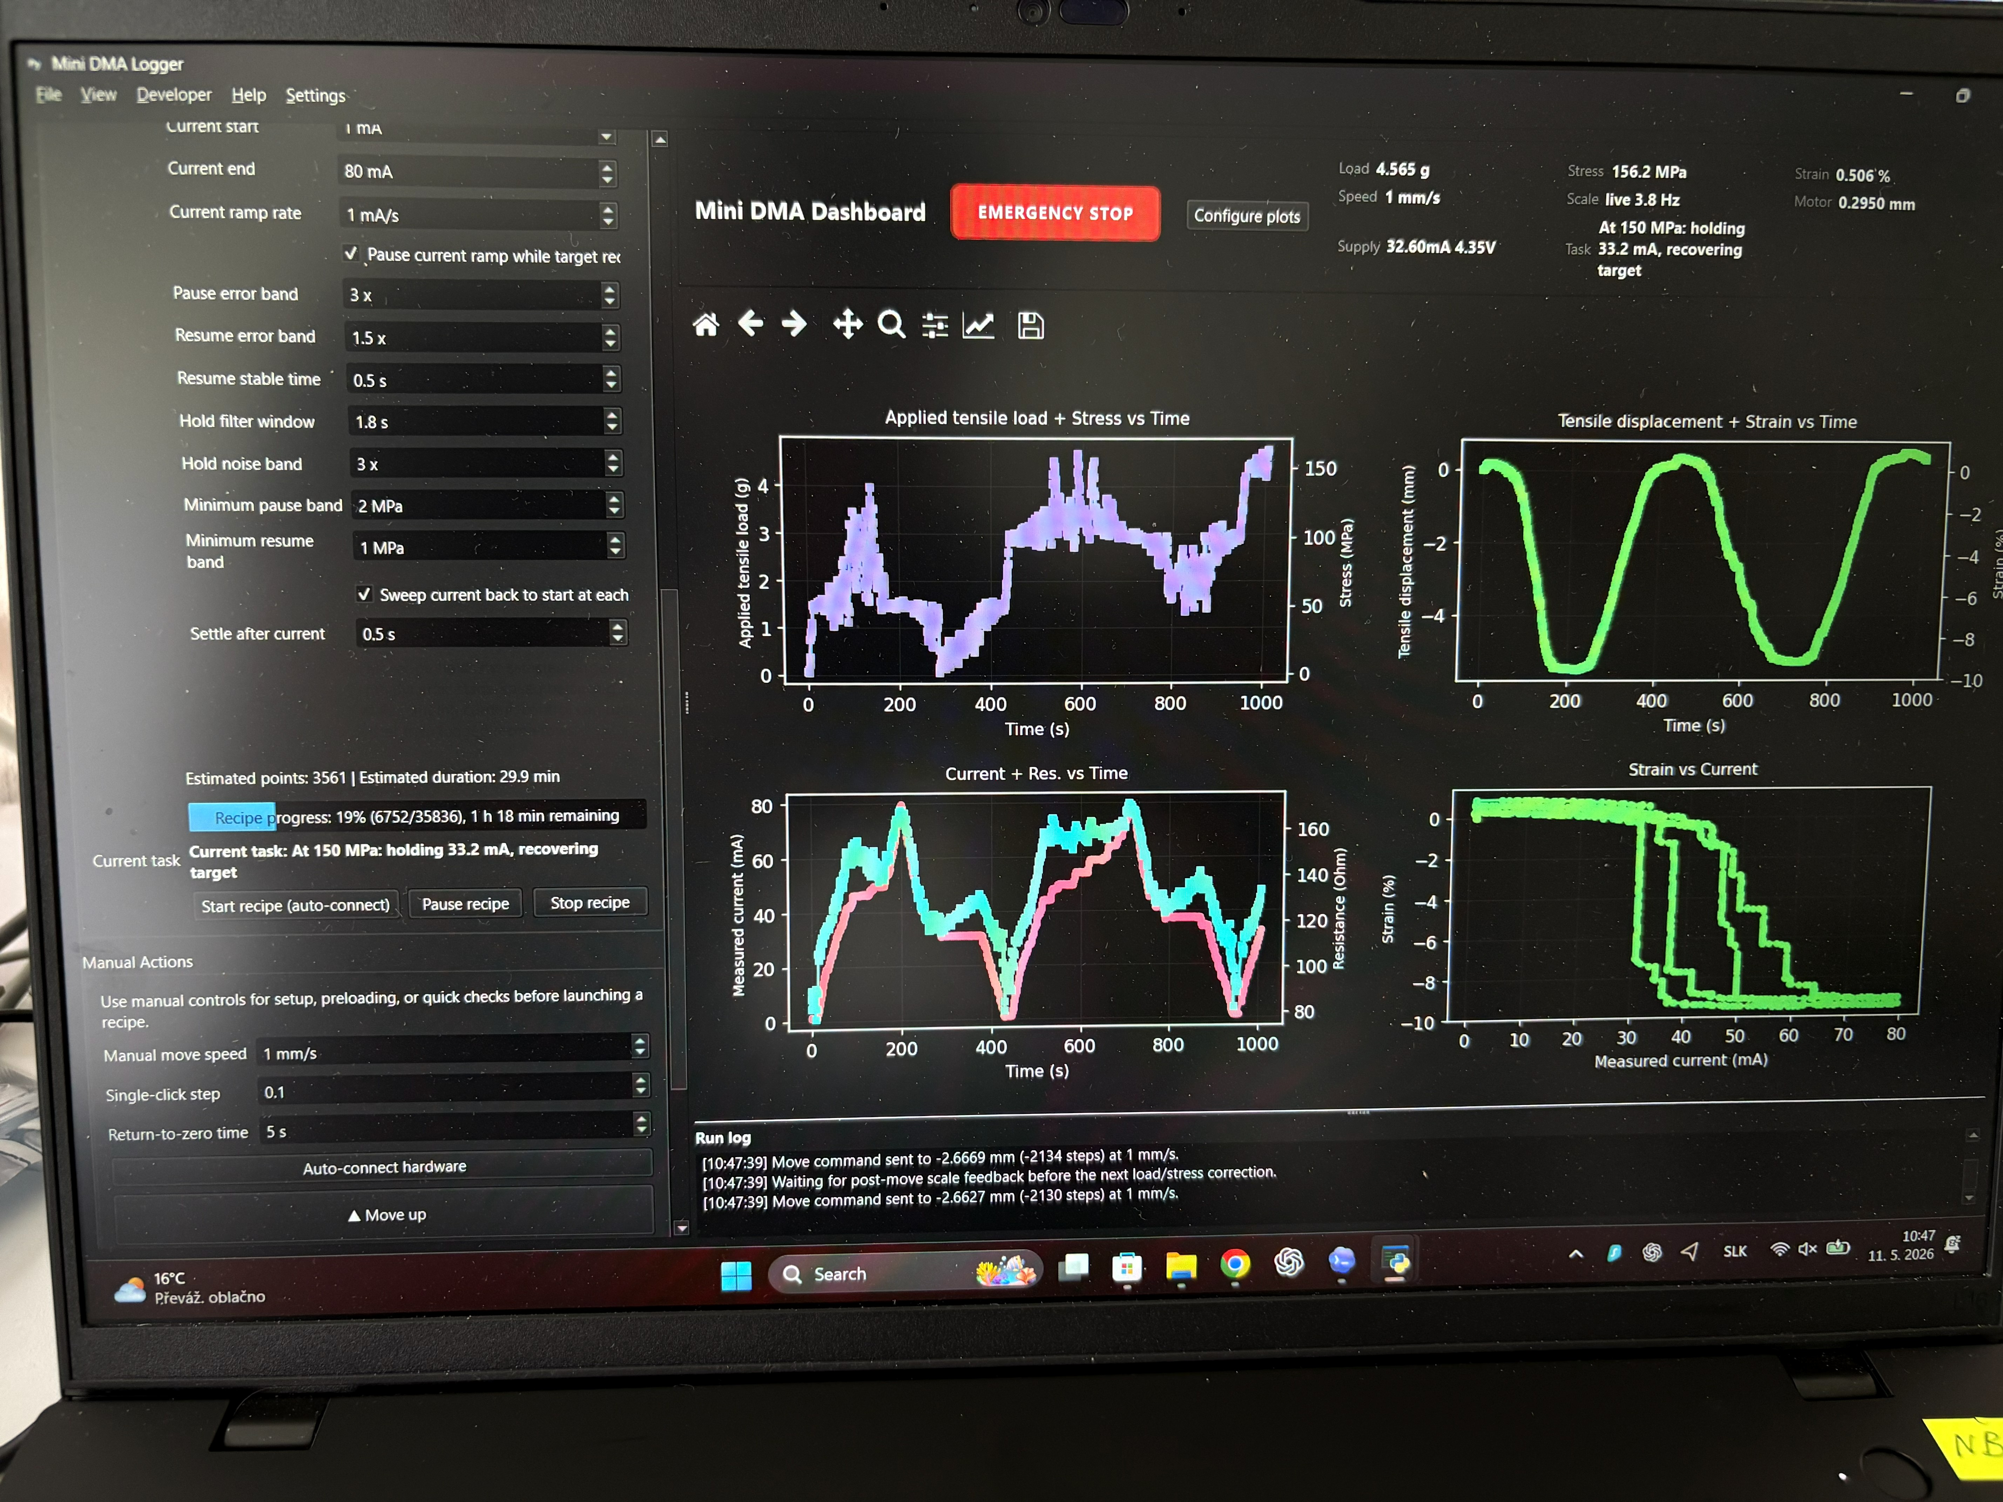
STATUS
What is ready, and what still has to be validated
done
controlled recipes
stress plateaus and current sweeps are automated
done
synchronized logging
load, strain, current, voltage, resistance, power
next
cross-check against DMA
same samples, same transformation range, better confidence
Notes:
I would be careful not to overclaim.
The machine is already producing controlled sweeps and synchronized logs.
The next scientific step is validation against commercial DMA, especially for samples where the screening trace looks promising.

Slide 12
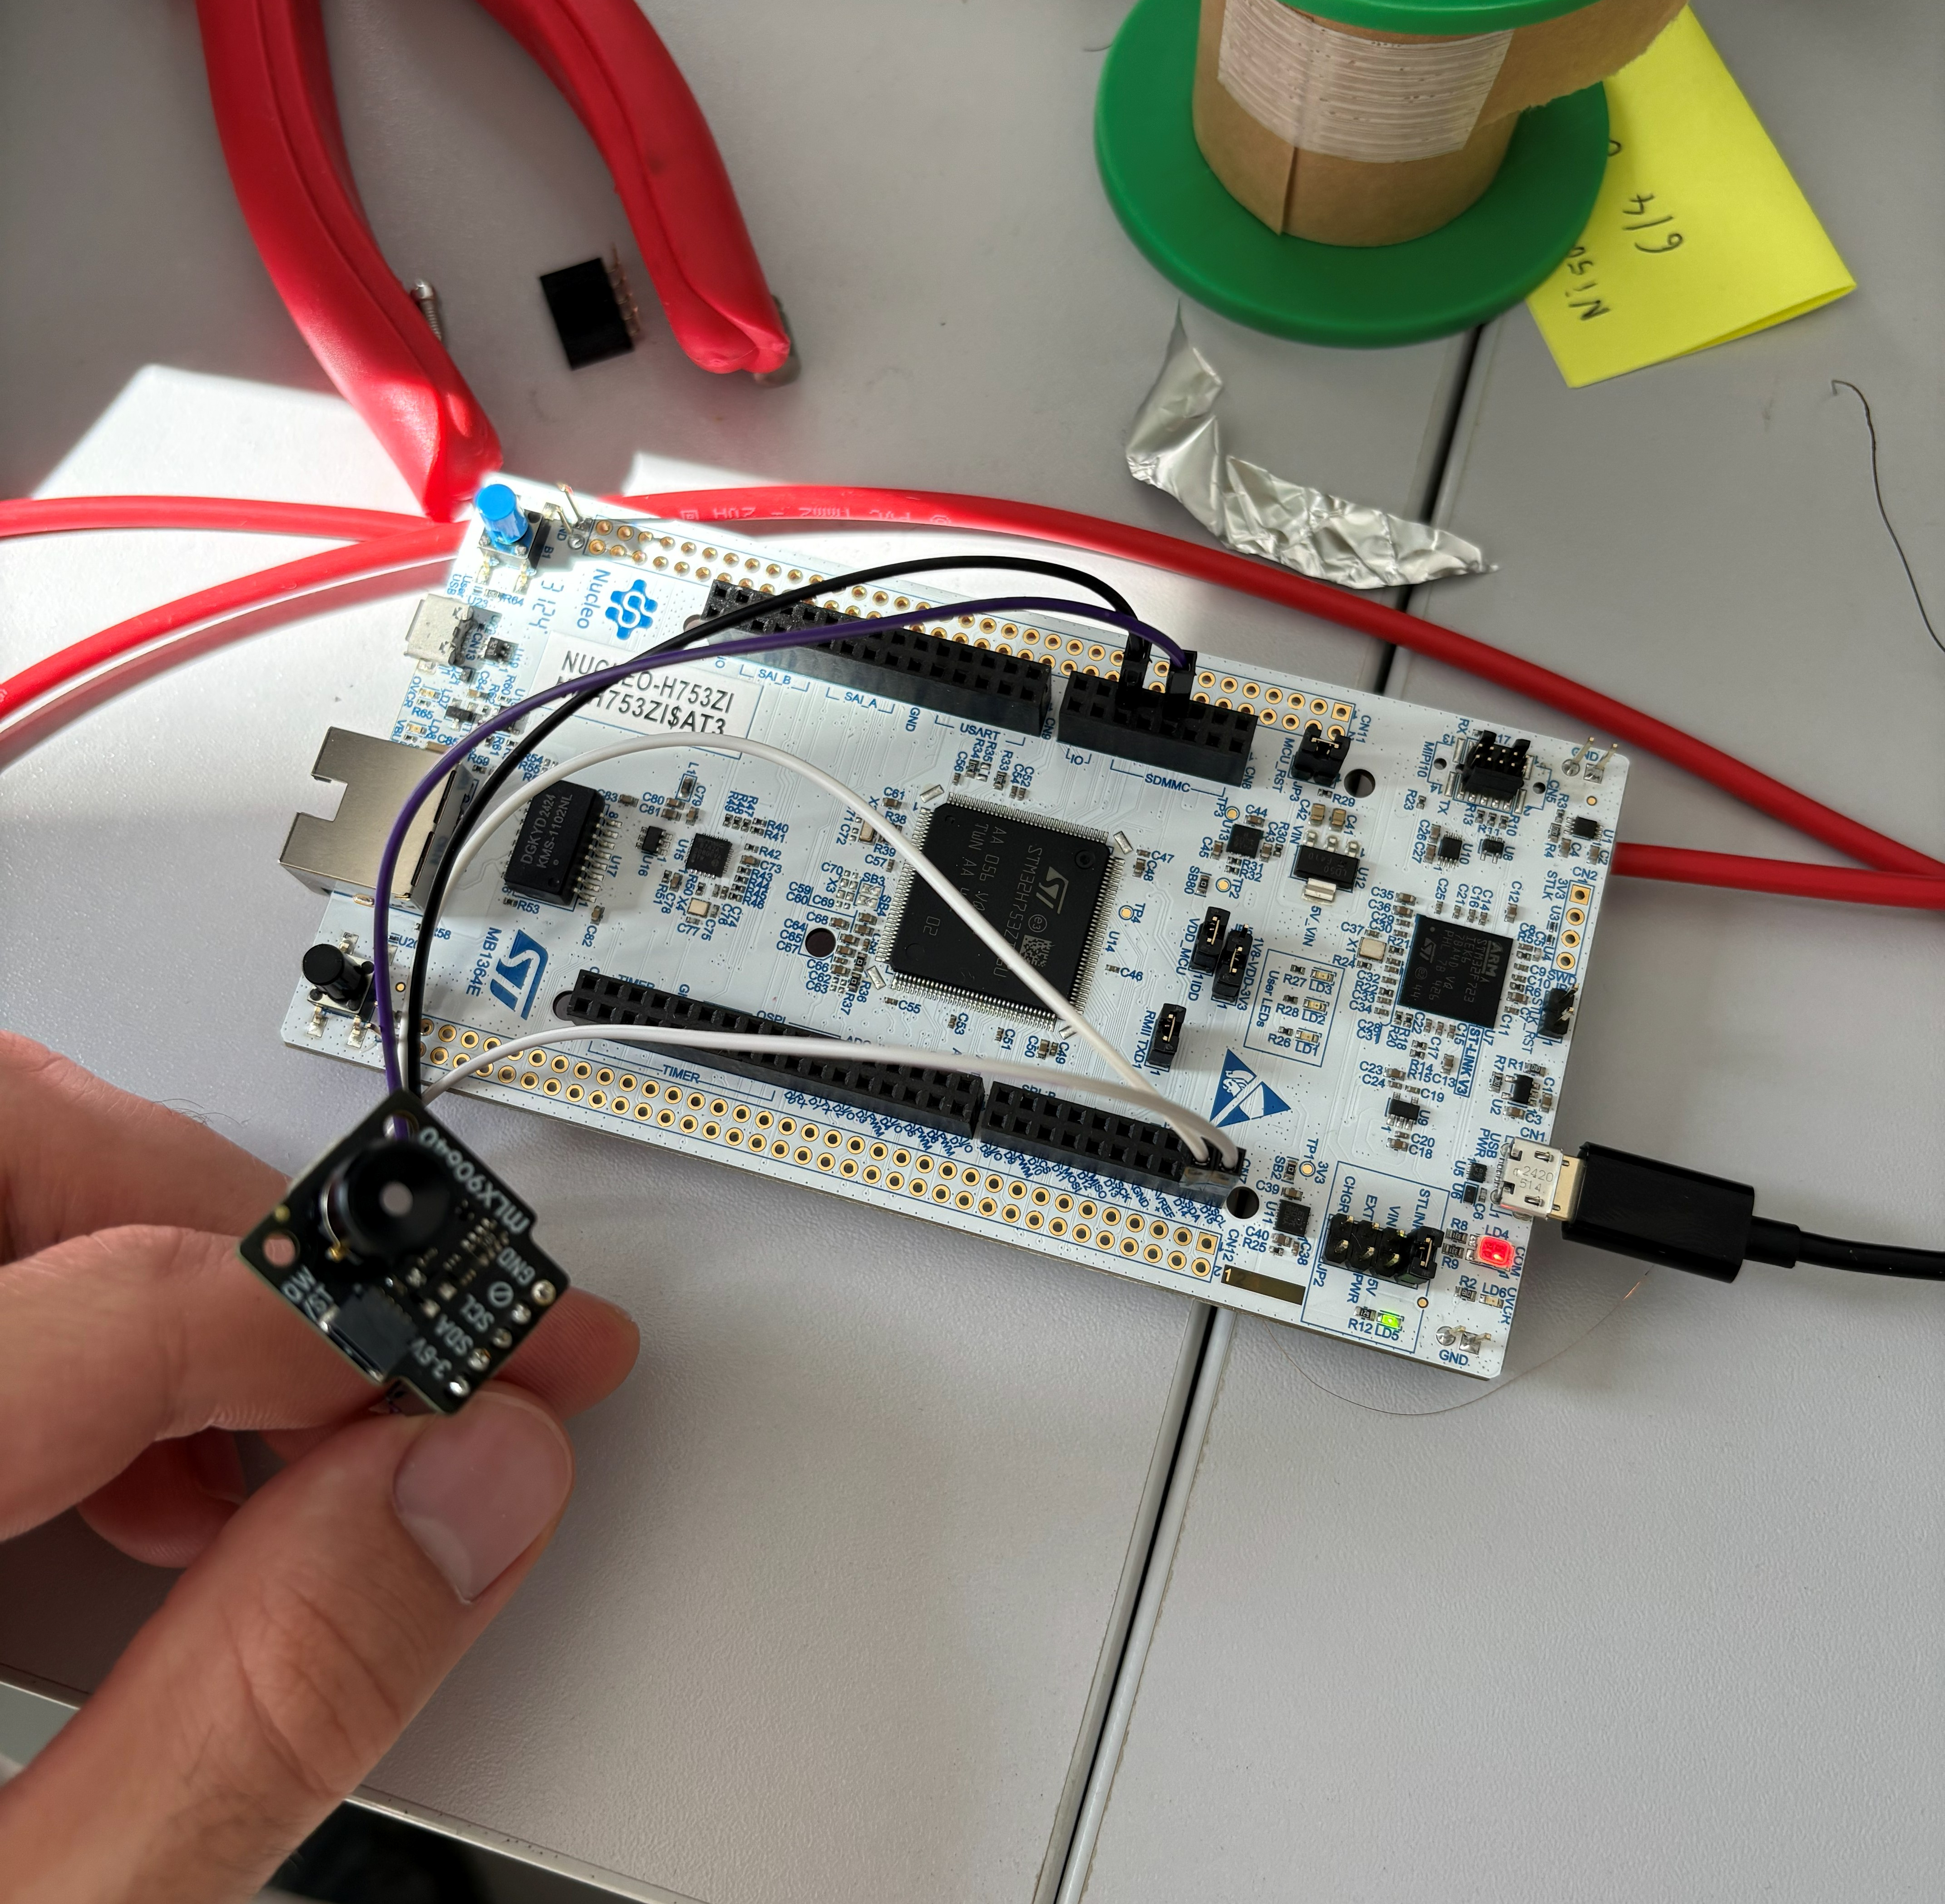
CLOSING
The instrument changes the pace of the project
More samples can be tested before the slow measurement.
-
prepare -> screen -> select -> validate
-
spend DMA time on better candidates
-
iterate preparation while the idea is still fresh
AI-assisted engineering compressed the build path; the validation remains experimental.
Notes:
This is the closing reflection, not a sales pitch.
I would say: the unusual part is how the instrument was built.
ChatGPT helped choose components and wiring, Codex installed drivers, read manuals, and wrote the software.
A task that would normally need several people and much more time became possible for one person with a clear physical idea.
But the final proof still comes from the measurements.

