Slide 1
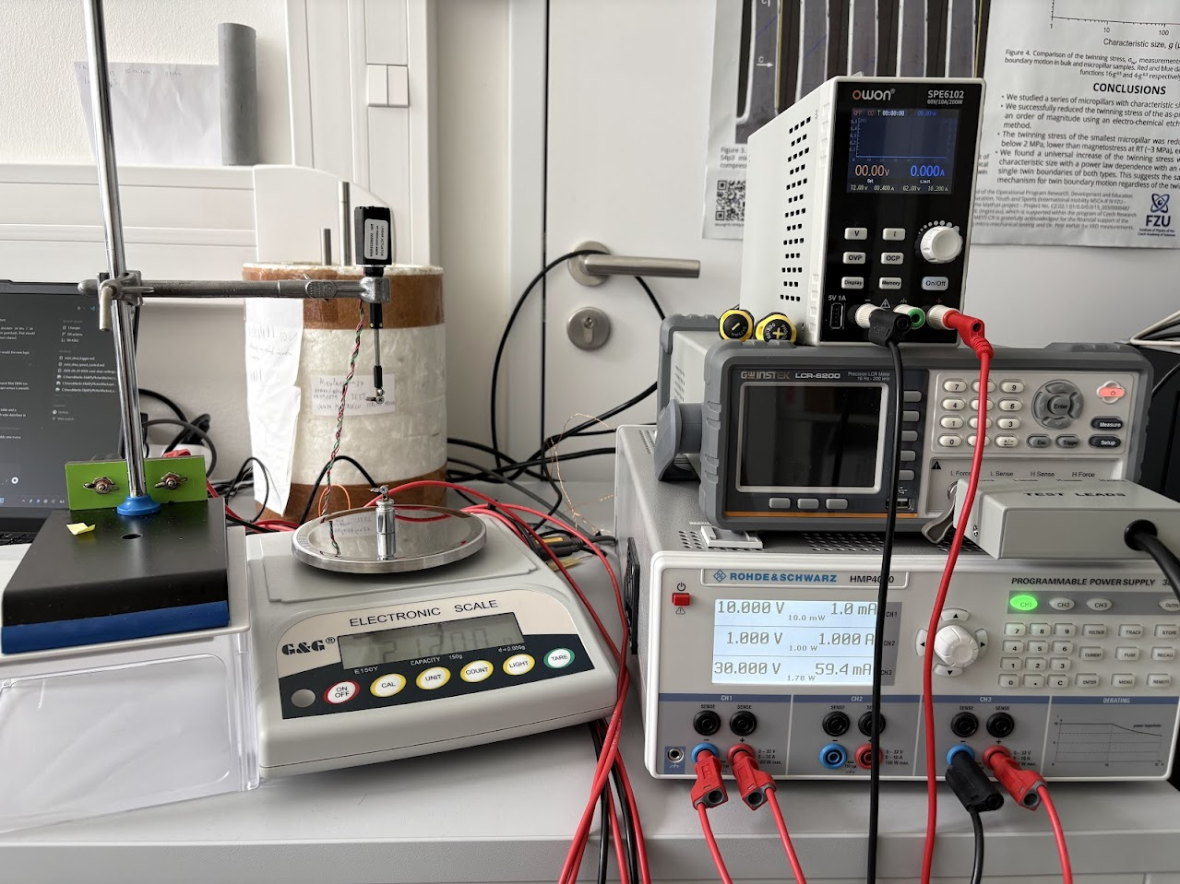
Instrumentation developed for Ni–Fe–Ga research
Fast iso-stress measurements – mini DMA
Martin Elias | 21 May 2026
01
Notes:
I want to show why we built a small Mini DMA setup and where it fits in our microwire workflow. The main point is not that it replaces a commercial DMA. The point is that it lets us screen many samples quickly before choosing the few that deserve slower validation.

Slide 2
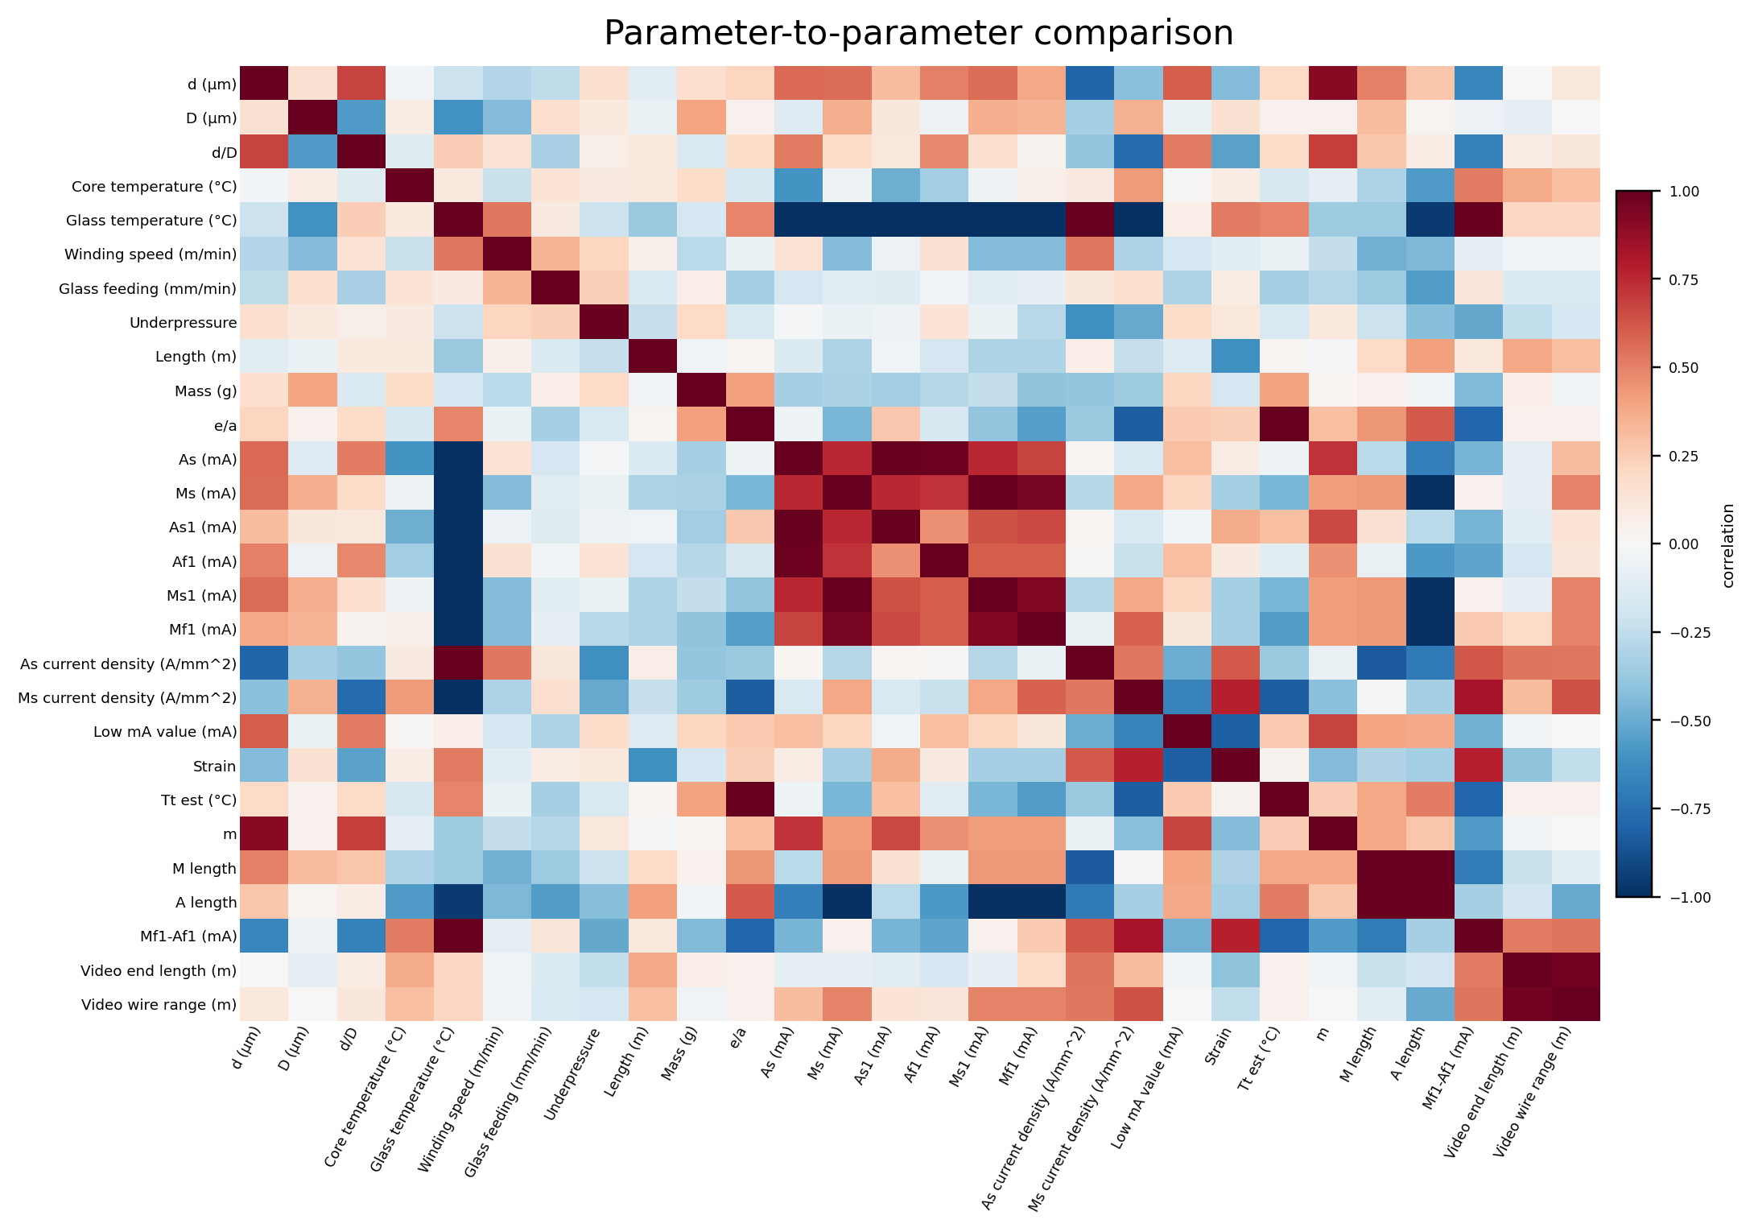
Motivation
Preparation, geometry, transformation temperatures, stress, and strain
The goal is to connect preparation data with experimental results.
More measurements make it easier to find wires with high strain.
We also need wires that survive high stress.
Correlation matrix from the microwire dataset
02
Notes:
This is why the Mini DMA is closely connected to the EDA work. The EDA is trying to connect fabrication and process data with experimental response. For example, here we already see process variables ranked by correlation with strain in the manual dataset. The Mini DMA gives us a way to generate more response data faster, so the correlations are not based only on slow manual measurements.

Slide 3
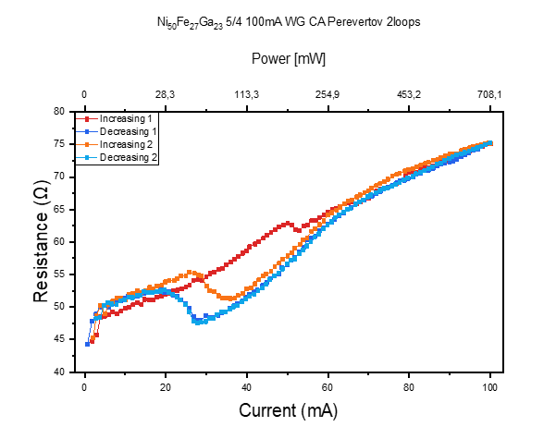
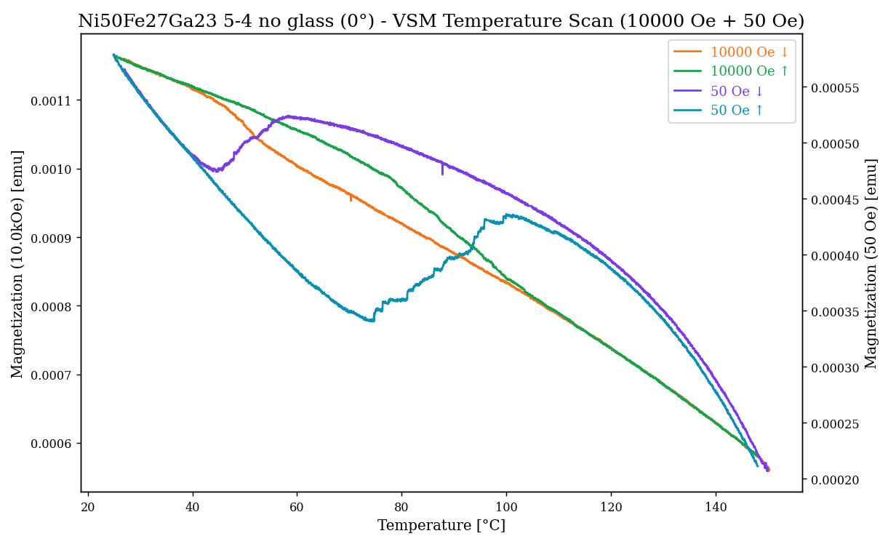
Motivation
Many samples
Fast feedback
Selected validation
03
Notes:
The goal here is preparation. We need a way to learn which preparation choices are promising before spending a lot of time on detailed validation. So the workflow is many samples, fast feedback, then selected validation.

Slide 4
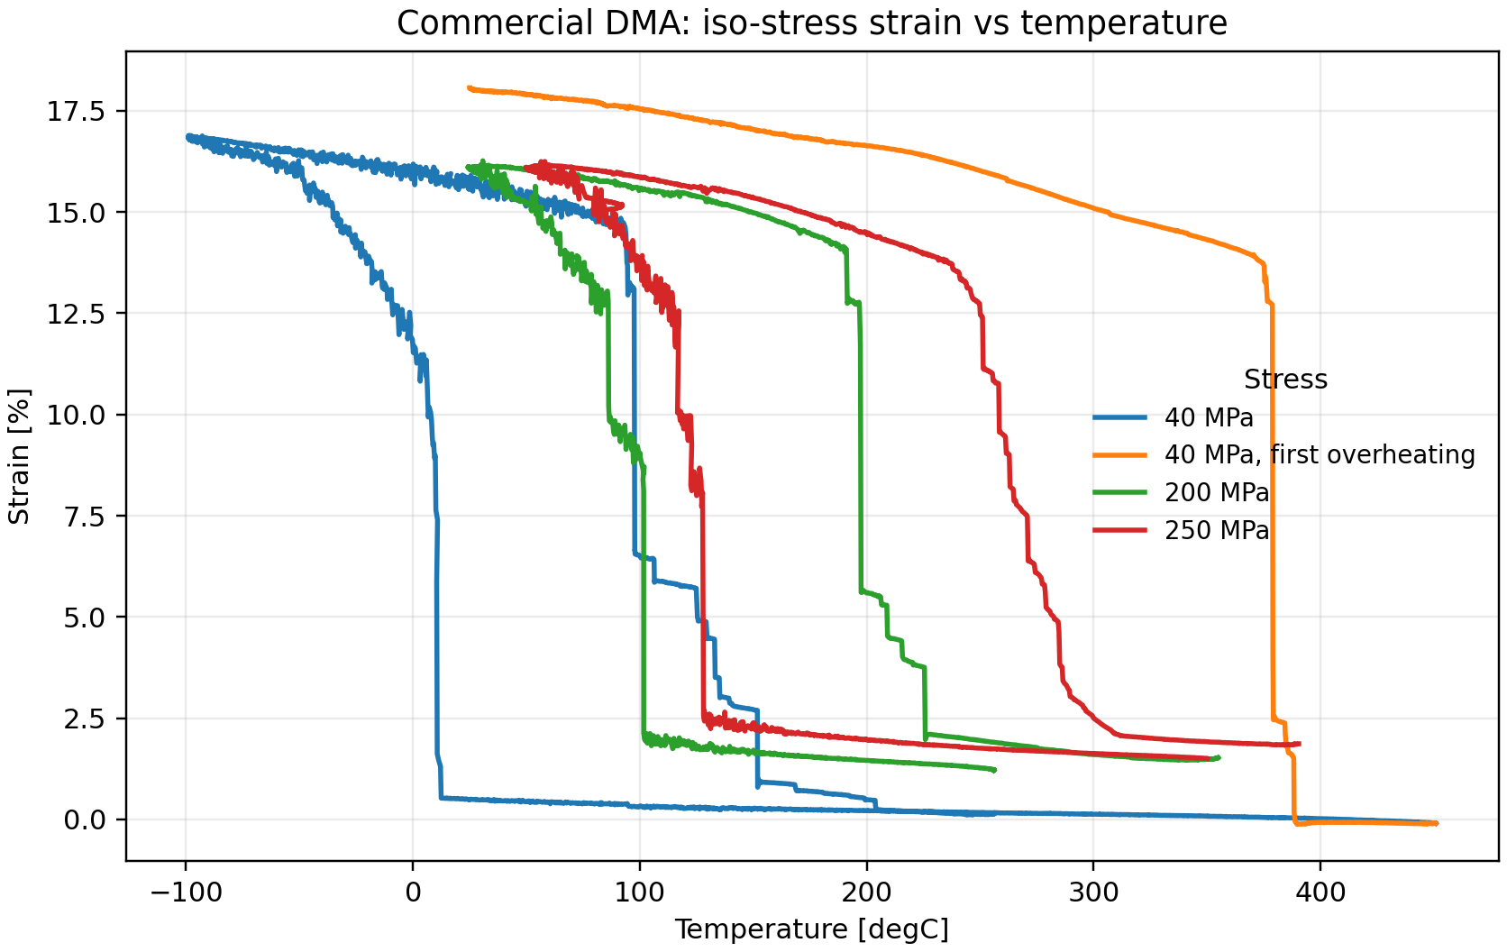
Commercial DMA
High precision and established method.
Good for selected samples and final validation.
Too slow and expensive to be the first screen for every preparation variant.
Commercial DMA graph from previous measurements
04
Notes:
Commercial DMA is still the reference measurement. It is more precise and it is the method we trust for validation. The problem is using it as the first filter. If every preparation variant has to go through this step first, feedback is too slow.

Slide 5
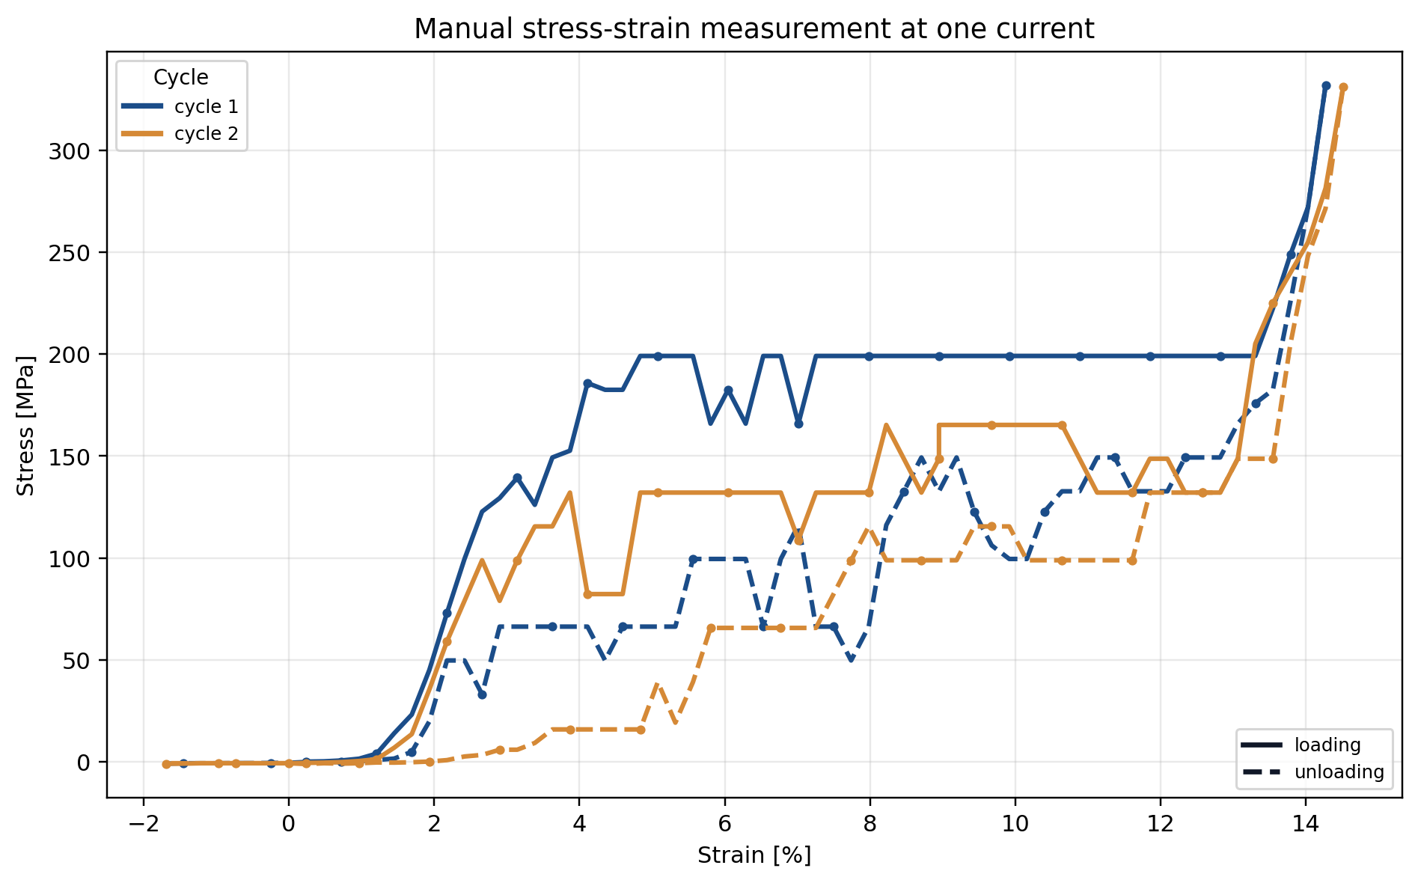
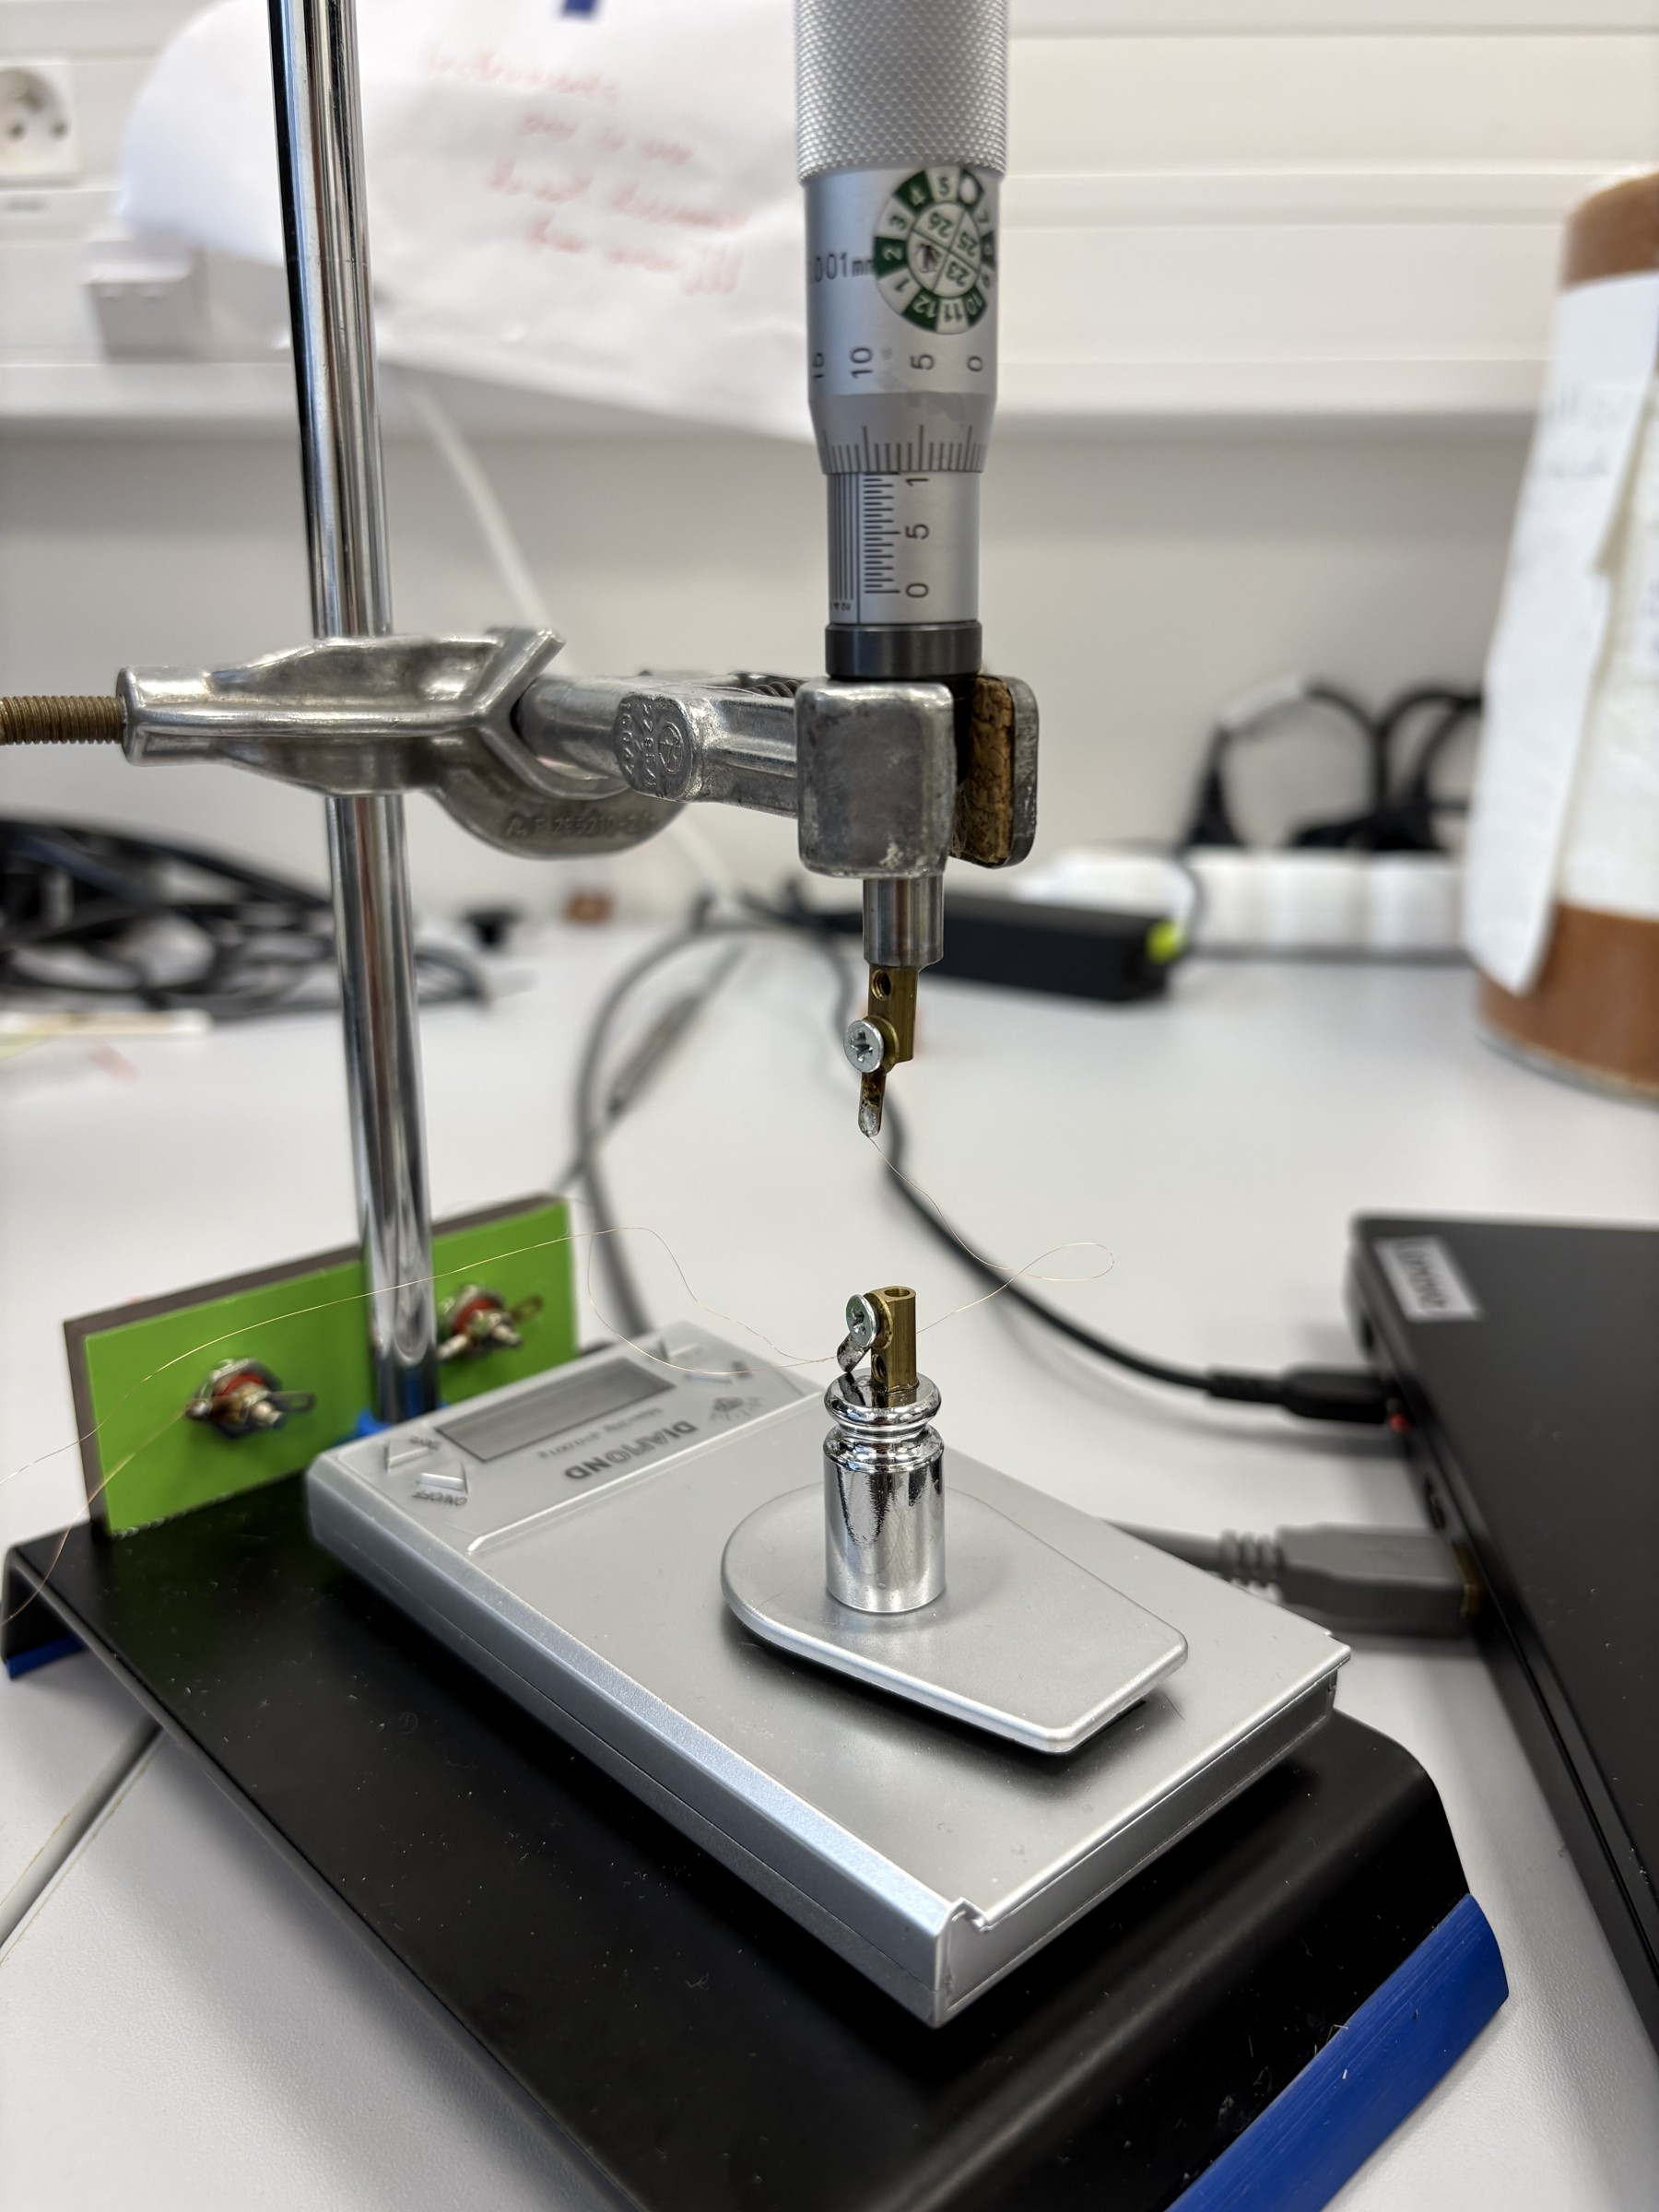
Manual stress-strain measurements were useful but slow
One current value
could take ~30 min
Each point required manual adjustment and waiting.
The result is a snapshot at one current, not a controlled transformation scan.
It is hard to repeat this enough times for screening.
05
Notes:
Before this setup, I was doing stress-strain measurements manually. They are useful, but one measurement at one current value could take around half an hour of hands-on work. That is not practical if the goal is to screen many wires and many preparation conditions.

Slide 6
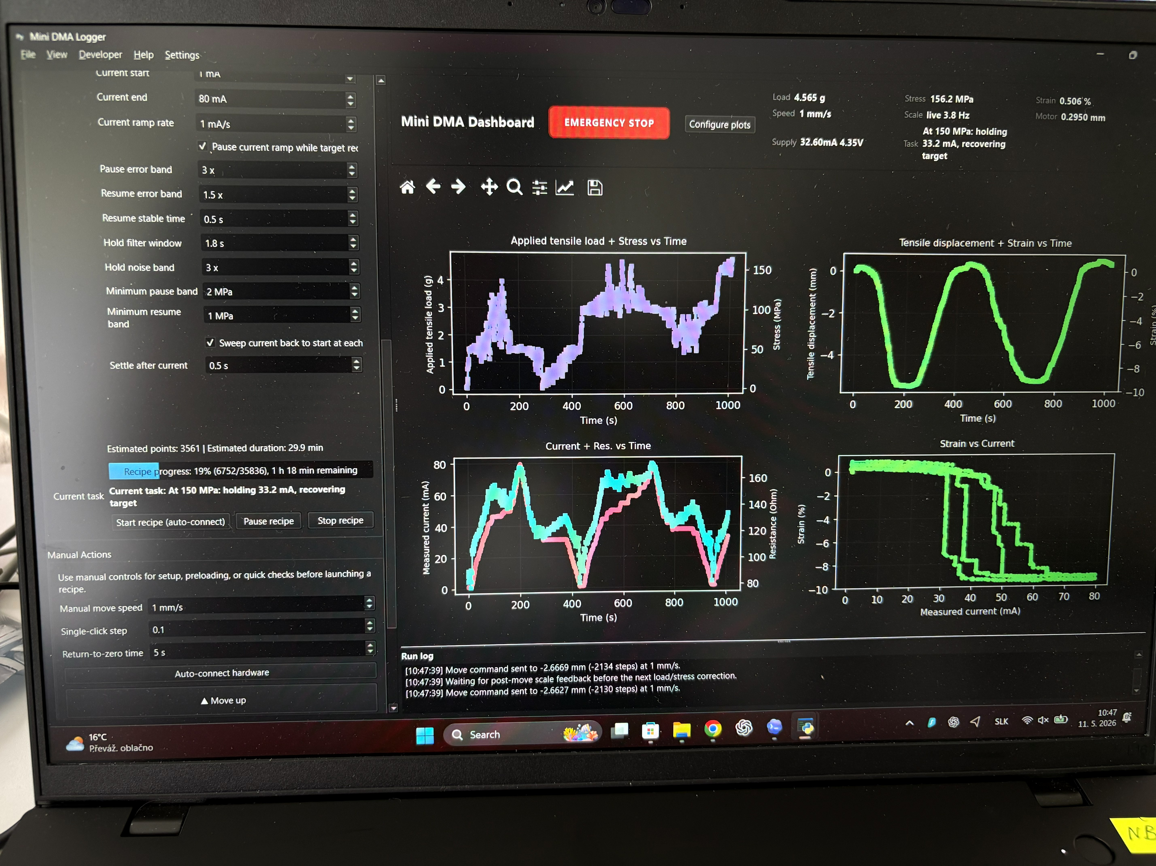
Mini “DMA”
06
Notes:
Commercial DMA is still the reference measurement. It is more precise and it is the method we trust for validation. The problem is using it as the first filter. If every preparation variant has to go through this step first, feedback is too slow.

Slide 7
How the iso-stress measurement works
1
Set target stress
2
Increase current and heat the wire
3
Wire contracts, stress rises
4
Motor moves down to restore target
Software view
Motor displacement gives strain.
07
Notes:
The measurement works like an isostress measurement on a commercial DMA. I set a stress target. Then the current increases and the wire heats. When transformation starts, the wire contracts, so the load on the scale changes and the calculated stress rises. The motor then moves down to bring the stress back to the target. Since we know how much the motor moved, we know the strain. On cooling, the wire elongates again and the motor moves in the opposite direction to hold the same stress.

Slide 8
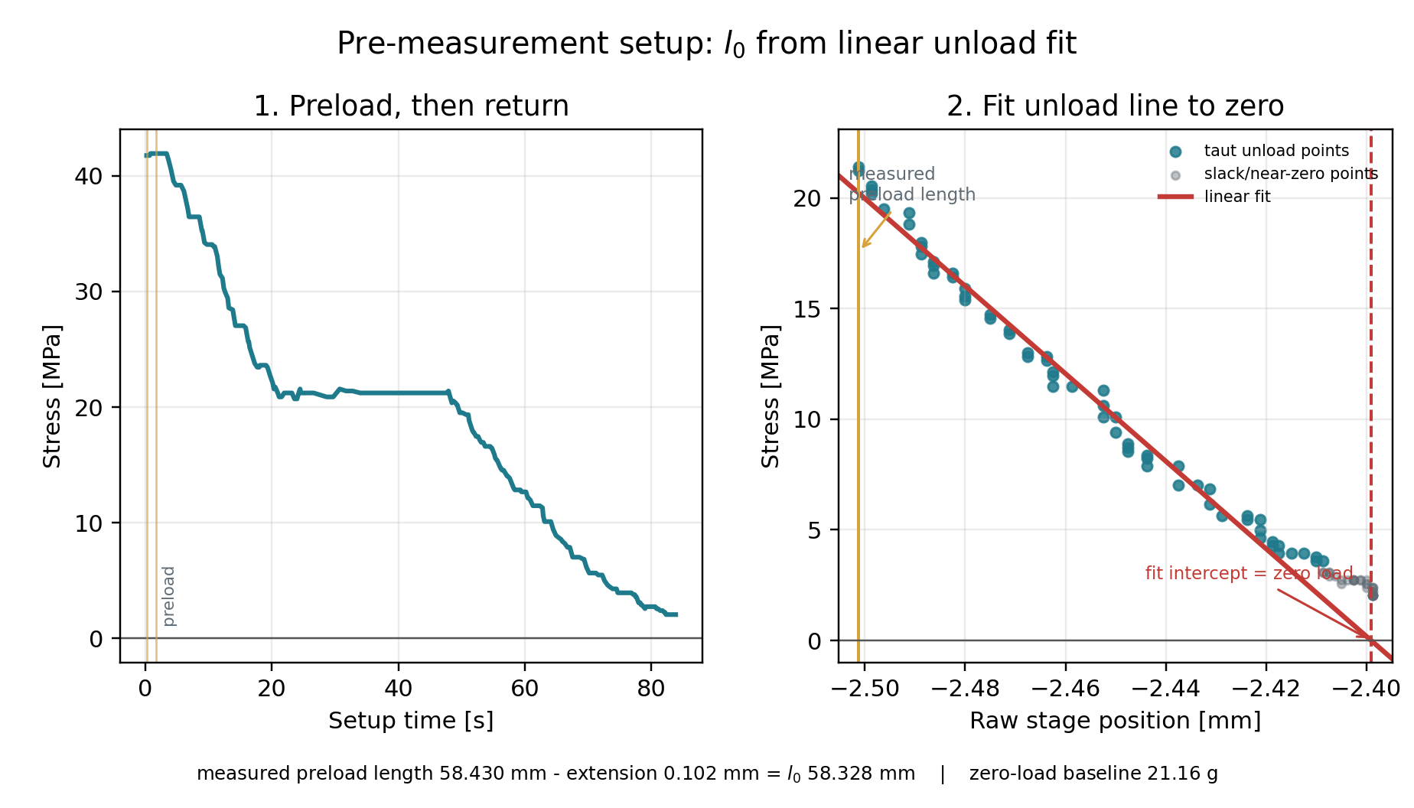
Baseline and initial length
The setup measures displacement, not absolute wire length.
At the start, it goes to a known stress target and asks for the measured wire length.
Then it lowers the load and finds the point where load no longer follows the linear displacement trend.
That point becomes the zero-load baseline.
Baseline and initial-length calculation
08
Notes:
Because the setup only knows motor displacement, I first need to establish the initial wire length. At the start of a run, the system moves to a known stress target, for example 20 MPa, and asks me to enter the measured wire length. Then it moves back toward zero load. The wire can still pull slightly even when it is not perfectly straight, so I do not simply use the first low force value. Instead, I fit the linear part of load versus displacement and detect where the response stops following that line. That becomes the new baseline. Since I know the displacement from the measured target state to this baseline, I can calculate the effective initial length.

Slide 9
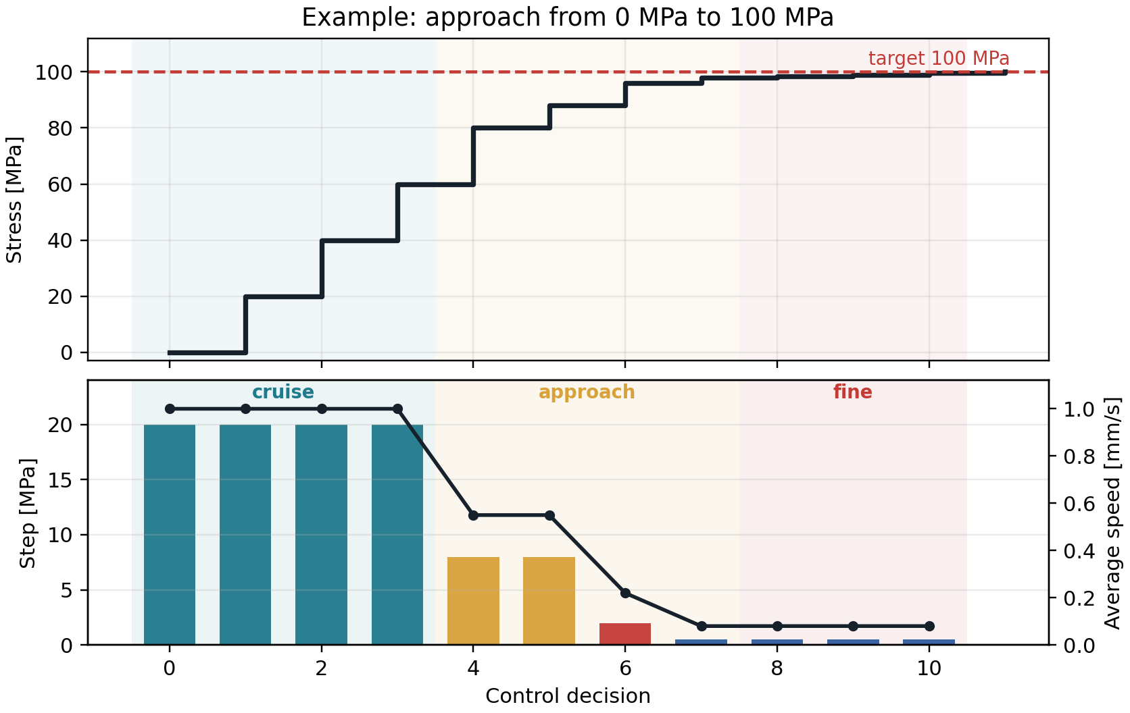
The motor approaches the target in two modes
Far from target
larger steps + continuous cruise mode
Near target
single moves, fresh scale value, then next move
Final step size: 10 micrometers
Target approach example
09
Notes:
The control has to be precise but not painfully slow. When it is far from the target, the motor takes larger steps and can move continuously in a cruise mode. Because the scale value has about 200 milliseconds of latency, the controller checks retrospectively whether it is approaching correctly. Near the target, it switches to a more careful mode: move, wait for a fresh scale value, then move again. The closer it gets, the smaller the step becomes, down to a single 10 micrometer step.

Slide 10
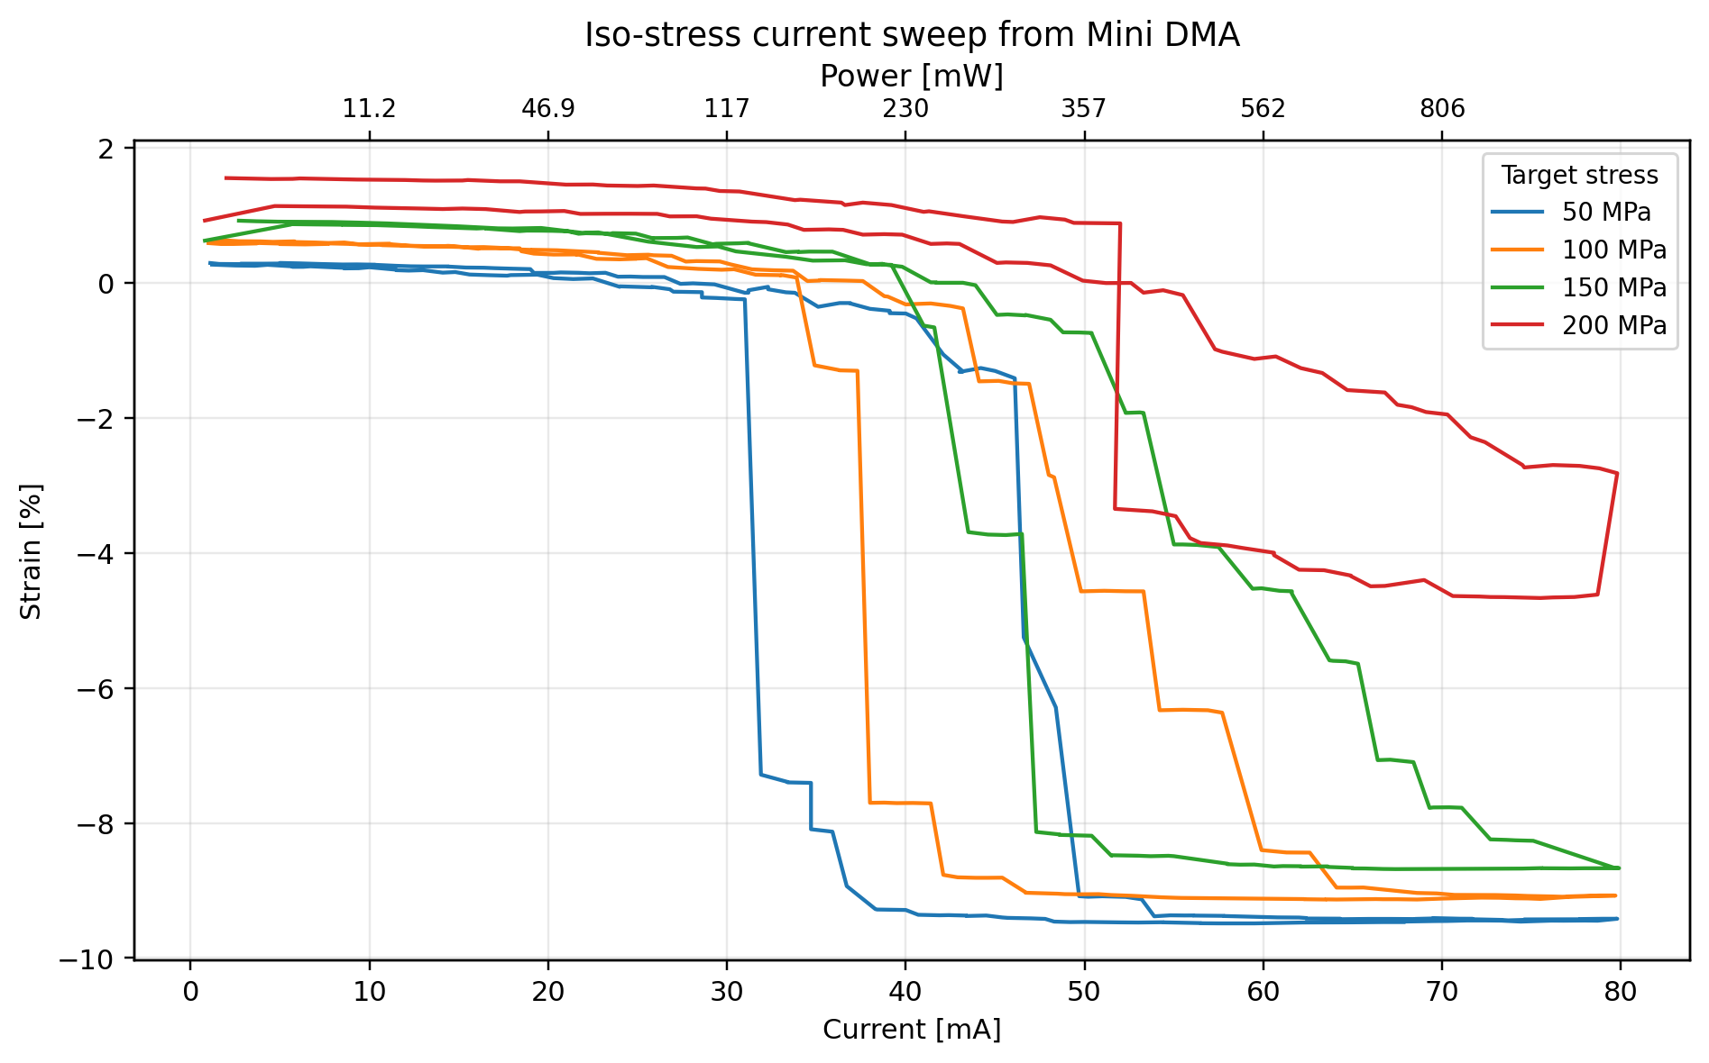
First Mini DMA current sweeps
This is the first real measurement from the setup.
The higher stress curves were removed here to keep the graph readable.
Because current is measured, power for a target contraction can also be estimated.
Mini DMA run: 50-200 MPa targets
10
Notes:
This is a real measurement from the Mini DMA setup. For this presentation I would keep only the lower stress curves on the plot, because the full version is too cluttered. Since the current is measured during the sweep, we can also calculate the electrical power needed to reach a given contraction, for example 10 percent. That matters for practical actuator applications, where the power requirement is part of the usefulness of the wire.

Slide 11
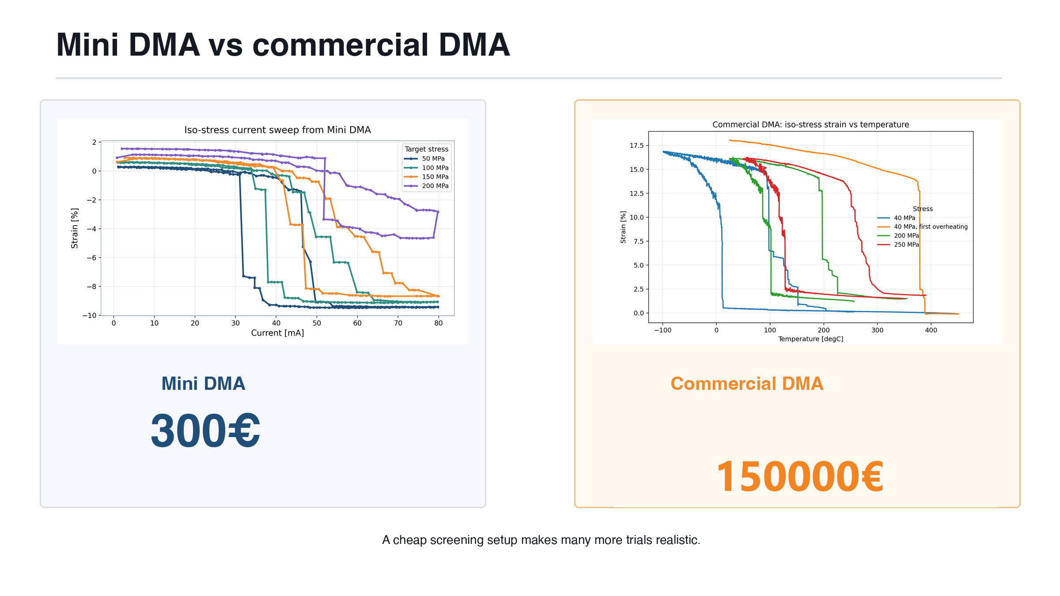
11
Notes:
I would show the two graph types side by side and then make the price contrast very explicit. The numbers are approximate, but the order of magnitude is the point: a cheap screening setup lets us try many more wires before choosing what deserves commercial DMA time.

Slide 12
Use Mini DMA before commercial DMA
Mini DMA
screening
Keep only
promising wires
DMA
validation
The Mini DMA is a decision tool: it helps decide what is worth measuring carefully.
That turns the slow reference method into a validation step, not a bottleneck.
Mini DMA setup
DMA result
12
Notes:
This is the intended workflow. The Mini DMA sits before commercial DMA. It is not presented as a better commercial instrument. It is a faster decision tool that lets us reserve the reference measurement for the best candidates.

Slide 13
Codex made this a one-person prototype
The hardware, wiring, drivers, and software came together in about two weeks.
ChatGPT
picked components
ChatGPT
explained wiring
Codex
wrote software
Codex
installed drivers
The bigger message: AI can turn small experimental ideas into working lab tools much faster than before.
13
Notes:
The last point is that this was not only a hardware project. It was also an example of what AI makes possible now. ChatGPT helped choose the components and explained the wiring in very concrete terms, down to which cable should go to which pin. Then I connected it to the PC and Codex wrote the software, installed the correct drivers, and helped make the setup actually run. Overall, it took around two weeks. A few years ago I would probably need someone for electronics and someone else for software. Now, if someone has a small experimental idea, they can get surprisingly far by themselves. That is the part I want people to notice and use more.

Slide 14
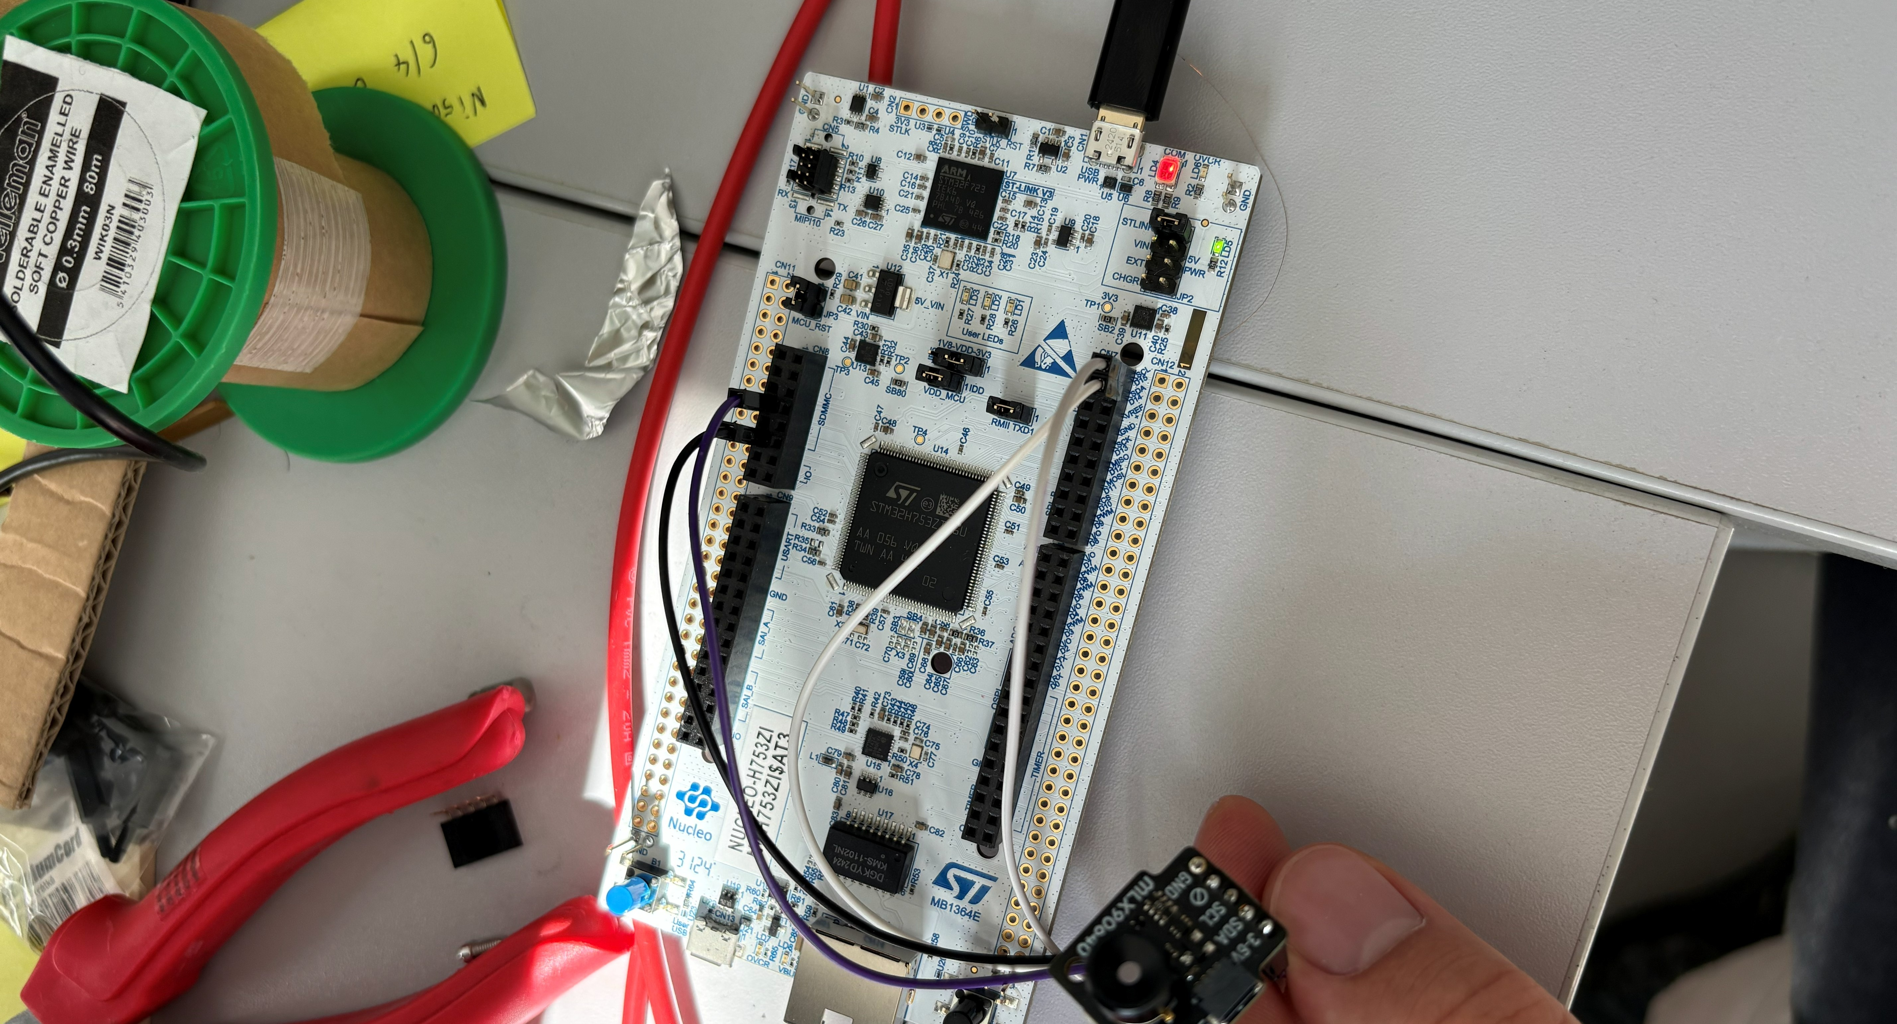

Next step: add temperature to the same run
40€, 110°FOV, 62 FPS
100 μm
Elastocaloric effect
14
Notes:
I removed the synthetic thermal graph here because it was not the real image you wanted. The next step is to connect the thermal camera to the same measurement so we know not only the current and power, but also the actual temperature of the wire. That would also let us measure the thermal response during transformation, including the elastocaloric effect. I could not find the real thermocamera frame from the older presentation in the local repo, so this slide uses only the real camera-hardware photo for now.

