Slide 1


BILLS
BILLS
BILLS

Slide 2
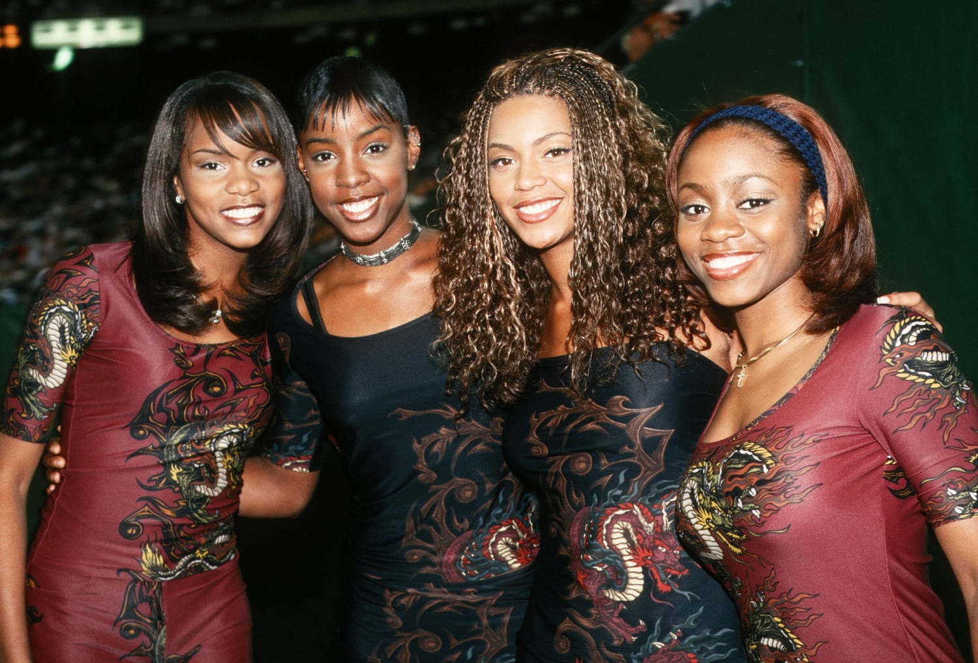






INTUITIVE
ENGAGING
ACCESSIBLE
STREAMLINED
CONSISTENT
SEAMLESS
AFFORDABLE
NO PREMIUM
NO SUBSCRIPTIONS
UNINTUITIVE
FRUSTRATING
DISORGANIZED
CLUTTERED
OVERWHELMING
UNCLEAR
OVERPRICED
PREMIUM
SUBSCRIPTIONS

Slide 3
UNINTUITIVE
FRUSTRATING
DISORGANIZED
INTUITIVE
ENGAGING
ACCESSIBLE
STREAMLINED
CONSISTENT
SEAMLESS
AFFORDABLE
NO PREMIUM
NO SUBSCRIPTIONS
CLUTTERED
OVERWHELMING
UNCLEAR
OVERPRICED
PREMIUM
SUBSCRIPTIONS

Slide 4
UNINTUITIVE
FRUSTRATING
DISORGANIZED
CLUTTERED
OVERWHELMING
UNCLEAR
INTUITIVE
ENGAGING
ACCESSIBLE
STREAMLINED
CONSISTENT
SEAMLESS
AFFORDABLE
NO PREMIUM
NO SUBSCRIPTIONS
OVERPRICED
PREMIUM
SUBSCRIPTIONS

Slide 5
UNINTUITIVE
FRUSTRATING
DISORGANIZED
CLUTTERED
OVERWHELMING
UNCLEAR
OVERPRICED
PREMIUM
SUBSCRIPTIONS
INTUITIVE
ENGAGING
ACCESSIBLE
STREAMLINED
CONSISTENT
SEAMLESS
AFFORDABLE
NO PREMIUM
NO SUBSCRIPTIONS

Slide 6
UNINTUITIVE
FRUSTRATING
DISORGANIZED
CLUTTERED
OVERWHELMING
UNCLEAR
OVERPRICED
PREMIUM
SUBSCRIPTIONS
STREAMLINED
CONSISTENT
SEAMLESS
AFFORDABLE
NO PREMIUM
NO SUBSCRIPTIONS
INTUITIVE
ENGAGING
ACCESSIBLE

Slide 7
UNINTUITIVE
FRUSTRATING
DISORGANIZED
CLUTTERED
OVERWHELMING
UNCLEAR
INTUITIVE
ENGAGING
ACCESSIBLE
STREAMLINED
CONSISTENT
SEAMLESS
OVERPRICED
PREMIUM
SUBSCRIPTIONS
AFFORDABLE
NO PREMIUM
NO SUBSCRIPTIONS

Slide 8
UNINTUITIVE
FRUSTRATING
DISORGANIZED
CLUTTERED
OVERWHELMING
UNCLEAR
STREAMLINED
CONSISTENT
SEAMLESS
AFFORDABLE
NOPREMIUM
NO SUBSCRIPTIONS
INTUITIVE
ENGAGING
ACCESSIBLE
OVERPRICED
PREMIUM
SUBSCRIPTIONS

Slide 9
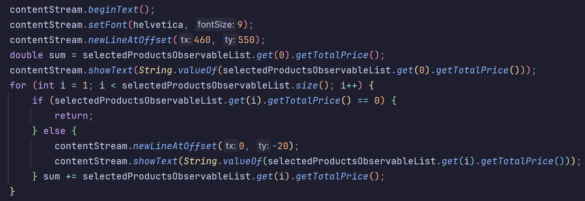
BEHIND THE SCENES

Slide 10
THANK YOU FOR LISTENING

