Slide 1

Landmark Recognition
Big Data Content Analytics

Slide 2
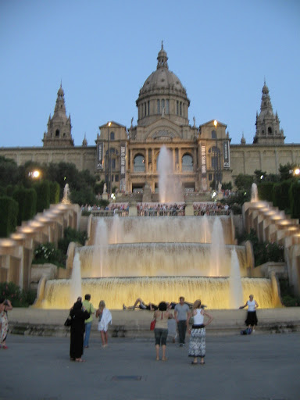
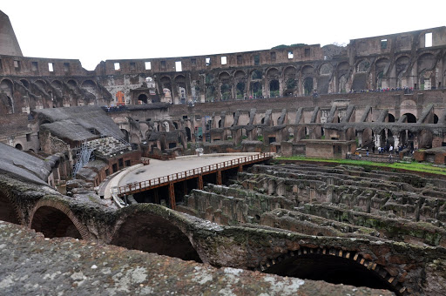
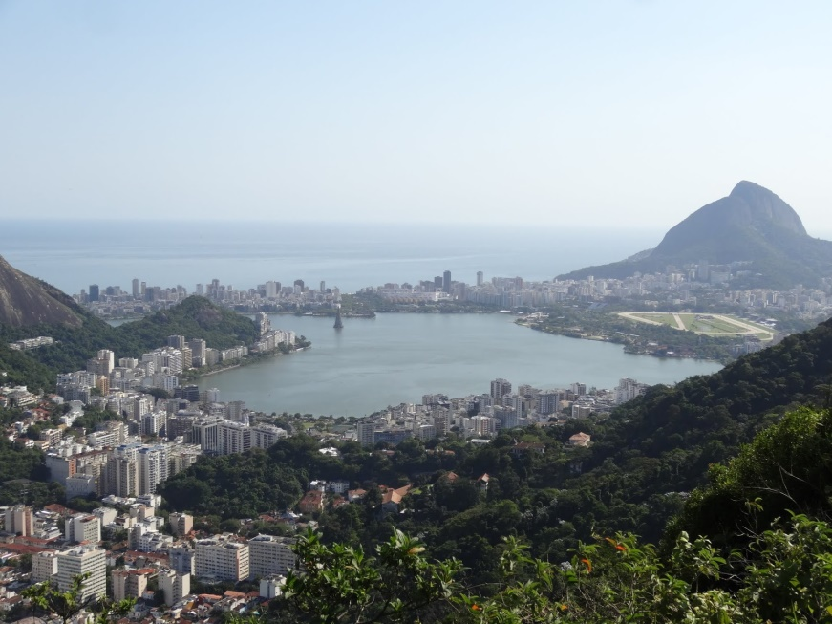
The Challenge
Predict landmark labels directly from image pixels

Slide 3
Our Dataset
90531 Training Images
22632 Validation Images
19951
Test Images
50 Unique Landmarks

Slide 4
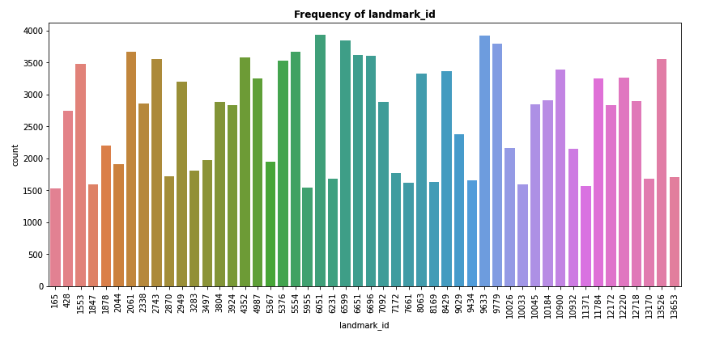
Landmark Frequency

Slide 5
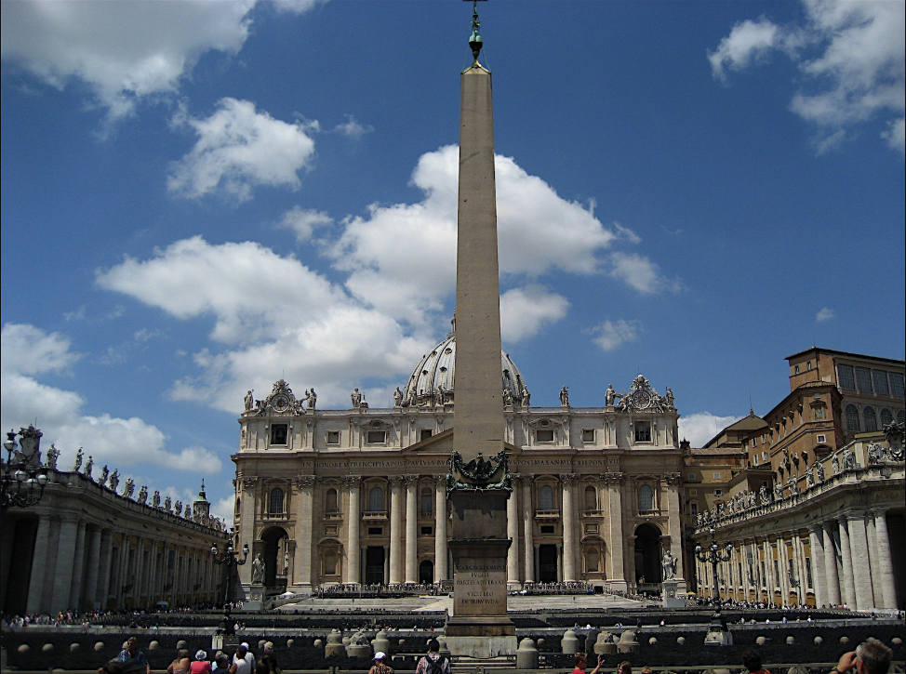
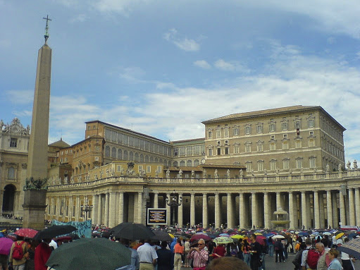

Which is the most frequent landmark?

Slide 6
Images Preprocessing
Converted images to RGB
Resized images to 150x150 pixels
Augmented images using zoom, flips, shifts and rotations

Slide 7
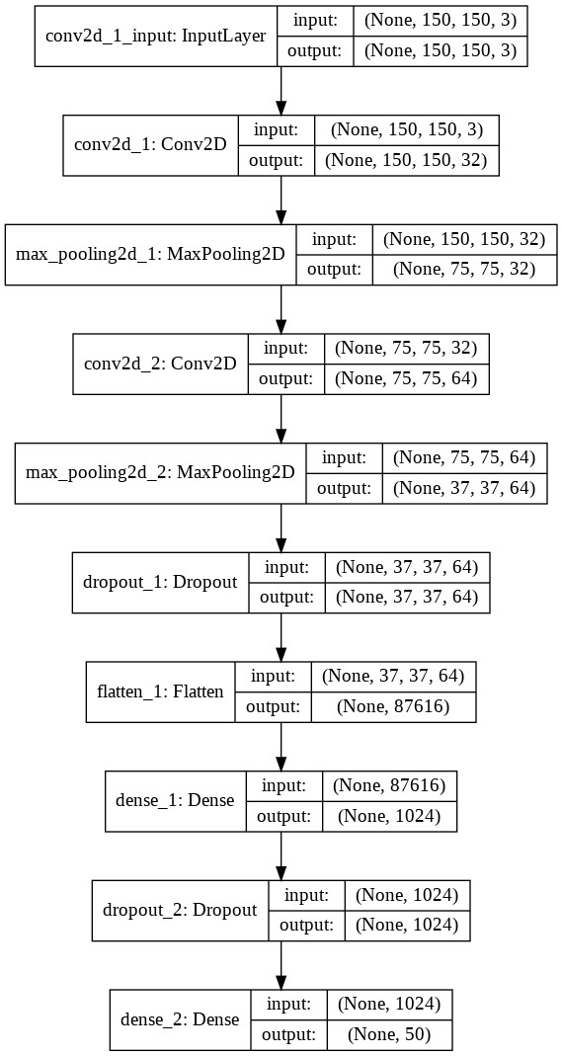
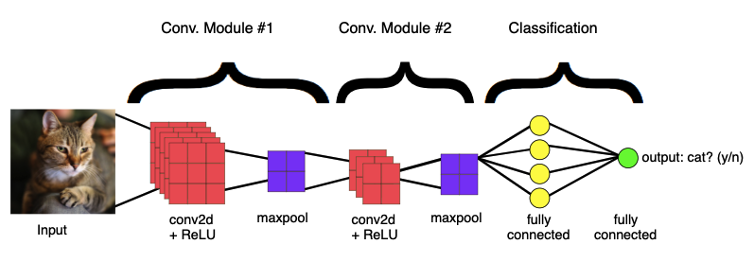
CNN Model
(Layers + Results)

Slide 8
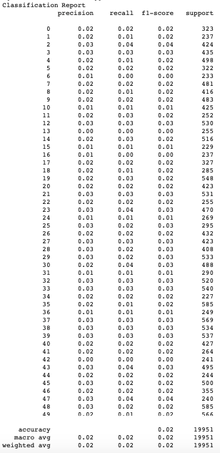
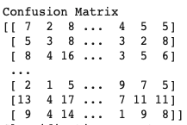
Classification Report - Confusion Matrix

Slide 9
