Slide 1
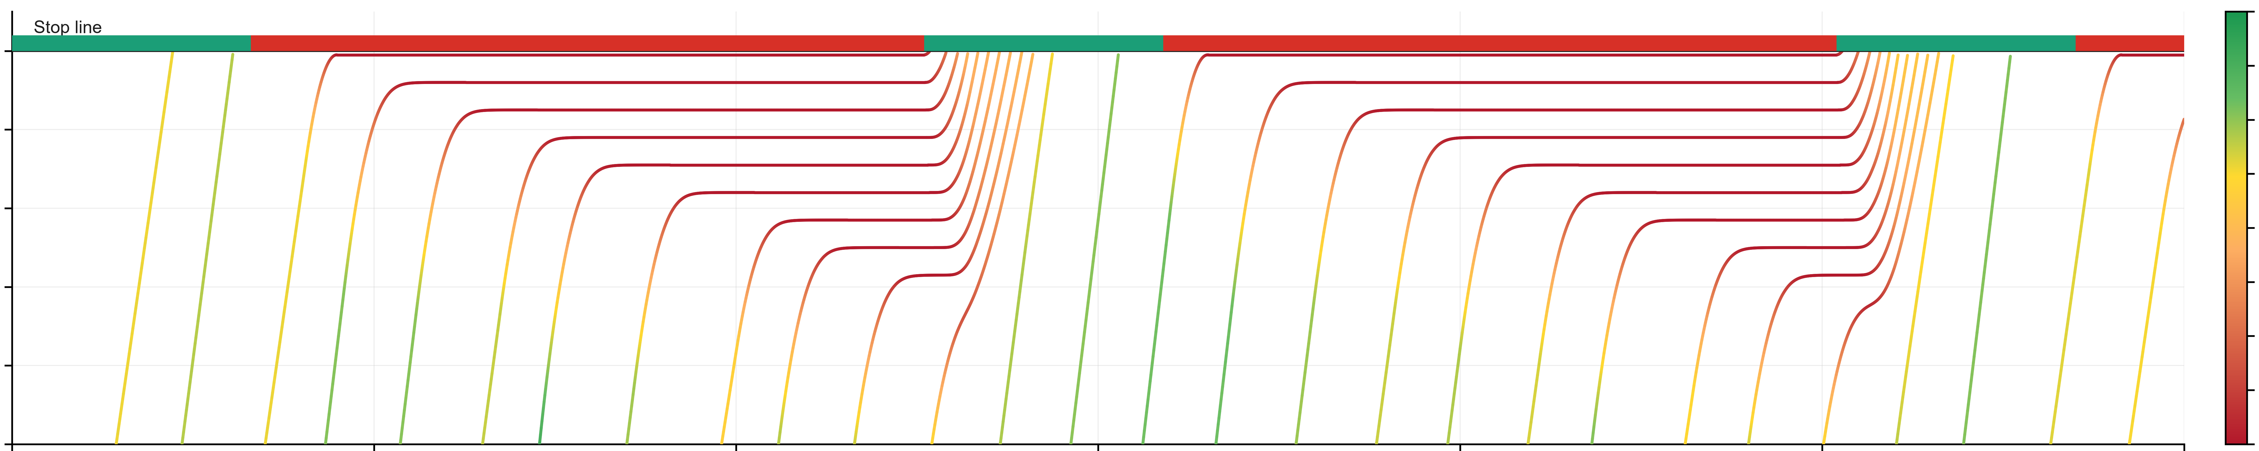
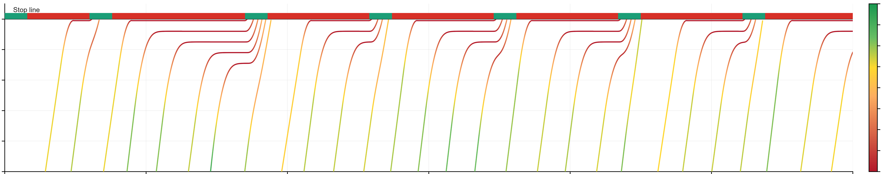
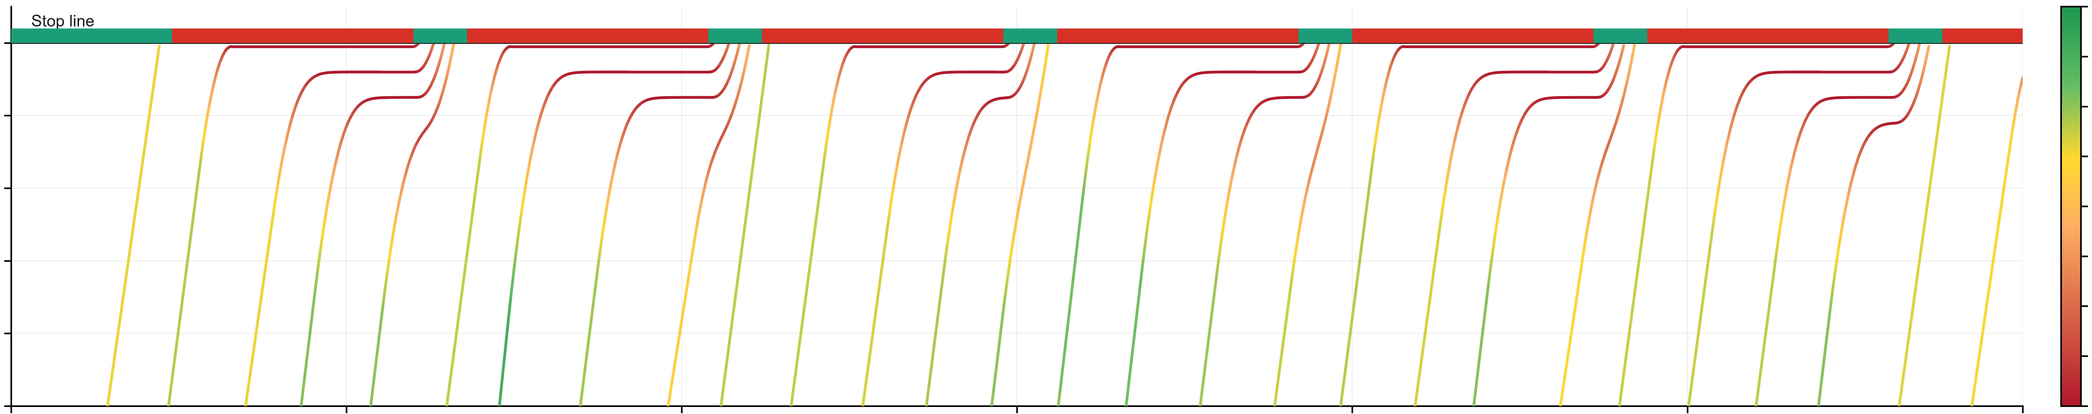
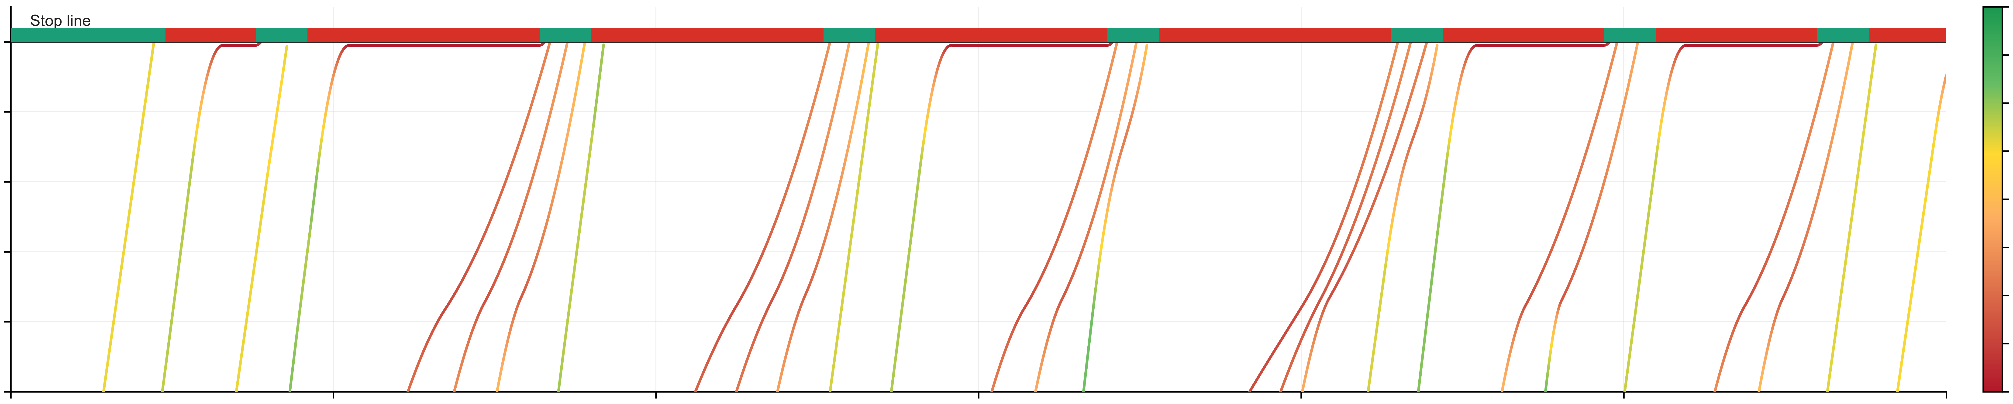
200
Green Signal
Red Signal
20.0
17.5
180
15.0
160
12.5
Speed (m/s)
Distance (m)
10.0
140
7.5
120
5.0
2.5
100
(a) No optimization with fixed signal timing plan
0.0
200
20.0
17.5
180
15.0
160
12.5
Speed (m/s)
Distance (m)
10.0
140
7.5
120
5.0
2.5
100
(b) Integrated optimization with 0% CAV penetration rate
0.0
200
20.0
17.5
180
15.0
160
12.5
Speed (m/s)
Distance (m)
10.0
140
7.5
120
5.0
100
2.5
(c) Integrated optimization with 40% CAV penetration rate
0.0
200
20.0
17.5
180
15.0
160
12.5
Speed (m/s)
Distance (m)
10.0
140
7.5
120
5.0
2.5
100
250
300
0.0
0
50
100
150
200
Time (s)
(d) Integrated optimization with 100% CAV penetration rate

Slide 2
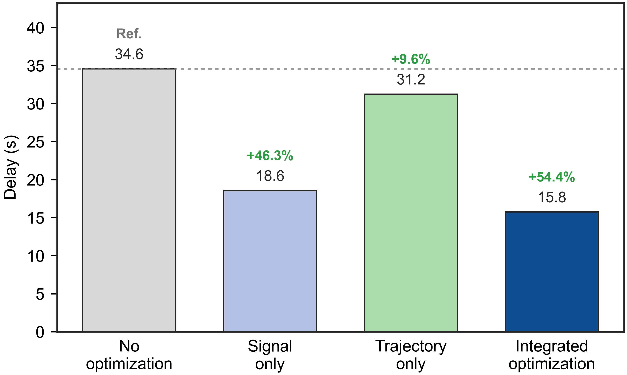
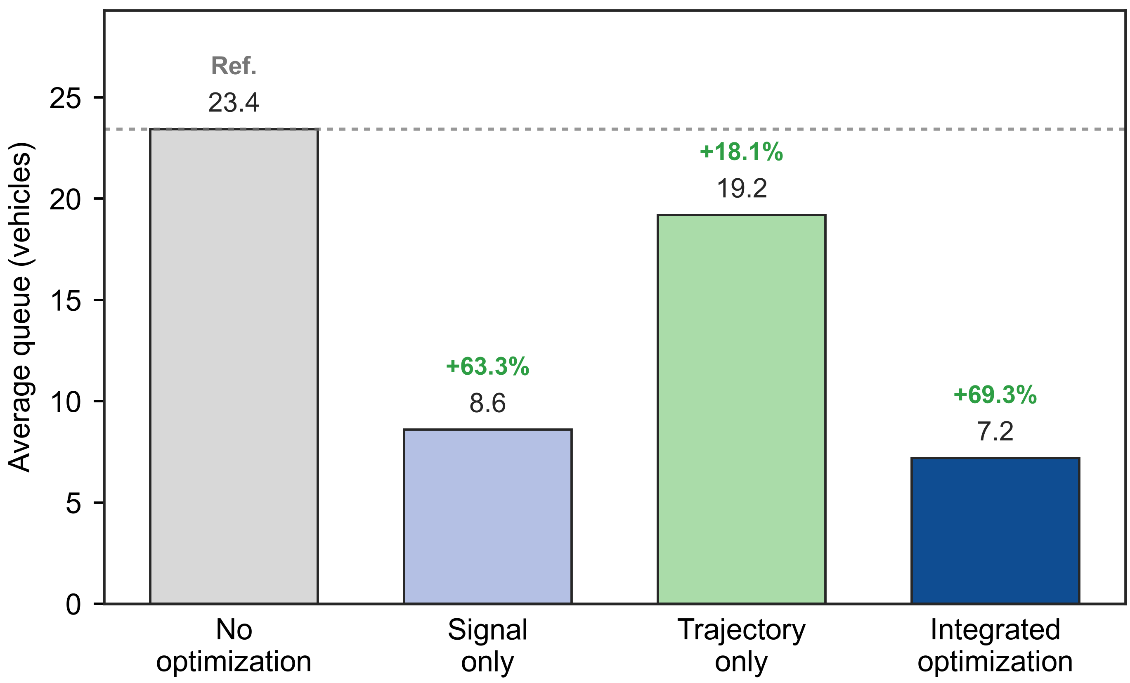
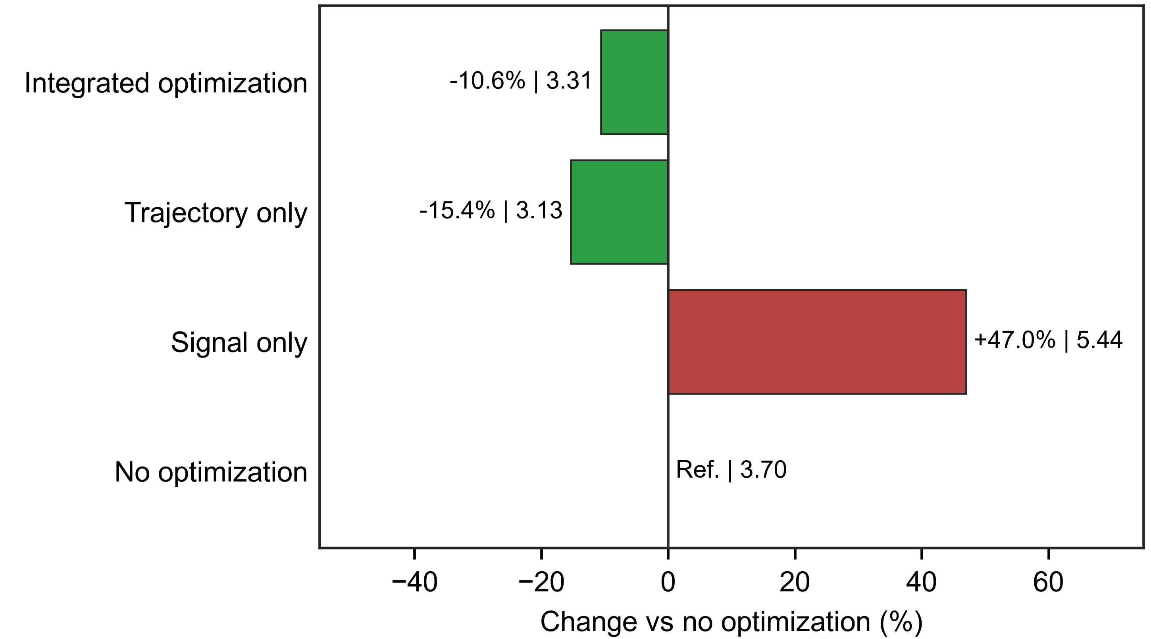
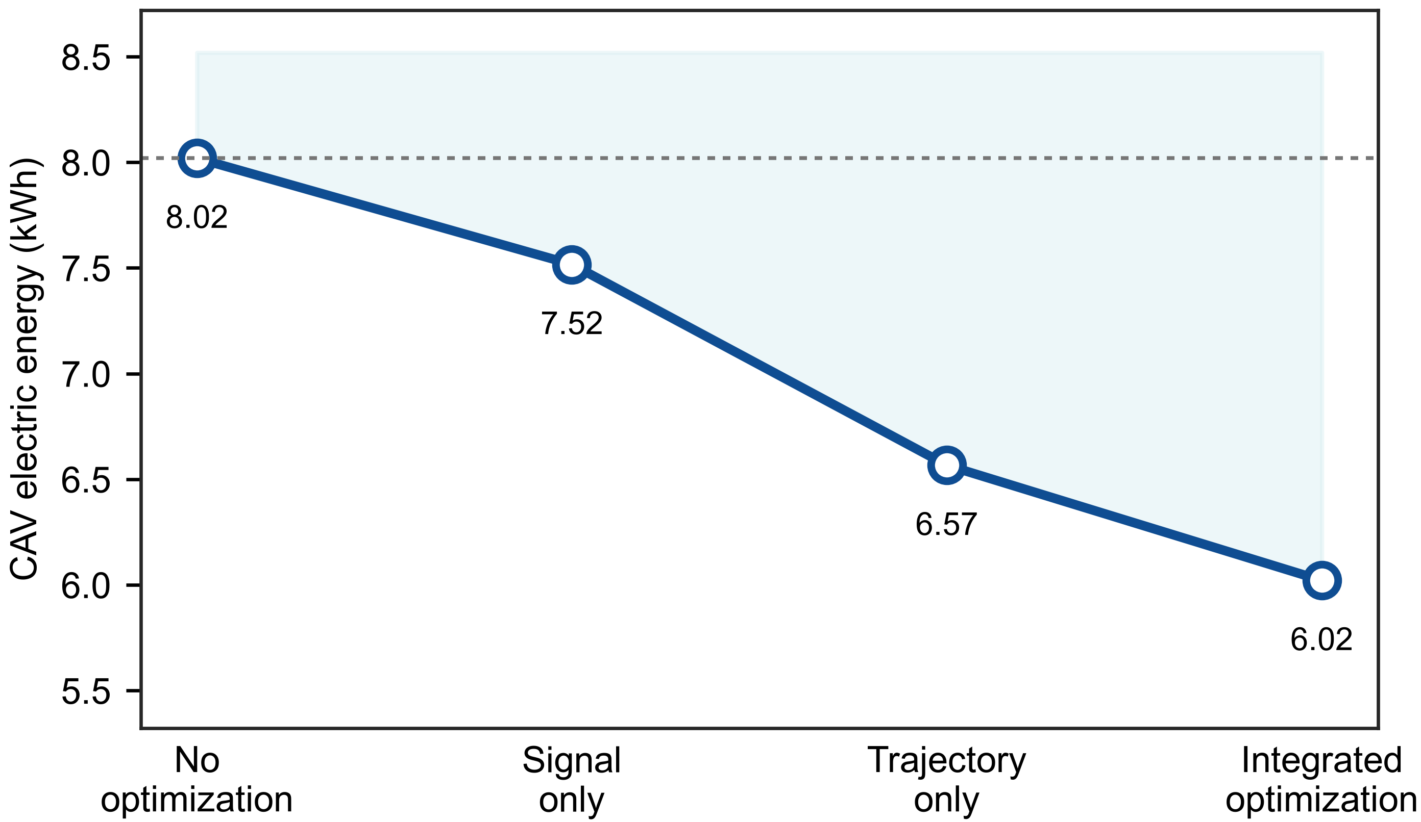
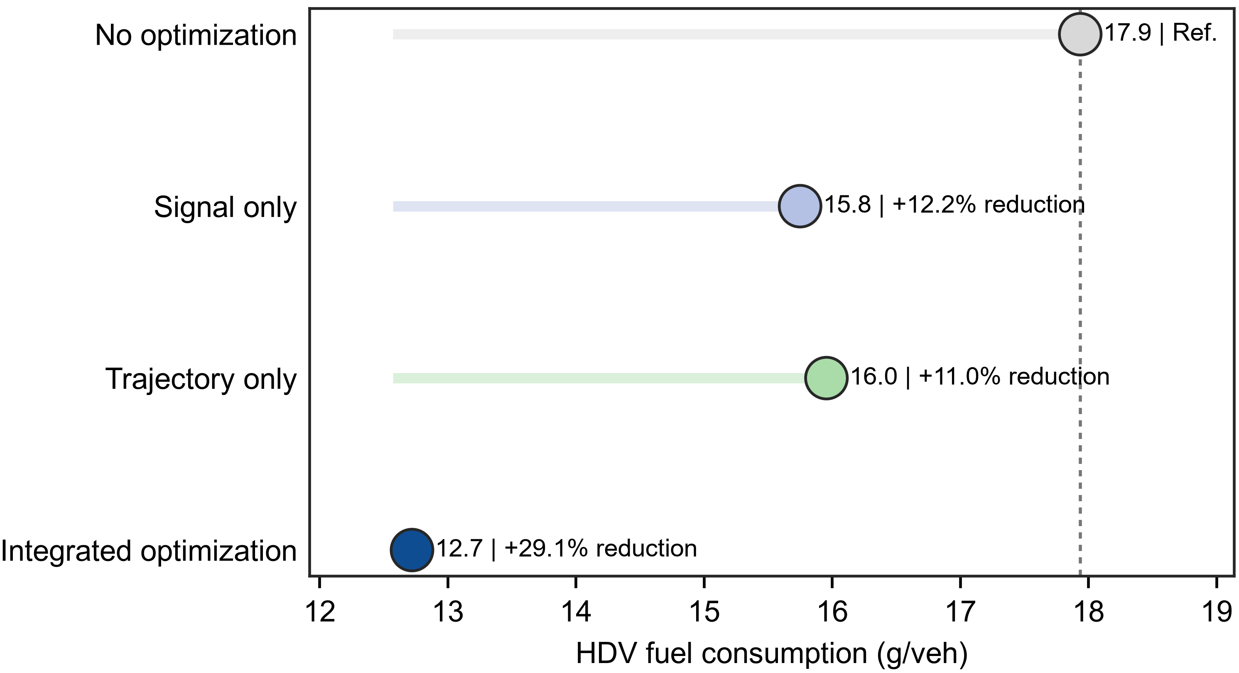
Notes:
English. Integrated optimization produced the lowest delay, decreasing total delay from 34.57 s under no optimization to 15.75 s, a 54.4% reduction. Signal-only optimization already captured a large fraction of this benefit (46.3% reduction), whereas trajectory-only optimization gave a smaller delay reduction (9.6%). This pattern indicates that delay relief was primarily driven by signal control, with trajectory optimization adding a further gain when combined with signal optimization.
中文。 Integrated optimization 取得最低延误，总延误由无优化的 34.57 s 降至 15.75 s，降幅为 54.4%。仅信号优化已经获得主要收益，降幅为 46.3%；仅轨迹优化的降幅较小，为 9.6%。这说明延误改善主要由信号控制贡献，轨迹优化在与信号优化结合后进一步放大收益。
English. Queue length followed the signal-control pattern even more strongly. Integrated optimization reduced the average queue from 23.43 vehicles to 7.20 vehicles (69.3% reduction), outperforming the signal-only result (8.60 vehicles). Trajectory-only optimization also reduced the queue to 19.20 vehicles (18.1% reduction), but the smaller gain suggests that queue discharge was governed mainly by signal timing and was further improved when the signal decision was integrated with trajectory control.
中文。 排队长度更明显地体现了信号控制的主导作用。Integrated optimization 将平均排队从 23.43 辆降至 7.20 辆，降幅为 69.3%，优于仅信号优化的 8.60 辆。仅轨迹优化也将排队降至 19.20 辆，降幅为 18.1%，但收益较小，说明排队消散主要受信号配时影响，而信号决策与轨迹控制集成后可进一步改善排队。
English. HDV fuel consumption benefited from both optimization components. Integrated optimization reduced HDV fuel use from 17.94 g/veh to 12.72 g/veh, a 29.1% reduction. Figure 3 now uses actual fuel consumption on the x-axis, so the leftward position of Integrated optimization directly indicates lower fuel use. Signal-only and trajectory-only optimization produced similar partial reductions (12.2% and 11.0%, respectively), while their combination delivered the largest reduction.
中文。 HDV 油耗同时受益于信号优化和轨迹优化。Integrated optimization 将 HDV 油耗从 17.94 g/veh 降至 12.72 g/veh，降幅为 29.1%。图3现在以实际油耗作为横轴，因此 Integrated optimization 位于更靠左的位置，直接表示油耗更低。仅信号优化和仅轨迹优化分别带来 12.2% 与 11.0% 的部分改善，而二者结合后收益最大。
English. CAV electric energy use was lowest under Integrated optimization, falling from 8.02 kWh to 6.02 kWh (24.9% reduction). Trajectory-only optimization produced a larger energy reduction than signal-only optimization, indicating that CAV energy use was more sensitive to speed-profile smoothing than to signal timing alone. The Integrated optimization result shows that signal efficiency can still be combined with trajectory control to obtain the best energy outcome.
中文。 CAV 电耗在 Integrated optimization 下最低，由无优化的 8.02 kWh 降至 6.02 kWh，降幅为 24.9%。仅轨迹优化的节能效果强于仅信号优化，说明 CAV 电耗对速度剖面的平滑程度更敏感。Integrated optimization 结果进一步表明，信号效率提升可以与轨迹控制结合，从而获得最佳电耗表现。
English. Jerk revealed how trajectory control changed the comfort trade-off. Signal-only optimization increased mean absolute jerk from 3.70 to 5.44 m s${−3}^{}$, whereas trajectory-only optimization reduced jerk to 3.13 m s${−3}^{}$. Integrated optimization lowered jerk relative to signal-only optimization by 39.2% and also reduced it below the no-optimization case by 10.6%. Thus, the corrected result indicates that the integrated strategy can improve both efficiency and the ride-comfort proxy.
中文。 jerk 结果体现了轨迹控制对舒适性权衡的改变。仅信号优化将平均绝对 jerk 从 3.70 m s${−3}^{}$ 提高至 5.44 m s${−3}^{}$，而仅轨迹优化将其降至 3.13 m s${−3}^{}$。Integrated optimization 相较仅信号优化降低了 39.2% 的 jerk，并且比无优化进一步降低 10.6%。因此，修正后的结果表明集成策略能够同时改善效率和舒适性代理指标。

Slide 3
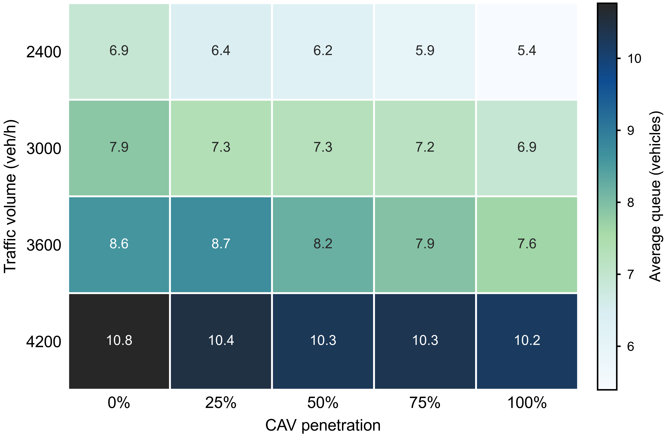
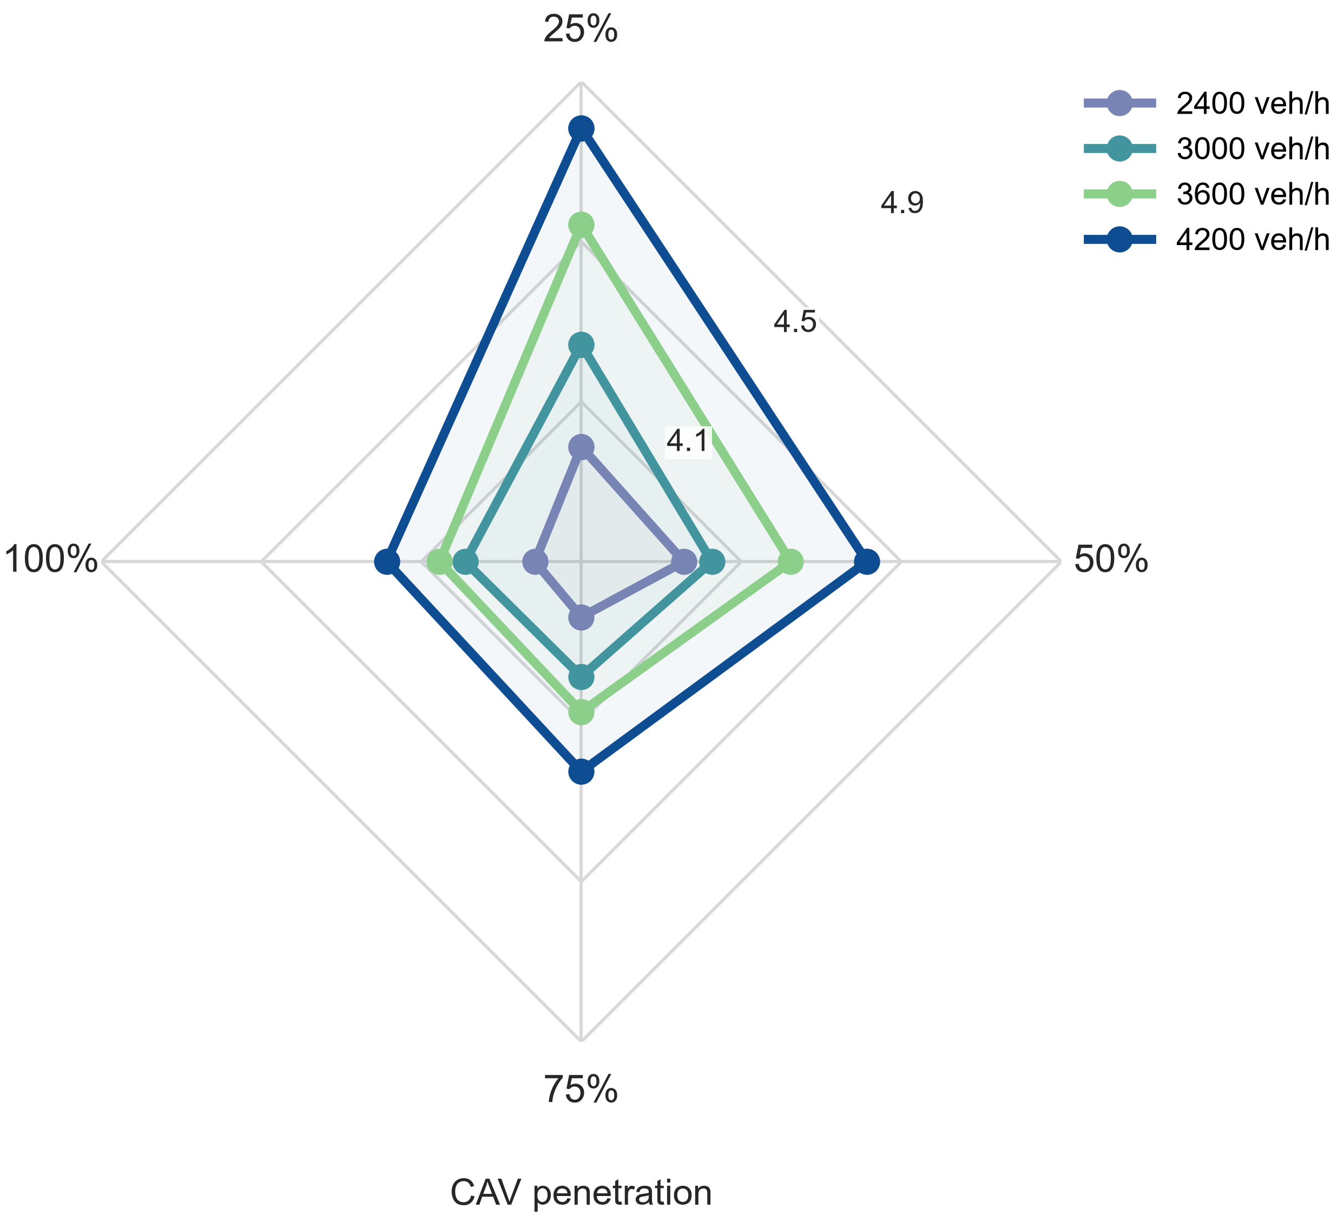
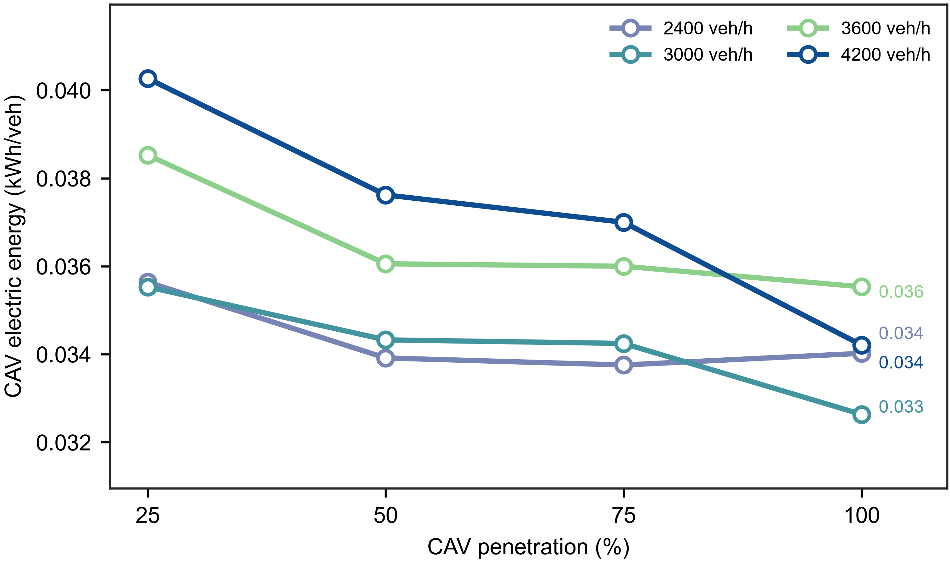
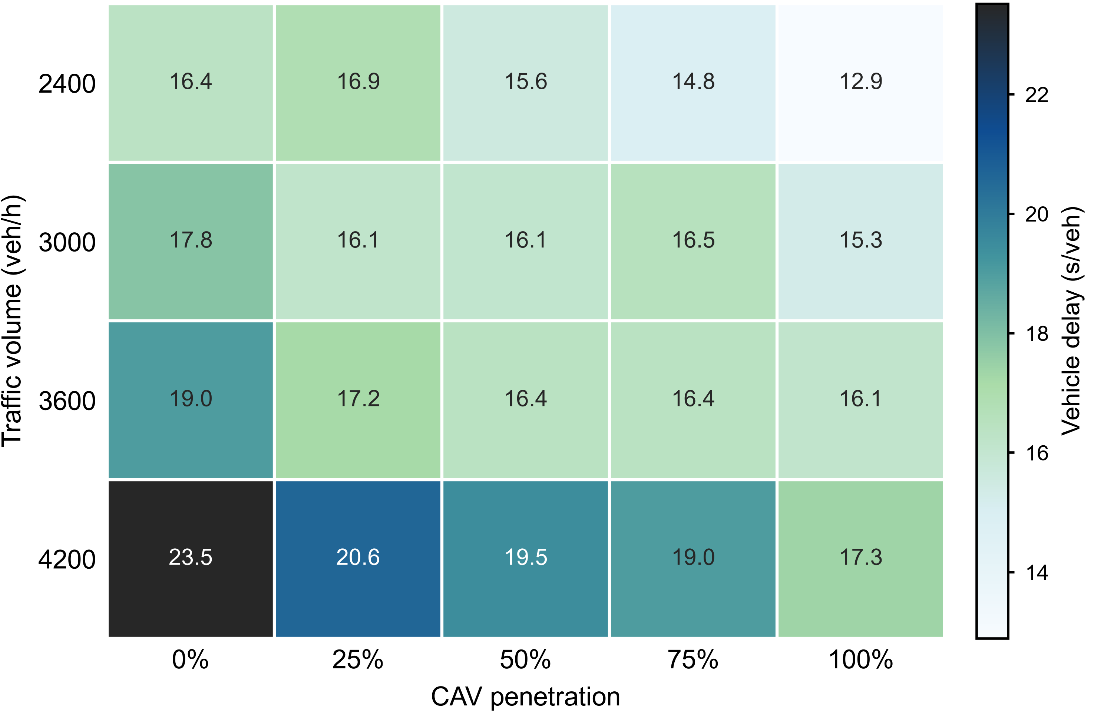
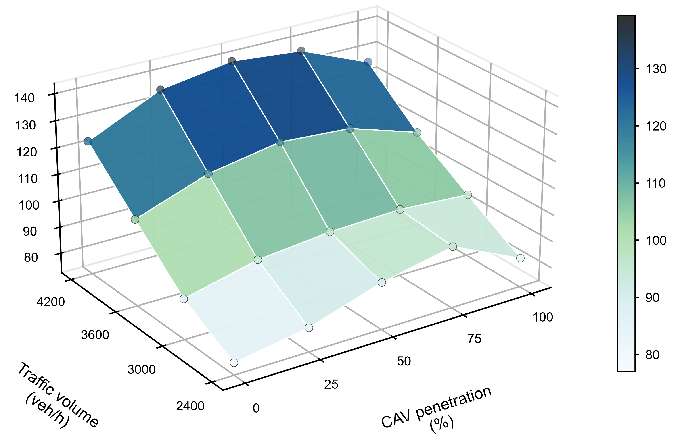
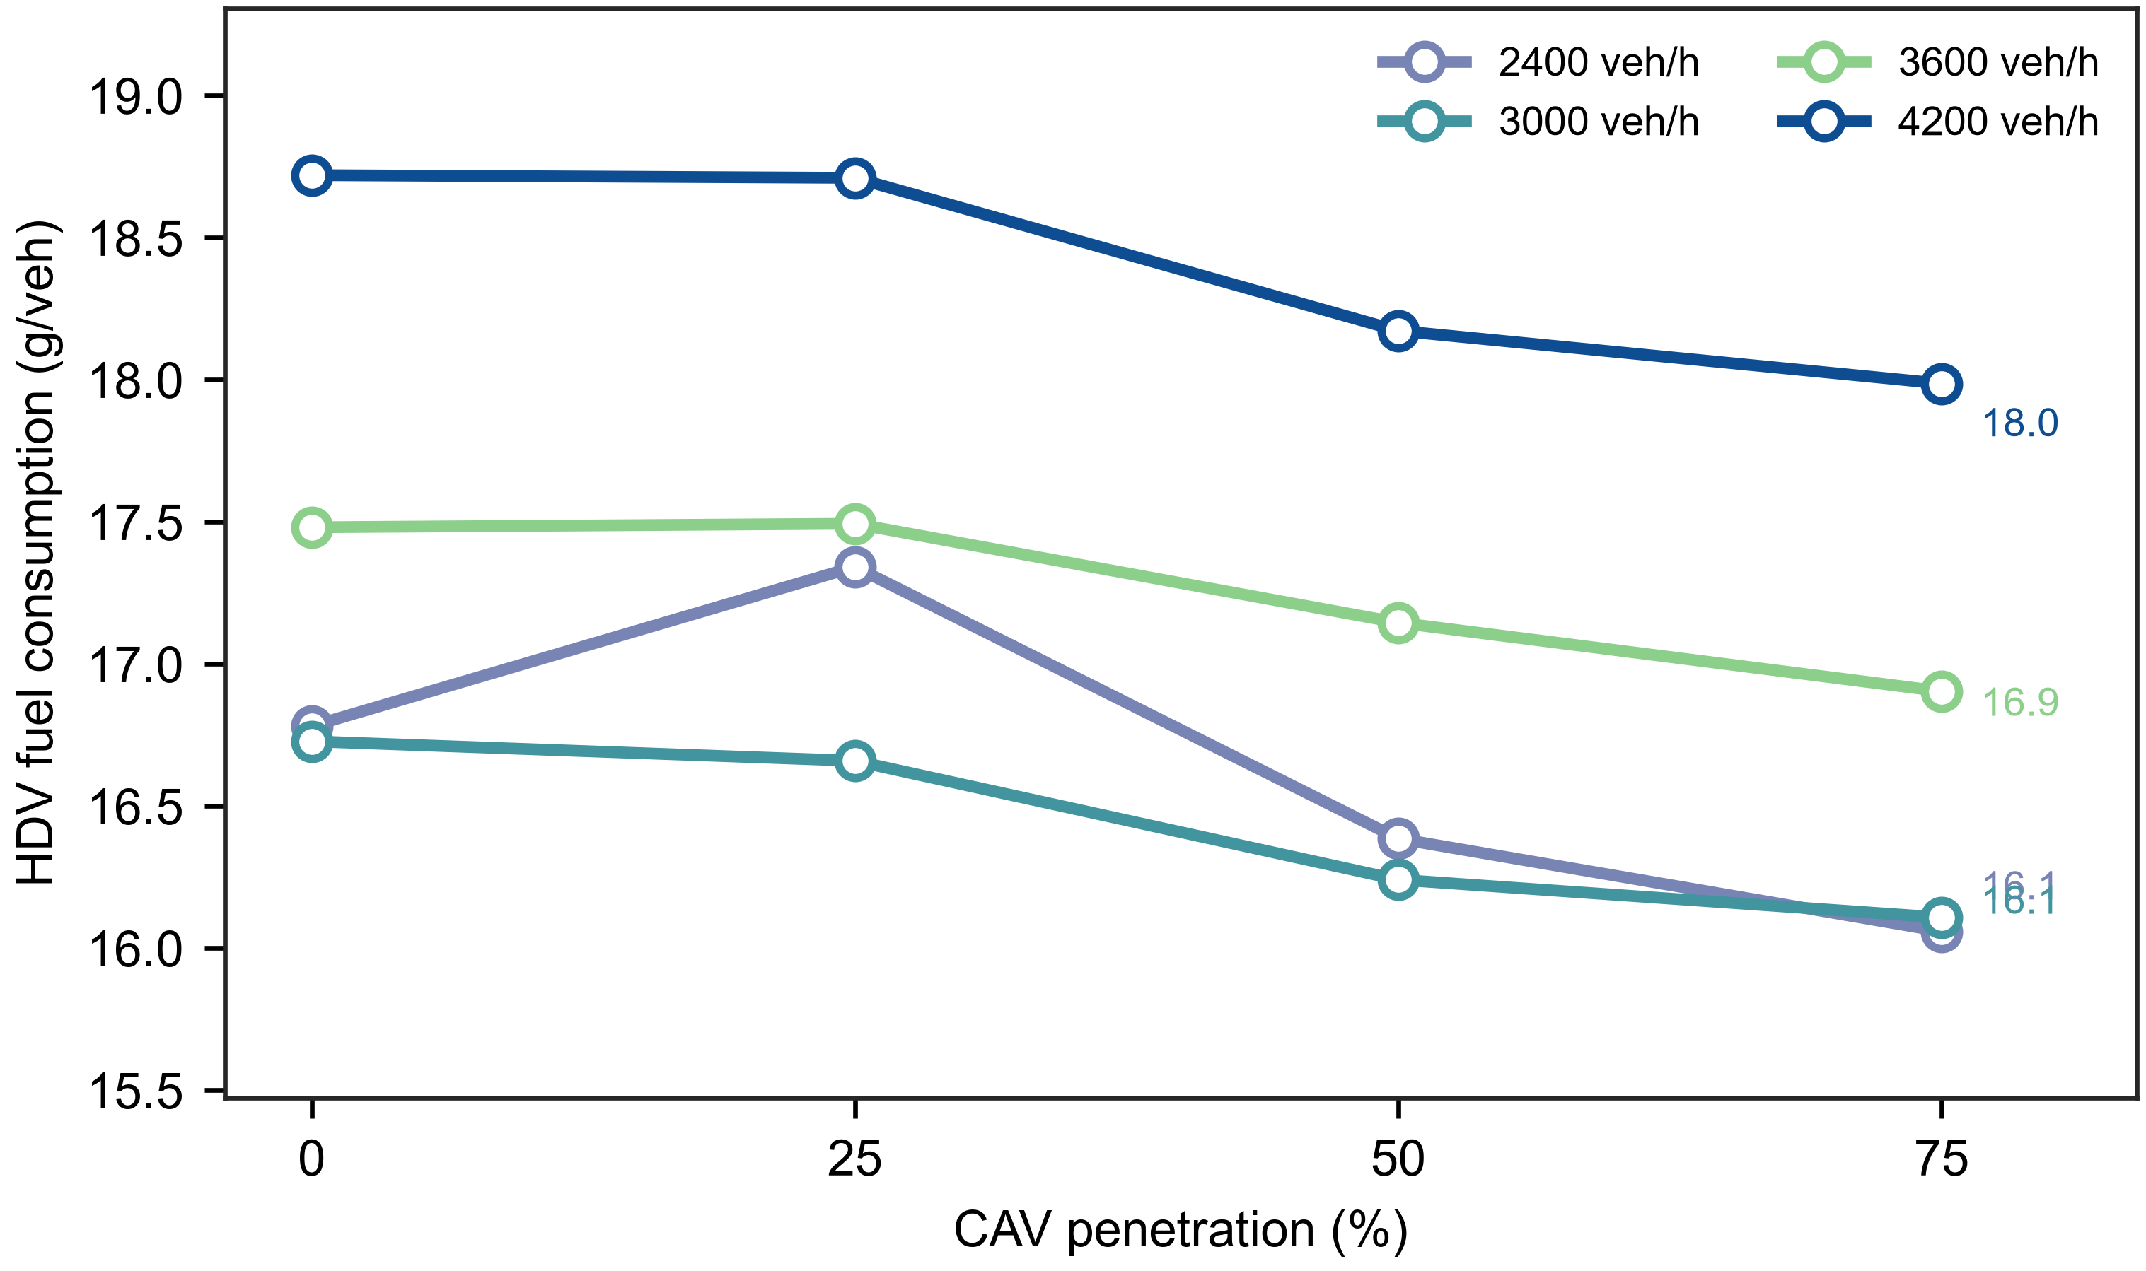
Notes:
English. Delay generally increased with traffic volume and decreased with higher CAV penetration. Across the four traffic volumes, moving from 0% to 100% CAV penetration reduced delay by an average of 19.2%. The best cell was 12.89 s/veh at 2400 veh/h and 100% CAV penetration, whereas the worst cell was 23.51 s/veh at 4200 veh/h and 0% penetration. The pattern suggests that Integrated optimization becomes especially valuable as the CAV share increases.
中文。 延误总体随交通量升高而增大，并随 CAV 渗透率提高而降低。在四个交通量水平上，从 0% 提高到 100% CAV 渗透率平均降低延误 19.2%。最优单元为 2400 veh/h、100% CAV 渗透率下的 12.89 s/veh；最差单元为 4200 veh/h、0% 渗透率下的 23.51 s/veh。这说明 Integrated optimization 的延误收益会随着 CAV 比例增加而更加明显。
English. Queue length rose with traffic volume, while the benefit of CAV penetration was more limited than for delay. Increasing CAV penetration from 0% to 100% reduced the average queue by 12.6% across volumes, but the high-demand case retained a large queue even at full penetration. The minimum queue was 5.40 vehicles, and the maximum was 10.76 vehicles. This indicates that penetration improves discharge, but demand pressure remains the dominant queue driver.
中文。 排队长度随交通量增加而上升，CAV 渗透率带来的排队改善弱于延误改善。从 0% 到 100% CAV 渗透率，四个交通量下平均排队降低 12.6%，但高交通量场景即使在全 CAV 条件下仍保持较高排队。最小排队为 5.40 辆，最大排队为 10.76 辆。这表明渗透率提升有助于放行效率，但交通需求压力仍是排队的主导因素。
English. HDV fuel consumption increased with traffic volume and showed modest reductions at higher CAV penetration before the 100% CAV case became not applicable. Comparing 0% and 75% CAV penetration, HDV fuel use decreased by an average of 3.8% across volumes. The lowest applicable value was 16.06 g/veh, and the highest was 18.72 g/veh. The modest magnitude suggests that HDV fuel savings depend on both smoother flow induced by CAVs and the remaining HDV operating environment.
中文。 HDV 油耗随交通量增加而上升，并在较高 CAV 渗透率下出现温和下降；100% CAV 条件下因不存在 HDV 而不适用。比较 0% 与 75% CAV 渗透率，HDV 油耗平均降低 3.8%。适用单元中的最低值为 16.06 g/veh，最高值为 18.72 g/veh。改善幅度相对有限，说明 HDV 油耗收益同时取决于 CAV 诱导的交通流平滑效应和剩余 HDV 的运行环境。
English. CAV energy use was not applicable at 0% CAV penetration and otherwise tended to increase under heavier traffic. Within each demand level, higher CAV penetration generally reduced per-CAV energy use; from 25% to 100% penetration, the average reduction was 8.9%. The maximum energy use occurred at 4200 veh/h and 25% penetration, whereas the minimum occurred at 3000 veh/h and 100% penetration. This pattern is consistent with energy benefits from smoother integrated trajectories and reduced interaction with HDVs.
中文。 0% CAV 渗透率下 CAV 电耗不适用；在存在 CAV 的条件下，电耗总体随交通量增加而升高。在同一交通量下，提高 CAV 渗透率通常会降低单位 CAV 电耗；从 25% 提高到 100% 渗透率，平均降幅为 8.9%。最大电耗出现在 4200 veh/h、25% 渗透率，最小电耗出现在 3000 veh/h、100% 渗透率。这与集成轨迹更平滑、且与 HDV 交互减少带来的节能作用一致。
English. CAV jerk increased with traffic volume but decreased as penetration rose from 25% to 100%, with an average reduction of 8.1%. The worst applicable jerk value was 4.79 m s${−3}^{}$ at 4200 veh/h and 25% penetration, while the lowest was 3.86 m s${−3}^{}$. This suggests that mixed traffic at low CAV penetration creates more irregular CAV responses, whereas higher penetration enables smoother integrated motion.
中文。 CAV jerk 随交通量升高而增加，但从 25% 提高到 100% 渗透率时总体下降，平均降幅为 8.1%。适用单元中的最大 jerk 为 4.79 m s${−3}^{}$，出现在 4200 veh/h、25% 渗透率；最低值为 3.86 m s${−3}^{}$。这说明低 CAV 渗透率下的混行交互更容易造成 CAV 响应不规则，而高渗透率有利于形成更平滑的集成控制行驶。
English. Computation time stayed within the minute-scale range of 77.0-139.3 s across all tested conditions. It generally increased with traffic volume, but the maximum occurred at 4200 veh/h and 50% penetration rather than at the highest-demand full-penetration case. From 0% to 100% penetration, wall time increased by 6.1% on average across traffic volumes, indicating that computational burden is not strictly monotonic in penetration and may depend on solver interactions with mixed-fleet composition.
中文。 所有测试条件下计算时间均处于 77.0-139.3 s 的分钟级范围。计算时间总体随交通量增加而升高，但最大值出现在 4200 veh/h、50% 渗透率，而不是最高交通量且全 CAV 的情形。从 0% 到 100% 渗透率，四个交通量下的 wall time 平均增加 6.1%，说明计算负担并不随渗透率单调变化，可能还受混合车队组成与求解过程交互影响。

Slide 4
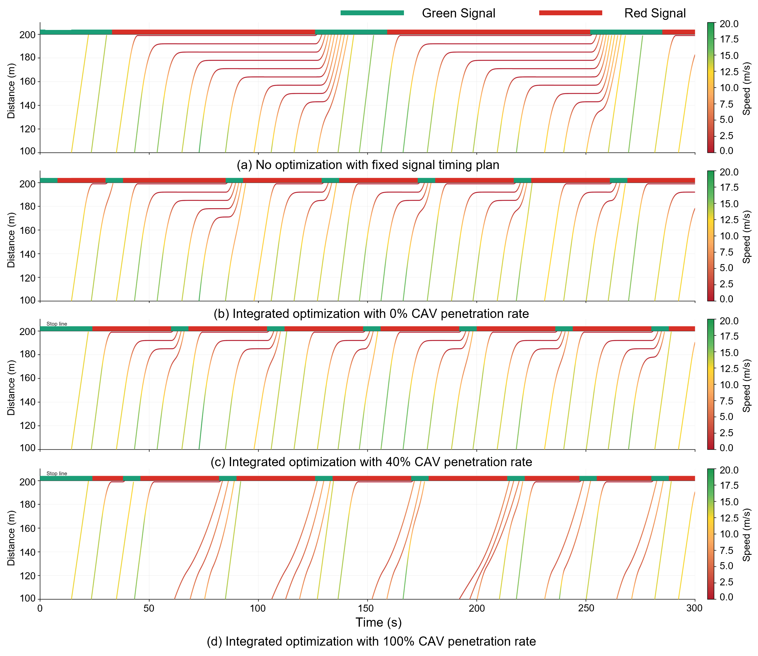
Notes:
时空图结果表明，信号-轨迹协同优化能够有效改善停车线附近的微观交通运行状态，主要体现为排队积聚减少、低速滞留减弱以及启停行为下降。在无优化场景下，车辆轨迹在停车线前出现较长的水平或近水平段，说明车辆在红灯期间存在明显等待，且排队现象较为突出。引入协同优化后，即使在 CAV 渗透率为 0% 的条件下，车辆放行过程也更加规律，表明单纯的信号优化已经能够在一定程度上降低延误。随着 CAV 渗透率由 40% 提高至 100%，车辆轨迹进一步呈现出更加平滑、连续的特征，低速红色轨迹段和停车线前的明显停车现象逐步减少。这说明协同优化策略能够使车辆由被动等待红灯逐渐转向提前减速、平滑接近和有序通过，从而提升停车线上游 100 m 控制区域内的放行效率与交通流稳定性。需要说明的是，上述结论主要来自时空图的定性可视化证据，后续可结合车均延误、停车次数和通行效率等定量指标进一步验证。
The time-space diagrams indicate that signal-trajectory cooperative optimization improves microscopic traffic operations near the stop line by reducing queue formation, low-speed dwelling, and repeated stop-and-go behavior. In the no-optimization scenario, vehicle trajectories show long horizontal or near-horizontal segments before the stop line, indicating substantial red-light waiting and queue accumulation. When cooperative optimization is introduced, even at 0% CAV penetration, the stop-line discharge becomes more regular, suggesting that optimized signal timing alone can partially relieve delay. As the CAV penetration rate increases from 40% to 100%, trajectories become smoother and more continuous, with fewer low-speed segments and less pronounced stopping before the stop line. These patterns suggest that the proposed cooperative strategy increasingly shifts vehicles from passive red-light waiting to anticipatory speed adjustment, thereby improving discharge efficiency and stabilizing traffic flow within the upstream 100 m control region. This conclusion is based on the qualitative trajectory and signal patterns shown in the time-space diagrams; quantitative delay, stop frequency, and throughput indicators should be reported separately to further support the visual evidence.

Slide 5
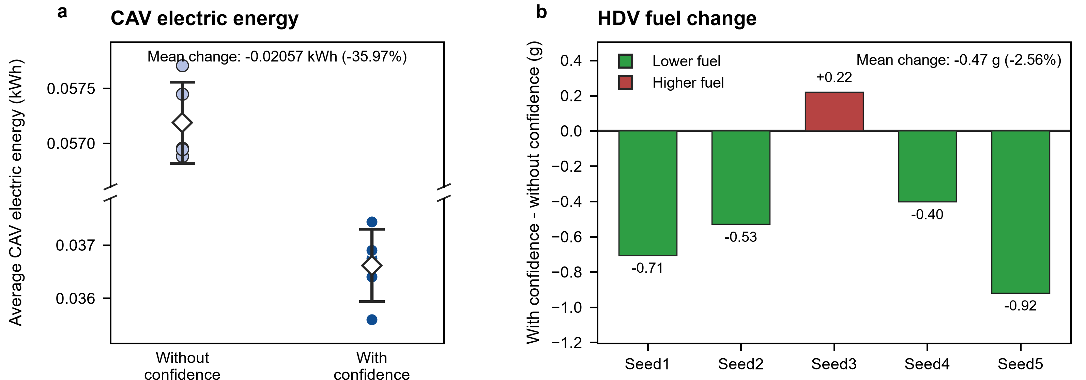
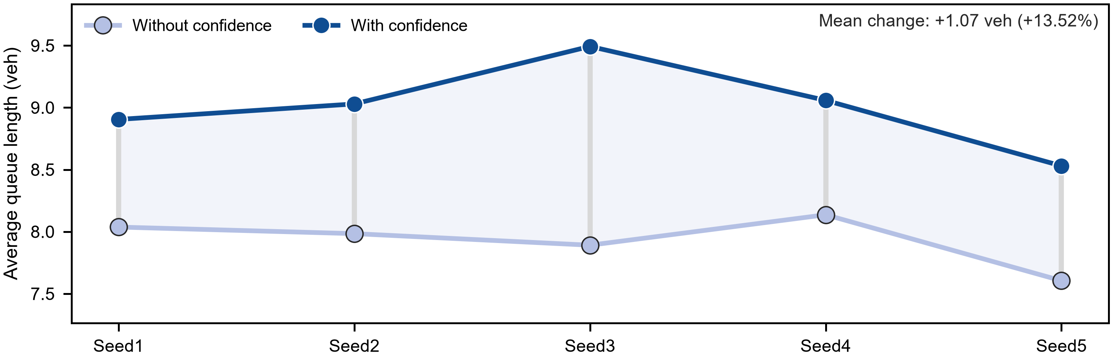
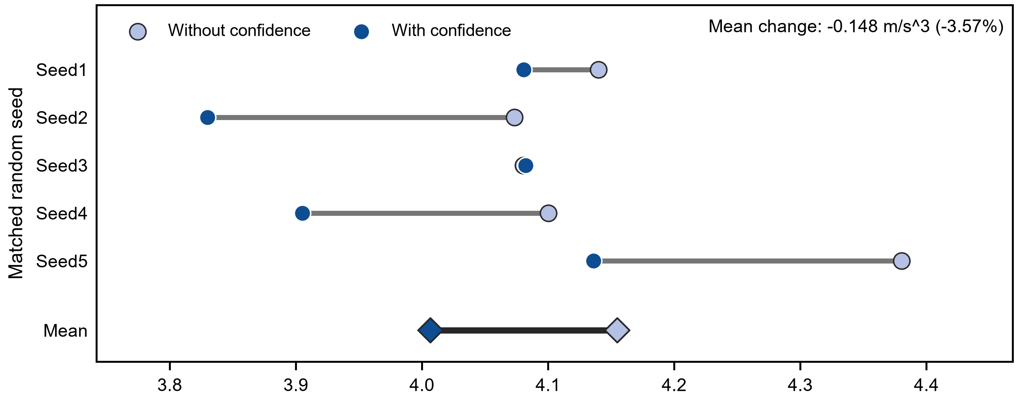
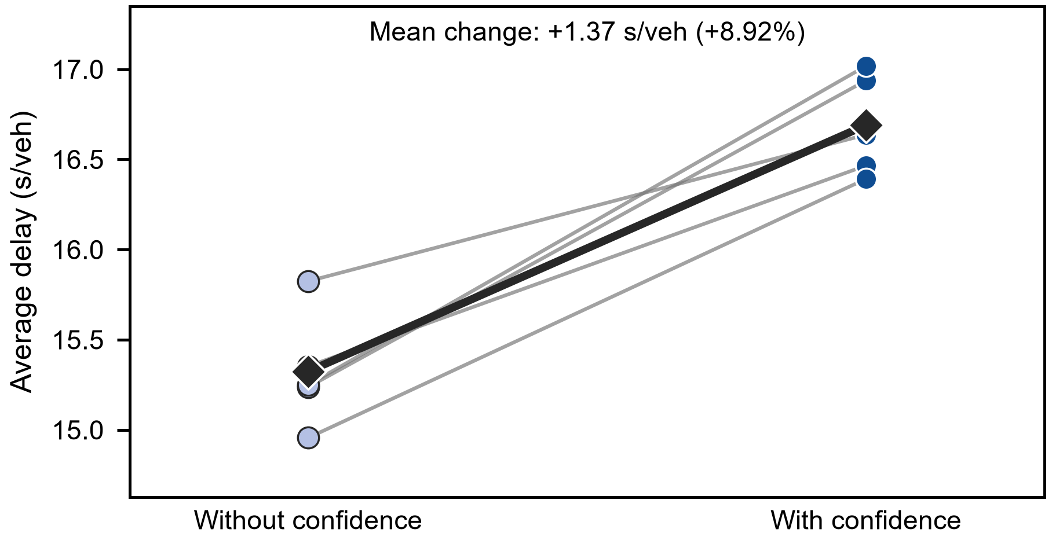
Notes:
With confidence 使车均延误由 15.32 s/veh 增至 16.69 s/veh，平均变化为 +1.37 s/veh（+8.92%）。5 个匹配 seed 的延误均上升，逐 seed 增幅介于 5.14%–11.61% 之间（双侧精确符号翻转 p = 0.062）。所有 seed 均出现效率损失，说明该趋势更像是两种控制结构差异的系统性结果，而非某个随机交通实现造成的异常。无置信度基线从信号 DQN 中删除置信度通道，并将后方 HDV 置信度固定为 1.0、位置噪声固定为 0；这相当于假设 HDV 完全信任前方 CAV，采用模型允许的最小 IDM 期望时距，并按确定性方式跟驰。这种乐观假设允许控制器利用更紧凑的车队和更理想的信号–轨迹配合。引入动态置信度后，只要置信度低于 1.0，模型中的 HDV 期望时距就会增大，同时后向机会约束还要面对随机位置分布。因此，上层信号策略和下层 MPC 均不能再默认 HDV 会作出完全理想的响应。在 50% CAV 渗透率下，CAV 经常充当后续 HDV 的移动前车，CAV 进度或车队紧凑度的轻微下降会沿车队向上游传播并累积为延误。
With confidence increased mean vehicle delay from 15.32 to 16.69 s/veh, a mean change of +1.37 s/veh (+8.92%). Delay increased in all five matched seeds, with seed-level increases ranging from 5.14% to 11.61% (exact two-sided sign-flip p = 0.062). This uniform efficiency penalty is consistent with the structural difference between the two controllers rather than a single adverse realization. The no-confidence baseline removes the confidence channel from the signal DQN and fixes rear-HDV confidence at 1.0 with zero position noise, which represents complete trust, the minimum modeled IDM headway, and deterministic following. That optimistic model permits the controller to exploit compact platoons and nominal phase-trajectory coordination. In contrast, dynamic confidence generally enlarges the modeled HDV headway whenever confidence is below 1.0 and introduces a stochastic rear-HDV position distribution into the chance constraint. The upper-level signal policy and lower-level MPC therefore act on less idealized response assumptions. At 50% CAV penetration, a CAV is often a moving leader for one or more HDVs, so a modest reduction in CAV progress or platoon compactness can propagate upstream and accumulate as vehicle delay.
平均排队长度由 7.93 辆增至 9.00 辆（+13.52%；平均变化 +1.07 辆）。所有 seed 均上升，增幅范围为 10.79%–20.29%，其中 Seed3 的增幅最大（+20.29%；精确 p = 0.062）。 排队长度的相对增幅（13.52%）高于延误增幅（8.92%），说明效率损失主要集中在低速或停车状态，而不只是所有车辆巡航速度均匀下降。置信度感知跟驰会增大有效车队间距、降低车队放行紧凑度；当 HDV 响应可靠性较低时，含置信度的信号策略也可能不再选择名义条件下最快的相位序列。这些局部变化会减少单位有效绿灯内的放行车辆数，使残余排队延续到下一相位。Seed3 的放大效应符合一种拥堵阈值机制：一旦某一周期未能清空队列，下一到达车队便会与残余队列叠加，使损失呈非线性增长。不过，该解释仍属于机制推断，因为当前六项结果尚未直接提供相位利用率、饱和流率、停车次数和残余队列跨周期传播数据。
Mean queue length increased from 7.93 to 9.00 vehicles (+13.52%; mean change +1.07 vehicles). Every seed increased, from 10.79% to 20.29%, and Seed3 showed the largest increase (+20.29%; exact p = 0.062). The queue increase (13.52%) was proportionally larger than the delay increase (8.92%), indicating that the efficiency loss was concentrated in low-speed or stopped states rather than being only a uniform reduction in cruising speed. Confidence-aware following can enlarge effective platoon gaps and reduce discharge compactness; confidence-conditioned signal actions can also redistribute green time away from the nominally fastest sequence when the observed HDV response is less reliable. These local changes lower the number of vehicles discharged per effective green and allow residual queues to carry into subsequent phases. The amplification in Seed3 is consistent with a threshold effect: once a residual queue is not cleared, the next arrival platoon joins it and the penalty grows nonlinearly. This interpretation is plausible but remains indirect because phase utilization, saturation flow, stop counts, and residual-queue carryover were not included in the six reported outcomes.
平均每辆到达 CAV 的电耗由 0.05719 kWh 降至 0.03662 kWh，平均降低 35.97%（-0.02057 kWh）。5 个 seed 均下降，降幅介于 34.27%–38.03%（精确 p = 0.062）。平均每辆到达 HDV 的油耗降低 2.56%（-0.47 g），逐 seed 变化范围为 -5.03%–+1.22%（精确 p = 0.125）。 CAV 电耗在所有 seed 中大幅且稳定下降，这与下层目标函数的结构一致：MPC 同时惩罚凸牵引力代理项、加速度和 jerk，并通过速度跟踪及软 SUMO 进度下限约束抑制单纯停车节能。相较于固定置信度 1.0，动态置信度通常会预测更大的 HDV 跟驰时距，从而减弱后方 HDV 对前方 CAV 保持激进紧凑轨迹的压力，使优化器能够采用更多滑行和更小的控制变化，降低正向牵引功率需求。但 CAV 电耗降幅（35.97%）远大于 jerk 降幅（3.57%），说明仅靠平顺化不足以解释全部变化。延误和排队同步增加表明，较低运行速度、更长等待、绿波到达条件变化或高功率再加速次数减少也参与了节能。此外，优化内部使用的是电耗代理目标，而图中电耗由实际 SUMO 速度和加速度事后计算；二者方向一致具有支持意义，但“每辆到达 CAV 电耗”仍可能偏好较慢的运行点，后续应增加单位里程电耗与系统吞吐量以排除这种归一化影响。HDV 油耗收益较小，是因为 HDV 油耗并未直接进入 CAV 轨迹目标，只能通过跟驰传播间接受益。更平顺的 CAV 运动可削弱后车加速波，但更长排队会增加怠速与再起步成本。排队增幅最大的 Seed3 也是唯一出现 HDV 油耗上升的 seed（+1.22%），说明拥堵成本可以抵消平顺跟驰带来的节油收益。
CAV electric energy decreased from 0.05719 to 0.03662 kWh per arrived CAV, a mean reduction of 35.97% (-0.02057 kWh). All five seeds decreased, with reductions between 34.27% and 38.03% (exact p = 0.062). HDV fuel consumption decreased by 2.56% on average (-0.47 g per arrived HDV), with seed-level changes from -5.03% to +1.22% (exact p = 0.125). The large and highly repeatable CAV energy reduction is compatible with the lower-level objective, which penalizes a convex traction-force proxy together with acceleration and jerk while retaining speed tracking and a soft SUMO progress floor. Relative to the fixed-confidence value of 1.0, dynamic confidence can predict a larger HDV following headway and therefore reduce the pressure on the leading CAV to preserve an aggressive, tightly coupled trajectory. The optimizer can then use more coasting and smaller control changes, reducing positive traction demand. However, the 35.97% energy reduction is much larger than the 3.57% jerk reduction, so smoother control alone is unlikely to explain the full magnitude. The simultaneous increases in delay and queue length indicate that lower speed, longer waiting, altered green-wave access, or fewer high-power accelerations also contributed. The optimization uses an energy proxy whereas the reported electricity is evaluated ex post from realized SUMO speed and acceleration; the agreement in direction is therefore informative, but energy per arrived vehicle can still favor a slower operating point and should be complemented by energy per distance and system throughput. The smaller HDV fuel benefit is an indirect spillover because HDV fuel is not directly minimized by the CAV trajectory objective. Smoother CAV motion can attenuate acceleration waves for following HDVs, but longer queues add idling and restart costs. Seed3, which had the largest queue increase, was also the only seed with higher HDV fuel (+1.22%), showing that congestion costs can overwhelm the smoothing benefit.
CAV 平均绝对 jerk 由 4.155 降至 4.007 m/s^3（-3.57%；平均变化 -0.148 m/s^3）。5 个 seed 中有 4 个改善，逐 seed 变化范围为 -5.98%–+0.04%（精确 p = 0.125）。 该方向与 MPC 中显式设置的 jerk 平方项和加速度平方项一致。置信度条件预测可在后向交互变得紧迫之前改变可行加速度序列，使控制器将速度修正分配到多个 MPC 步，而不是在后期施加突变控制。含置信度的信号策略也可能减少部分由相位切换触发的加速–制动转换。需要注意的是，优化目标惩罚的是预测时域内 jerk 平方，而报告指标是实际运行中的平均绝对 jerk；因此，跨 seed 的下降是对机制方向的外部一致性支持，而不是对目标函数的简单重复。 Seed3 的 jerk 基本不变（+0.04%），且该 seed 同时具有最强的排队增长，说明拥堵导致的停车与再起步可能抵消局部轨迹平顺化优势。
Mean absolute CAV jerk decreased from 4.155 to 4.007 m/s^3 (-3.57%; mean change -0.148 m/s^3). Four of five seeds improved, with changes ranging from -5.98% to +0.04% (exact p = 0.125). The direction is consistent with the explicit squared-jerk and squared-acceleration terms in the MPC objective. A confidence-conditioned prediction changes the feasible acceleration sequence before a close rear interaction becomes critical, allowing the controller to distribute a speed correction across several MPC steps instead of applying a late abrupt command. Confidence-aware signal timing may also reduce some phase-induced accelerate-brake transitions. The reported metric is realized mean absolute jerk rather than the squared prediction-horizon term used in optimization, so the cross-seed reduction provides external consistency rather than a tautological restatement of the objective. The near-zero increase in Seed3 (+0.04%) coincided with the strongest queue growth, suggesting that congestion-driven stopping and restarting can erase the local smoothing advantage.

Slide 6
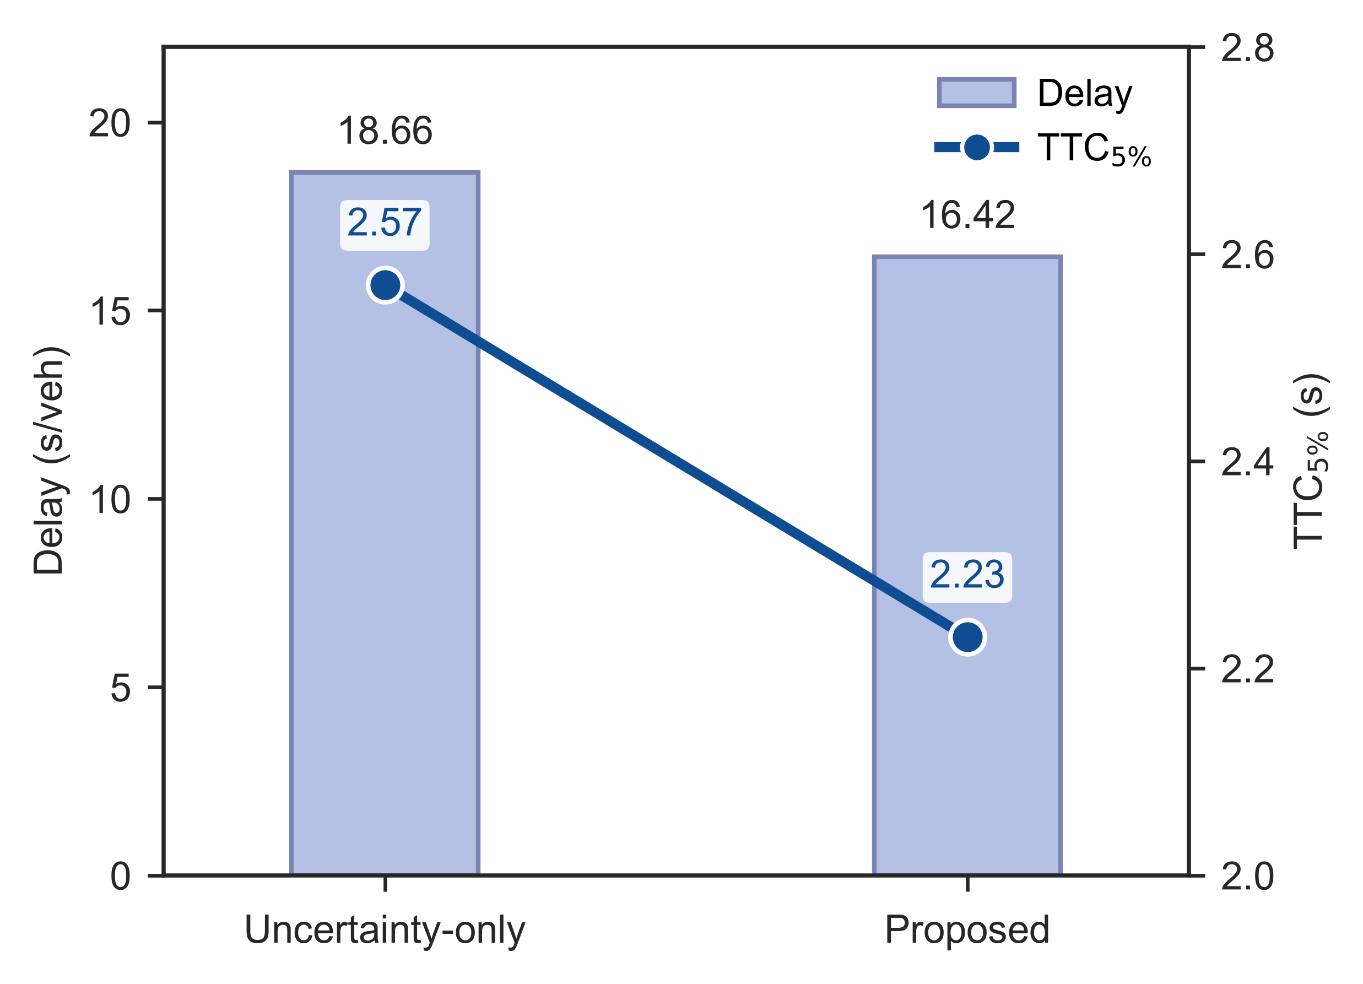
Notes:
与仅考虑随机扰动而不引入置信度优化的方法相比，所提出的置信度双层融合控制将平均延误由18.66 s/veh降低至16.42 s/veh，绝对减少2.24 s/veh，相对改善12.0%。然而，TTC第5百分位由2.57 s下降至2.23 s，降低0.34 s，即下尾安全裕度减少13.2%。因此，该结果表明置信度融合能够明显改善交通效率，但尚未表现出同步的后向安全提升，而是呈现出一定的效率—安全权衡。由于当前数据仅包含汇总值，缺少不同随机种子下的变异程度和置信区间，上述差异应作为描述性结果解读，暂不能据此判断统计显著性。
Compared with the uncertainty-only method, the proposed confidence-integrated bilevel controller reduced the average delay from 18.66 to 16.42 s veh⁻¹, corresponding to an absolute reduction of 2.24 s veh⁻¹ and a relative improvement of 12.0%. However, the 5th percentile of TTC decreased from 2.57 to 2.23 s, representing a reduction of 0.34 s or 13.2% in the lower-tail safety margin. These results therefore indicate a clear improvement in traffic efficiency, but not a simultaneous enhancement in rear-end safety; instead, they reveal an efficiency–safety trade-off. Because only aggregated values were available without seed-level variability or confidence intervals, the comparison remains descriptive and does not establish statistical significance.

Slide 7
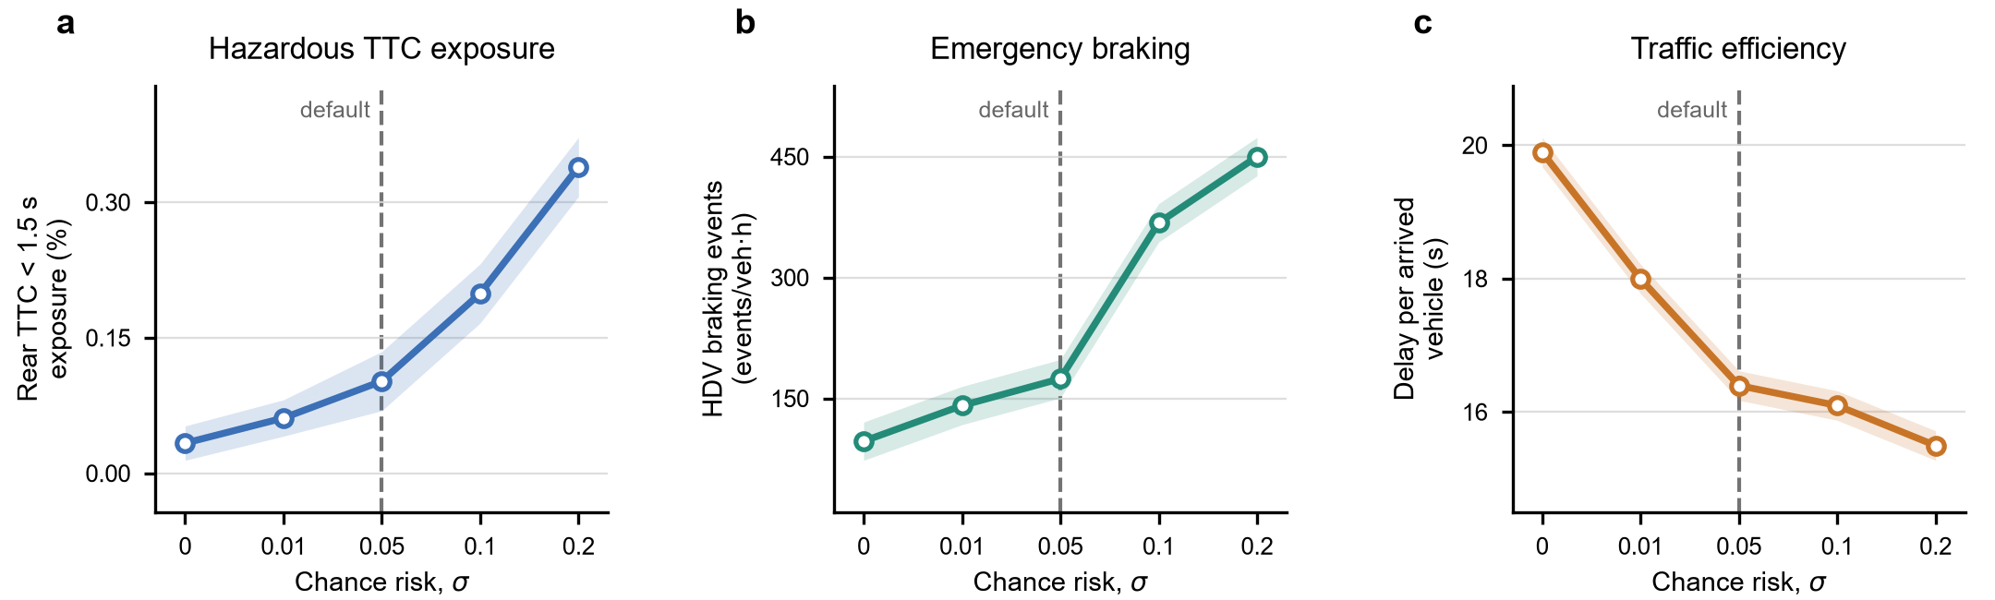
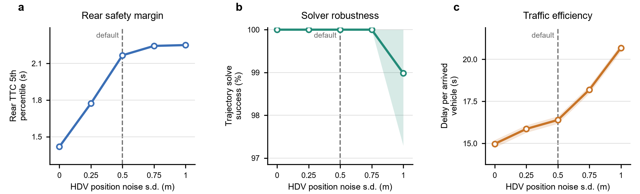
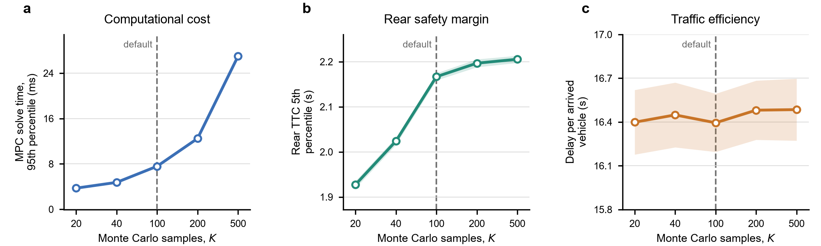
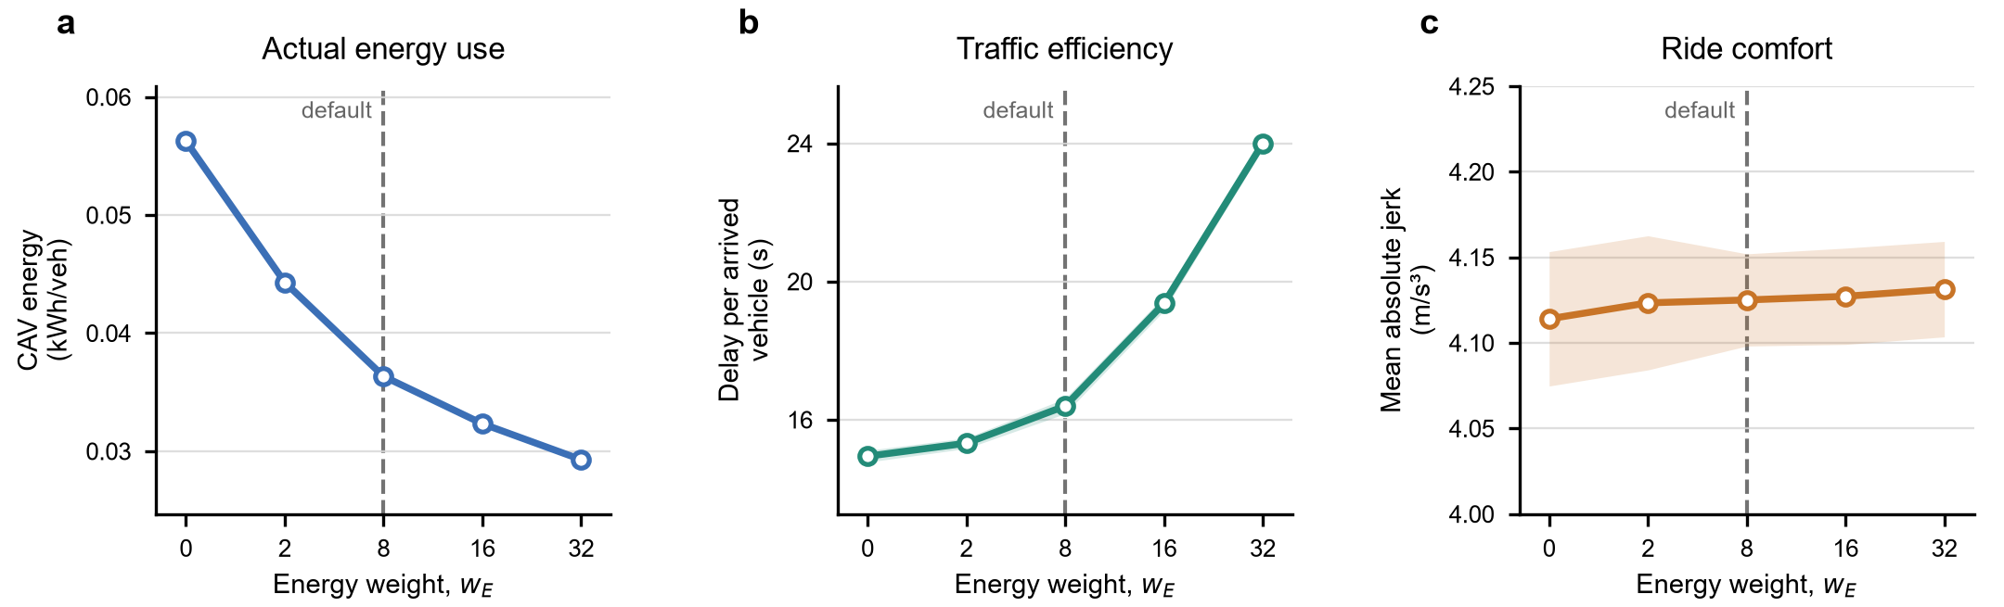
Notes:
随着 chance_sigma 增大，安全与效率之间呈现一致的描述性权衡。后向危险TTC暴露均值从0时的0.0333%增至默认值0.05时的0.1019%，并在0.20时达到0.3389%；后方HDV紧急制动事件率相应由96.84增至174.40和449.96 events veh(^{-1}) h(^{-1})，而单位到达车辆延误则由19.89 s降至16.39 s和15.49 s。相对于0.05，将约束放宽至0.10仅使平均延误降低1.83%，却使危险TTC暴露和紧急制动率分别增加95.19%和110.93%；反之，将其收紧至0.01可使两项安全风险指标分别降低40.04%和19.10%，但延误增加9.76%。该规律与参数机制一致：允许更高的样本违反比例会放松后向安全约束，使轨迹更高效但风险更高。因此保留0.05作为默认值较为合理：更严格的取值虽能继续改善安全，却需要明确的效率代价；更宽松的取值带来的延误收益很小，安全指标却开始快速恶化，0.05位于本组结果的折中拐点附近。
Increasing chance_sigma produced a consistent safety-efficiency trade-off in the rerun experiments. Mean hazardous rear-TTC exposure increased from 0.0333% at 0 to 0.1019% at the default 0.05 and 0.3389% at 0.20, while the rear-HDV emergency-braking rate rose from 96.84 to 174.40 and 449.96 events veh(^{-1}) h(^{-1}), respectively; over the same range, delay decreased from 19.89 to 16.39 and 15.49 s per arrived vehicle. Relative to 0.05, relaxing the constraint to 0.10 reduced mean delay by only 1.83% but increased hazardous TTC exposure by 95.19% and emergency braking by 110.93%. Conversely, tightening it to 0.01 reduced the two safety-risk metrics by 40.04% and 19.10%, at a 9.76% delay cost. This pattern is consistent with the mechanism of a larger violation allowance relaxing the rear-safety constraint and permitting more efficient but riskier trajectories. The default value of 0.05 is therefore retained as the observed knee: stricter values buy additional safety at a clear efficiency cost, whereas larger values provide little further delay reduction before the safety metrics deteriorate rapidly.
随着假定的HDV位置噪声标准差增大，控制器表现得更加保守。后向TTC的5%分位数均值从0 m时的1.418 s，依次增至0.25、0.50、0.75和1.00 m时的1.773、2.167、2.243和2.250 s；单位到达车辆延误则由14.97 s依次增至15.86、16.39、18.20和20.69 s。轨迹求解成功率在0–0.75 m范围内保持100%，到1.00 m时均值降至98.98%。因此，默认值0.50 m已经获得了大部分安全裕度：与确定性预测相比，后向TTC 5%分位数提高52.82%，延误增加9.48%；继续将噪声提高到0.75–1.00 m，仅比默认值增加3.54%–3.86%的TTC裕度，却使延误增加11.00%–26.18%，并在最高噪声水平出现求解成功率下降。由此，0.50 m可作为兼顾中等不确定性、完整观测可行性和效率的默认工作点，避免0.75–1.00 m区间内快速上升的效率代价。需要强调的是，这一解释针对规划器所采用的不确定性分布，不能等同于“未建模的真实预测误差越大，系统反而越安全”
Raising the assumed HDV position-noise standard deviation made the controller progressively more conservative. The mean fifth percentile of rear TTC increased from 1.418 s at 0 m to 1.773, 2.167, 2.243 and 2.250 s at 0.25, 0.50, 0.75 and 1.00 m, whereas delay increased from 14.97 to 15.86, 16.39, 18.20 and 20.69 s per arrived vehicle. Trajectory-solution success remained 100% through 0.75 m and decreased to a mean of 98.98% at 1.00 m. Thus, the default 0.50 m captured most of the safety-margin gain: relative to the deterministic setting, rear-TTC p05 was 52.82% higher with a 9.48% delay increase, whereas increasing noise beyond 0.50 m yielded only 3.54–3.86% additional TTC margin but raised delay by 11.00–26.18% relative to the default and eventually reduced solve success. The default is consequently supported as a moderate-uncertainty operating point that preserves full observed feasibility while avoiding the steep efficiency penalty at 0.75–1.00 m. This interpretation concerns the planner's assumed uncertainty distribution; it should not be read as evidence that unmodelled real prediction errors necessarily improve safety.
增大 w_energy 可持续降低CAV实际电耗，但延误代价逐步加快，且未在本实验的jerk指标上带来相应的舒适性收益。CAV单位车辆电耗均值从权重0时的0.05626 kWh vehicle(^{-1})，依次降至权重2、8、16和32时的0.04431、0.03634、0.03233和0.02929 kWh vehicle(^{-1})；单位到达车辆延误则由14.94 s依次增至15.32、16.39、19.36和24.00 s。平均绝对jerk始终处于4.114–4.131 m s(^{-3})的窄区间内，变化不足0.5%，且置信区间高度重叠，说明在加速度和jerk权重保持不变时，提高能耗权重并未形成具有实际意义的平顺性改善趋势。默认权重8相较于移除能耗项使电耗降低35.40%，代价是延误增加9.72%；继续提高至16和32虽可在默认值基础上再节能11.04%和19.41%，却分别使延误增加18.11%和46.37%。因此，w_energy=8 接近能耗—效率折中曲线的拐点：它已获得大部分节能收益，而更高权重的边际节能幅度减小、延误代价明显加速。
Increasing w_energy monotonically reduced actual CAV energy consumption but imposed an increasingly steep delay penalty, with no corresponding comfort benefit in the measured jerk. Mean energy use declined from 0.05626 kWh vehicle(^{-1}) at 0 to 0.04431, 0.03634, 0.03233 and 0.02929 kWh vehicle(^{-1}) at weights 2, 8, 16 and 32, while delay increased from 14.94 to 15.32, 16.39, 19.36 and 24.00 s per arrived vehicle. Mean absolute jerk remained within 4.114–4.131 m s(^{-3}), a range of less than 0.5%, and its confidence bands strongly overlapped; the energy term therefore did not produce a practically meaningful smoothing trend under the fixed acceleration and jerk weights. At the default weight of 8, energy was 35.40% lower than with the energy objective removed, for a 9.72% delay increase. Beyond 8, weights 16 and 32 saved a further 11.04% and 19.41% energy relative to the default but increased delay by 18.11% and 46.37%. The default value of 8 is therefore close to the energy-efficiency knee: it secures most of the available energy reduction before marginal savings become smaller and the delay cost accelerates.
随着Monte Carlo采样数增加，后向安全裕度逐渐收敛至平台，而计算成本几乎持续上升。单次MPC求解时间的95%分位数从20个样本时的3.73 ms，依次增至40、100、200和500个样本时的4.74、7.58、12.49和26.99 ms；后向TTC 5%分位数均值则由1.927 s依次增至2.024、2.167、2.197和2.205 s。与此同时，单位到达车辆延误始终处于16.39–16.48 s的窄区间，各水平相对默认值的均值变化均小于0.56%。与100个样本相比，增加至200和500个样本仅使后向TTC 5%分位数提高1.38%和1.79%，却使求解时间增加64.66%和255.93%；20和40个样本虽然计算更快，但相对于默认值的后向安全裕度分别低11.05%和6.59%，且本数据中未观察到TTC或延误的seed间变异明显增大。因此，sample_num=100 可视为数值稳定性与计算效率之间的拐点：它已经获得大部分安全指标的收敛收益，同时避免200–500个样本带来的快速计算成本增长，且交通延误基本不受影响。
Increasing the Monte Carlo sample count improved the estimated rear-safety margin toward a plateau but increased computational cost almost continuously. The 95th-percentile MPC solve time rose from 3.73 ms at 20 samples to 4.74, 7.58, 12.49 and 26.99 ms at 40, 100, 200 and 500 samples. Over the same levels, mean rear-TTC p05 increased from 1.927 to 2.024, 2.167, 2.197 and 2.205 s, whereas delay remained confined to 16.39–16.48 s per arrived vehicle, with all mean deviations from the default below 0.56%. Relative to 100 samples, increasing the count to 200 or 500 improved rear-TTC p05 by only 1.38% or 1.79% but raised solve time by 64.66% or 255.93%. Conversely, 20 and 40 samples reduced solve time but underestimated the converged rear-safety margin by 11.05% and 6.59%; their between-seed variability in TTC and delay did not increase materially in this dataset. The default of 100 samples is therefore supported as the numerical-efficiency knee: it captures most of the safety-metric convergence while avoiding the rapidly growing cost of 200–500 samples, with essentially unchanged traffic delay.

Slide 8
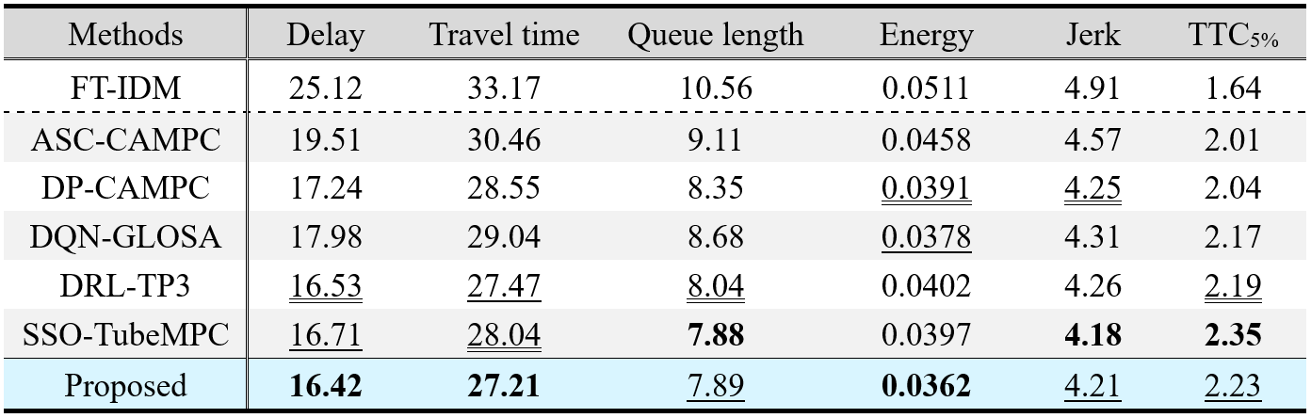
Notes:
表 X 从交通效率、能源消耗、乘坐舒适性和追尾安全性四个方面对七种控制策略进行了比较。所提方法取得了最低的车均延误（16.42）、行程时间（27.21）和能耗（0.0362），并在排队长度（7.89）、jerk（4.21）和后向碰撞时间的 5% 分位数（\(\mathrm{TTC}_{5\%}=2.23\)）上均排名第二，因此是唯一在六项指标中均位列前两名的方法。与 FT-IDM 相比，所提方法分别将车均延误、行程时间、排队长度、能耗和 jerk 降低了 34.63%、17.97%、25.28%、29.16% 和 14.26%，同时将 \(\mathrm{TTC}_{5\%}\) 提高了 35.98%。这些结果表明，信号配时与车辆轨迹的协同优化能够在缓解交叉口拥堵和减少启停行为的同时，改善车辆运行平稳性与低分位追尾安全性。
进一步的受控对比揭示了性能提升的主要来源。在保持 CAMPC 轨迹控制器不变的情况下，所提方法在全部指标上均优于 ASC-CAMPC 和 DP-CAMPC：其车均延误分别降低了 15.84% 和 4.76%，能耗分别降低了 20.96% 和 7.42%，而 \(\mathrm{TTC}_{5\%}\) 分别提高了 10.95% 和 9.31%。这一结果与学习型信号控制器能够更好地适应非线性、时变车辆到达特征相一致，而感应信号控制主要依赖当前交通状态进行反应式决策，DP 控制的性能则可能受到预测模型精度以及状态–动作离散化的限制。另一方面，在保持 DQN 信号策略不变时，以 CAMPC 替代 GLOSA 后，车均延误、排队长度、能耗和 jerk 分别降低了 8.68%、9.10%、4.23% 和 2.32%，\(\mathrm{TTC}_{5\%}\) 提高了 2.76%。虽然 GLOSA 通过减少红灯到达取得了较低能耗，但其决策主要集中于绿灯窗口利用；CAMPC 则在滚动时域内进一步考虑了车辆动力学、车辆间相互作用及后车行为不确定性，因而在通行效率、能耗、舒适性和安全性之间取得了更加均衡的改善。
与两种完整协同优化方法相比，所提方法在六项指标上的数值均优于 DRL-TP3，其中能耗降低了 9.95%，但车均延误和行程时间的改善幅度仅为 0.67% 和 0.95%。SSO-TubeMPC 在排队长度、jerk 和 \(\mathrm{TTC}_{5\%}\) 上取得最优结果，而所提方法的车均延误、行程时间和能耗分别降低了 1.74%、2.96% 和 8.82%。SSO-TubeMPC 更好的平稳性和低分位安全性可能源于固定管束收缩所保留的保守可行域，但较大的安全间距和更加克制的车辆响应也可能增加行程时间和能耗。相比之下，所提方法根据预测不确定性动态调整置信水平，在周围车辆行为可预测时减少不必要的保守性，并在不确定性升高时保留更大的安全裕度。因此，所提方法的主要优势并非对某一单项指标的极致优化，而是在效率、能耗与安全性之间实现了更优的综合权衡。需要指出的是，Proposed 与 SSO-TubeMPC 的排队长度几乎相同（7.89 与 7.88），且其相对于 DRL-TP3 的部分优势较小；在缺少重复实验和统计检验的情况下，这些差异应表述为数值趋势，而不宜直接称为具有统计显著性的提升。
Table X compares the seven strategies in terms of traffic efficiency, energy consumption, ride comfort, and rear-end safety. The proposed method achieved the lowest average vehicle delay (16.42), travel time (27.21), and energy consumption (0.0362), while ranking second in queue length (7.89), jerk (4.21), and the 5th percentile of rear-end time-to-collision (\(\mathrm{TTC}_{5\%}=2.23\)). It was therefore the only method ranked among the top two across all six metrics. Compared with FT-IDM, the proposed method reduced delay, travel time, queue length, energy consumption, and jerk by 34.63%, 17.97%, 25.28%, 29.16%, and 14.26%, respectively, while increasing \(\mathrm{TTC}_{5\%}\) by 35.98%. These results demonstrate that coordinating signal timing and vehicle trajectories can simultaneously mitigate intersection congestion, reduce stop-and-go operations, and improve the lower-tail safety performance.
Controlled comparisons further clarify the sources of these improvements. With CAMPC retained as the trajectory controller, the proposed method outperformed ASC-CAMPC and DP-CAMPC across all metrics; for example, it reduced delay by 15.84% and 4.76%, reduced energy consumption by 20.96% and 7.42%, and increased \(\mathrm{TTC}_{5\%}\) by 10.95% and 9.31%, respectively. This pattern is consistent with the learned signal controller being better able to match phase allocation to nonlinear and time-varying vehicle arrivals, whereas actuated control remains primarily reactive and DP-based control may be constrained by model accuracy and state–action discretization. Conversely, with the DQN signal policy retained, replacing GLOSA with CAMPC reduced delay, queue length, energy consumption, and jerk by 8.68%, 9.10%, 4.23%, and 2.32%, respectively, while increasing \(\mathrm{TTC}_{5\%}\) by 2.76%. Although GLOSA effectively reduced energy consumption by avoiding red-light arrivals, its advisory decisions mainly focused on green-window utilization. The receding-horizon CAMPC formulation additionally accounted for vehicle dynamics, inter-vehicle interactions, and rear-vehicle uncertainty, thereby producing more balanced improvements across mobility, energy, comfort, and safety.
Compared with the two complete cooperative optimization baselines, the proposed method returned better numerical values than DRL-TP3 for all six metrics, including a 9.95% reduction in energy consumption, although the improvements in delay and travel time were only 0.67% and 0.95%. SSO-TubeMPC achieved the best queue length, jerk, and \(\mathrm{TTC}_{5\%}\), whereas the proposed method reduced delay, travel time, and energy consumption by 1.74%, 2.96%, and 8.82%, respectively. The stronger smoothness and lower-tail safety of SSO-TubeMPC are consistent with fixed tube tightening maintaining conservative feasibility margins under uncertainty; however, the resulting larger headways and more restrained vehicle responses may increase travel time and energy use. By adapting the confidence level to the predicted uncertainty, the proposed method can reduce unnecessary conservatism when surrounding vehicles are predictable while retaining larger safety margins under elevated uncertainty. Consequently, the proposed method provides a favourable efficiency–energy–safety trade-off rather than optimizing a single metric. Nevertheless, the nearly identical queue lengths of Proposed and SSO-TubeMPC (7.89 versus 7.88) and the small differences from DRL-TP3 should be interpreted as numerical trends unless their statistical significance is verified through repeated experiments.

