Slide 1
AMIGOS

Slide 2
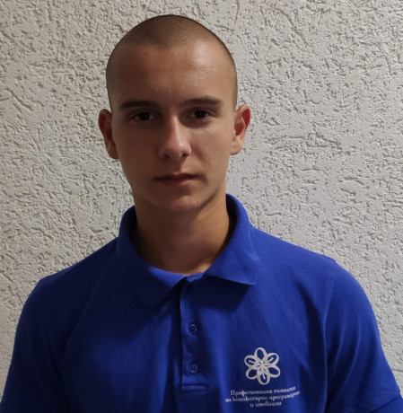

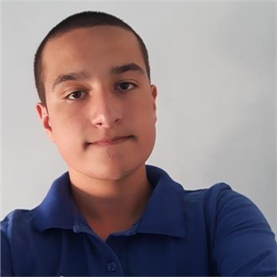
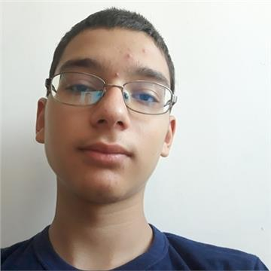
Martin Mechkov Scrum Trainer
Polya Dimitrova Front-End Developer
Martin Martinov Back-End Developer
Kristian Tsvetkov QA Engineer

Slide 3








Used Programs and Technologies

Slide 4
Stages of realization
01
02
03
04
Mind storming
Workflow organization
Realization
Testing

Slide 5

Future Ideas

Slide 6
Thank You For Your Attention!

