Slide 1

UNTITLED

Slide 2
Meet The Team
Maria Ilcheva Back-End Developer
Vanina Teneva QA Engineer
Martin Mechkov Scrum Trainer
Hristo Kovachev
Front-End Developer

Slide 3









Used Programs and Technologies

Slide 4
Steps of work
IDEA
REALIZATION
POLISHING
1
3
5
2
4
6
ORGANIZATION
TESTING
PRESENTING

Slide 5



Project Summery
RECURSIVE BACKTRACKING ALGORITHM
RANDOMIZED DEPTH-FIRST SEARCH

Slide 6
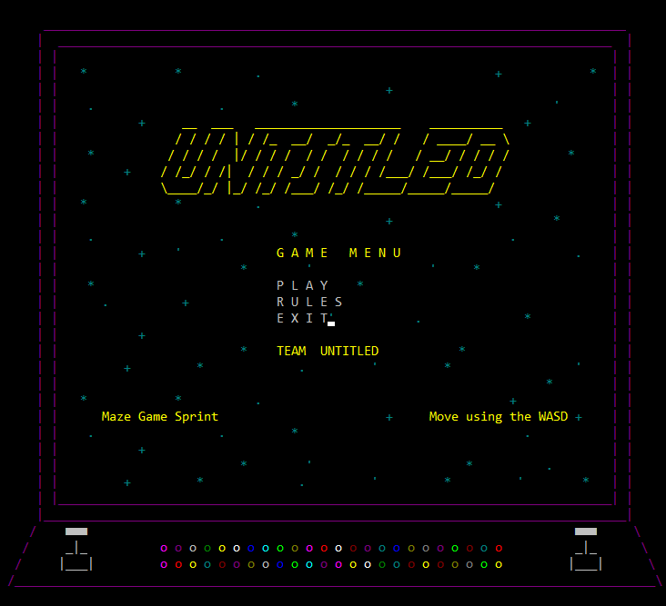
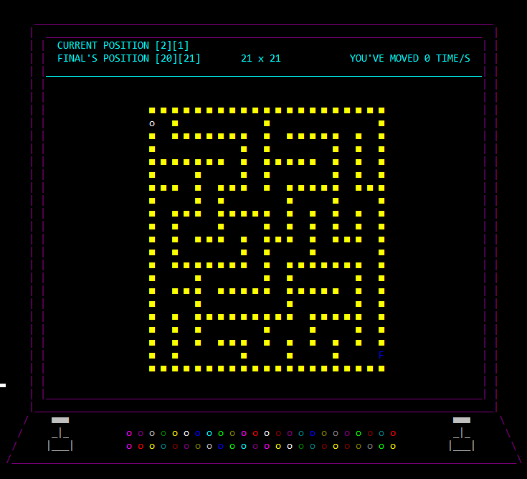
Our Program

Slide 7





Future Ideas

Slide 8

Thank You For Your Attention
Thank You For Your Attention

