Slide 1

UNIVERSITY OF DAMASCUS
Start
SIDE CHANNEL ATTACKS IN CLOUD COMPUTING
What is side channel attacks
Types of attacks based on the side channel
Countermeasures
عدي الخزاعي
محمد لؤي العش معاذ العجلاني محمد علي العقال

Slide 2

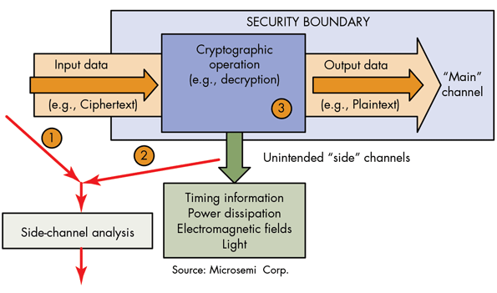

UNIVERSITY of DAMASCUS
What is Side channel attacks?
What is Side channel??
* Side-channel attacks aim to retrieve secret data from a cryptographic system by observing factors outside the normal computation.
* While it is good to have a system that is mathematically secure, this
alone does not tell the whole story. There are attacks that aim not at the mathematical properties of the cryptographic system, but at implementation,hardware, electromagnetic radiation, timing and even sound. can provide an extra source of information, which can be exploited to break the system

Slide 3
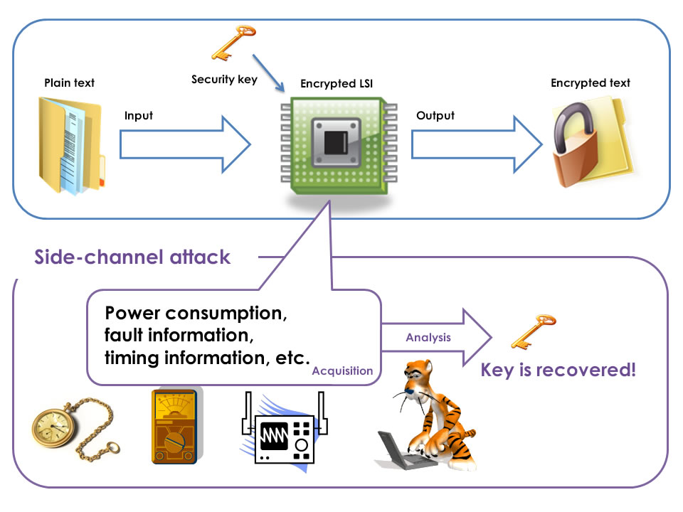
UNIVERSITY of DAMASCUS
Types of attacks based on the side channel
Types of attacks based on the side channel
attacks that target power consumption
attacks that target timing
attacks that target faulty computations.

Slide 4
UNIVERSITY of DAMASCUS
Types of attacks based on the side channel
* Power analysis attacks are based on the notion that power consumption of cryptographic hardware is not constant during execution
Power analysis
Simple Power Analysis
Differential Power Analysis

Slide 5
UNIVERSITY of DAMASCUS
Types of attacks based on the side channel
Simple Power Analysis
Power analysis
* With simple power analysis, we can attempt to retrieve information directly from the power consumption of the device.
Simple Power Analysis
* such that any conditional branches that depend on secret data potentially leak information about that data
* A common example used for illustration is the RSA public-key cryptography system . In RSA, decryption is performed by exponentiation of the ciphertext with the secret key.
A fast and straightforward
way to do this is by employing exponentiation by squaring

Slide 6
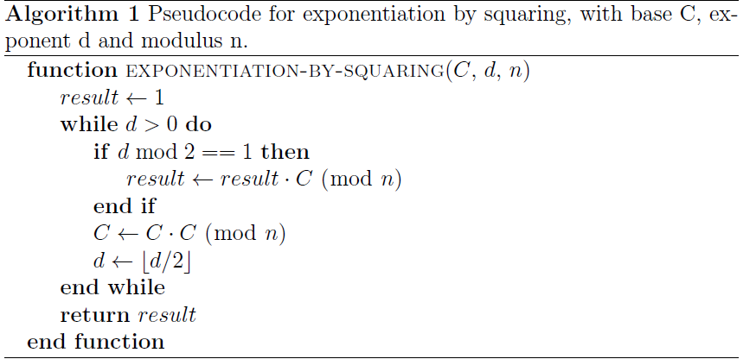
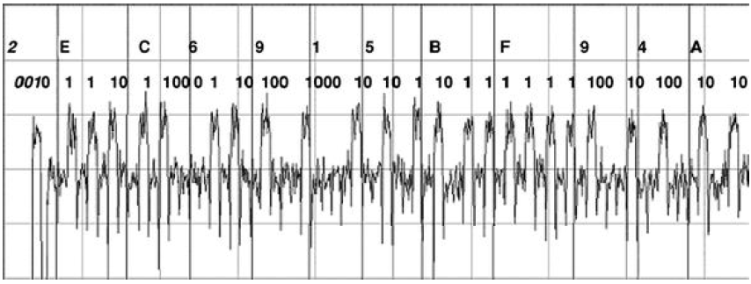
UNIVERSITY of DAMASCUS
Types of attacks based on the side channel
Simple Power Analysis
Power analysis
.

Slide 7
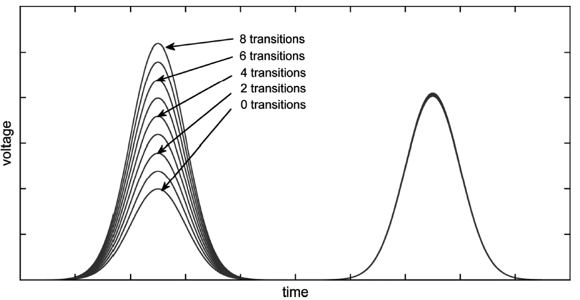
UNIVERSITY of DAMASCUS
Types of attacks based on the side channel
Differential Power Analysis
Power analysis
* Simple power analysis works well on cryptographic algorithms that have a strong correlation between the values of secret data and the power consumption of the hardware. Such a strong correlation is, however, not always present. In many such cases, differential power analysis can be of use
Differential Power Analysis

Slide 8
UNIVERSITY of DAMASCUS
Types of attacks based on the side channel
Countermeasures
Power analysis
Countermeasures
For the case of simple power analysis, it is generally enough to ensure no conditional branches depend on secret data. For instance, one can prevent simple power analysis on RSA decryption as mentioned above by adding dummy operations that ensure all code paths perform the same computations. Alternatively, one can employ a different method of exponentiation, called the Montgommery Powering Ladder

Slide 9
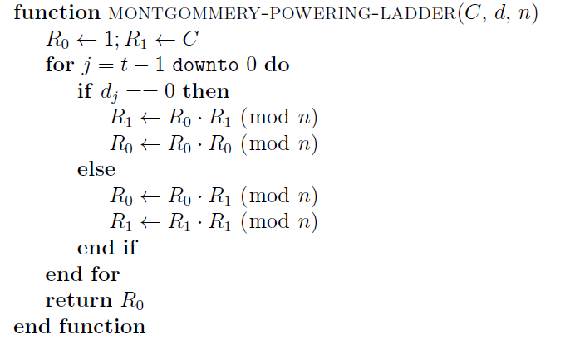
UNIVERSITY of DAMASCUS
Types of attacks based on the side channel
Countermeasures
Power analysis
Pseudocode for the Montgommery Powering Ladder, with base C, exponent d and modulus n. dj is the j^th bit of d.
Countermeasures

Slide 10
UNIVERSITY of DAMASCUS
Types of attacks based on the side channel
Countermeasures
Power analysis
Preventing differential power analysis is more complicated. For public-key algorithms, it is possible to blind the secret data
Countermeasures
This paper aims at presenting a new countermeasure against Side-Channel Analysis (SCA) attacks, whose implementation is based on a hardware-software co-design. The hardware architecture consists of a microprocessor, which executes the algorithm using a false key, and a coprocessor that performs several operations that are necessary to retrieve the original text that was encrypted with the real key. The coprocessor hardly affects the power consumption of the device, so that any classical attack based on such power consumption would reveal a false key. Additionally, as the operations carried out by the coprocessor are performed in parallel with the microprocessor, the execution time devoted for encrypting a specific text is not affected by the proposed countermeasure. In order to verify the correctness of our proposal, the system was implemented on a Virtex 5 FPGA. Different SCA attacks were performed on several functions of AES algorithm. Experimental results show in all cases that the system is effectively protected by revealing a false encryption key.

Slide 11
UNIVERSITY of DAMASCUS
Types of attacks based on the side channel
Timing
Timing
1- Conventional timing attacks
Secret Data
Time taken to perform a computation in order to retrieve the Secret Data
Cache-timing :
A cache-timing attack aims to recover secret data by monitoring cache performance.

Slide 12
UNIVERSITY of DAMASCUS
Types of attacks based on the side channel
1- Conventional timing attacks
Timing
Example: RSA Decryption E(x) = x^{d} mod n
Conventional timing attacks
function exponentiation-by-squaring(C, d, n)
result ← 1
while d > 0 do
if d mod 2 == 1
result ← result · C (mod n)
C ← C · C (mod n)
d ← bd/2c
return result
A cache-timing attack aims to recover secret data by monitoring cache performance.

Slide 13
UNIVERSITY of DAMASCUS
Types of attacks based on the side channel
1- Conventional timing attacks
Timing
How To Attack?
Conventional timing attacks
How to Attack?
…..Samples!!!
How much Time?
How many Samples???

Slide 14
UNIVERSITY of DAMASCUS
Types of attacks based on the side channel
1- Conventional timing attacks
Timing
Countermeasures:
Conventional timing attacks
How to Attack?
Noise addition: adding Dummy computations
Constant Time Execution
Force All crypto operations to take the same time
Countermeasures
Performance ~ Confidentiality

Slide 15
UNIVERSITY of DAMASCUS
Types of attacks based on the side channel
Timing
2- Cache Timing
Cache Timing
Recover Secret Data by monitoring cache performance

Slide 16
UNIVERSITY of DAMASCUS
Types of attacks based on the side channel
Timing
2- Cache Timing
Cache Timing
How to Attack?
Statistically get the key by comparing with timing calculated in advance
for some know keys

Slide 17
UNIVERSITY of DAMASCUS
Types of attacks based on the side channel
Timing
2- Cache Timing
Cache Timing
How to Attack?
Flush And Reload

Slide 18
UNIVERSITY of DAMASCUS
Types of attacks based on the side channel
2- Cache Timing
Timing
Countermeasures
Cache Timing
How to Attack?
Disallow cache altogether
No cache sharing
Redesign the cache
Random permutation cache
Countermeasures

Slide 19
UNIVERSITY of DAMASCUS
Types of attacks based on the side channel
Countermeasures
timing
* For conventional timing attacks, it is recommended to employ blinding . This way, any data leaked reveals nothing about the secret key.
Countermeasures
* To prevent cache-timing attacks suggest to redesign the current method of caching, proposing a random permutation cache, which randomises the cache allocation so as to not reveal which parts of the cache correspond to what data. It is worth noting that hardware implementations of cryptographic algorithms generally lack any form of caching, meaning that only software implementations meant for general-purpose computers are vulnerable to this type of attack

Slide 20
UNIVERSITY of DAMASCUS
Types of attacks based on the side channel
Fault analysis
Fault analysis
* Fault analysis attacks attempt to retrieve secret data from the result of faulty computations.
Fault analysis
* These computations may come about through faulty hardware
or deliberate tampering with the device or software.

Slide 21
UNIVERSITY of DAMASCUS
Types of attacks based on the side channel
Fault analysis
Fault analysis
Conventional fault analysis :
Conventional fault analysis aims to retrieve secret data by analysing the result of faulty encryptions
Differential fault analysis :
Some researchers expand on the notion of fault analysis, making it applicable to symmetric cryptographic systems as well. They call their approach differential fault analysis. Their attack works under the assumption that it is possible to induce a fault in the computation at some random point.

Slide 22
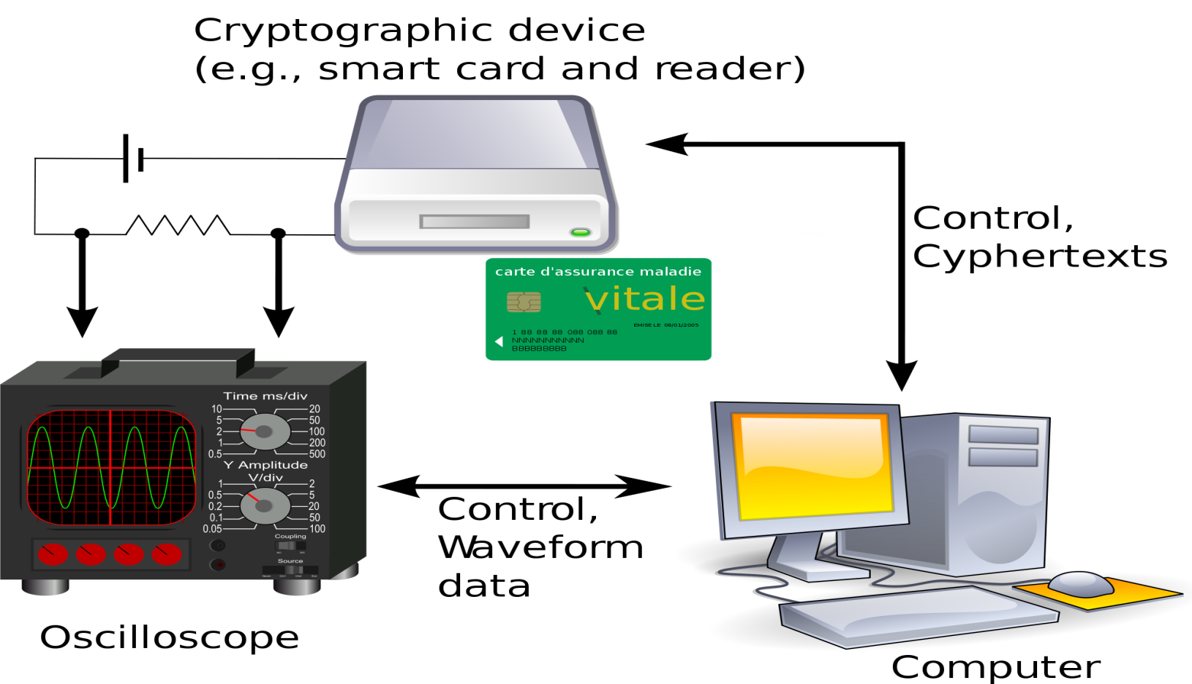
UNIVERSITY of DAMASCUS
Types of attacks based on the side channel
Countermeasures
Fault analysis
* One way of defending against fault analysis attacks is to check the result of the cryptographic function before outputting it.
Countermeasures

Slide 23
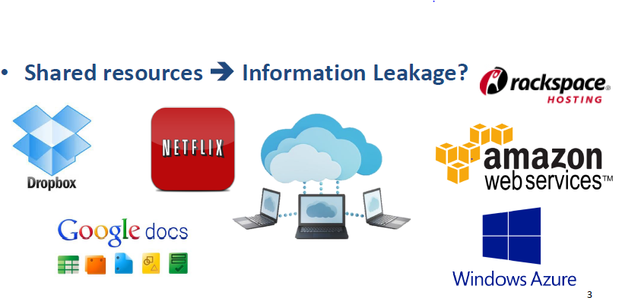
UNIVERSITY of DAMASCUS
Side Channel attack in Cloud Computing
Cloud Computing
Resources on the internet
Advantages: shared resources is cost effictive
Disadvantages: Users’ Security
What is Cloud ?

Slide 24
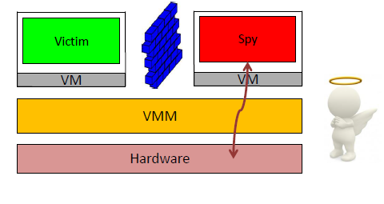
UNIVERSITY of Damascus
Side Channel attack in Cloud Computing
Virtual Machines
Multi-tenancy in Cloud
One machine for many clients
Problem
Shared Cache
What is Cloud ?
Virtual Machine

Slide 25
UNIVERSITY of Damascus
Side Channel attack in Cloud Computing
How To Attack?
The attacker place his virtual machine as a co-resident machine in the cloud environment
What is Cloud ?
Virtual Machine
How to attack?

Slide 26
UNIVERSITY of Damascus
Side Channel attack in Cloud Computing
How To Attack?
The attacker place his virtual machine as a co-resident machine in the cloud environment
What is Cloud ?
Virtual Machine
How to attack?

Slide 27
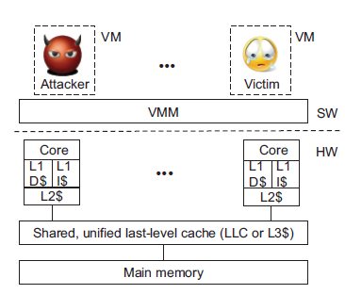
UNIVERSITY of Damascus
Side Channel attack in Cloud Computing
Cache-based side channel attack
What is Cloud ?
Virtual Machine
How to attack?
Cache-based side channel attack

Slide 28
UNIVERSITY of Damascus
Side Channel attack in Cloud Computing
What is Cloud ?
Types
Virtual Machine
How to attack?
Cache-based side channel attack
Types

Slide 29
UNIVERSITY of Damascus
Side Channel attack in Cloud Computing
Access-driven attack
Prime and probe
Flush and reload
What is Cloud ?
Virtual Machine
How to attack?
Cache-based side channel attack
Types
Access-driven attack

Slide 30
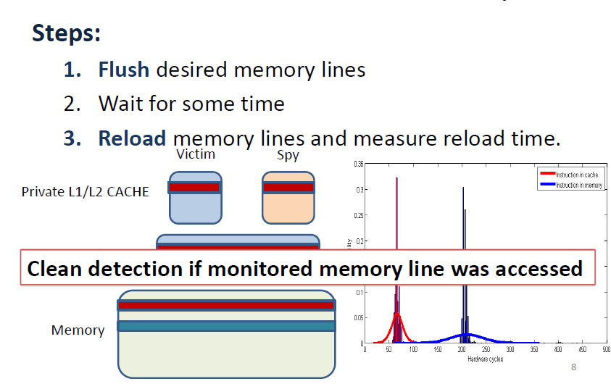
UNIVERSITY of Damascus
Side Channel attack in Cloud Computing
Flush and reload
What is Cloud ?
Virtual Machine
How to attack?
Cache-based side channel attack
Types
Access-driven attack
Flush and reload

Slide 31
UNIVERSITY of Damascus
security
security

Slide 32
UNIVERSITY of Damascus
Side Channel attack in Cloud Computing
What is Cloud ?
Virtual Machine
How to attack?
Trace-driven attack
Cache-based side channel attack
Types
Access-driven attack
Flush and reload
Trace-driven attack

Slide 33
UNIVERSITY of HOUSTON
References
CloudRadar: A Real-Time Side-Channel Attack Detection System in Clouds
http://link.springer.com/chapter/10.1007%2F978-3-319-45719-2_6
Side-Channel Attacks: Ten Years After Its Publication and the Impacts on Cryptographic Module Security Testing
http://csrc.nist.gov/groups/STM/cmvp/documents/fips140-3/physec/papers/physecpaper19.pdf
Defending against cache-based side-channel attacks
http://ac.els-cdn.com/S1363412703001043/1-s2.0-S1363412703001043-main.pdf?_tid=faf09d24-9084-11e6-be2500000aacb35d&acdnat=1476281330_c4a212c4cadc07504d1d939c6d55ee01
References

Slide 34

UNIVERSITY of HOUSTON
Thanks !!
Thanks!

