Slide 1

Requirements Capture
Based on Chapter 6 of Bennett, McRobb and Farmer:
Object Oriented Systems Analysis and Design Using UML, (2nd Edition), McGraw Hill, 2002.

Slide 2
In This Lecture You Will Learn:
The distinction between the current and required systems
When and how to apply the main fact finding techniques
The roles played by users
The need to document requirements

Slide 3
User Requirements
Need to understand how the organization operates at present
What are the problems with the current system?
What are the requirements users have of a new system that are not in the current system?

Slide 4
Current System
Much of the current system meets the needs of people who use it
Sections of the system no longer meet the needs of the organization
Some aspects of the organization’s work are not covered by the current system
The system can no longer evolve but needs to be replaced

Slide 5
Current System
It is important to understand current system to carry functionality forward into new system
It is also important to understand it so that shortcomings and defects can be corrected in the new system

Slide 6
Current System
Yourdon (1989) argues against spending a lot of time analysing the existing system—it’s being replaced!
SSADM makes the case for modelling the current system—much of its functionality will be required in the new system

Slide 7
Reasons for Investigating the Current System
Functionality is required in new system
Data must be migrated into new system
Technical documentation provides details of processing algorithms
Defects of existing system must be avoided
Parts of existing system may have to be kept
We need to understand the work of the users
Baseline information about the existing system helps set targets for the new one

Slide 8
New Requirements
Organizations operate in a rapidly changing business environment
Organizations operate in a changing technical environment
Governments and supra-governmental organizations introduce legislation
Organizations merge, demerge, take over and get taken over
All this drives the need to replace systems and build new ones

Slide 9
Types of Requirements
Functional
Non-functional
Usability

Slide 10
Functional Requirements
Describe what a system must do
Include:
  processes
  interfaces with users and other systems
  what the system must hold data about
Modelled with Use Case Diagrams. Later will be modelled with other kinds of diagrams that show the structure of the system (Class Diagrams) and its behaviour (Interaction Diagrams and Statechart Diagrams)

Slide 11
Non-functional Requirements
Concerned with how well the system performs
Include:
  response times
  volumes of data
  security considerations
Documented in Requirements List or in Use Case Model (for requirements that can be linked to specific use cases)

Slide 12
Usability Requirements
Concerned with matching the system to the way that people work
Sets measurable objectives
Include:
  characteristics of users
  tasks users undertake
  situational factors
  acceptance criteria for the working system
Documented in Requirements List. May be tested by Prototypes

Slide 13
Fact Finding Techniques
Background Reading
Interviewing
Observation
Document Sampling
Questionnaires

Slide 14
Background Reading
Aim is to understand the organization and its business objectives
Includes:
  reports
  organization charts
  policy manuals
  job descriptions
  documentation of existing systems

Slide 15
Background Reading
Advantages:
  helps to understand the organization before meeting the people who work there
  helps to prepare for other types of fact finding
  documentation of existing system may help to identify requirements for functionality of new system

Slide 16
Background Reading
Disadvantages:
  written documents may be out of date or not match the way the organization really operates
Appropriate situations:
  analyst is not familiar with organization
  initial stages of fact finding

Slide 17
Interviewing
Aim is to get an in-depth understanding of the organization’s objectives, users’ requirements and people’s roles
Includes:
  managers to understand objectives
  staff to understand roles and information needs
  customers and the public as potential users

Slide 18
Interviewing
Advantages:
  personal contact allows the inetrviewer to respond adaptively to what is said
  it is possible to probe in greater depth
  if the interviewee has little or nothing to say, the interview can be terminated

Slide 19
Interviewing
Disadvantages:
  can be time-consuming and costly
  notes must be written up or tapes transcribed after the interview
  can be subject to bias
  if interviewees provide conflicting information this can be difficult to resolve later

Slide 20
Interviewing
Appropriate situations:
  most projects
  at the stage in fact finding when in-depth information is required
Requires skill to carry out effectively (See Box 6.1 for guidelines)

Slide 21
Observation
Aim is to see what really happens, not what people say happens
Includes:
  seeing how people carry out processes
  seeing what happens to documents
  obtaining quantitative data as baseline for improvements provided by new system
  following a process through end-to-end
Can be open-ended or based on a schedule

Slide 22
Observation
Advantages:
  first-hand experience of how the system operates
  high level of validity of the data can be achieved
  verifies information from other sources
  allows the collection of baseline data

Slide 23
Observation
Disadvantages:
  people don’t like being observed and may behave differently, distorting the findings
  requires training and skill
  logistical problems for the analyst with staff who work shifts or travel long distances
  ethical problems with personal data

Slide 24
Observation
Appropriate situations:
  when quantitative data is required
  to verify information from other sources
  when conflicting information from other sources needs to be resolved
  when a process needs to be understood from start to finish

Slide 25
Document Sampling
Aims to find out the information requirements that people have in the current system
Also aims to provide statistical data about volumes of transactions and patterns of activity
Includes:
  obtaining copies of empty and completed documents
  counting numbers of forms filled in and lines on the forms
  screenshots of existing computer systems

Slide 26
Document Sampling
Advantages:
  for gathering quantitative data
  for finding out about error rates
Disadvantages:
  not helpful if the system is going to change dramatically
Appropriate situations:
  always used to understand information needs
  where large volumes of data are processed
  where error rates are high

Slide 27
Questionnaires
Aims to obtain the views of a large number of people in a way that can be analysed statistically
Includes:
  postal, web-based and email questionnaires
  open-ended and closed questions
  gathering opinion as well as facts

Slide 28
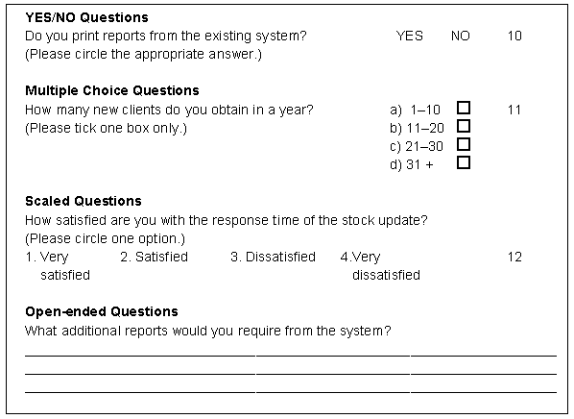

Slide 29
Questionnaires
Advantages:
  economical way of gathering information from a large number of people
  effective way of gathering information from people who are geographically dispersed
  a well designed questionnaire can be analysed by computer

Slide 30
Questionnaires
Disadvantages:
  good questionnaires are difficult to design
  no automatic way of following up or probing more deeply
  postal questionnaires suffer from low response rates

Slide 31
Questionnaires
Appropriate situations:
  when views of large numbers of people need to be obtained
  when staff of organization are geographically dispersed
  for systems that will be used by the general public and a profile of the users is required

Slide 32
Questionnaires
Require skill to design effectively (See Box 6.2 for guidelines)

Slide 33
User Involvement
A variety of stakeholders:
  senior management—with overall responsibility for the organization
  financial managers—who control budgets
  managers of user departments
  representatives of users of the system

Slide 34
User Involvement
Different roles:
  subjects of interviews
  representatives on project committees
  evaluators of prototypes
  testers
  as trainees on courses
  end-users of new system

Slide 35
Documenting Requirements
Documentation should follow organizational standards
CASE tools that produce UML models maintain associated data in a repository
Some documents will need separate storage in a filing system:
  interview notes
  copies of existing documents
  minutes of meetings
  details of requirements

Slide 36
Documenting Requirements
Documents should be kept in a document management system with version control
Use use cases to document functional requirements
Maintain a separate requirements list
Review requirements to exclude those that are not part of the current project

Slide 37
Requirements
Analyst
Project Initiation
Document
Elicit
requirements
Glossary
Candidate
Requirements
Select
requirements
Requirements
List
Develop
use cases
Use Case Model

Slide 38
Requirements
Team
Use Case Model
Requirements
List
Project Initiation
Document
Requirements
capture and modelling
Interface
Prototypes
Initial System
Architecture
Glossary

Slide 39
Summary
In this lecture you have learned about:
The distinction between the current and required systems
When and how to apply the main fact finding techniques
The roles played by users
The need to document requirements

Slide 40
References
Oppenheim (2000)
Allyson et al. (1996)
Usability is covered in more detail in Chapter 16 of Bennett, McRobb and Farmer
Chapter A2 shows products of requirements capture and modelling
(For full bibliographic details, see Bennett, McRobb and Farmer)

Slide 41
Use Case Diagrams
Based on Chapter 6 of Bennett, McRobb and Farmer:
Object Oriented Systems Analysis and Design Using UML, (2nd Edition), McGraw Hill, 2002.

Slide 42
In This Lecture You Will Learn:
The purpose of use case diagrams
The notation of use case diagrams
How to draw use case diagrams
How to write use case descriptions
How prototyping can be used with use case modelling

Slide 43
Drawing Use Case Diagrams
Purpose
  document the functionality of the system from the users’ perspective
  document the scope of the system
  document the interaction between the users and the system using supporting use case descriptions (behaviour specifications)

Slide 44
Notation of Use Case Diagrams
Communication
Use case
association
Change a client
contact
Staff Contact
Actor
System or subsystem boundary

Slide 45
Notation of Use Case Diagrams
Actors
  drawn as stick people with a name
  the roles that people, other systems or devices take when communicating with a particular use case or use cases
  not the same as job titles or people
    people with one job title may play the roles of several actors
    one actor may represent several job titles

Slide 46
Notation of Use Case Diagrams
Use cases
  drawn as ellipses with a name in or below each ellipse
  describe a sequence of actions that the system performs to achieve an observable result of value to an actor
  the name is usually an active verb and a noun phrase

Slide 47
Notation of Use Case Diagrams
Communication associations
  line drawn between an actor and a use case
  can have arrow heads to show where the communication is initiated (arrow points away from the initiator)
  represent communication link between an instance of the use case and an instance of the actor

Slide 48
Notation of Use Case Diagrams
Sub-systems
  drawn as a rectangle around a group of use cases that belong to the same sub-system
  in a CASE tool, use cases for different sub-system are usually placed in separate use case diagrams, and the rectangle is redundant

Slide 49
Notation of Use Case Diagrams
Dependencies
  Extend and Include relationships between use cases
  shown as stereotyped dependencies
  stereotypes are written as text strings in guillemets: «extend» and «include»

Slide 50
Notation of Use Case Diagrams
Extend relationship
  one use case provides additional functionality that may be required in another use case
  there may be multiple ways of extending a use case, which represent variations in the way that actors interact with the use case
  extension points show when the extension occurs
  a condition can be placed next to the dependency arrow (Note that it is not put in square brackets, unlike conditions in activity diagrams.)

Slide 51
Check campaign
budget
Extension points
Summary print: system displays balance
«extend»
user requires print-out
Campaign
Manager
Print campaign
summary

Slide 52
Notation of Use Case Diagrams
Include relationship
  one use case always includes the functionality of another use case
  a use case may include more than one other
  can be used to separate out a sequence of behaviour that is used in many use cases
  should not be used to create a hierarchical functional decomposition of the system

Slide 53
Assign staff to work on a campaign
«include»
Find campaign
Campaign
Manager

Slide 54
Notation of Use Case Diagrams
Generalization
  shows that one use case provides all the functionality of the more specific use case and some additional functionality
  shows that one actor can participate in all the associations with use cases that the more specific actor can plus some additional use cases

Slide 55
Record completion
of an advert
Staff
Contact
Change a client
contact
Assign individual staff to work on a campaign
Assign staff to work on a campaign
Campaign
Manager
Assign team of staff to work on a campaign

Slide 56
Use Case Descriptions
Can be a simple paragraph
Assign staff to work on a campaign
  The campaign manager wishes to record which staff are working on a particular campaign. This information is used to validate timesheets and to calculate staff year-end bonuses.

Slide 57
Use Case Descriptions
Can be a step-by-step breakdown of interaction between actor and system
Assign staff to work on a campaign
Actor Action System Response
1. The actor enters the client name. 2. Lists all campaigns for that client.
3. Selects the relevant campaign. 4. Displays a list of all staff members not already allocated to this campaign.
5. Highlights the staff members 6.Presents a message confirming
to be assigned to this campaign. that staff have been allocated.
Alternative Courses
Steps 1–3. The actor knows the campaign name and enters it directly.

Slide 58
Use Case Descriptions
Many projects use templates
  name of use case
  pre-conditions
  post-conditions
  purpose
  description
  alternative courses
  errors

Slide 59
Behaviour Specifications
Rather than (or as well as) using text, a use case can be linked to another diagram that specifies its behaviour
Typically a Collaboration Diagram, a Sequence Diagram or a Statechart Diagram

Slide 60
Drawing Use Case Diagrams
Identify the actors and the use cases
Prioritize the use cases
Develop each use case, starting with the priority ones, writing a description for each
Add structure to the use case model: generalization, include and extend relationships and sub-systems

Slide 61
Prototyping
Use case modelling can be supported with prototyping
Prototypes can be used to help elicit requirements
Prototypes can be used to test out system architectures based on the use cases in order to meet the non-functional requirements

Slide 62
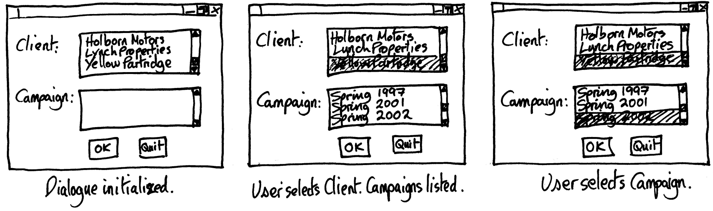
Prototyping
For user interface prototypes, storyboarding can be used with hand-drawn designs

Slide 63
Prototyping
User interface prototypes can be implemented using languages other than the one that the system will be developed in
Campaign Selection
Campaign Selection
Campaign Selection
Client:
Holborn Motors
Lynch Properties
Yellow Partridge
Zeta Systems
Client:
Holborn Motors
Lynch Properties
Yellow Partridge
Zeta Systems
Client:
Holborn Motors
Lynch Properties
Yellow Partridge
Zeta Systems
Yellow Partridge
Yellow Partridge
Campaign:
Campaign:
Spring Jewellery Campaign 1997
Spring Jewellery Campaign 2001
Spring Jewellery Campaign 2002
Summer Collection 1998
Campaign:
Spring Jewellery Campaign 1997
Spring Jewellery Campaign 2001
Spring Jewellery Campaign 2002
Summer Collection 1998
Spring Jewellery Campaign 2002
OK
Quit
OK
Quit
OK
Quit
Dialogue initialized.
User selects Client. Campaigns listed.
User selects Campaign.

Slide 64
Summary
In this lecture you have learned about:
The purpose of use case diagrams
The notation of use case diagrams
How to draw use case diagrams
How to write use case descriptions
How prototyping can be used with use case modelling

Slide 65
References
Jacobson et al. (1992)
Rosenberg and Scott (1999)
Cockburn (2000)
(For full bibliographic details, see Bennett, McRobb and Farmer)

