Slide 1

Data Management Design
Based on Chapter 18 of Bennett, McRobb and Farmer:
Object Oriented Systems Analysis and Design Using UML, (2nd Edition), McGraw Hill, 2002.

Slide 2
In This Lecture You Will Learn:
The different ways of storing persistent objects
The differences between object and relational databases
How to design data management objects
How to extend sequence diagrams to include data management objects

Slide 3
Persistence
Some objects are transient, exist in memory and are discarded when an application terminates
Some objects must exist from one execution of an application to another or be shared among different instances of applications. Such objects are persistent objects
Notes:
Examples of transient objects include instances of boundary and control classes and the objects used in applications like on-screen calculators. (Note for computer science students, the objects in a calculator may include things like stacks and registers, not just digits or floating point numbers.)
Persistent objects include the books, borrowers and loans in a library system. A loan of a book to a borrower may be created on one occasion on one machine, and is accessed from another machine on another occasion, for example to send out overdue book reminders.

Slide 4
Persistence Mechanisms
Files hold data, typically on magnetic media such as disks and tapes
Database management systems (DBMS) hold tables of data (relational DBMS) or objects (object DBMS)
DBMS use files to store data or objects, but they hide the physical processes for storing data beneath a layer of abstraction
Objects can also be serialized directly to files

Slide 5
Persistence Architecture
The choice of the architecture for persistence is a system design issue
The design of storage for specific classes and associations within the framework of that architecture is a class design issue
The overall design may be constrained by having to operate with existing systems or using existing DBMS

Slide 6
Persistence Design Questions
Can files be used for some storage?
Is it truly an O-O system or just an interface to a relational database using Java or C++?
Will the system use an existing DBMS?
Will it use a relational DBMS?
Will it use an object DBMS?

Slide 7
Persistence Design Questions
What is the logical layering of the system?
What is the physical layering of the system?
Is the system distributed? Does this include distributed data storage?
What protocols will be used to communicate within the system?

Slide 8
File Systems
Files and record structures
Fixed length (padded)
Variable length (delimited)
Header and detail
Tagged data (XML)
12345678901234567890123456789012345
Simon Bennett Leice
ster GB 21322012002
”Simon”,”Bennett”,”Leicester”,”GB”,213,”22-01-2002”
1,”Simon”,”Bennett”
2,1,”0077098641”,2002
2,2,”0077096738”,2001
<Author>
<Forename>Simon</Forename>
<Surname>Bennett</Surname>
</Author>
Notes:
Ask what kind of design trade-offs might have to be made with these different kinds of file record structures.
Fixed length – easy to process, but wastes storage
Variable length – more difficult to process (looking for delimiters), but saves storage space
Header and detail – allows for structure in data, may need line type and line no.
Tagged data – self-describing, but storage overhead for tags.

Slide 9
File Systems
File organization
Serial—new records appended
Sequential—records ordered in file, usually according to a numeric key
Random—uses an algorithm to convert a key to an address in the file

Slide 10
File Systems
File access methods
Serial—to read serial and sequential files
Index-sequential—using indexes to find records in a sequential file and improve access time
Direct—using relative or hashed addressing to move directly to the required record in the file

Slide 11
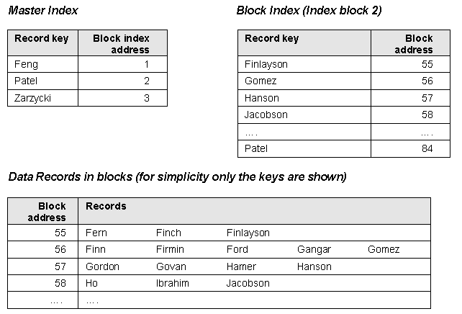
Index-sequential Access
Searching for Hamer using index-sequential file access
Notes:
Looking for the record for Hamer
Search the Master Index until you reach a key that is greater than Hamer (in string comparison terms).
Go to the Block Index for that key (2).
Search the Block Index until you reach a key that is greater than Hamer (in string comparison terms).
Goto the Block for that key.
Search through the block until you find the right record with the required key.
(If you get to the end of the block without finding the record then it doesn’t already exist.)

Slide 12
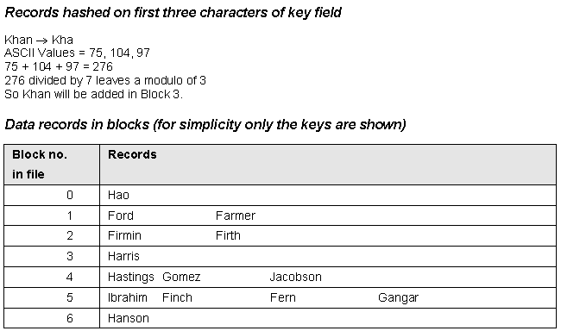
Direct Access

Slide 13
Improving Access
Creating a linked list in random files to make it possible to read records in sequential order
Adding a secondary index keyed on a field that is not the key on which the main access method is based
Indexes can be inverted files or use other techniques such as B-trees

Slide 14
File Types
Master files
Transaction files
Index files
Temporary file or work files
Backup files
Parameter files
Notes:
Students may be familiar with the temporary files that are helpfully left by certain applications (that must remain nameless) cluttering up the temp directories on their hard disks.

Slide 15
File Example
Using files in Java to handle localization of prompts and messages
Use the java.util.Locale class to hold information about the current locale
  language_country_variant
  fr_FR_EURO
  fr_CA
  en_UK
  en_AU

Slide 16
File Example
The Java class java.util.ResourceBundle uses the locale to load a file with locale-specific values e.g. UIResources_fr_FR_EURO
Java code to use this:
resources = ResourceBundle.getBundle(”UIResources”, currentLocale);
Button cancelButton = new Button(resources.getString(”Cancel”);
rather than
Button cancelButton = new Button(”Cancel”);
Notes:
The font Bell MT has been used here to give a Courier-like font, but get all the code onto the lines without wrapping. If it is not on your machine, you may want to change this from whatever it defaults to.

Slide 17
Resource File
File for French is UIResources_fr_FR_EURO
Contains
Cancel = Annuler
OK = OK
File = Fichier
…

Slide 18
Database Management
Systems (DBMS)
Problems with files:
  redundancy—number of files grows with applications, and data is duplicated
  inconsistency—data is updated in one application’s files, but not in another’s
  maintenance problems—changes to data structures mean changes to many programs
  difficulty combining data—business needs may mean users want data from different applications

Slide 19
DBMS
Corporate database consolidates data for different applications
Each application then has its own view of a subset of the data
Application 1
Database
Application 2

Slide 20
DBMS Schema
Ultimately data in databases is stored in files, but their structure is hidden from developers
External Schema
The view on data used by
application programs.
Conceptual Schema
The logical model of data that is
separate from how it is used.
Internal Schema
The physical storage of data in
files and indexes.

Slide 21
DBMS Features
Data Definition Language (DDL)
Data Manipulation Language (DML)
Integrity Constraints
Transaction Management
Concurrency
Security
Tuning of Storage

Slide 22
Advantages of DBMS
Eliminate unnecessary duplication of data
Enforce data integrity through constraints
Changes to conceptual schema need not affect external schema
Changes to internal schema need not affect the conceptual schema
Many tools are available to manage the database

Slide 23
Disadvantages of DBMS
Cost of investing in the DBMS
Running cost, including staff (Database Administrators) to manage the DBMS
Processing overhead in converting data to format required by programs

Slide 24
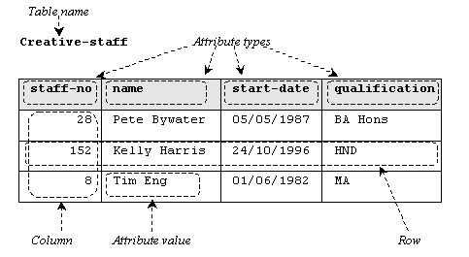
Types of DBMS
Relational—represent data in tables
  tables consist of rows of data organized in columns

Slide 25
Types of DBMS
Object—store objects as objects
  designed to handle complex nested objects for graphical and multimedia applications
Object-relational—hybrid databases that can store data in tables but can also store objects in tables

Slide 26
Relational DBMS
To store objects in a relational database, the objects have to be ‘flattened’ into tables
Complex objects have to be taken apart and the parts stored in different tables
When retrieved from the database, the object has to be reassembled from the parts in different tables

Slide 27
Normalization
Data from complex structures is ‘flattened’ into tables
Typically normalization is carried out as far as ‘Third Normal Form’
In an object-oriented system, we may use normalization to convert classes to table schemas

Slide 28
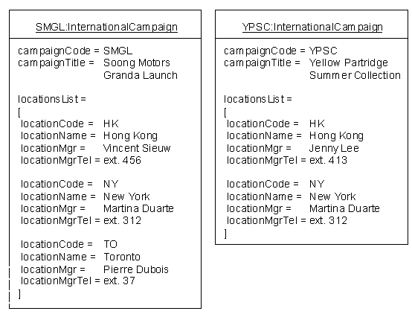
Normalization Example

Slide 29
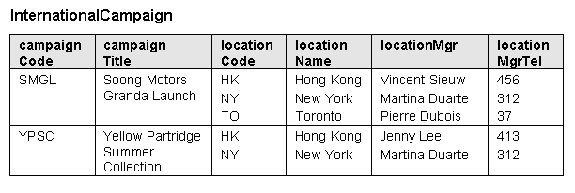
Objects as a Table
To get to First Normal Form, break out the repeating groups

Slide 30
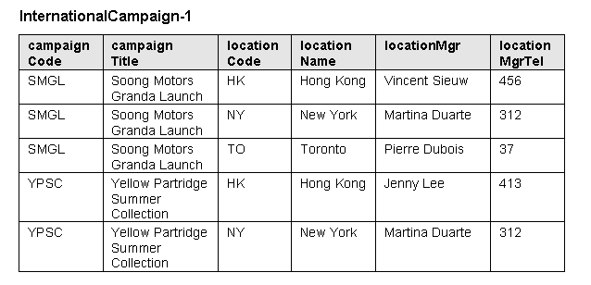
First Normal Form

Slide 31
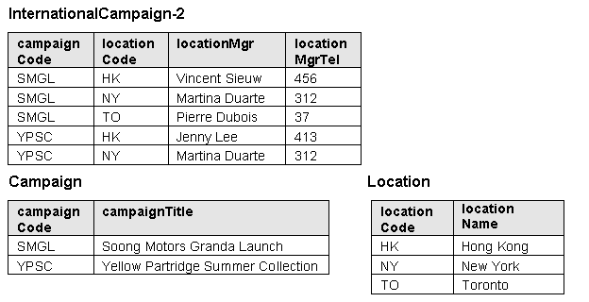
Second Normal Form

Slide 32
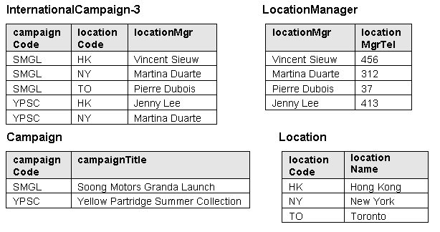
Third Normal Form

Slide 33
Alternative Approach
Classes with simple data structure become tables
Object IDs become primary keys
Where classes contain another class as an attribute create a table for the embedded class
For collections create two tables, one for the objects in the collection, the other to hold Object IDs of the containing objects and the contained objects

Slide 34
Alternative Approach
One-to-many associations can be treated like collections
Many-to-many associations become two separate tables for the objects and a table to hold pairs of Object IDs
One-to-one associations are implemented as foreign-key attributes—each class gains an extra attribute for the Object ID of the other

Slide 35
Alternative Approach
To implement inheritance
  only implement the superclass as a table including all subclass attributes
  only implement the subclasses as tables, duplicating superclass attributes in each
  implement superclass and subclasses as tables with shared primary keys
Each approach has disadvantages

Slide 36
Object DBMS
ODBMS have the advantage that objects can be stored directly
Object Data Management Group (ODMG) standard
Not all object databases conform to the standard
Object databases are closely linked to programming languages with ways of navigating through the database

Slide 37
Sample C++
ObjectStore Operation
IntCampaign * CreativeStaff::findIntCampaign
( string campaignCode )
{
IntCampaign * intCampaignPointer;
intCampaignPointer = staffIntCampaignList.getValue().query_pick(
“IntCampaign*”,
“campaignCode == this->campaignCode”,
os_database::of(this));
return intCampaignPointer;
}

Slide 38
Object DBMS
Some will transparently ‘materialize’ objects from the database when they are referred to
Update transactions need to be bracketed with start and finish transaction methods
Operations are still implemented in object-oriented languages

Slide 39
Designing Data
Management Classes
Alternatives (two in bold are covered here):
  add save and retrieve operations to classes
  make save and retrieve class-scope methods
  allow all persistent objects to inherit from a PersistentObject superclass
  use collection classes to manage persistence
  use broker classes to manage persistence
  use a parameterized class to handle persistence for different classes

Slide 40
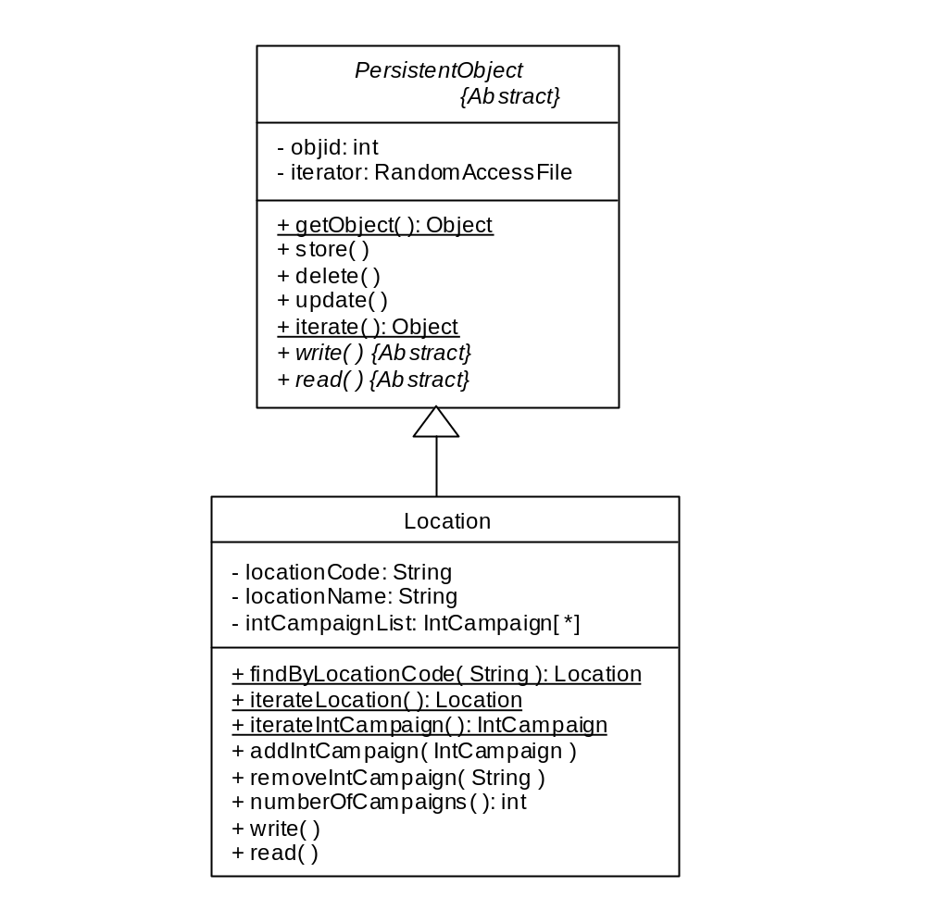
PersistentObject
Create an abstract superclass and make all persistent classes inherit from it

Slide 41
PersistentObject
Materialization as Class Method
Sequence diagram
Campaign
Manager
:ListCampaigns
Location
Dialog
GetNumberOf
findByLocation
Campaigns( )
Code
Location(
locationCode,
(locCode)
locationName,
intCampaignList[ ])
:Location
numberOfCampaigns( )

Slide 42
Database Broker
Use a broker class responsible for materializing instances of each class from the database
materializes
Location
LocationBroker
-
instance: LocationBroker
-
LocationBroker( )
+ instance( ): LocationBroker
+ findByLocationCode( String ): Location
+ iterateLocation( ): Location

Slide 43
Database Broker
Materializes Instances
Sequence diagram
Campaign
Manager
:ListCampaigns
:LocationBroker
Dialog
GetNumberOf
findByLocation
Campaigns( )
Code
Location(
locationCode,
(locCode)
locationName,
intCampaignList[ ])
:Location
numberOfCampaigns( )

Slide 44
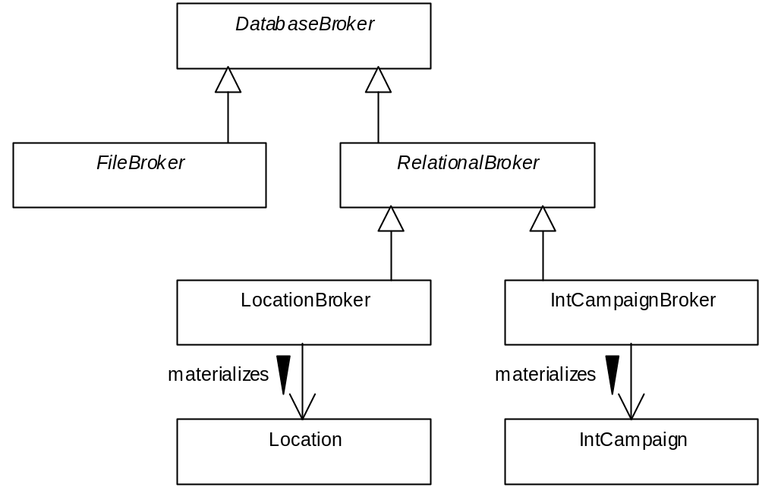
Inheritance Hierarchy of Database Brokers

Slide 45
RelationalBroker and Other Classes
oracle::jdbc::driver::Oracle
RelationalBroker
Driver
java::sql::Connection
Location
Broker
materializes
java:sql::Statement
Location
java::sql::ResultSet

Slide 46
Package Diagram
sun.jdbc
java.sql
«
import»
«
import»
Broker
Application
Framework
Brokers

Slide 47
Proxy Pattern
Proxy objects act as placeholders for the real objects, e.g. IntCampaigns in Locations
The IntCampaignProxy has the same interface as IntCampaign, but no data
When a Location requires data about one of its IntCampaigns, it sends a message to the Proxy
The Proxy requests the Broker to materialize the IntCampaign and passes the message on

Slide 48
Proxy Pattern
The Proxy can then replace the reference to itself in the Location with a reference to the real materialized object
This approach can be combined with caching of objects
The caches can be used by the Broker to check whether an object is already in memory and save materializing it from the database if it is

Slide 49
Adding Caches
Six caches
  new clean cache
  new dirty cache
  new deleted cache
  old clean cache
  old dirty cache
  old deleted cache

Slide 50
Transaction Commit
Cache Actions
Six caches
  new clean cache
  new dirty cache
  new deleted cache
  old clean cache
  old dirty cache
  old deleted cache
Cache actions
  write to database
  write to database
  delete from cache
  delete from cache
  write to database
  delete from database

Slide 51
Class Diagram with
Caches and Proxies
Cache
6
1
DatabaseBroker
«
Interface
»
RelationalBroker
IntCampaign
Interface
«
realize»
«
realize»
«
Proxy
»
IntCampaignBroker
IntCampaignProxy
runs in
materializes
Location
IntCampaign

Slide 52
Collaboration Diagram
1.2 inMemory( )
1 printList( )
:Location
1.1 getTitle( )
:IntCampaignProxy
1.6 getTitle( )
1.3 [not in memory]
getIntCampaign
( objectid )
:IntCampaign
:IntCampaignBroker
1.5 [not in cache]
1.4 * inCache
retrieveIntCampaign
( objectid )
( objectid )
:Cache
Notes:
1.1 The Location sends the message getTitle() to the IntCampaignProxy.
1.2 The IntCampaignProxy checks whether the IntCampaign is in memory.
1.3 It is not, so it then requests the object by object identifier from the broker, IntCampaignBroker.
1.4 The IntCampaignBroker checks if the object is in a Cache.
1.5 It is not, so the IntCampaignBroker retrieves the object from the database and returns it to the IntCampaignProxy.
1.6 The IntCampaignProxy sends the getTitle() message to the IntCampaign object and returns the result to the Location.

Slide 53
Using a Framework
Why develop a framework when you can use an existing one?
Object-table mappings
  Toplink
  CocoBase
Products that will map attributes of classes to columns in a relational database table

Slide 54
Using a Framework
J2EE Application Servers
Enterprise JavaBeans (EJBs) can be used – Entity Beans for business objects
Container-Managed Persistence (CMP) is a framework for J2EE containers to handle the persistence of instances of entity beans
Use J2EE Patterns (Alur et al., 2001)

Slide 55
Summary
In this lecture you have learned about:
The different ways of storing persistent objects
The differences between object and relational databases
How to design data management objects
How to extend sequence diagrams to include data management objects

Slide 56
References
Silberschatz et al. (1996)
Howe (2001)
Eaglestone and Ridley (1998)
Alur, Crupi and Malks (2001)
(For full bibliographic details, see Bennett, McRobb and Farmer)

