Slide 1

Systems Development Methodologies
Based on Chapter 22 of Bennett, McRobb and Farmer:
Object Oriented Systems Analysis and Design Using UML, (2nd Edition), McGraw Hill, 2002.
<footer>© Bennett, McRobb and Farmer 2002,
and De Montfort University 2002

Slide 2
In This Lecture You Will Learn:
What a systems development methodology is
Why methodologies are used
The need for different methodologies
The main features of one methodology
Notes:
For reasons of time and space, this presentation does not cover some later parts of Chapter 22. In particular:
Participative Design
Hard and Soft Methodologies
Issues in choosing a methodology
…are not discussed.

Slide 3
Why Methodology?
Techniques of system development must be organized if they are to work together
  Analyst has drawn collaboration diagrams for main use cases
  Should she now convert these to sequence diagrams and write operation specifications?
  Or concentrate on class diagram, inheritance and composition structures?
UML itself contains nothing that helps to make this decision

Slide 4
Why Methodology?
Organization of tasks is not contained within the techniques
Must be described at a higher level of abstraction
Method of a project means the particular way that tasks in that project are organized
Sometimes called process of software development

Slide 5
Method or Methodology?
Often taken to mean the same, but actually these terms differ
Method = step-by-step description of the steps involved in doing a job
No two projects are identical, so method is specific to one project
Methodology = set of general principles that guide the choice of a method suited to a specific task or project

Slide 6
Method vs Methodology
Level of abstraction
Example of application
Typical product
Task
Developing a first-cut class diagram
Specific version of a class diagram
Technique
Description of how to carry out a technique, e.g. UML class modelling
Any UML class diagram
Method
Specific techniques used on a particular project that lead to a specific software product
A product costing system
Methodology
General selection and sequence of techniques capable of producing a range of software products
A range of business software applications

Slide 7
What Is a Methodology?
Avison and Fitzgerald (1988): a collection of
  Procedures
  Techniques
  Tools
  Documentation aids
Organized within a lifecycle structure
Usually also with an underlying philosophy which captures a particular view of the meaning and purpose of IS development

Slide 8
Elements of a Methodology
UML class diagram is a technique
Rational Rose (CASE software) is a tool
‘Find classes by inspecting use case descriptions’ is a procedure
‘Operation specifications should not be written until class model is stable’ is an aspect of structure
Analysis and Design are stages or activities
‘OO development promotes software which is robust and resilient to change’ is a philosophy

Slide 9
Elements of a Methodology
Three complementary views in software development:
  Data view—attributes and associations that must be stored within the software
  Process view—operations carried out on the data
  Temporal view—sequence of processes and time constraints (also sequences of events that impinge on the system)
Methodology needs techniques to discover, analyse and model each of these views

Slide 10
Why Use a Methodology?
Many advantages claimed
  Helps produce better quality product
    Better documented software
    More acceptable to user
    More maintainable software
    More consistent software
  Helps ensure user requirements are met
  Helps project manager control the project
  Reduces development costs
  Promotes communication among all parties

Slide 11
Example Methodology: OPEN
Stands for Object-oriented Process, Environment and Notation (Graham et al., 1998)
The methodology includes specifications of:
  Activities
  Tasks
  Techniques
  Deliverables
  Notation

Slide 12
OPEN
Basic principles include iterative and incremental development, and
In OPEN, activities
  have both pre- and post-conditions
  are carried out within timeboxes (as in DSDM)
OPEN has its own notation, COMN, that is a rival to UML

Slide 13
Unified Software Development Process (USDP)
Public domain methodology for Object-Oriented software development
Produced by Rational.com team
Main principles:
  Use-case driven
  Architecture-centric
  Iterative development
  Incremental development

Slide 14
Use-Case Driven
In USDP the basic element is a single interaction between user and system
Use cases are the start of modelling
Unit from which later models are derived
Each use case is a thread that links requirements to implementation
Has practical significance for users
Constant reminder to systems developers that only users’ requirements really matter

Slide 15
Use Case-Driven 1
Add new staff
Accountant

Slide 16
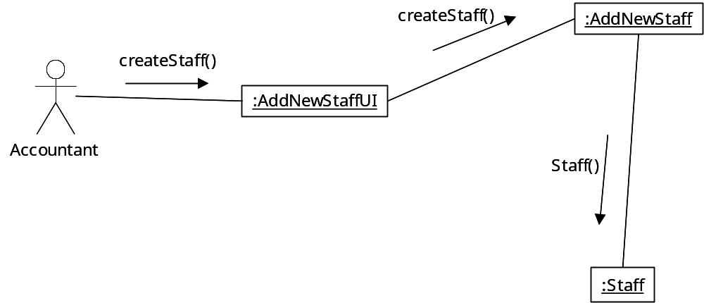
Use Case-Driven 2

Slide 17
Use Case-Driven 3
Staff Member
staffName
staffNo
staffStartDate
assignStaffContact()
assignNewStaffGrade()

Slide 18
Architecture-Centric
In USDP, software architecture is a theme from the earliest stages of a project
Reflected most obviously in:
  Stereotyping of boundary, control and entity classes
  Use of packages to organize both models and development activity

Slide 19
Architecture-centric
Analysis
Package
Campaign
Staff
Management
Management
User
Interface
Control

Slide 20
Iterative Development
The USDP lifecycle is cyclic:
  Analyse a bit
  Design that bit
  Code the design
  Test the code
  Refine the analysis and repeat

Slide 21
Incremental Development
USDP aims to deliver working, free-standing, useful ‘chunks’ of software, one at a time
(Corresponds to DSDM in this respect)
In its simplest form, each use case may represent one increment of delivered software

Slide 22
Activities and Phases
Activity has meaning for developers
Phase matters to project manager
Phases are sequential, delineated by milestones
Each milestone is a decision point:
  Begin next phase or stop now?
Manager’s focus shifts from one phase to the next
Within each phase, activities iterate

Slide 23
Phases
Inception
Elaboration
Construction
Transition
Iterations
1
1
1
2
2
2
3
3
3
4
4
4
5
5
5
6
6
6
7
7
7
8
8
Workflows
8
Requirements
Analysis
Design
Implementation
Test

Slide 24
Phases and Iterations
No set rule for number of iterations
Within a phase, workflows are the same
All 4 phases run from requirements to testing, but emphasis changes
At first, main effort is on capture, modelling, analysis of requirements
Later phases emphasize implementation and testing

Slide 25
Inception Phase
Essentially a feasibility stage: do potential risks outweigh potential benefits
Decision based partly on CBA
Viability of project judged on delivery of a small subset of requirements as working software

Slide 26
Inception Phase
Main activities:
  Requirements capture
  Analysis
  Small amount of design, implementation and testing
Even at this early stage, iteration is likely
OO approach makes this possible

Slide 27
Elaboration Phase
Produce design for a suitable system
Aim is to reduce cost uncertainties
Demonstrate how system can be built within acceptable timescale and budget
Proportion of time spent on design activities increases
Small increase in time on implementation and testing (still small in relation to analysis and design)

Slide 28
Construction phase
Build, through several iterations, a system capable of satisfactory operation in target environment
Implementation and testing rapidly become core activities
Each iteration moves away from design and towards testing

Slide 29
Transition phase
Achieves the intended full capability of the system
Deals with any defects or problems that have emerged
Includes system conversion, if older system is being replaced

Slide 30
Workers and Activities
USDP differentiates between real people and the more abstract worker
A Worker is a project role, e.g.
  use-case specifier
  system architect
  component engineer
  integration tester
No direct one-to-one mapping between people and workers

Slide 31
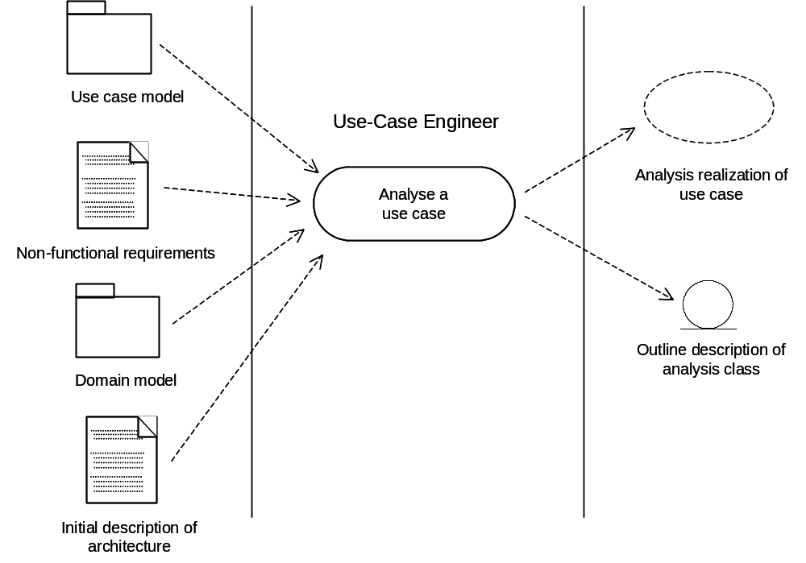
Inputs and Outputs of an Activity

Slide 32
The Analysis Workflow in USDP
Analyse Architecture
Analyse
Analyse
Analyse
Analyse
Analyse
Architect
Analyse
Architecture
architecture
architecture
architecture
architecture
architecture
Analyse a
Use Case
Analyse a
Analyse a
Analyse a
Analyse a
Analyse a
Use Case Engineer
Analyse a
Use Case
Use Case
Use Case
Use Case
Use Case
Use Case
Analyse a
Class
Analyse a
Package
Analyse a
Analyse a
Analyse a
Analyse a
Analyse a
Analyse a
Analyse a
Analyse a
Analyse a
Analyse a
Analyse a
Component Engineer
Analyse a
Package
Package
Package
Package
Package
Class
Package
Class
Class
Class
Class
Class
adapted from Jacobson et al., 1999

Slide 33
USDP: Summary
The most mature OO methodology yet
Has roots in:
  Booch method (good at design and implementation)
  OMT (good at analysis)
  Objectory (strong at requirements engineering and system architecture)
USDP strives to bring these together
Also large and complex: significant learning curve involved, or tailor to fit

Slide 34
Summary
In this lecture you have learned about:
The role of a methodology in IS development
The main principles, phases and activities of USDP
How USDP relates to contemporary IS development

