Slide 1



THE EFFECTIVENESS OF ULTRAVIOLET LIGHTS IN DISINFECTING
USING AN AUTOMATIC DISINFECTION BOX
IMPLEMENTED WITH ARDUINO
Bagas, John Christopher B.
Guerrero, Charles Adriane S.
Saralde, Marcus M.
Pabanil, Michael John P.
Engr. Pedrito Tenerife Jr.
Methods of Engineering Research

Slide 2

Introduction
Problem: Pandemic, demand in disinfecting materials.
Propose solution: The effectiveness of ultraviolet lights in disinfecting using an automatic disinfection box Implemented with Arduino
3609
POLYTECHNIC UNIVERSITY OF THE PHILIPPINES

Slide 3
Statement of the Problem
1. What is the significant difference between uv-based disinfectant and alcohol-based disinfectant in terms of their effectiveness?
2. Is there a significant effect among the different factors listed below in terms of its effectiveness?
Intensity of ultraviolet to be used
Duration time to ultraviolet light exposure
3. How efficient the automatic disinfection box in terms of:
Production cost
Conveniency
3609
POLYTECHNIC UNIVERSITY OF THE PHILIPPINES

Slide 4
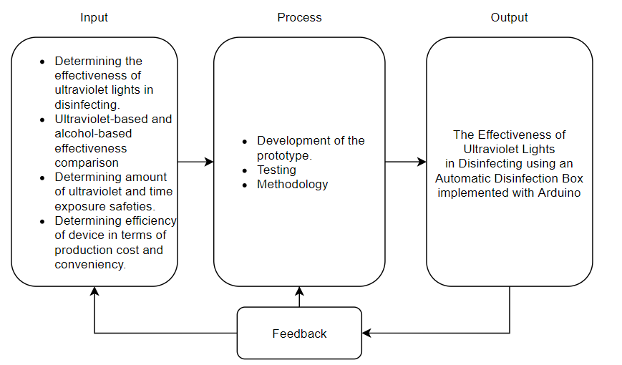
Research Paradigm
3609
POLYTECHNIC UNIVERSITY OF THE PHILIPPINES

Slide 5
Significance of the Study
1. To health and safety officers - Automated disinfection promotes contactless, safe and good social distancing practice.
2. To the user – Contactless disinfection.
3. To the environment – Less plastic waste residue. reusable.
4. To the future researchers - Serves as good foundation of contactless. automatic and innovative method of disinfection.
3609
POLYTECHNIC UNIVERSITY OF THE PHILIPPINES

Slide 6
Scope and Limitations
130L, 100W, 154H cm
Determining significant difference between ultraviolet-based and alcohol based (70% alcohol content, isopropyl) disinfection
Determining significant effect in effectiveness in the amount of ultraviolet to be used (222nm, 254nm UVC), time of ultraviolet exposure.
Determining efficiency of the automatic disinfection box implemented with Arduino in terms of production cost and conveniency.
3609
POLYTECHNIC UNIVERSITY OF THE PHILIPPINES

Slide 7
Scope and Limitations
Determining the significant difference of uv-based disinfection and specific brands of alcohol.
3609
POLYTECHNIC UNIVERSITY OF THE PHILIPPINES

Slide 8
Synthesis of Related Literature and Studies
The related literature and studies show the germicidal and disinfecting ability of 222nm UV-C lamps.
The disinfection units are manually operated
Automatic conveyor ultraviolet disinfection with tunnel allowing objects up to 55 cm wide.
3609
POLYTECHNIC UNIVERSITY OF THE PHILIPPINES

Slide 9
Research Design
Quantitative experimental research design: for SOP 1-3a
Qualitative research design: for SOP 3b
Method of analysis
T-test
One sample t-test
ANOVA
Likert scale
Tools and methods
3609
POLYTECHNIC UNIVERSITY OF THE PHILIPPINES

Slide 10
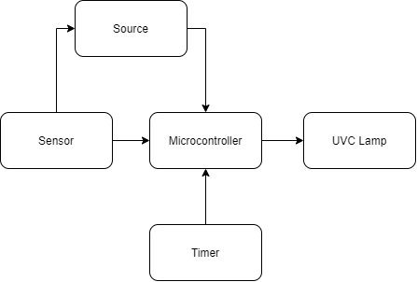
Diagrams
Figure 1: Block diagram
3609
POLYTECHNIC UNIVERSITY OF THE PHILIPPINES

Slide 11
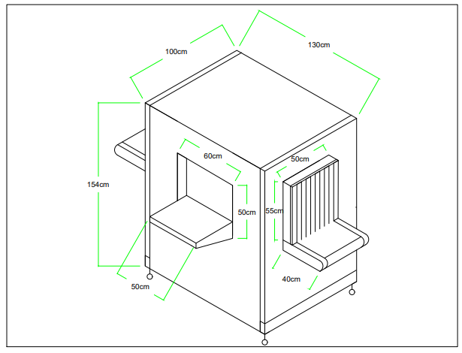
Diagrams
Figure 2: Prototype Design
3609
POLYTECHNIC UNIVERSITY OF THE PHILIPPINES

Slide 12
List of materials

Slide 13
Video ng circuit

