Slide 1
BIOBRAIN

Slide 2
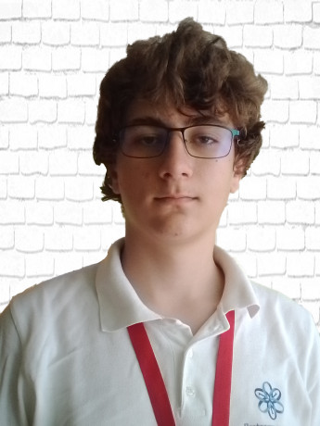
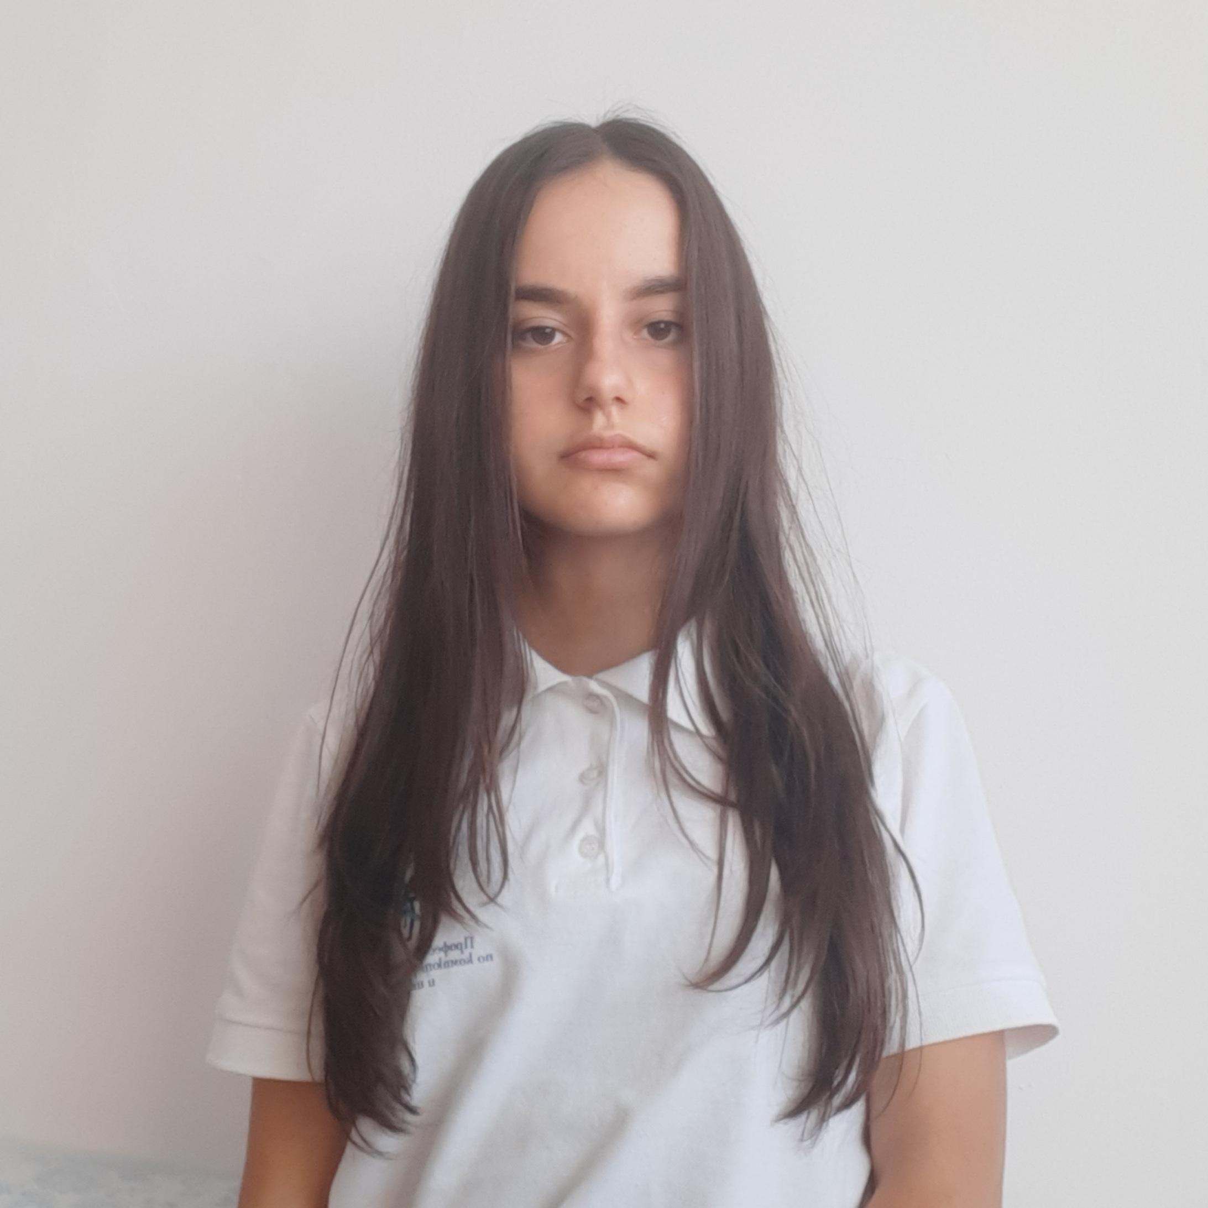
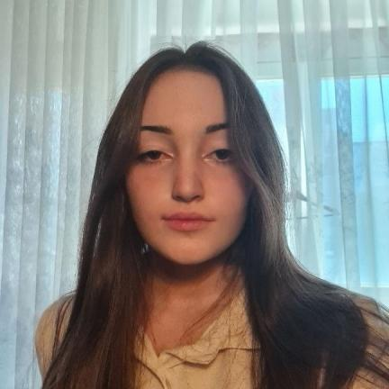
OUR TEAM
Martin Stoyanov 10B scrum trainer
Yana Ilcheva 10V front-end developer
Polina Dineva 10G back-end developer

Slide 3
IDEA
We wanted to create an educational game about
ecology.

Slide 4
TASK
REALIZATION
TEST
ORGANIZATION
PRESENT

Slide 5






USED TECHNOLOGY

Slide 6
LET’S MOVE TO THE GAME

Slide 7
THANK YOU FOR YOUR ATTENTION
Do you have any questions?

