Slide 1
ASSIGNMENT PART B PRESENTATION
Examining a loan dataset

Slide 2
GROUP DETAILS
Assignment : Exploring how the finance industry use big data analytics
Group Members:
Darrel Shakri Bin Ahmad Shakri 1141327906
MEMBER B
MEMBER C

Slide 3
PRESENTATION FLOW
Introduce the dataset
Questions to be answered by exploring the dataset
Exploratory data analysis
Creating a prediction model
Analyzing prediction results
Conclusions

Slide 4
ABOUT THE DATASET
Dataset is about loans granted and their final status
Data is created as part of a competition concluded a year ago
Goal was to correctly classify loans as fully paid or charged off
Dataset is the training set for the competition
Contains over 100 thousand rows, with 19 columns

Slide 5
QUESTIONS TO BE ANSWERED
What is the ratio of fully paid loans and charged off loans?
Does having a high credit rating lead to higher chances of a fully paid loan?
What are the relationship between the term of the loan and the ratio of good and bad loans?
Does the loan amount have any effect on the chances of the loan being paid back in full?
What loan and applicant characteristics can best predict whether a loan will be paid back or not?

Slide 6
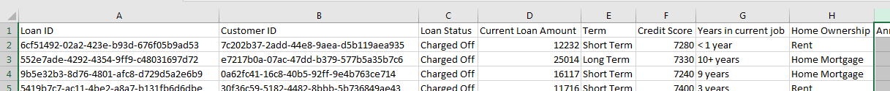
FEATURES OF THE DATASET
Can be grouped into 3 types
1st type: unique identifiers
2nd type: information regarding the granted loan
3rd type: information regarding the loan applicant
Consists of categorical, and numeric variables

Slide 7
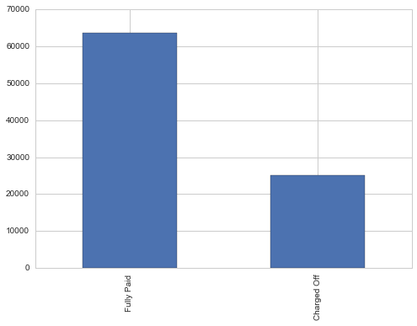
INITIAL OBERSVATIONS
Ratio of fully paid loans and charged off loans are skewed in favour of fully paid loans
Data is not complete; some features contains null values, or implausible values
Some categorical values defy possible categories detailed at the competition website.

Slide 8
PRE-PROCESSING STEPS
Found duplicated rows by examining the Loan ID for uniqueness.
All the values in the duplicated rows are exactly the same. Therefore, we remove the duplicates.
Rows with loan values at “99999999”, must be dealt with later
Categories contain same-meaning words spelled differently, fixed by combining the labels
Credit Scores contain invalid values, turns out they had 0 appended to the end.
Monthly Debt contains the dollar sign and the thousand separator.

Slide 9
FEATURE EXPLORATION
Exploring the categorical variables
Exploring the number variables, including a scatter matrix

Slide 10
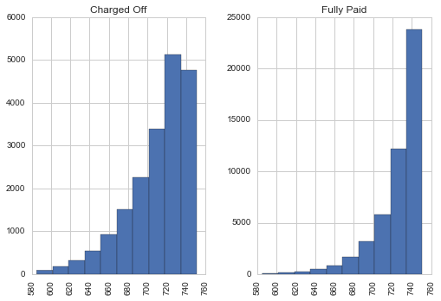
HISTOGRAM OF CREDIT SCORE

Slide 11
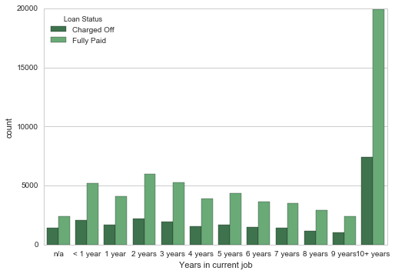
EMPLOYMENT LENGTH

Slide 12
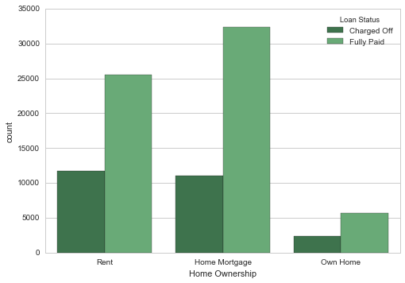
HOME OWNERSHIP

Slide 13
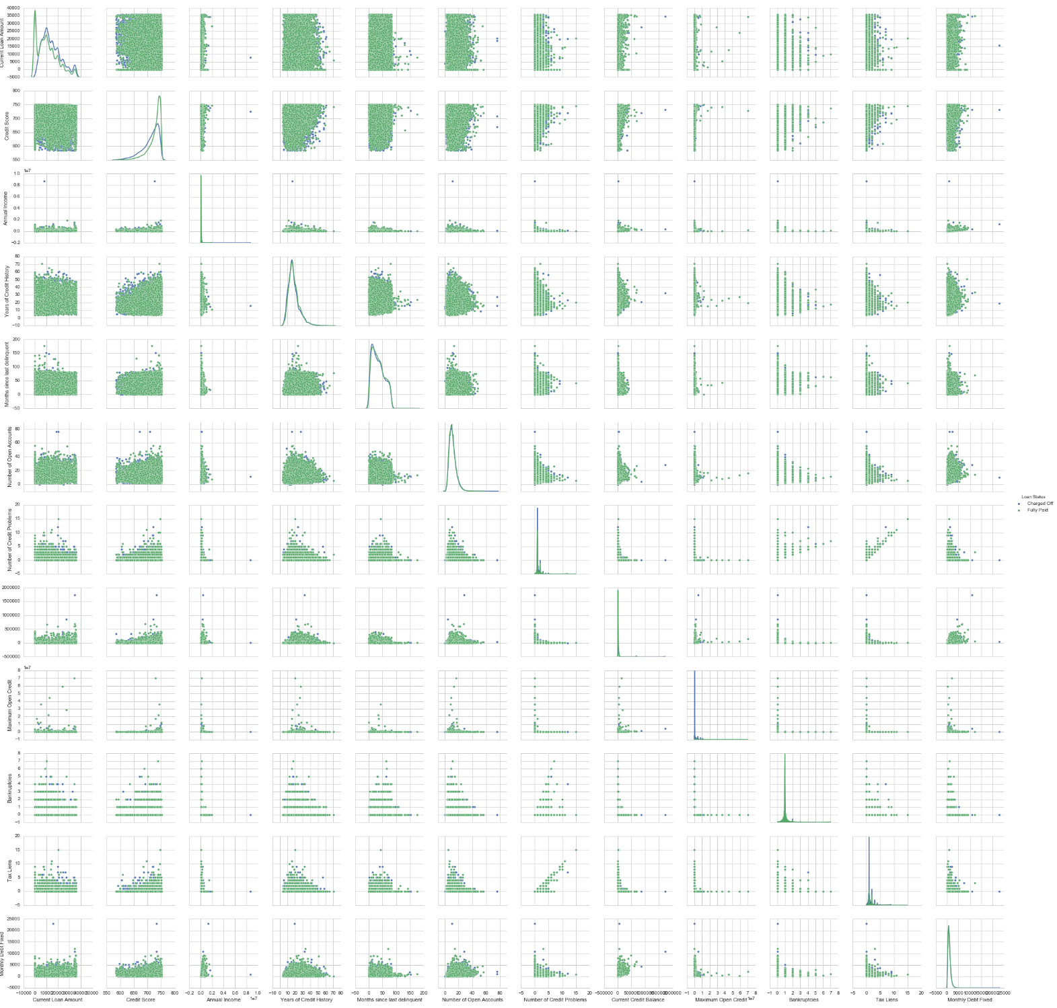
SCATTER MATRIX

Slide 14
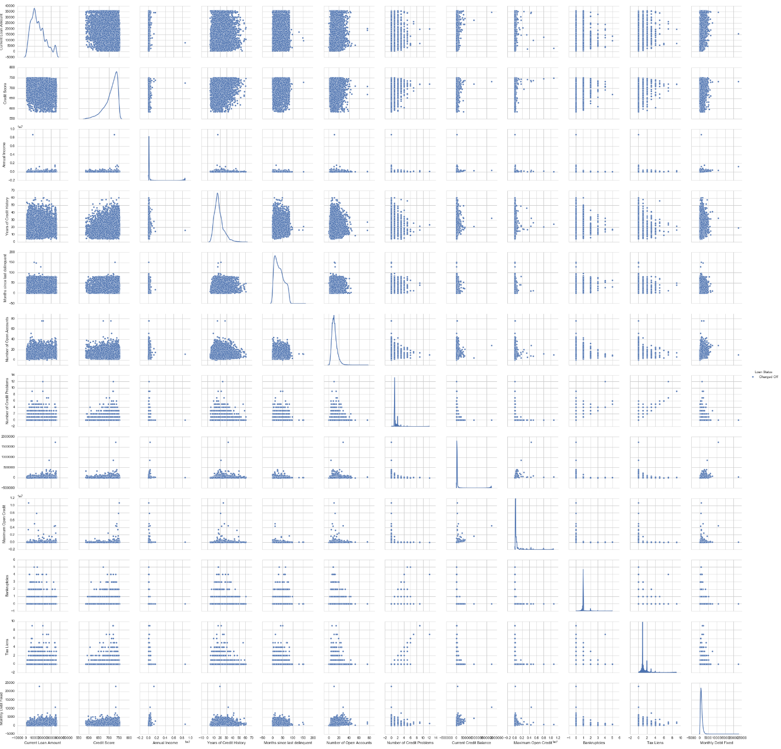
CHARGED OFF LOANS

Slide 15
PREDICTION ALGORITHM
To get some ideas of how to differentiate between loans, a decision tree is employed
The attribute splits may give some ideas
The dataset is set up to fit the decision tree by splitting categorical labels into binary variables
Loan values with 999999 set to -1 to identify that as outlier
Decision tree is set up with a max depth of 3
The data is split into training set and test set

Slide 16
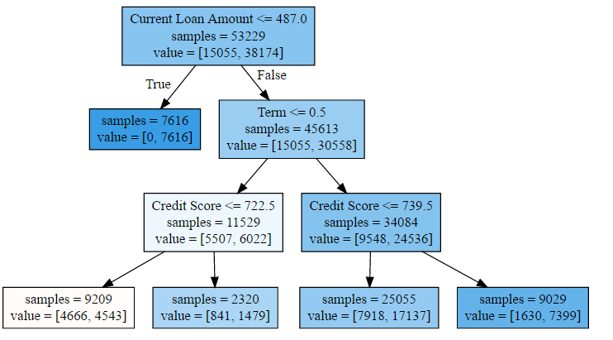
DECISION TREE

Slide 17
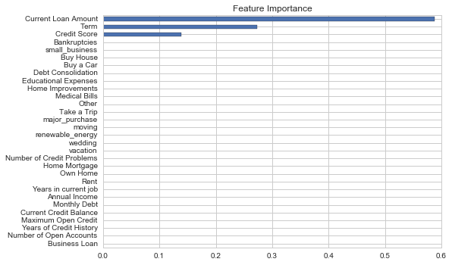
FEATURE IMPORTANCE
Picture on right shows the feature importance determined by decision tree
The categorical values are not of much use to the decision tree

Slide 18
ACCURACY
The decision tree is scored at about 71 percent when tested with the test set
However, due to the loan distribution, guessing all loans to be fully paid would probably yield better accuracy.
Therefore, we should judge the accuracy of the tree by the charged off loans

Slide 19
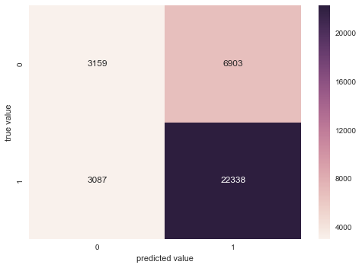
CONFUSION MATRIX
Image to the right shows the confusion matrix.
1 denotes fully paid loans, while 0 denotes charged off loans
The accuracy of guessing charged off loans is only about 32 percent
This does not improve when using a tree with a deeper max depth

Slide 20
CONCLUSIONS AND SUGGESTIONS
The decision tree failed to show any interesting descriptions of charged off loans
The categorical variables such as employment and loan purpose do not seem to be important
Suggestions include adding more charged off loans artificially to improve the distribution
Use another algorithm such as random forest for better prediction, but interpreting may be harder
Utilize feature engineering to obtain new features based on dataset

